Slide 1
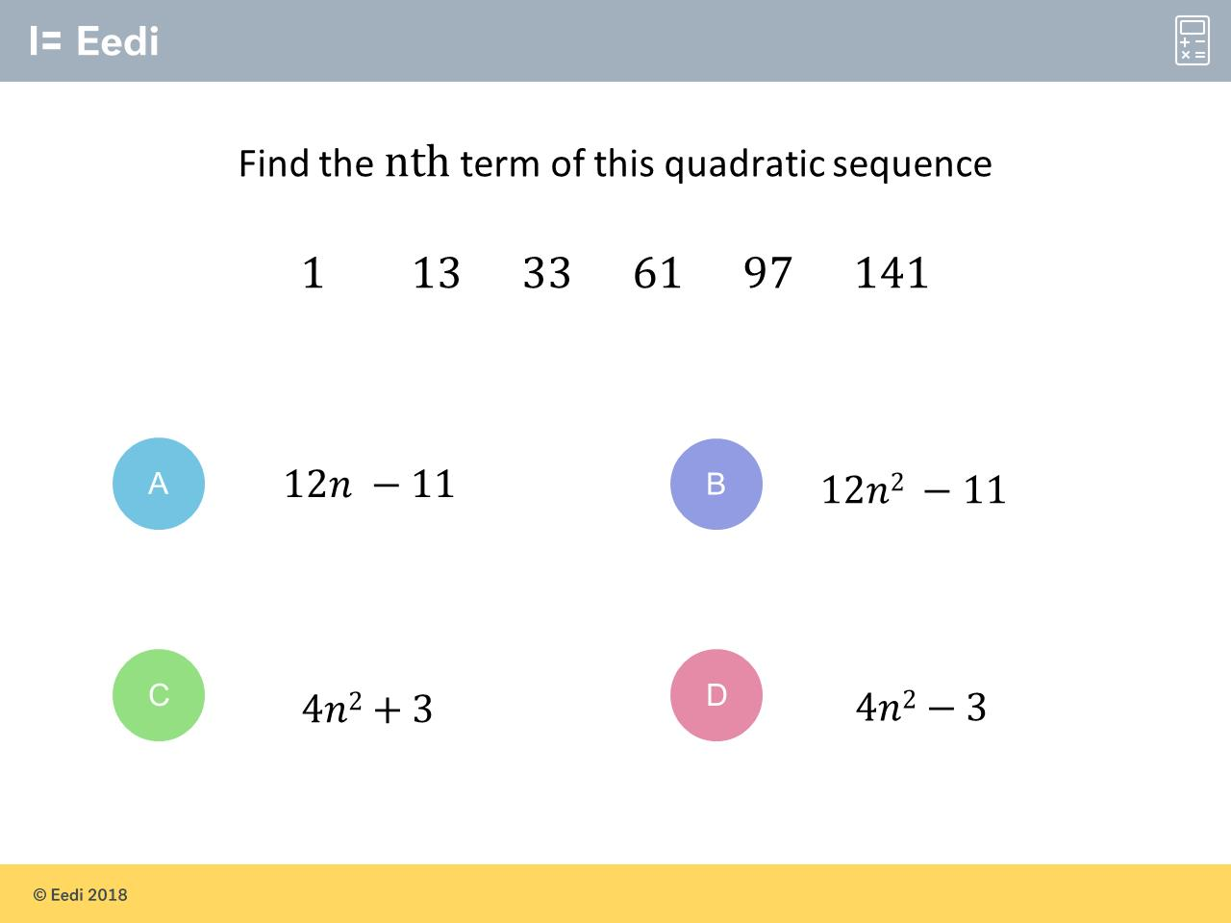
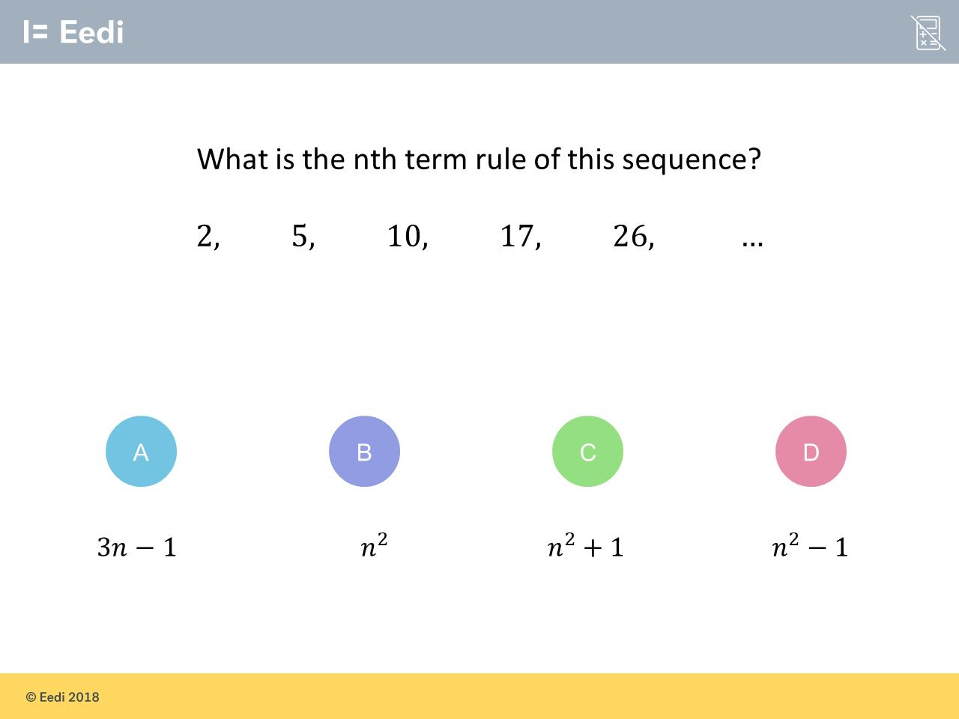
Worst answered question?
Most common wrong answer?

Slide 2
ANSWERS

Slide 3
Worst answered question?

Slide 4
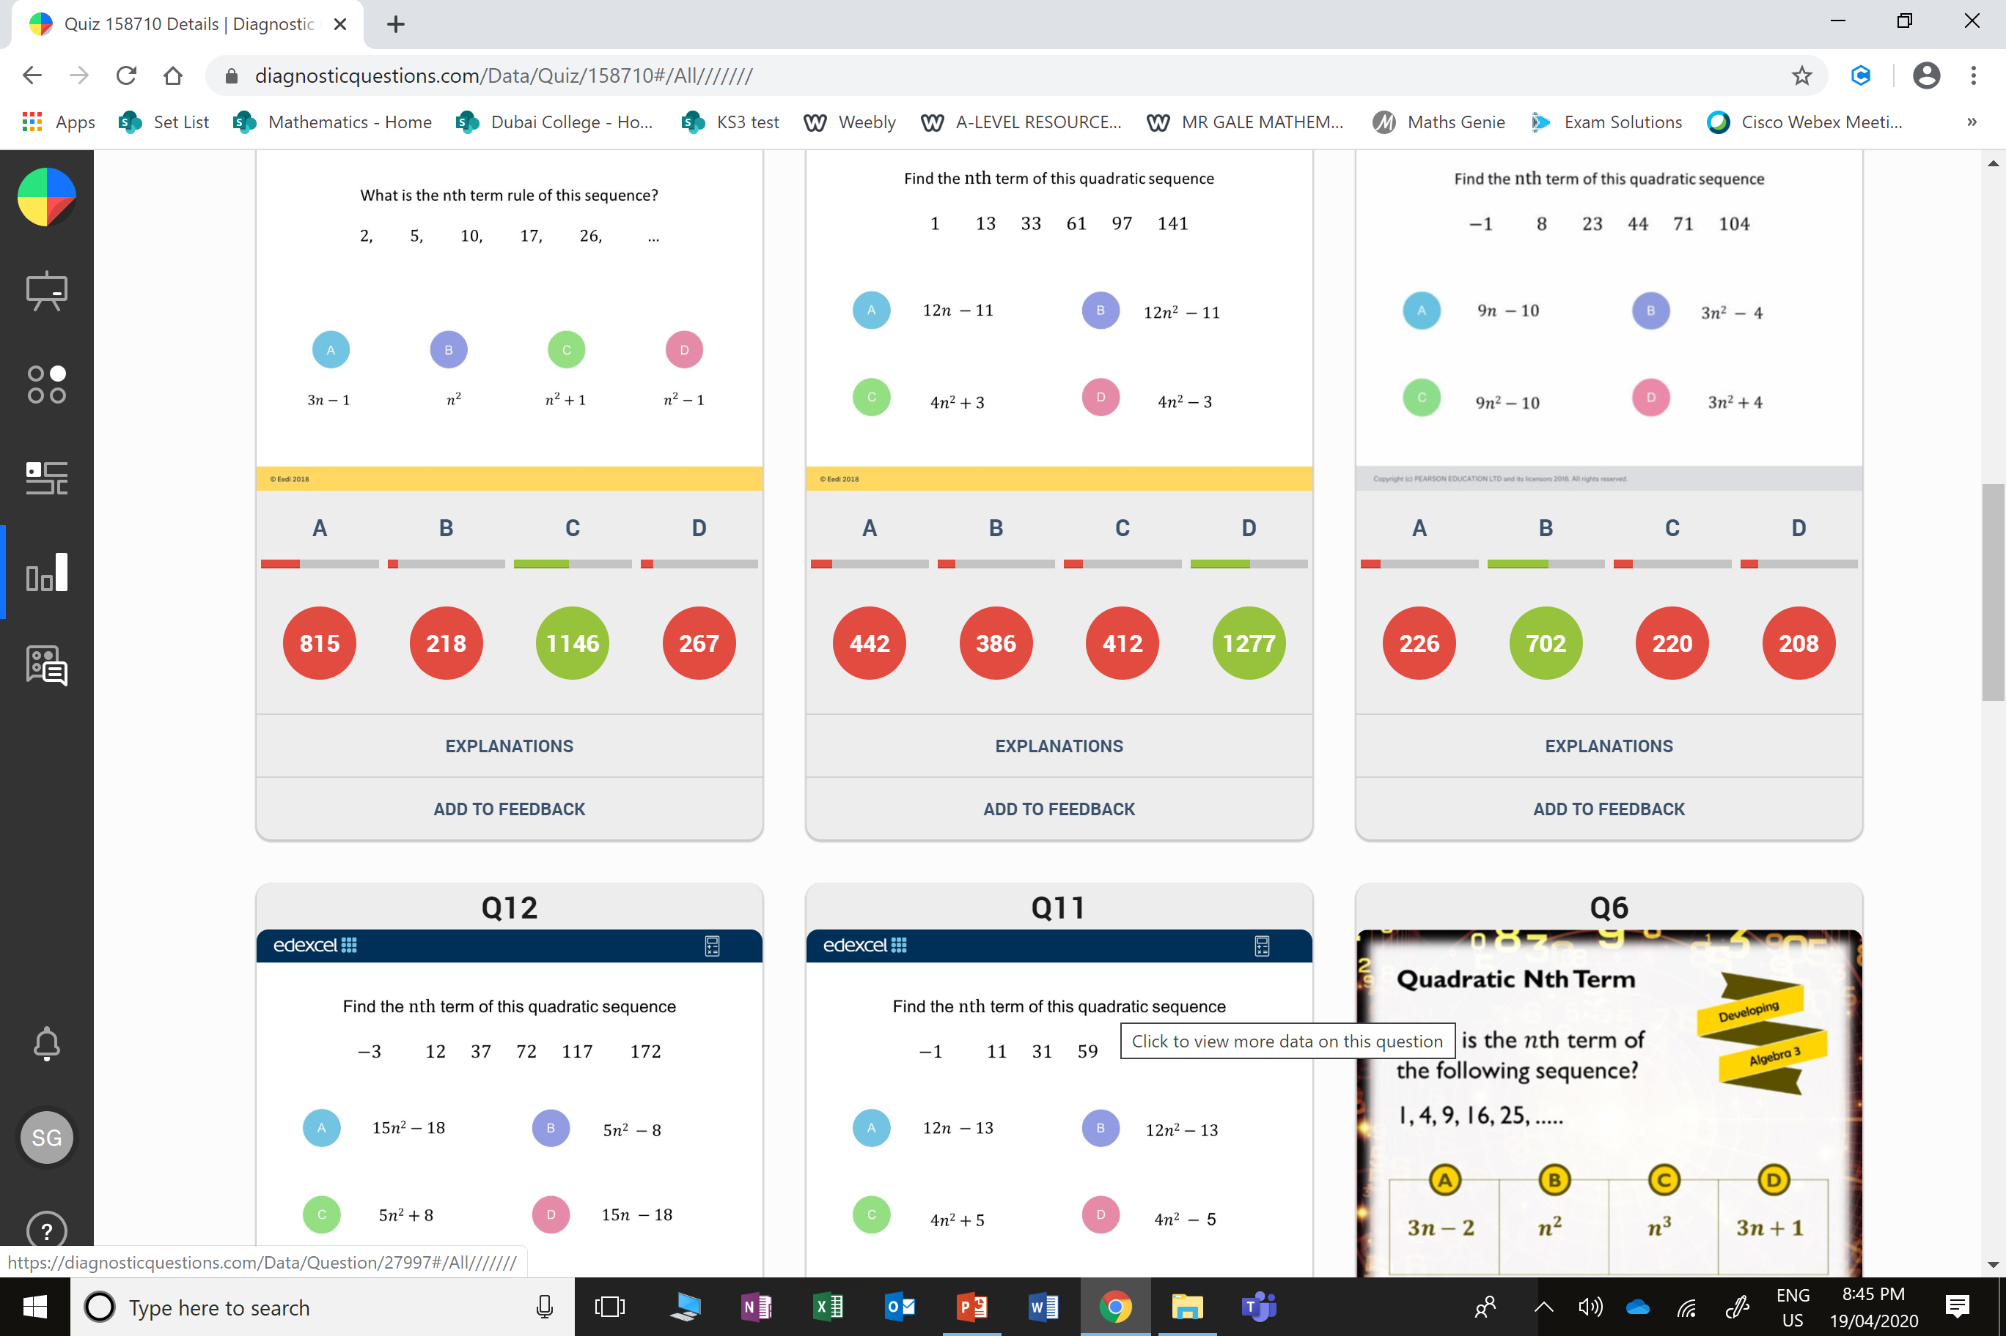
A
The student may have just used the first two numbers.

Slide 5
C
The student has treated this as a linear sequence for the first two terms.

