Slide 1
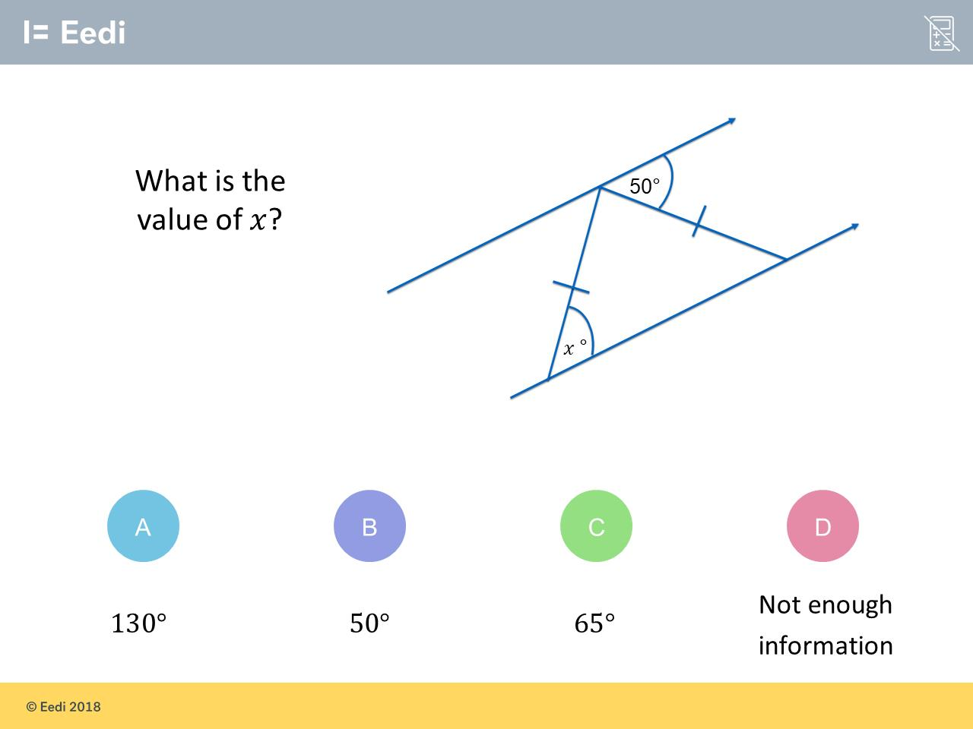
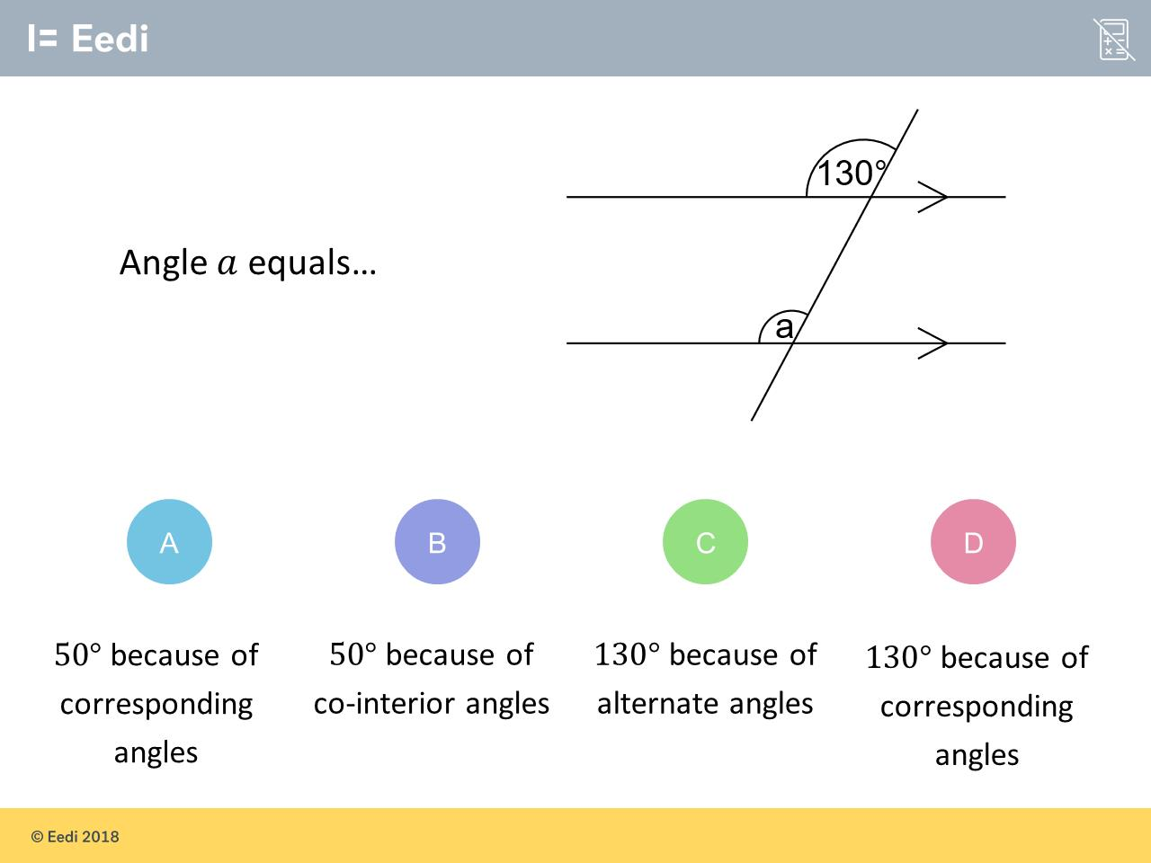
Worst answered question?
Most common wrong answer?

Slide 2
ANSWERS

Slide 3
Worst answered question?

Slide 4
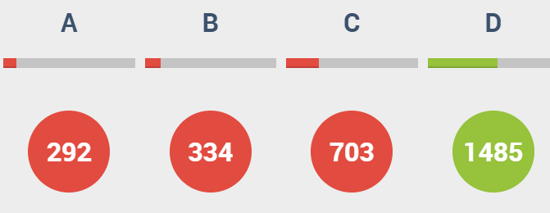
C
Right size but wrong name.

Slide 5
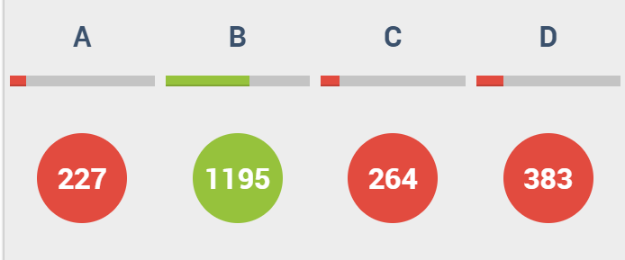
D
The students have not recognised the alternate angles.

