Slide 1
LO: Substitution
(Expressions and Formulae)

Slide 2
Expressions or Formula?
P = 3q + 2r
Formula

Slide 3
Expressions or Formula?
5b – c
Expression

Slide 4
Expressions or Formula?
3q + 2r
Expression

Slide 5
Expressions or Formula?
a = 5b – c
Formula

Slide 6
Expressions or Formula?
4d = 5b – 2g
Formula

Slide 7


Which one is correct?
x = 3
5x = 15 or 5x = 53

Slide 8
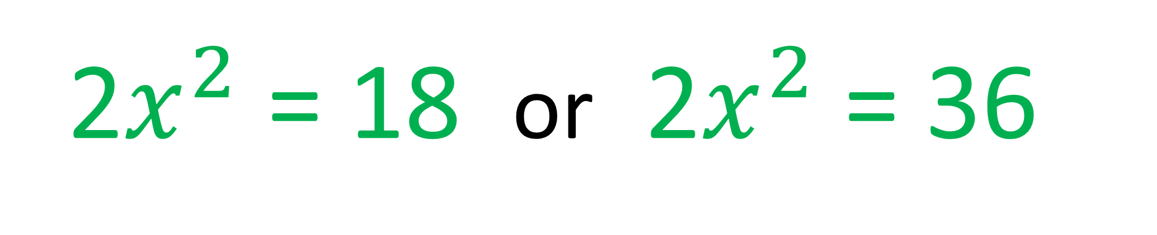
Which one is correct?
x = 3
2$x^{2}$ = 18 or 2$x^{2}$ = 36

Slide 9
P = 3w - 2l
Find the value of P when w = 2 and l = 4
P = 3(2) – 2(4)
P = 6)–(8)
P = –2

Slide 10
P = 3w – 2l
Find the value of P when w = 2 and l = -4
P = 3(2) – 2(–4)
P = 6 + 8)
P = 14

Slide 11
5x²
Evaluate the expressions when x = -3
5(–3)²
= 5(9)
= 45

Slide 12
x² – x
Evaluate the expressions when x = –3
(–3)² – (–3)
= (9) + 3
= 9 + 3
= 12

Slide 13
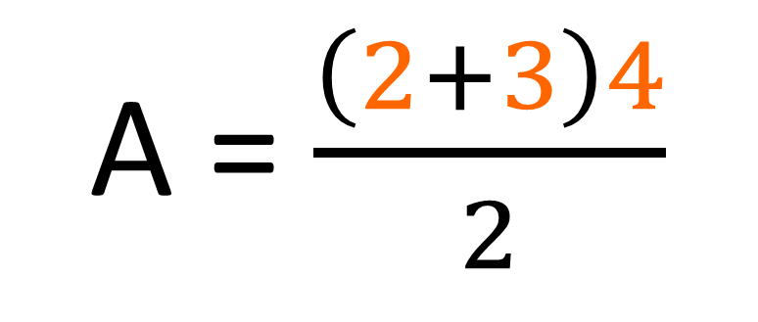
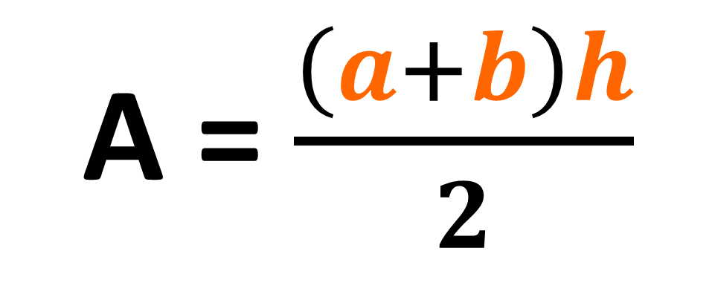
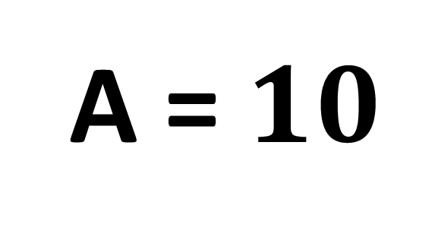
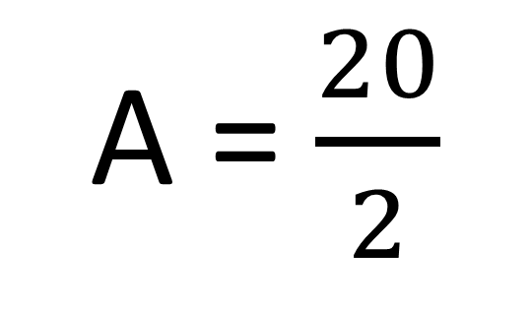
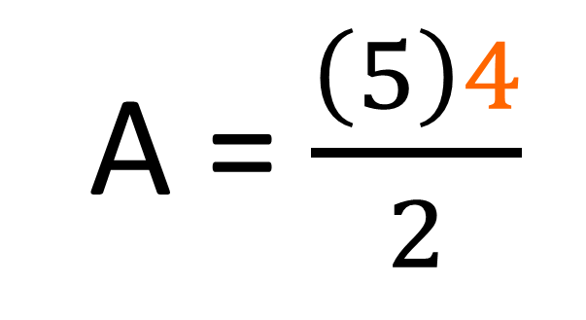
A = $\frac{\left(a+b\right)h}{2}$
Find the value of A when
a = 2
b = 3
h = 4
A = $\frac{\left(2+3\right)4}{2}$
A = $\frac{20}{2}$
A = $\frac{\left(5\right)4}{2}$
A = $10$

Slide 14
y = 3 and z = -5
Can you make an expression
that equals 15

