Slide 1
Numerical Methods
Introduction
Chapter 10
(Part 1 of 3)

Slide 2
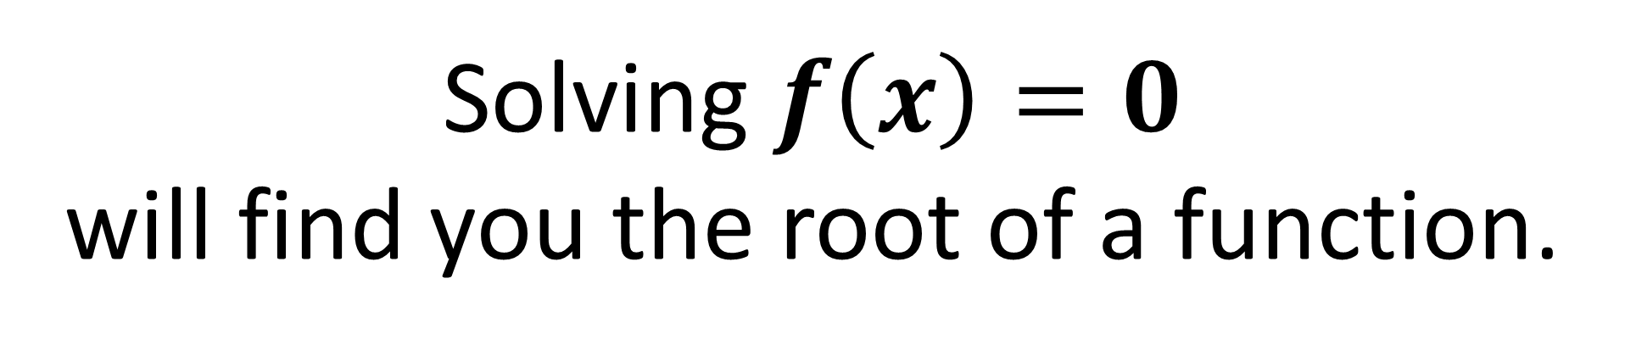
Solving $f\left(x\right)=0$
will find you the root of a function.
However, for some functions,
the ‘exact’ root is
complicated to calculate.

Slide 3
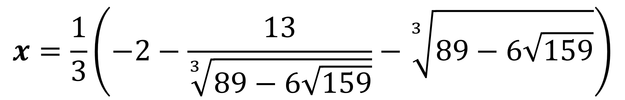
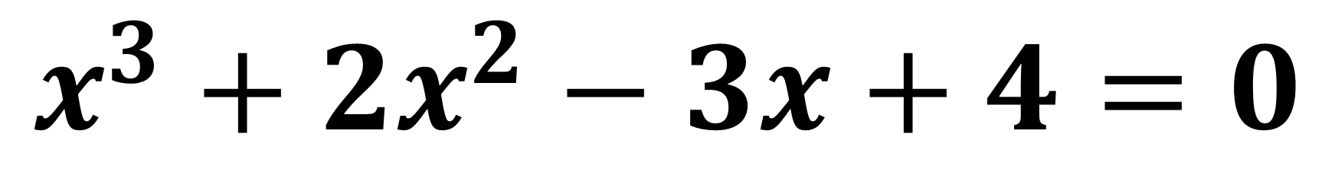
$$x^{3}+2x^{2}−3x+4=0$$
$$x=\frac{1}{3}\left(−2−\frac{13}{\sqrt[3]{89−6\sqrt{159}}}−\sqrt[3]{89−6\sqrt{159}}\right)$$

Slide 4
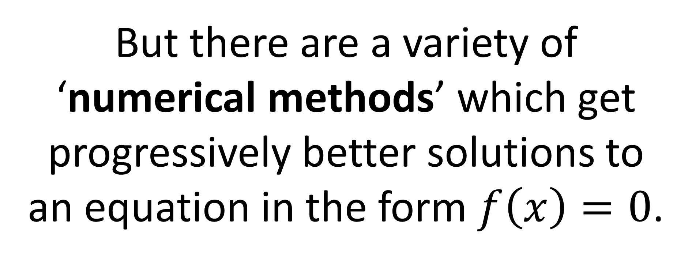
But there are a variety of ‘numerical methods’ which get progressively better solutions to an equation in the form $f\left(x\right)=0$.

Slide 5
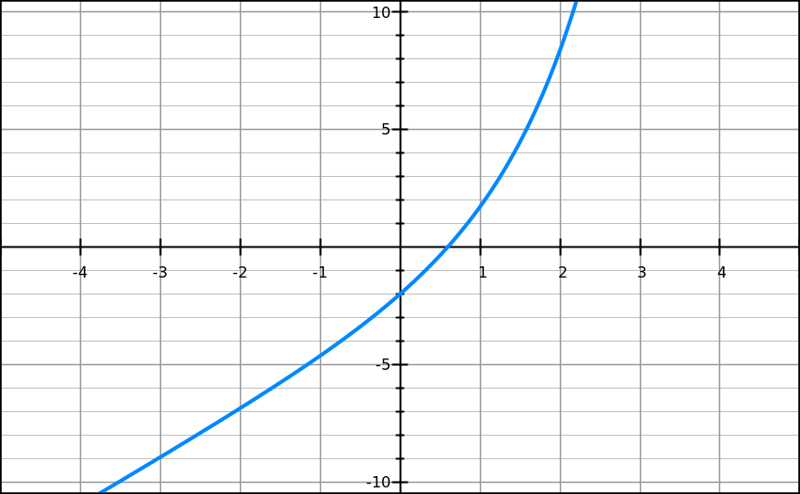
What can be found between the two co-ordinates?
Root

Slide 6
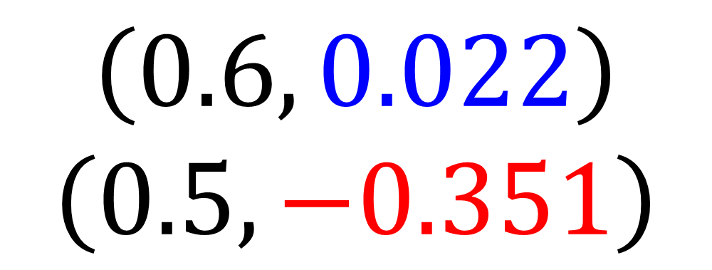
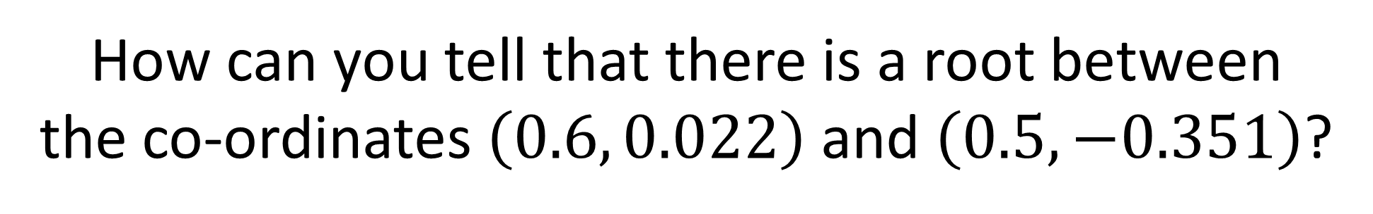
How can you tell that there is a root between
the co-ordinates $\left(0.6, 0.022\right)$ and $\left(0.5,−0.351\right)$?
$\left(0.6, 0.022\right)$ $\left(0.5,−0.351\right)$
The y values change in sign,
so a root must lie between 0.5 and 0.6

Slide 7
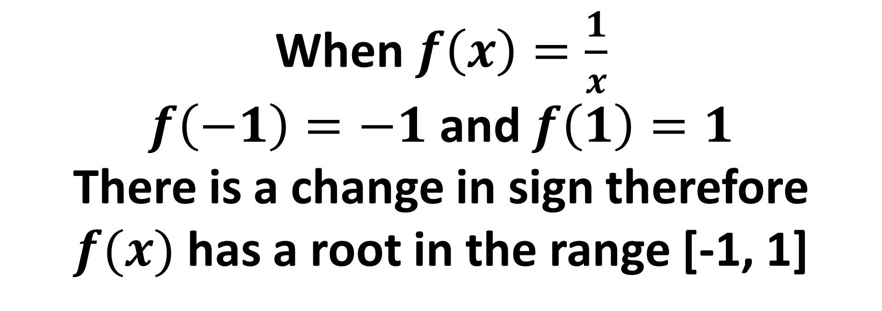
…but only if the function is continuous.
When $f\left(x\right)=\frac{1}{x}$
$f\left(−1\right)=−1$ and $f\left(1\right)=1$
There is a change in sign therefore
$f(x)$ has a root in the range [-1, 1]
Why is the above statement not true?

Slide 8




$$y$$
$$(1,1)$$
$$x$$
$$(−1,−1)$$
A function is continuous if the line does not ‘jump’.
A root is only guaranteed with a sign change if the function is continuous, as otherwise the line can skip past 0.
In this case due to a vertical asymptote.

Slide 9


…and no sign change
doesn’t mean there isn’t a root
$$y$$
Beware!
Just because there isn’t a sign change, doesn’t mean there’s no root in that interval.
root
root
$$x$$

Slide 10
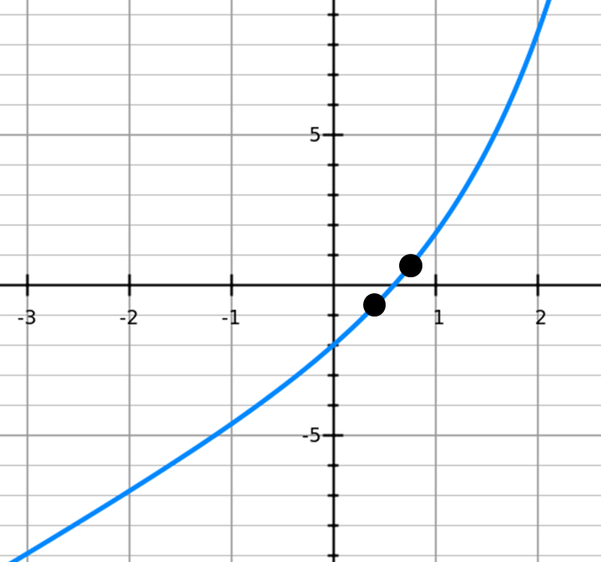
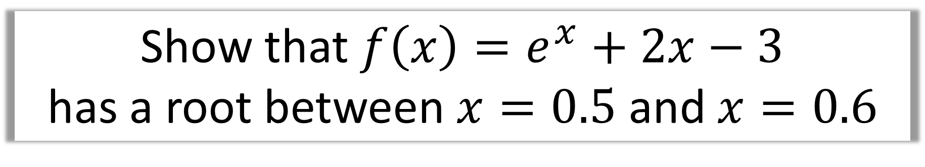
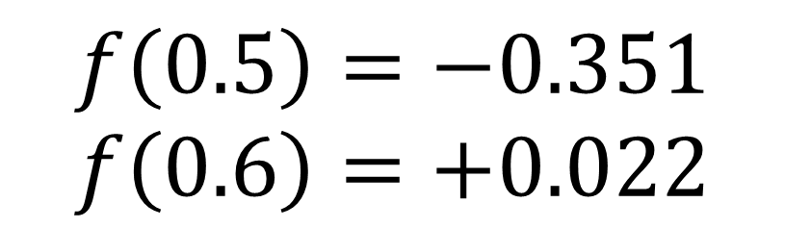
Show that ${f\left(x\right)=e}^{x}+2x−3$
has a root between $x=0.5$ and $x=0.6$
$$f\left(0.5\right)=−0.351 \\ f\left(0.6\right)=+0.022$$
Change in sign,
root must lie
between 0.5 and 0.6
and continuous function

Slide 11

How can you show that 0.507 is a root?
$$0.507$$

Slide 12
If you want to check a value is
a possible root,
choose a value either side
and find out if there is a change of sign.
Which values to choose?
The upper and lower bound
of the possible root.

Slide 13
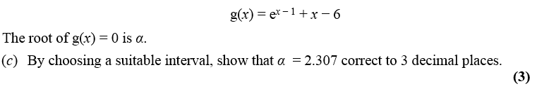
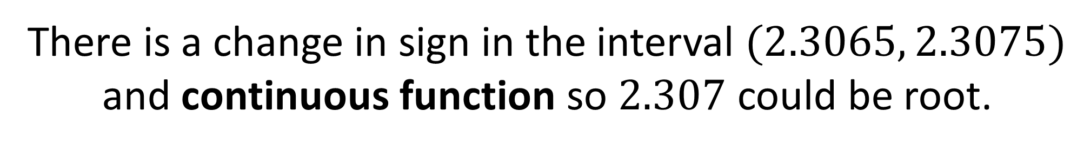
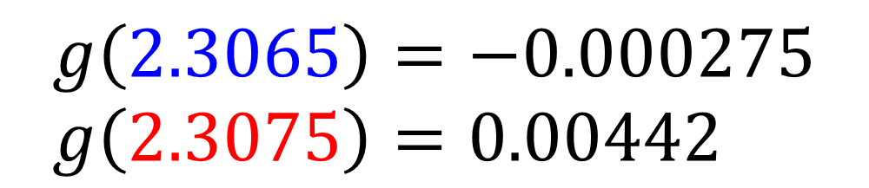
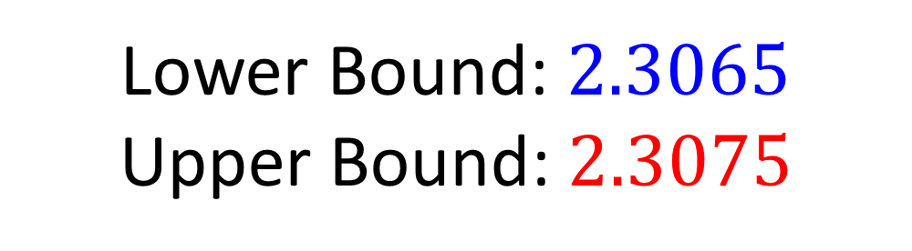
Lower Bound: $2.3065$
Upper Bound:$2.3075$
$$g\left(2.3065\right)=−0.000275 \\ g\left(2.3075\right)=0.00442$$
There is a change in sign in the interval $(2.3065, 2.3075)$ and continuous function so $2.307$ could be root.

Slide 14
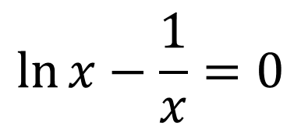

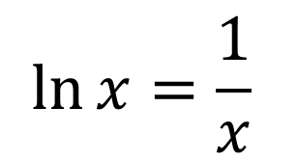
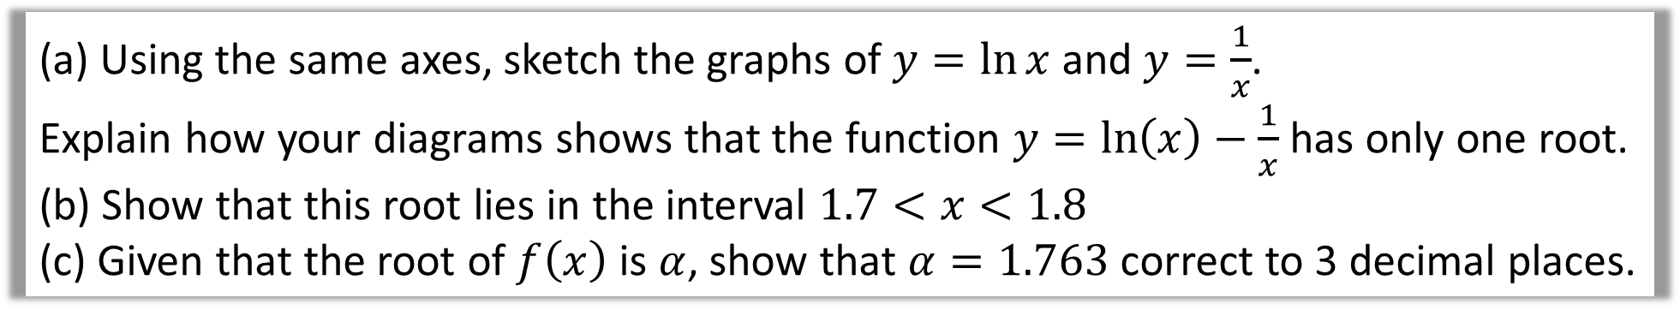
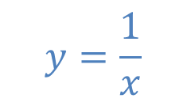


(a) Using the same axes, sketch the graphs of $y=\ln{x}$ and $y=\frac{1}{x}$.
Explain how your diagrams shows that the function $y=\ln\left(x\right)−\frac{1}{x}$ has only one root.
(b) Show that this root lies in the interval $1.7<x<1.8$
(c) Given that the root of $f\left(x\right)$ is $α$, show that $α=1.763$ correct to 3 decimal places.
$$y$$
a)
$$y=\frac{1}{x}$$
$$\ln{x}=\frac{1}{x}$$
$$y=\ln{x}$$
$$\ln{x}−\frac{1}{x}=0$$
$$x$$
There is only one point of intersection on the graph therefore only one root.

Slide 15
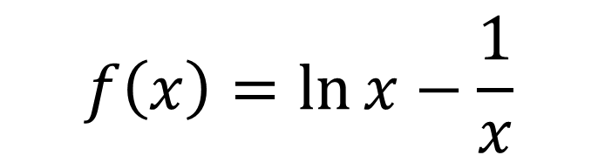
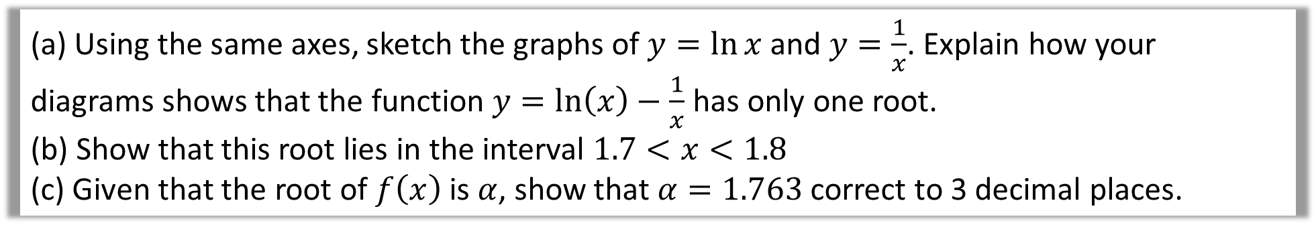
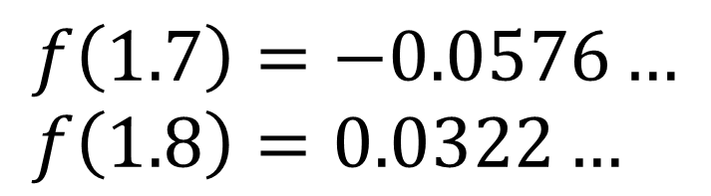
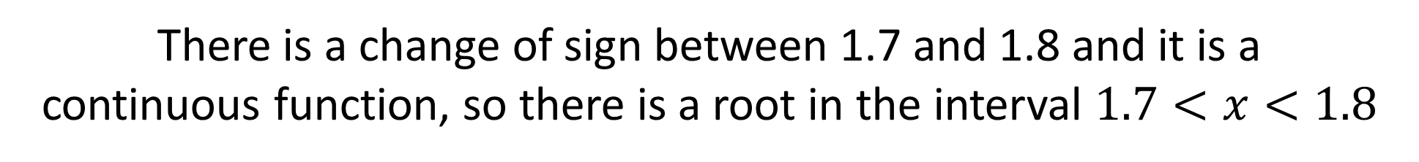
(a) Using the same axes, sketch the graphs of $y=\ln{x}$ and $y=\frac{1}{x}$. Explain how your diagrams shows that the function $y=\ln\left(x\right)−\frac{1}{x}$ has only one root.
(b) Show that this root lies in the interval $1.7<x<1.8$
(c) Given that the root of $f\left(x\right)$ is $α$, show that $α=1.763$ correct to 3 decimal places.
$$f\left(x\right)=\ln{x}−\frac{1}{x}$$
b)
$$f\left(1.7\right)=−0.0576… \\ f\left(1.8\right)=0.0322…$$
There is a change of sign between 1.7 and 1.8 and it is a
continuous function, so there is a root in the interval $1.7<x<1.8$

Slide 16
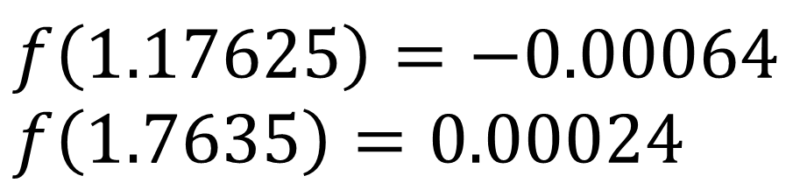
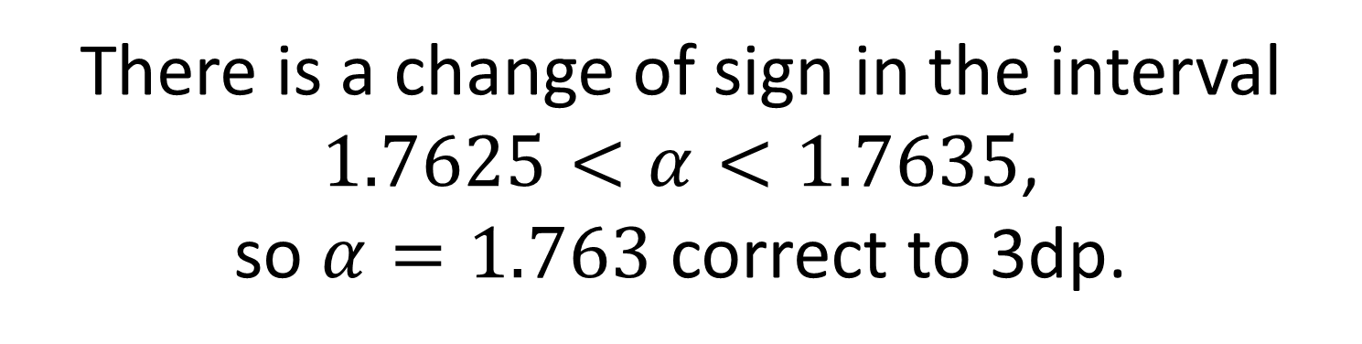
(a) Using the same axes, sketch the graphs of $y=\ln{x}$ and $y=\frac{1}{x}$. Explain how your diagrams shows that the function $y=\ln\left(x\right)−\frac{1}{x}$ has only one root.
(b) Show that this root lies in the interval $1.7<x<1.8$
(c) Given that the root of $f\left(x\right)$ is $α$, show that $α=1.763$ correct to 3 decimal places.
c)
$$f\left(1.17625\right)=−0.00064 \\ f\left(1.7635\right)=0.00024$$
There is a change of sign in the interval
$1.7625<α<1.7635$,
so $α=1.763$ correct to 3dp.

