Slide 1
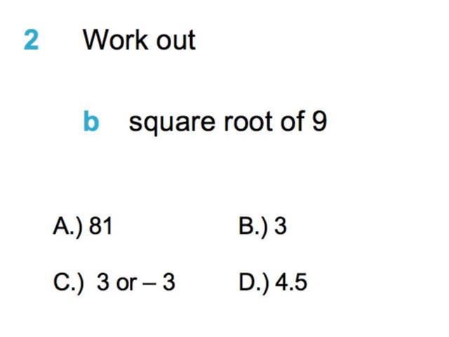
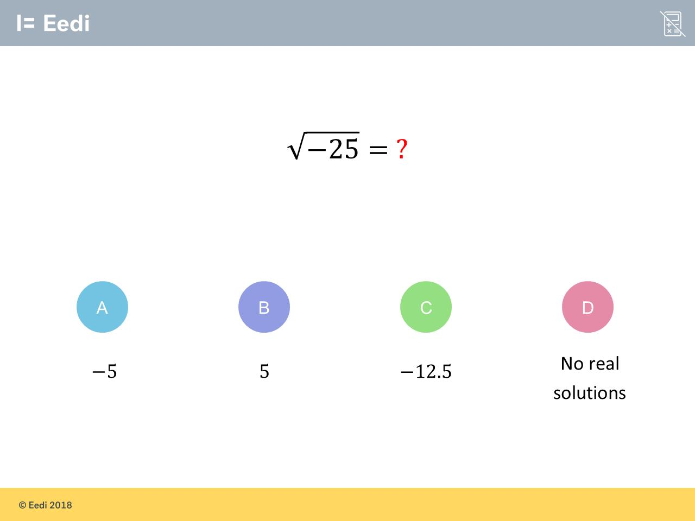
Worst answered question?
Most common wrong answer?

Slide 2
ANSWERS

Slide 3
Worst answered question?

Slide 4
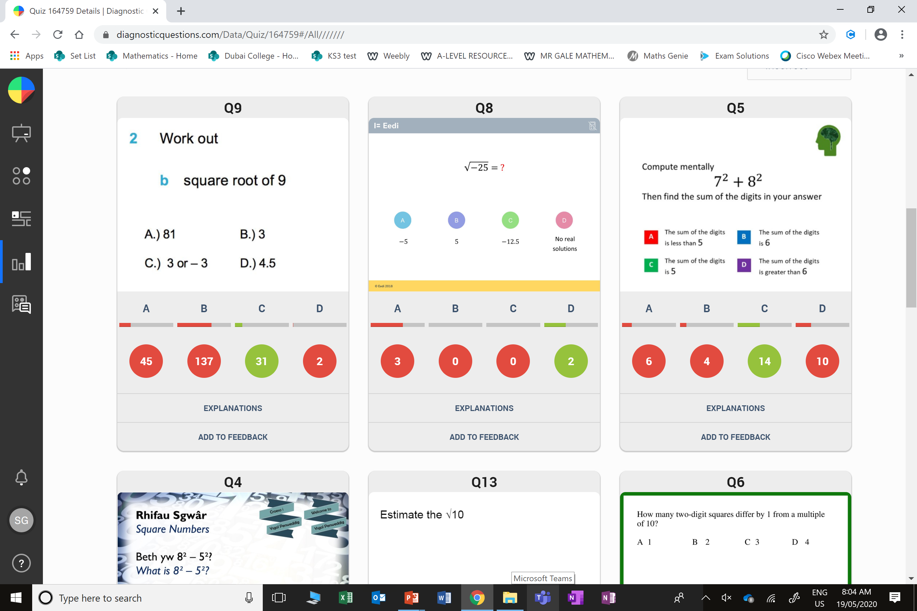
B
They did not realise that a square root always produces a + and - answer.

Slide 5
A
They did not realise you can not square root a negative .

