Slide 1
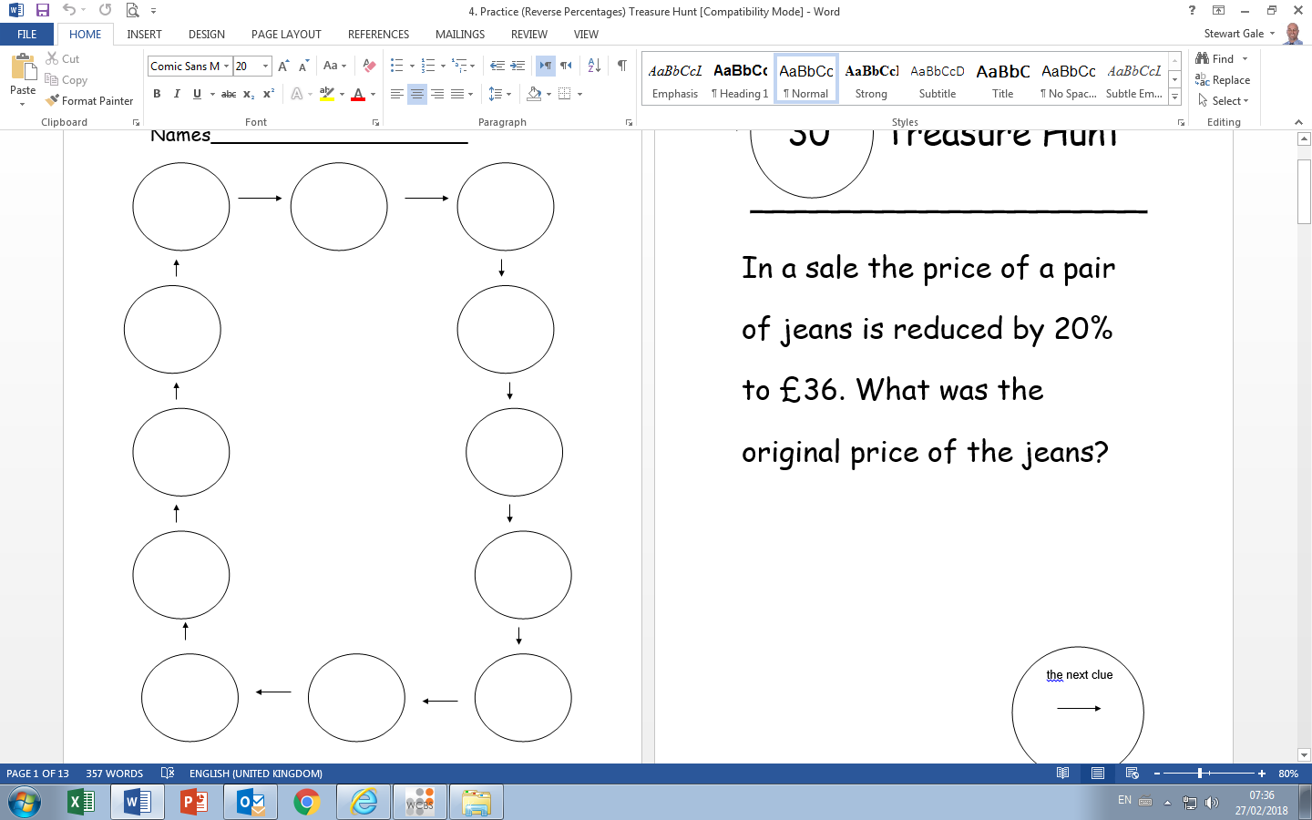
Follow the trail of the answers

Slide 2
ANSWERS

Slide 3
In a sale the price of a pair of jeans is reduced by 20% to £36. What was the original price of the jeans? | 45
In a sale the price of a coat is reduced by 10% to £45. What was the original price of the coat? | 50
A second hand car is valued £6000. This is a 20% decrease from when the car was brand new. What was the cost of the car brand new? | 7500
The number of pupils in a school falls by 8%. If there is now 2208 pupils, how many pupils were there before the fall? | 2400
In a sale the price of a pair of cost is reduced by 5% to £20.90. What was the original price of the coat? | 22
John’s second throw of the javelin in a competition is 70.4 metres. This is 11% shorter than his first throw. How far in metres was his first throw? | 80
The cost of a new TV in a sale is £1846 after a reduction of 29%. What was the original price? | 2600
In a sale the price of a laptop is reduced by 15% to £1147.50. What was the original price of the laptop? | 1350
A second hand car is valued £5400. This is a 75% decrease from when the car was brand new. What was the cost of the car brand new? | 7200
In a sale the price of a pair of shoes is reduced by 8% to £29.44. What was the original price of the shoes? | 32
John’s second throw of the javelin in a competition is 67.68metres. This is 6% shorter than his first throw. How far in metres was his first throw? | 72
In a sale the price of a football is reduced by 80% to £6. What was the original price of the football? | 30

