Slide 1
Moments
Non-uniform Rods
Chapter 4
(Part 3 of 4)

Slide 2
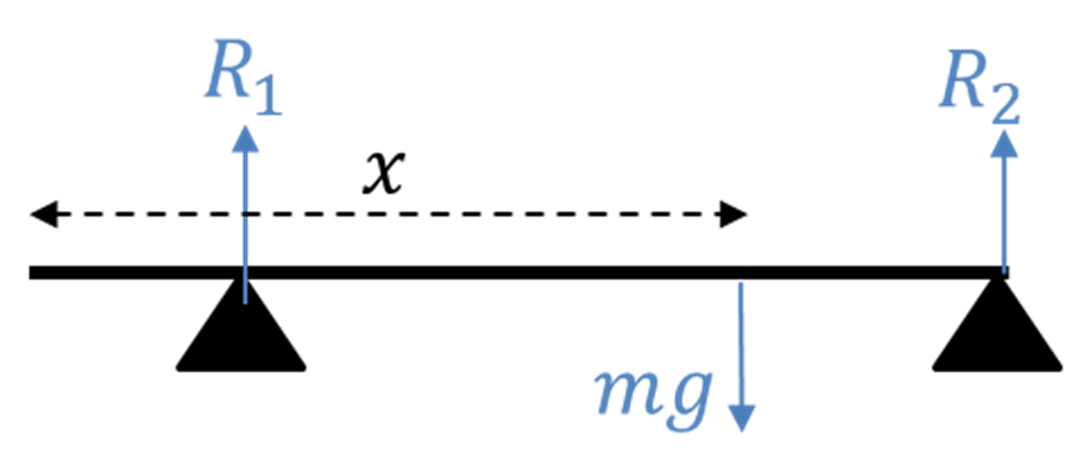
Non-uniform rods
You can’t model its weight as acting at the centre.

Slide 3
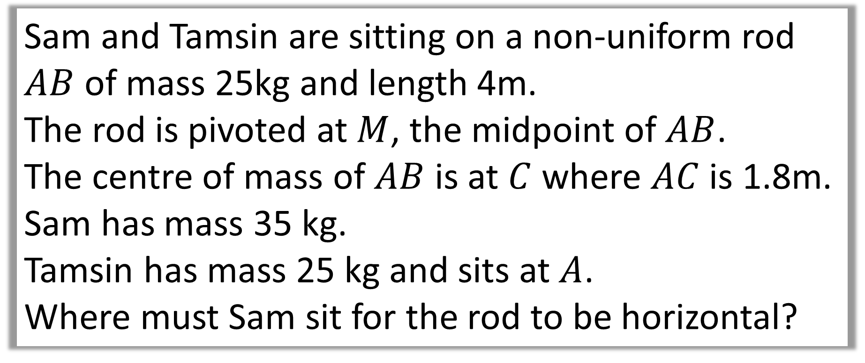
Question A
Sam and Tamsin are sitting on a non-uniform rod
$AB$ of mass 25kg and length 4m.
The rod is pivoted at $M$, the midpoint of $AB$.
The centre of mass of $AB$ is at $C$ where $AC$ is 1.8m.
Sam has mass 35 kg.
Tamsin has mass 25 kg and sits at $A$.
Where must Sam sit for the rod to be horizontal?

Slide 4
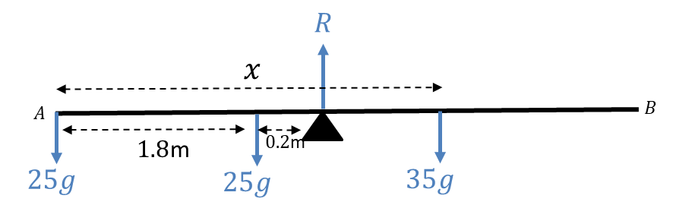
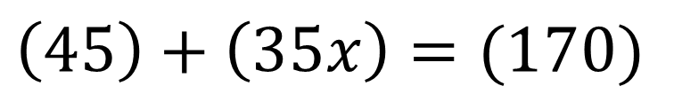
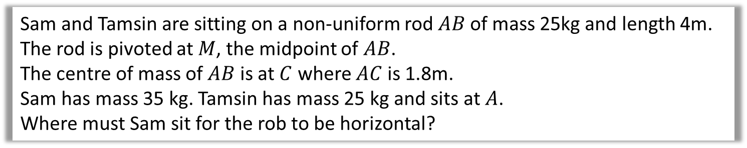


Sam and Tamsin are sitting on a non-uniform rod$AB$ of mass 25kg and length 4m.
The rod is pivoted at $M$, the midpoint of $AB$.
The centre of mass of $AB$ is at $C$ where $AC$ is 1.8m.
Sam has mass 35 kg. Tamsin has mass 25 kg and sits at $A$.
Where must Sam sit for the rob to be horizontal?
$$=85g$$
Moments (A)
$$1.8\left(25g\right)+x\left(35g\right)=2(85g)$$
$$\left(45\right)+\left(35x\right)=(170)$$
$$x=3.57$$

Slide 5
Question B
A uniform beam 𝐴𝐵, of mass 40 kg and length 5m, rests horizontally on support at 𝐶 and 𝐷,
where 𝐴𝐶=D𝐵=1m.
When a man of mass 80kg stands on the beam at 𝐸 the magnitude of the reaction at 𝐷 is twice the magnitude of the reaction at 𝐶.
By modelling the beam as a rod and the man as a particle, find the distance 𝐴𝐸.

Slide 6




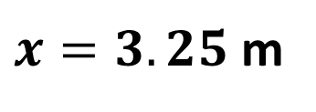


















A uniform beam $AB$, of mass 40 kg and length 5m, rests horizontally on support at $C$ and $D$, where $AC=DB=1$ m.
When a man of mass 80kg stands on the beam at $E$ the magnitude of the reaction at $D$ is twice the magnitude of the reaction at $C$. By modelling the beam as a rod and the man as a particle, find the distance $AE$.
$$x$$
$$R$$
$$=40g$$
$$2R$$
$$=80g$$
$4$m
$$C$$
$$D$$
$$A$$
$$B$$
$1$m
$1.5$m
$$E$$
$1$m
$$40g$$
$$80g$$
Find $R$
Moments (A)
$$R+2R=40g+80g$$
$$1\left(40g\right)+4\left(80g\right)=2.5\left(40g\right)+x\left(80g\right)$$
$$3R=120g$$
$$\left(40\right)+\left(320\right)=\left(100\right)+\left(80x\right)$$
$$R=40g$$
$x=3.25$ m

Slide 7
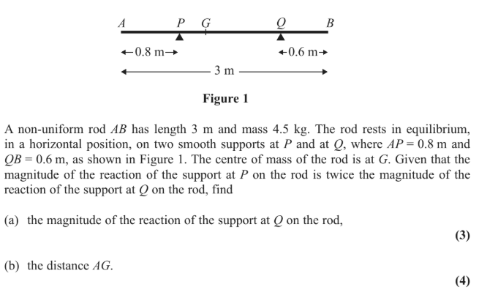
Question C

Slide 8
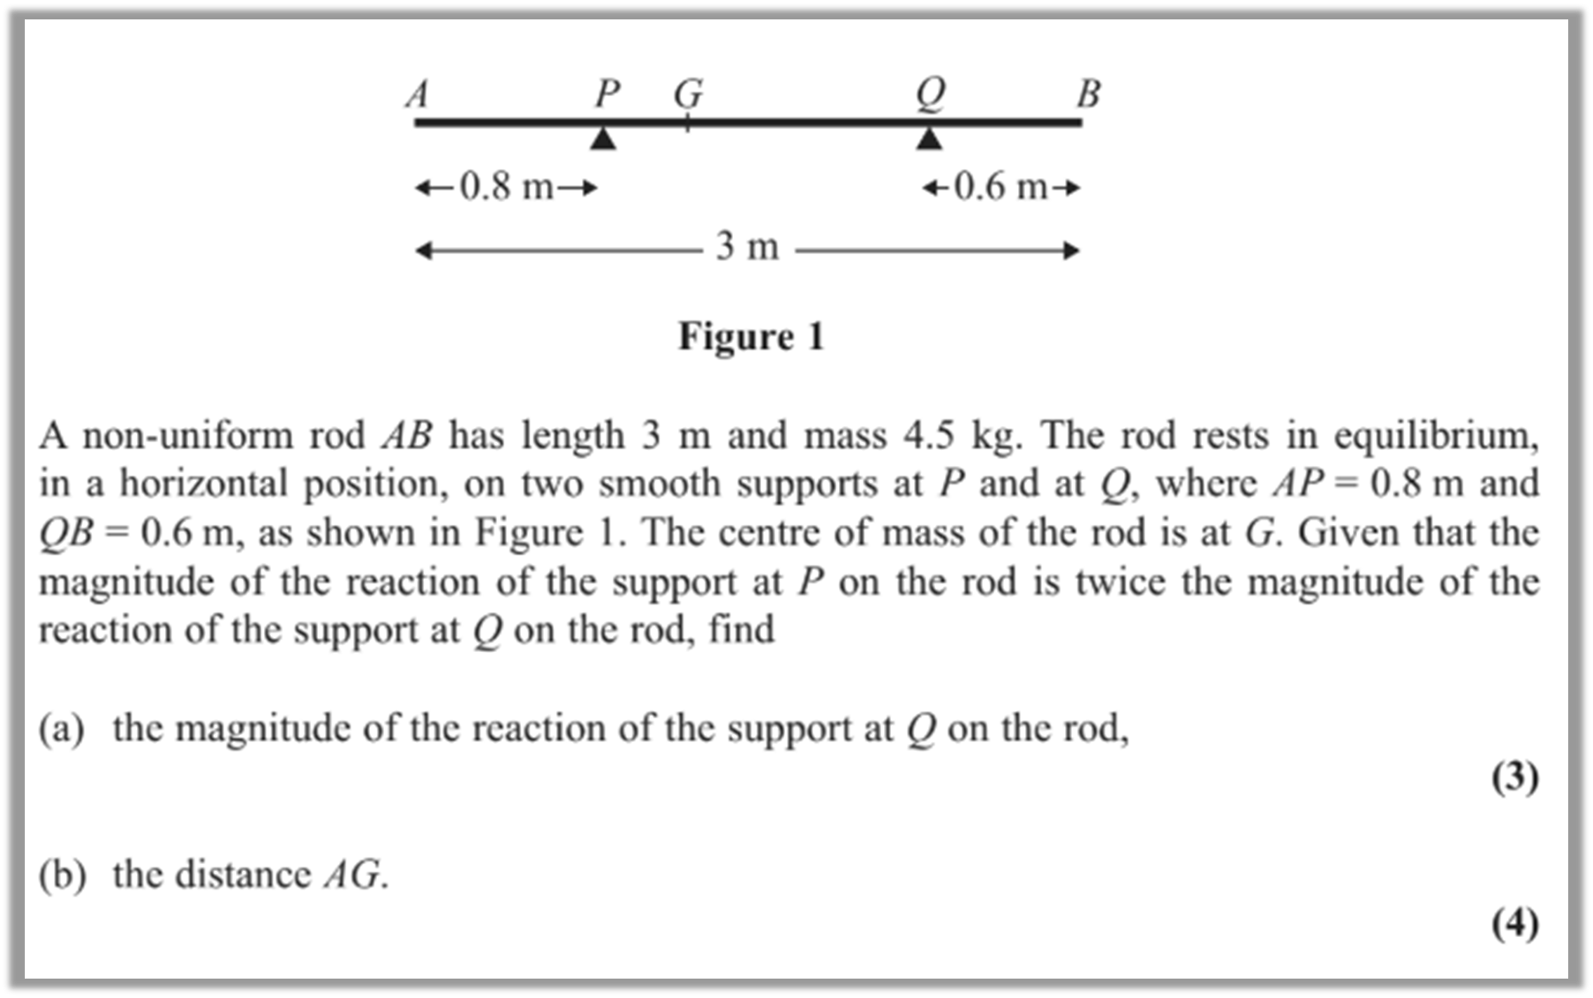
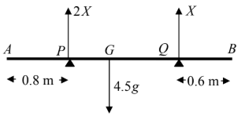


Slide 9
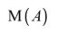
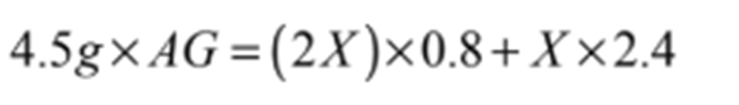
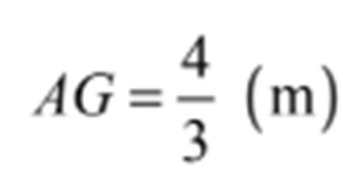
b

