Slide 1

Diagnostic Assessment .Delta 1
Unit 8
Metric and Imperial
Ratios - Sharing
Ratios – Fractions
Proportion

Slide 2
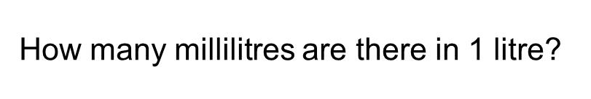
Question 1 – Metric

Slide 3
Answer 1 – Metric
CORRECT ANSWER | CORRECT EXPLANATION
1000 | There are 1000 ml in a litre.
COMMON MISTAKES | WHAT MIGHT BE YOUR MISTAKE
0.001 | The student has found the number of litres in a millimetre.
10 | The student may be confusing millilitres and centilitres.
100 | The student may be confusing centilitres and litres.

Slide 4
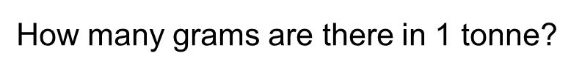
Question 2 – Metric

Slide 5
Answer 2 – Metric
CORRECT ANSWER | CORRECT EXPLANATION
1,000,000 | 1 tonne is 1000 kg, and 1kg is 1000 grams. So, 1 tonne = 1000 × 1000 = 1,000,000 grams.
COMMON MISTAKES | WHAT MIGHT BE YOUR MISTAKE
0.000001 | The student has given the number of tonnes in a gram.
1000 | The student has given the number of kilograms in a tonne.
2000 | The student has found 1000 + 1000, rather than multiplying.

Slide 6
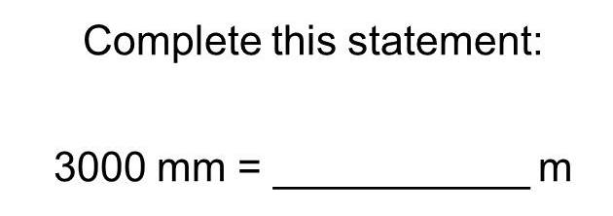
Question 3 – Metric

Slide 7
Answer 3 – Metric
CORRECT ANSWER | CORRECT EXPLANATION
3 m | There are 1000 mm in a metre, so we have 3000 mm = 3000/1000 = 3 m
COMMON MISTAKES | WHAT MIGHT BE YOUR MISTAKE
30 m | The student has used the conversion 100mm = 1m.
0.3 m | The student has used the conversion 10000mm = 1m.

Slide 8
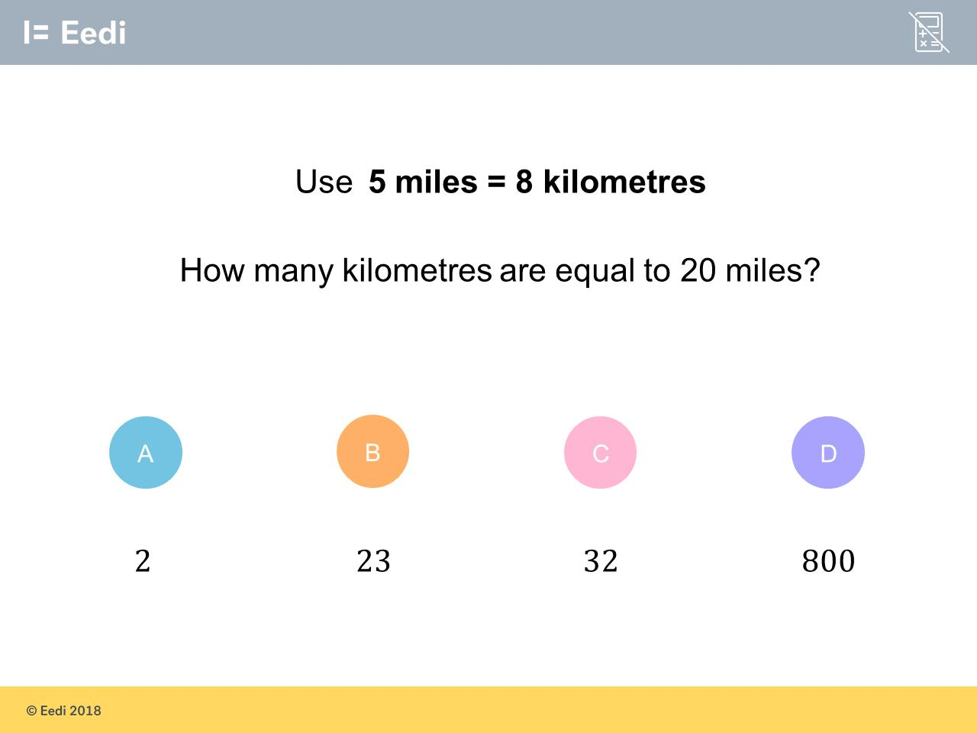
Question 4 – Metric to Imperial

Slide 9
Answer 4 – Metric to Imperial
CORRECT ANSWER | CORRECT EXPLANATION
32 | 20 ÷ 5 = 4 then 8 x 4 = 32km
COMMON MISTAKES | WHAT MIGHT BE YOUR MISTAKE
2 | The student has divided by 4, rather than multiplying.
23 | The student has added 15, which is the difference between 20 and 5 miles.
800 | The student has multiplied all of the numbers in the question together

Slide 10
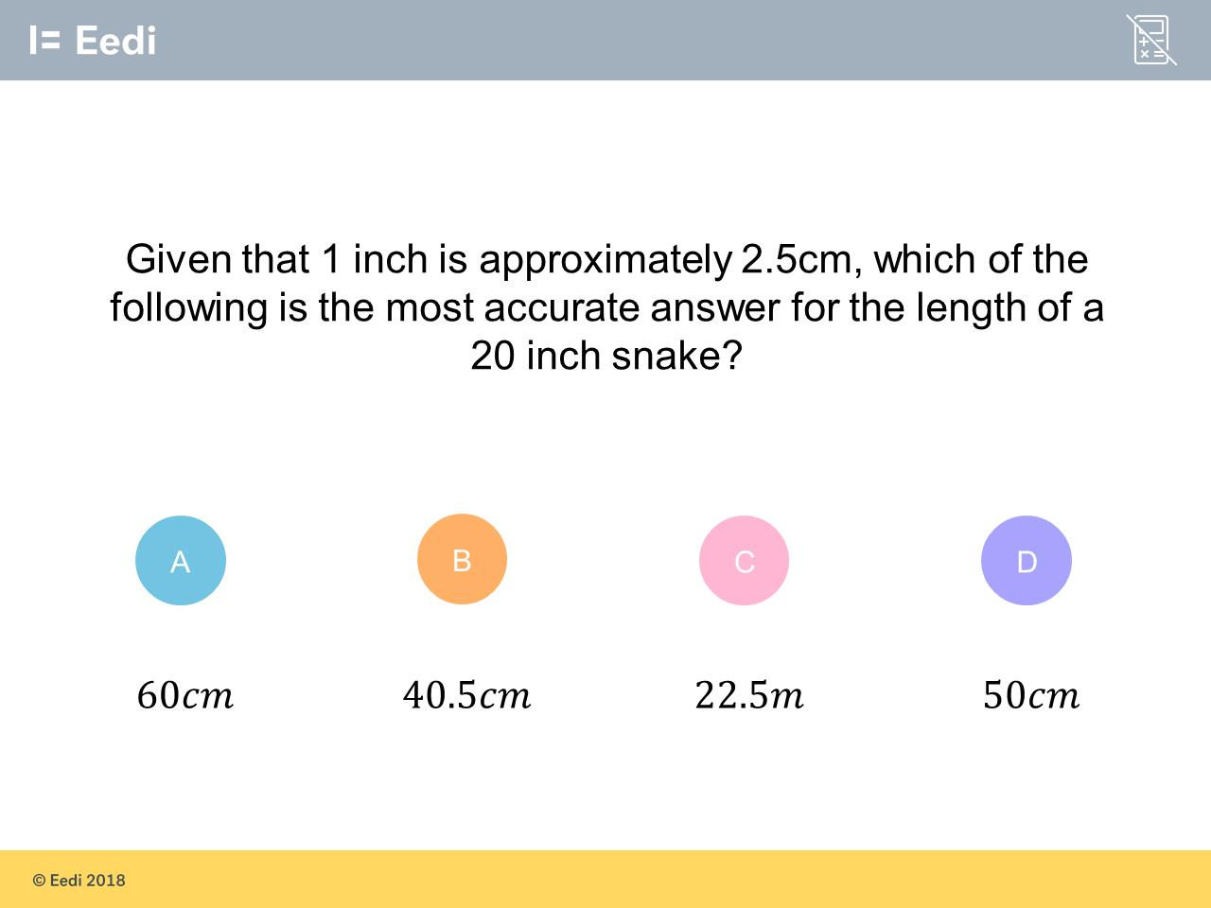
Question 5 – Metric to Imperial

Slide 11
Answer 5 – Metric to Imperial
CORRECT ANSWER | CORRECT EXPLANATION
50cm | If 1 inch = 2.5 cm, 20 inches = 20 × 2.5 = 50 cm.
COMMON MISTAKES | WHAT MIGHT BE YOUR MISTAKE
60cm | The student has multiplied by 3, as they have rounded up 2.5.
40.5cm | The student has multiplied by 2, and then adding 0.5.
22.5m | The student has added the numbers, rather than multiplying.

Slide 12
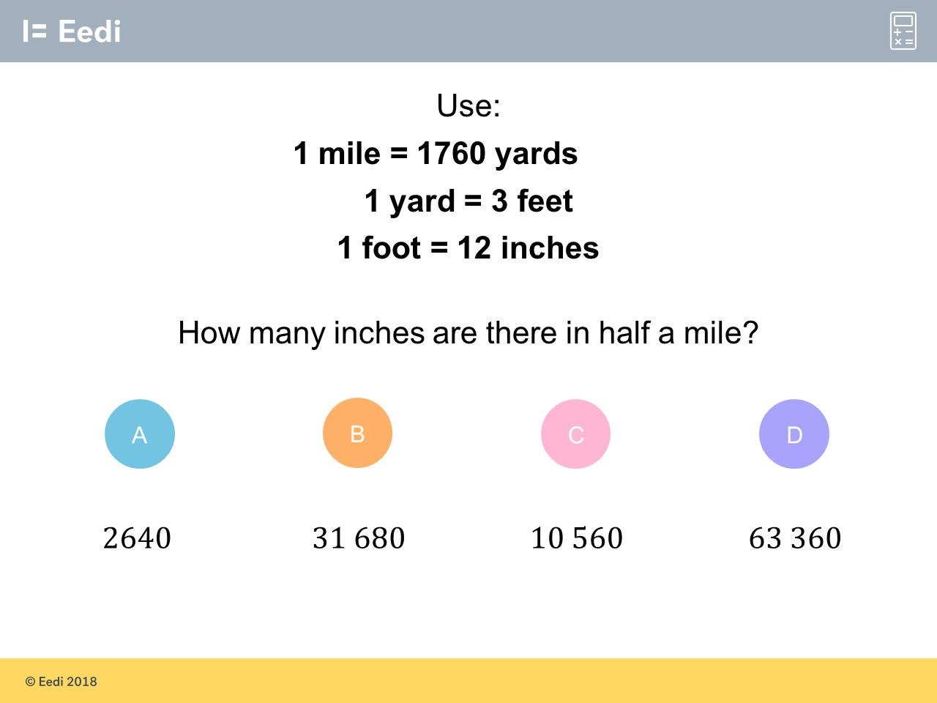
Question 6 – Metric to Imperial

Slide 13
Answer 6 – Metric to Imperial
CORRECT ANSWER | CORRECT EXPLANATION
31 680 | We have 1 mile = 1760 yards = 1760 × 3 = 5280 feet, then 5280 feet = 5280 × 12 = 63,360. Dividing this by 2 gives us 31 680 inches for half a mile.
COMMON MISTAKES | WHAT MIGHT BE YOUR MISTAKE
2640 | The student has found the number of feet in half a mile.
10560 | The student has used 1760 × 12, but has ignored the conversion from yards to feet.
63360 | The student has found the number of inches in 1 mile.

Slide 14
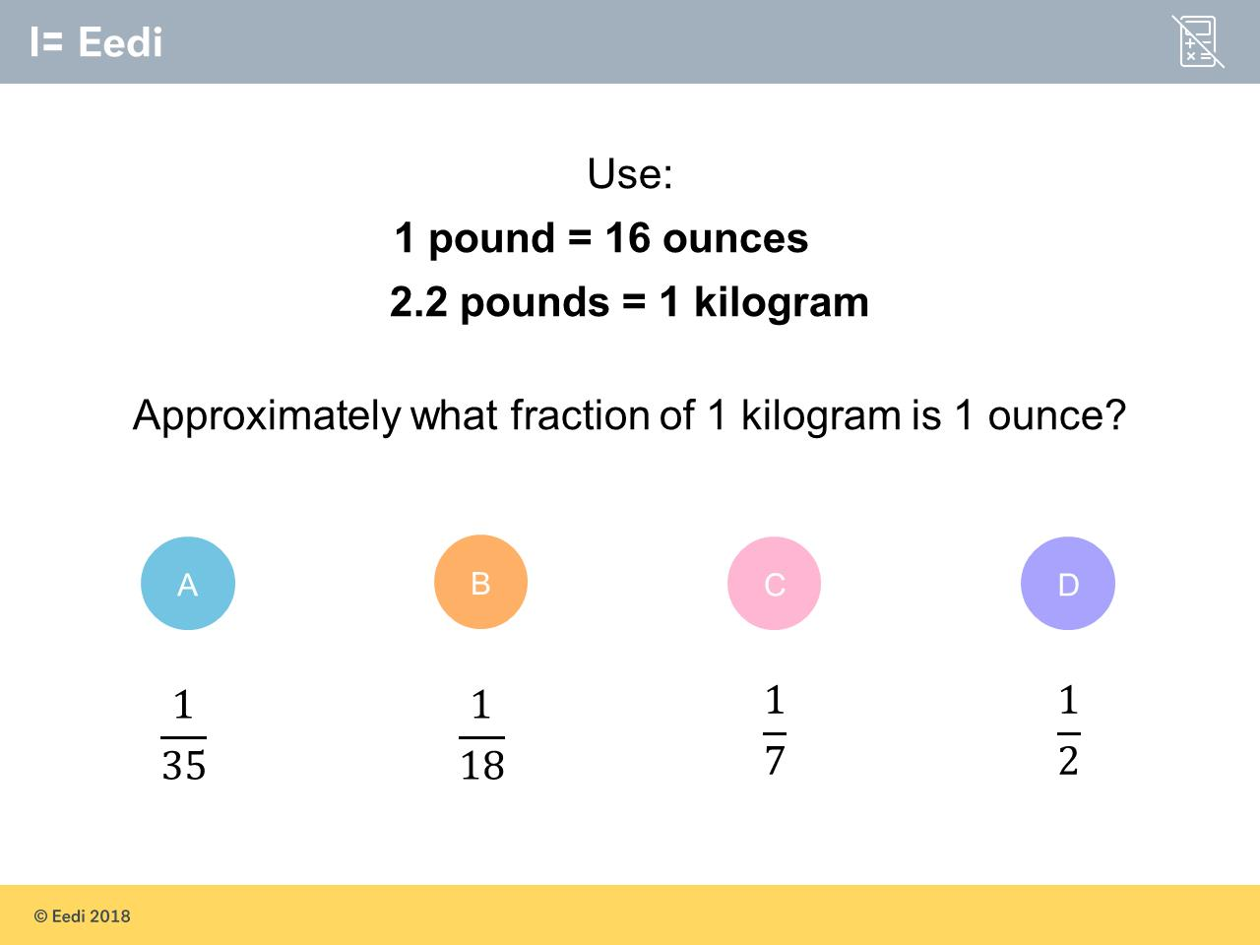
Question 7 – Metric to Imperial
How many ounces in a kilogram?

Slide 15
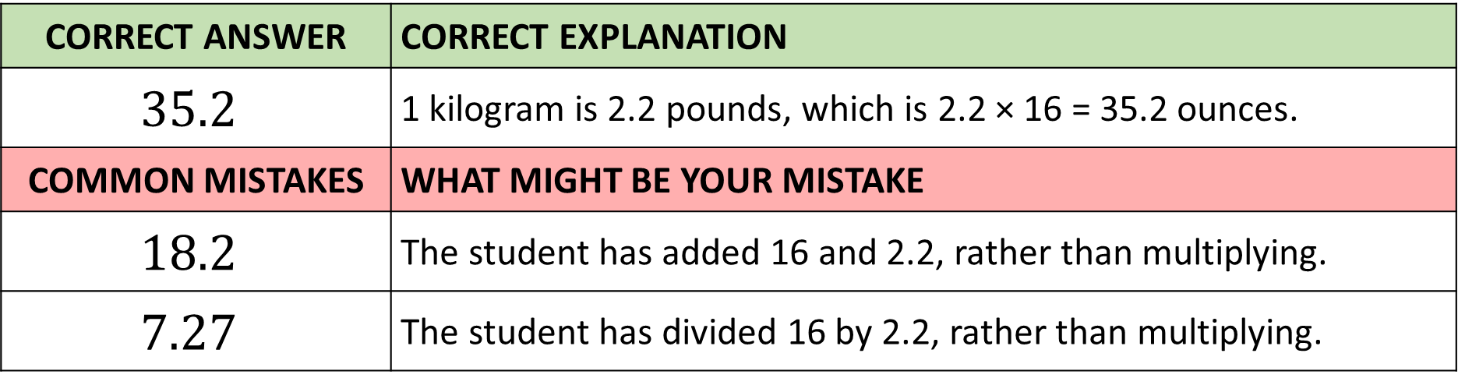
Answer 7 – Metric to Imperial
How many ounces in a kilogram?
CORRECT ANSWER | CORRECT EXPLANATION
$$35.2$$ | 1 kilogram is 2.2 pounds, which is 2.2 × 16 = 35.2 ounces.
COMMON MISTAKES | WHAT MIGHT BE YOUR MISTAKE
$$18.2$$ | The student has added 16 and 2.2, rather than multiplying.
$$7.27$$ | The student has divided 16 by 2.2, rather than multiplying.

Slide 16
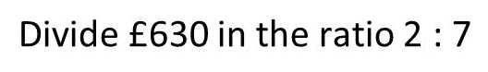
Question 8 – Ratios and Sharing

Slide 17
Answer 8 – Ratios and Sharing
CORRECT ANSWER | CORRECT EXPLANATION
140:490 | One part is 630/(2+7) = 70, then we have 70 × 2 = 140 and 70 × 7 = 490.
COMMON MISTAKES | WHAT MIGHT BE YOUR MISTAKE
315:90 | The student has divided the whole by the individual parts i.e. 630/2 and 630/7.
90:360 | The student has divided the whole by 7 for one part, rather than 2 + 7 = 9.
70:560 | The student has divided in the ratio 1:8.

Slide 18
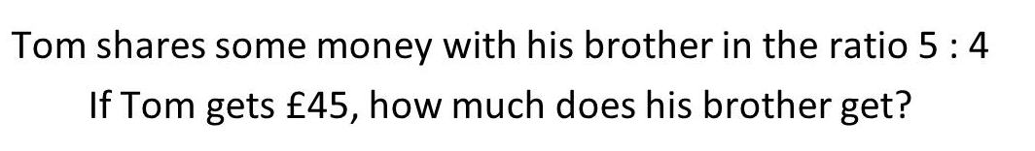
Question 9 – Ratios and Sharing

Slide 19
Answer 9 – Ratios and Sharing
CORRECT ANSWER | CORRECT EXPLANATION
£36 | One part is £45/ 5 = £9, and then we have 9 × 4 = £36.
COMMON MISTAKES | WHAT MIGHT BE YOUR MISTAKE
£25 | The student has divided by the total number of parts, rather than Tom's parts.
£20 | The student has divided by the total number of parts, rather than Tom's parts, and then multiplied by his brothers proportion.
£180 | The student has multiplied Tom's part by 4. They have not divided by 5 first.

Slide 20
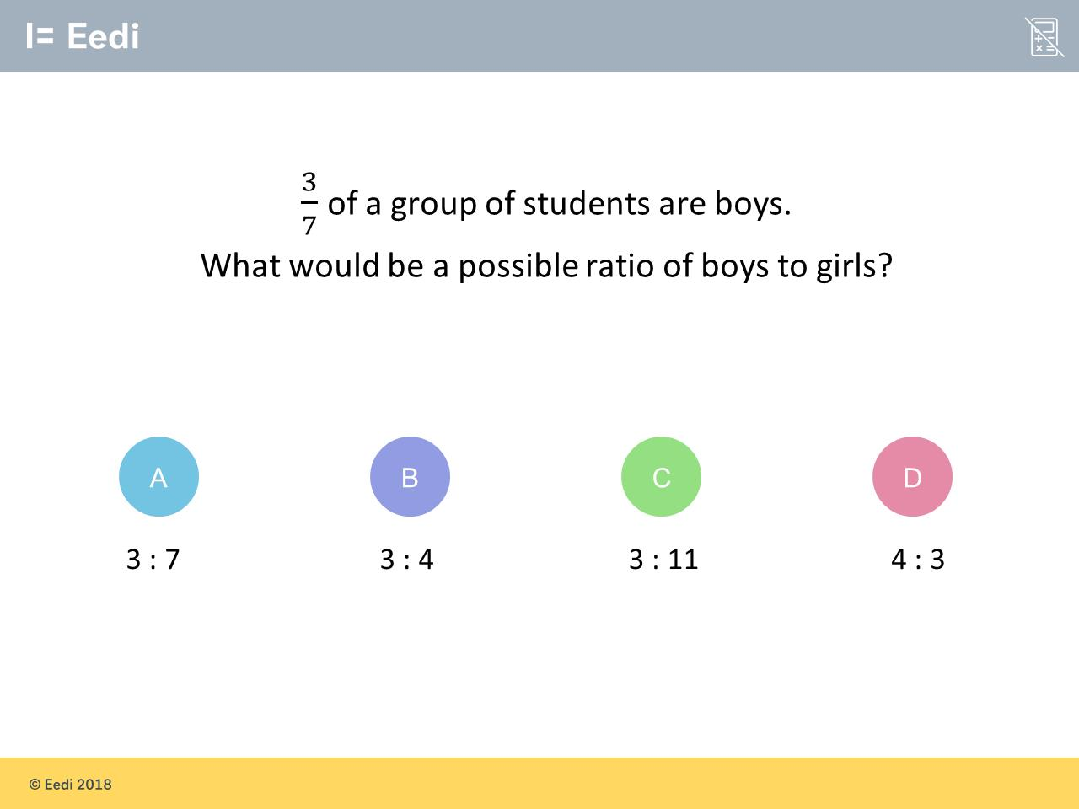
Question 10 – Ratios and Fractions

Slide 21
Answer 10 – Ratios and Fractions
CORRECT ANSWER | CORRECT EXPLANATION
3:4 | For every 7 students, 3 are boys and 4 are girls. The ratio is then 3:4.
COMMON MISTAKES | WHAT MIGHT BE YOUR MISTAKE
3:7 | The student has used the total number of students for the parts, rather than the number of girls.
3:11 | The student has added the numerator and denominator to get the number of parts
4:3 | The student has written the ratio of girls to boys..

Slide 22
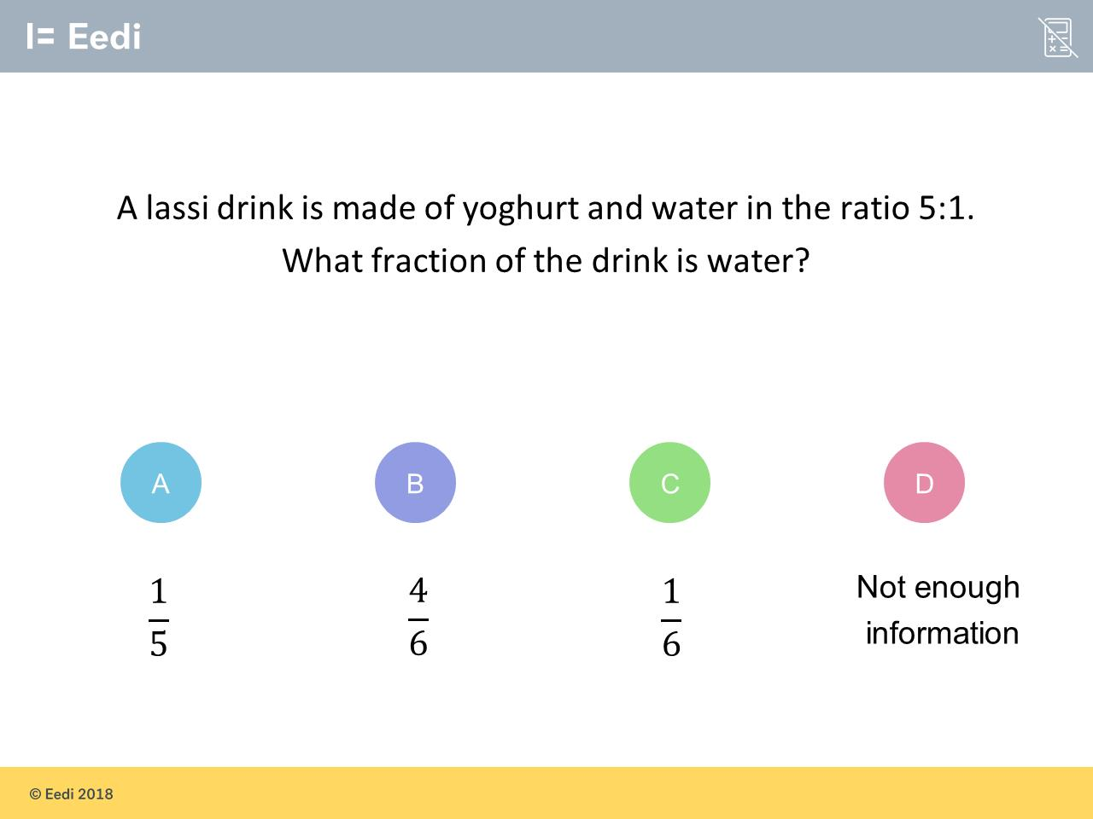
Question 11 – Ratios and Fractions
?

Slide 23
Answer 11 – Ratios and Fractions
CORRECT ANSWER | CORRECT EXPLANATION
$$\frac{1}{6}$$ | The total number of parts is 5 + 1 = 6, so the drink is 1/6th water.
COMMON MISTAKES | WHAT MIGHT BE YOUR MISTAKE
$$\frac{1}{5}$$ | The student has not worked out the total number of parts for the denominator.
$$\frac{4}{6}$$ | The student has found the fraction of yoghurt.
Not enough information | The student may think we need the volume of the drink.

Slide 24
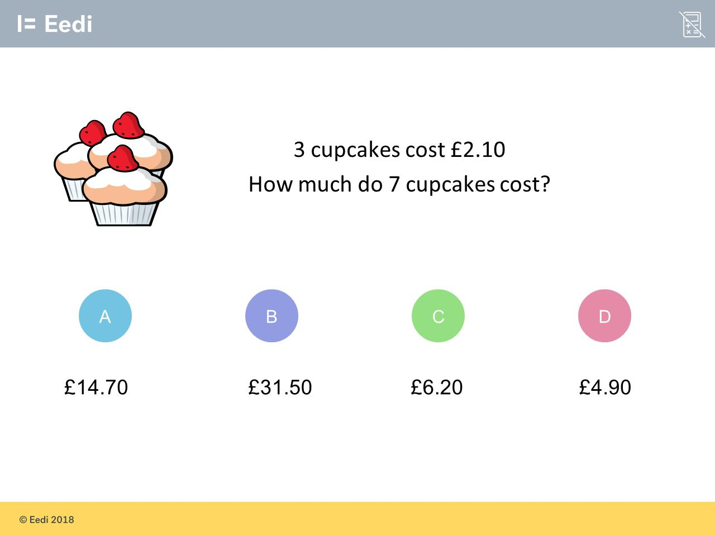
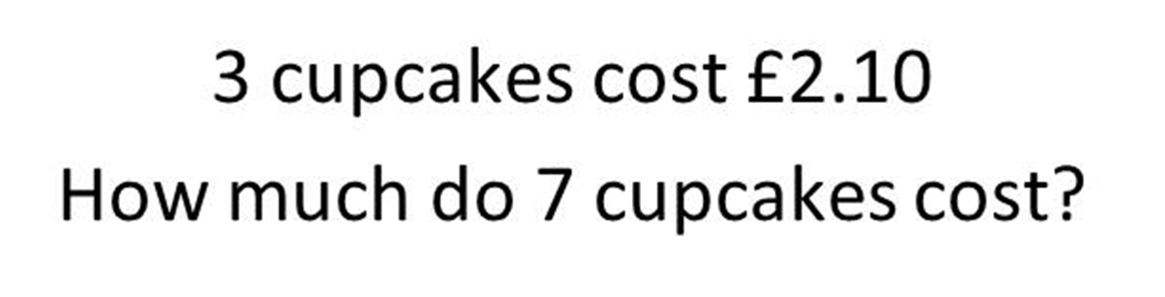
Question 12 – Proportion

Slide 25
Answer 12 – Proportion
CORRECT ANSWER | CORRECT EXPLANATION
£4.90 | 1 cupcake costs £2.10/3 = £0.70, so 7 cupcakes costs £0.70 × 7 = £4.90.
COMMON MISTAKES | WHAT MIGHT BE YOUR MISTAKE
£14.70 | The student has used £2.10 as the cost of 1 cupcake.
£31.50 | The student has made a calculation error. They may have multiplied all numbers together.
£6.20 | The student has multiplied £2.10 by 3, rather than dividing.

Slide 26
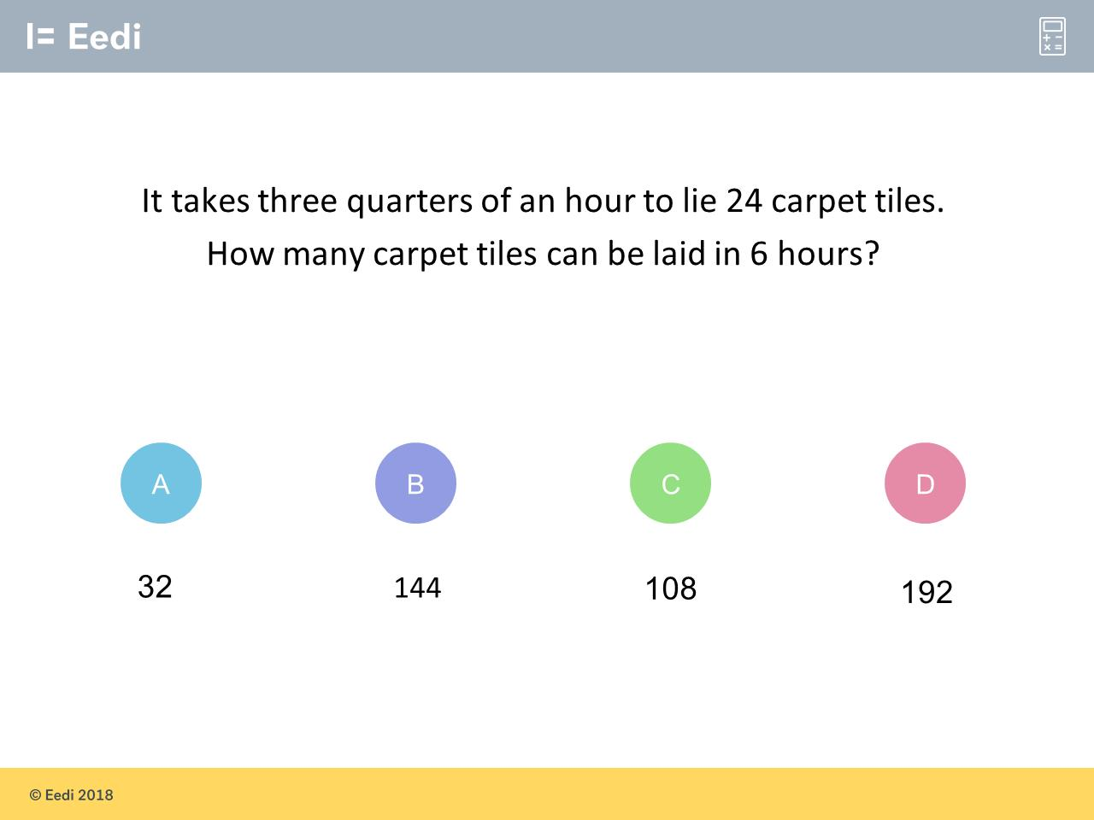
Question 13 – Proportion

Slide 27
Answer 13 – Proportion
CORRECT ANSWER | CORRECT EXPLANATION
192 | If 24 tiles can be laid in 3/4 of an hour, then 24/3=8 tiles can be laid in 1/4 hour. This means 8 x 4 = 32 tiles can be laid in 1 hour and therefore that 32 x 6 = 192 tiles can be laid in 6 hours.
COMMON MISTAKES | WHAT MIGHT BE YOUR MISTAKE
32 | You have found the number of tiles that can be laid in 1 hour! :) You just needed to multiply this by 6 to find the number that can be laid in 6 hours!
144 | You have successfully recognised that it will be necessary to multiply by 6! :) However, you've missed out the first step: the thing you need to multiply by 6 is the number of tiles that can be laid in 1 hour, not in 3/4 of an hour.
108 | To find how many tiles can be laid in 1 hour, we need to divide the number that can be laid in 3/4 of an hour by 3 and then multiply it by 4 (and then, as you successfully recognised, the answer needs to be multiplied by 6 to find how many tiles can be laid in 6 hours. However, it looks as though you divided by 4 and then multiplied by 3 instead.

