Slide 1
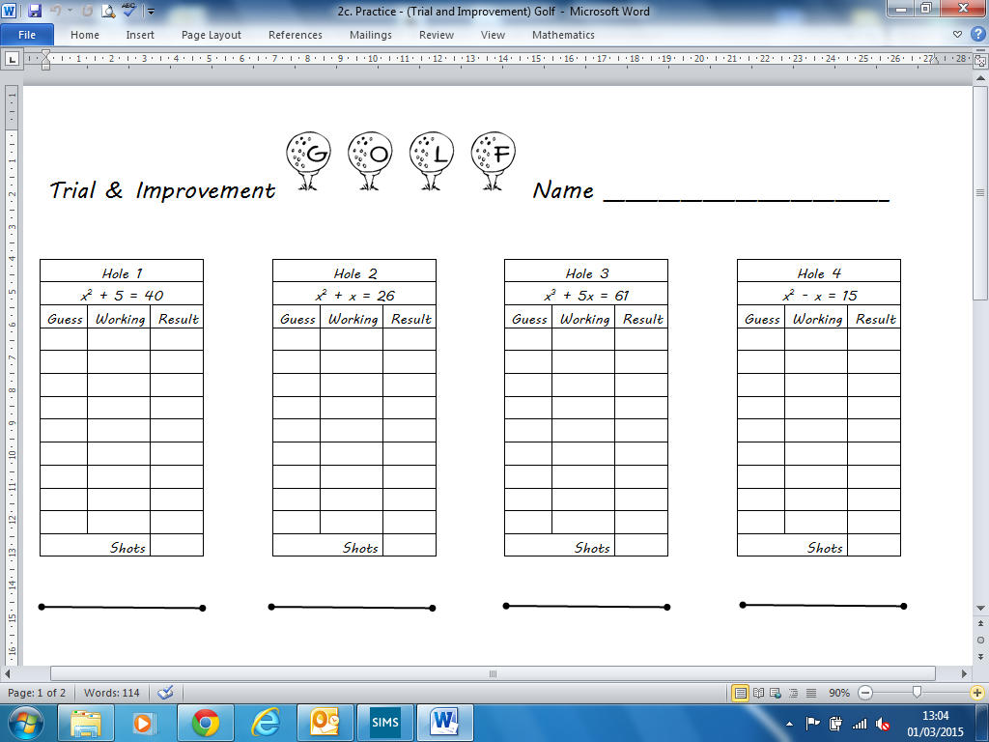
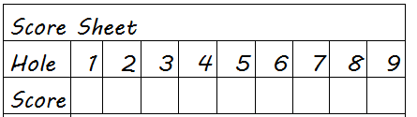
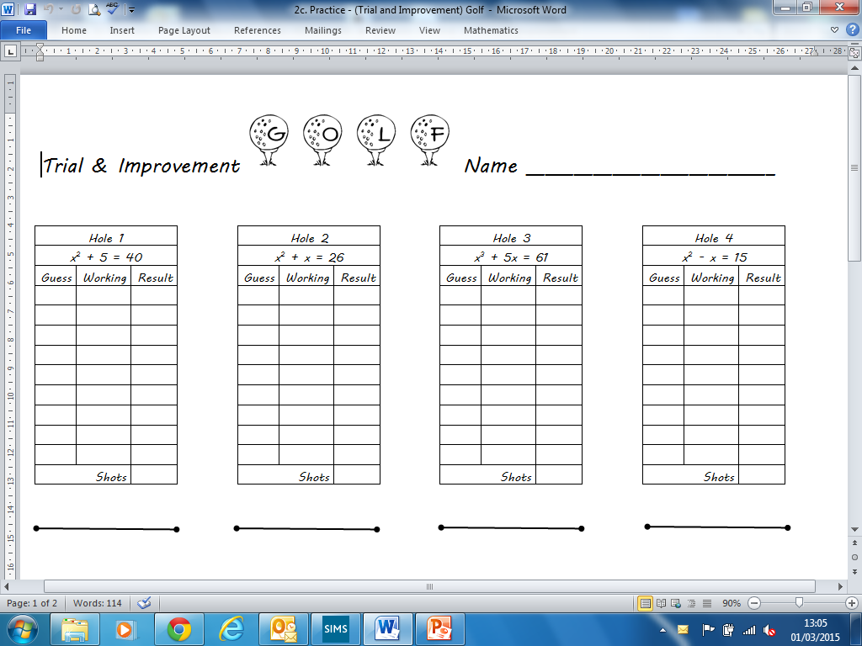
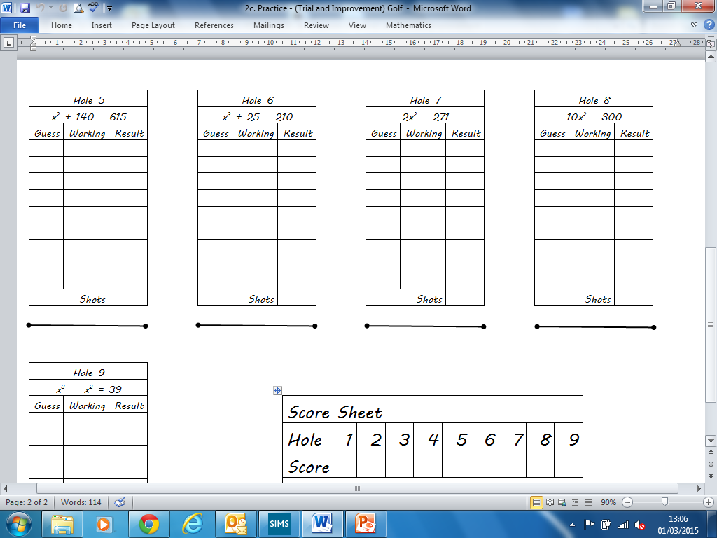

Give answers to 1dp
x is between 5 and 6
x is between 4 and 5
x is between 3 and 4
x =
x =
x =
x is between 4 and 5
x is between 21 and 22
x is between 5 and 6
x =
x =
x =
x is between 11 and 12
x is between 5 and 6
x is between 3 and 4
x =
x =
x =

Slide 2
Answers

Slide 3
Give answers to 1dp
x is between 5 and 6
x is between 4 and 5
x is between 3 and 4
Hole 2
Hole 3
5.9
Small
4.6
Small
3.5
Small
6.0
Big
4.7
Big
3.6
Big
5.95
Big
4.65
big
3.55
Big
x =
x =
x =
5.9
4.6
3.5
x is between 4 and 5
x is between 21 and 22
x is between 5 and 6
Hole 4
Hole 5
Hole 6
4.5
Big
21.7
Small
5.7
Big
4.4
Small
21.8
Big
5.6
Small
4.45
Big
21.75
Small
5.65
Small
x =
x =
x =
4.4
21.8
5.7
x is between 11 and 12
x is between 5 and 6
x is between 3 and 4
Hole 7
Hole 8
Hole 9
11.6
Small
5.4
Small
11.7
Big
5.5
Big
3.7
Small
11.65
Big
5.45
Small
3.8
Big
3.75
Small
x =
x =
11.6
5.5
x =
3.8

