Slide 1
LO: Percentages
of an Amount
(Calculator Method)

Slide 2
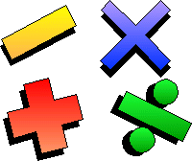
What is 34% of 193?
You can only use
one operation once.

Slide 3
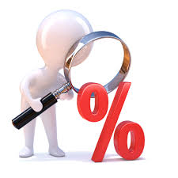
What is 34% of 193?
0.34 x 193 = 65.62
the multiplier
(34% as a decimal)

Slide 4
What is the multiplier for calculating…..
20%
0.2

Slide 5
What is the multiplier for calculating…..
2%
0.02

Slide 6
What is the multiplier for calculating…..
2.5%
0.025

Slide 7
What is the multiplier for calculating…..
70%
0.70

Slide 8
What is the multiplier for calculating…..
43%
0.43

Slide 9
What is the multiplier for calculating…..
120%
1.2

Slide 10
What is the multiplier for calculating…..
103%
1.03

Slide 11
What is the multiplier for calculating…..
0.1%
0.001

Slide 12
What is the calculation
for working out…..
3% of 120?
0.03 x 120

Slide 13
What is the calculation
for working out…..
30% of 120?
0.3 x 120

Slide 14
What is the calculation
for working out…..
32% of 120?
0.32 x 120

Slide 15
What is the calculation
for working out…..
1.5% of 120?
0.015 x 120

Slide 16
What is the calculation
for working out…..
130% of 120?
1.3 x 120

