Slide 1
Probability
Probability Trees
Chapter 2
(Part 4 of 4)

Slide 2
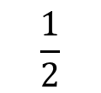
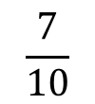


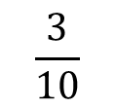


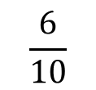



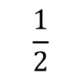
You have two bags, the first with 5 red balls and 5 blue balls, and the second with 3 red balls and 6 blue balls. You first pick a ball from the first bag,
and place it in the second. You then pick a ball from the second bag.
a) Draw a tree diagram.
b) You pick a red ball on your second pick.
c) Given that your second pick was red, the first pick was also red.
$$\frac{4}{10}$$
a)
$$R_{2}$$
$$\frac{1}{2}$$
$$R_{1}$$
$$\frac{6}{10}$$
$$B_{2}$$
$$\frac{3}{10}$$
$$R_{2}$$
$$\frac{1}{2}$$
$$B_{1}$$
$$\frac{7}{10}$$
$$B_{2}$$

Slide 3
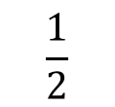
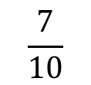


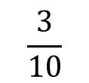

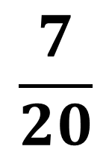

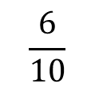

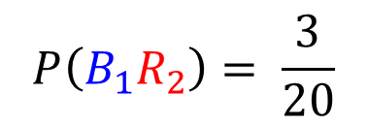
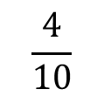

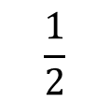
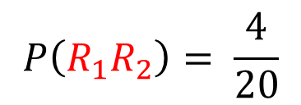
You have two bags, the first with 5 red balls and 5 blue balls, and the second with 3 red balls and 6 blue balls. You first pick a ball from the first bag,
and place it in the second. You then pick a ball from the second bag.
a) Draw a tree diagram.
b) You pick a red ball on your second pick.
c) Given that your second pick was red, the first pick was also red.
$$\frac{4}{10}$$
$$P\left(R_{1}R_{2}\right)= \frac{4}{20}$$
b)
$$R_{2}$$
$$\frac{1}{2}$$
$$R_{1}$$
$$\frac{6}{10}$$
$$B_{2}$$
$$\frac{3}{10}$$
$$R_{2}$$
$$P\left(B_{1}R_{2}\right)= \frac{3}{20}$$
$$\frac{7}{20}$$
$$\frac{1}{2}$$
$$B_{1}$$
$$\frac{7}{10}$$
$$B_{2}$$

Slide 4

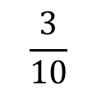
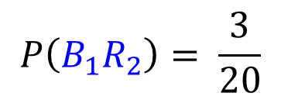


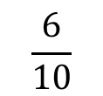
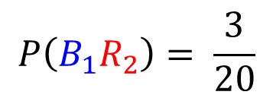
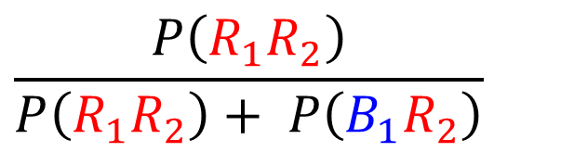
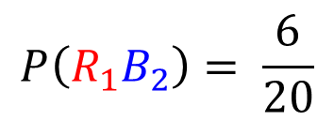


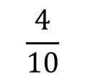


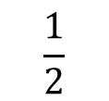
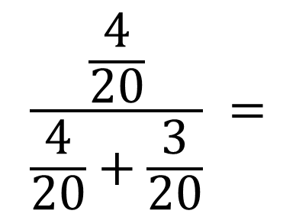

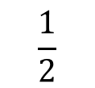
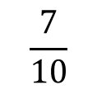
You have two bags, the first with 5 red balls and 5 blue balls, and the second with 3 red balls and 6 blue balls. You first pick a ball from the first bag,
and place it in the second. You then pick a ball from the second bag.
a) Draw a tree diagram.
b) You pick a red ball on your second pick.
c) Given that your second pick was red, the first pick was also red.
c)
$$\frac{4}{10}$$
$$P\left(R_{1}R_{2}\right)= \frac{4}{20}$$
$$R_{2}$$
$$\frac{P\left(R_{1}R_{2}\right)}{P\left({R_{1}R}_{2}\right)+ P\left(B_{1}R_{2}\right)}$$
$$\frac{1}{2}$$
$$R_{1}$$
$$\frac{6}{10}$$
$$B_{2}$$
$$P\left(R_{1}B_{2}\right)= \frac{6}{20}$$
$$\frac{\frac{4}{20}}{\frac{4}{20}+\frac{3}{20}} =$$
$$\frac{4}{7}$$
$$\frac{3}{10}$$
$$R_{2}$$
$$P\left(B_{1}R_{2}\right)= \frac{3}{20}$$
$$\frac{1}{2}$$
$$B_{1}$$
$$B_{2}$$
$$P\left(B_{1}R_{2}\right)= \frac{3}{20}$$
$$\frac{7}{10}$$

Slide 5
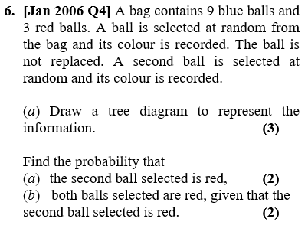

Slide 6
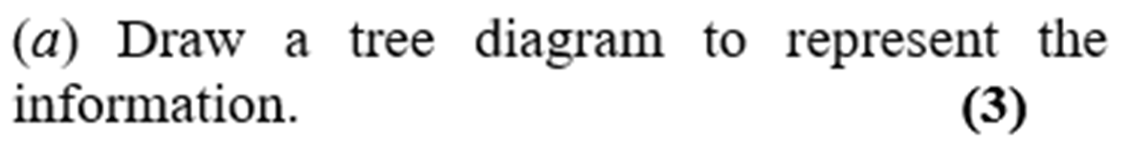
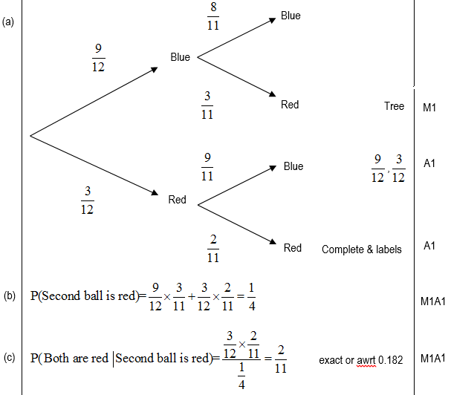

Slide 7
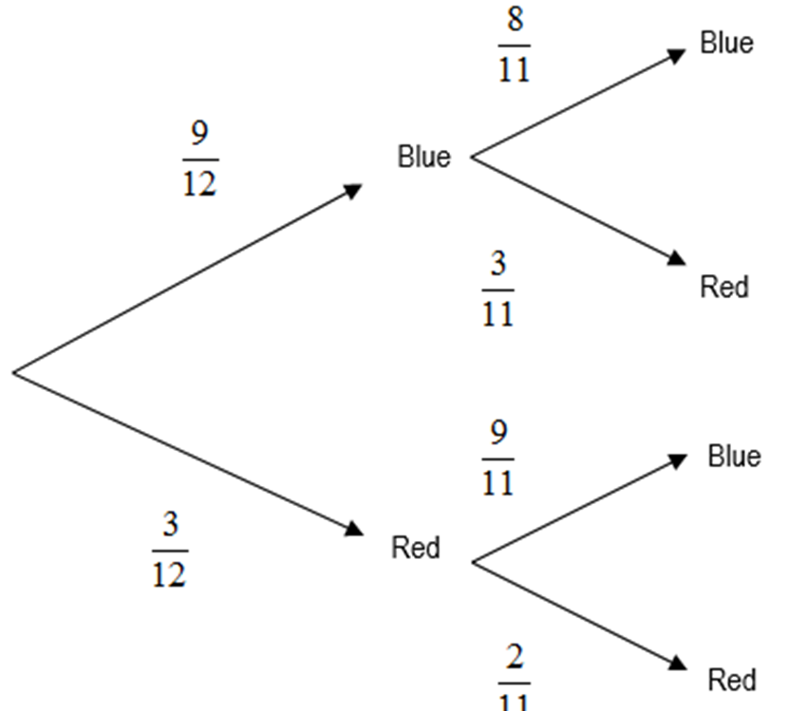

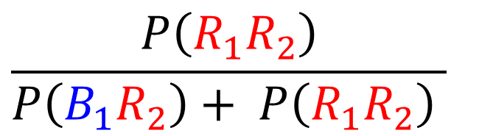
a)
$$P\left({B_{1}R}_{2}\right)+ P\left(R_{1}R_{2}\right)$$
$$\frac{P\left(R_{1}R_{2}\right)}{P\left({B_{1}R}_{2}\right)+ P\left(R_{1}R_{2}\right) }$$
b)

