Slide 1
Statistical Distributions
The Binomial Distribution
Chapter 6
(Part 2 of 3)

Slide 2
Binomial Distribution
A mathematical expression
consisting of two terms
connected by a plus or minus sign

Slide 3

Possible Successful Outcomes
1 Coin
No Tails
How many successful outcomes?
1

Slide 4
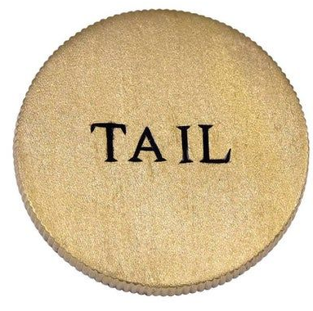
Possible Successful Outcomes
How many successful outcomes?
Two Coins
No Tails
Two Coins
One Tail
Two Coins
Two Tails
1
1
2

Slide 5
Possible Successful Outcomes
How many successful outcomes?
Three Coins
No Tails
Three Coins
One Tail
Three Coins
Two Tails
Three Coins
Three Tails
1
1
3
3

Slide 6
How many successful outcomes?
Four Coins
No Tails
Four Coins
One Tail
Four Coins
Two Tail
Four Coins
Tree Tail
Four Coins
Four Tail
1
1
4
4
6

Slide 7
1
1
2
1
1
3
3
1
1
4
6
4
1
1
5
10
10
5
1
Pascals Triangle!

Slide 8
Possible Successful Outcomes
20 Coins
4 Tails
How many successful outcomes?
A lot!
4845

Slide 9
nCr
nCr formula is used to find the number of ways of choosing
r objects from n objects
where the order is not important.

Slide 10
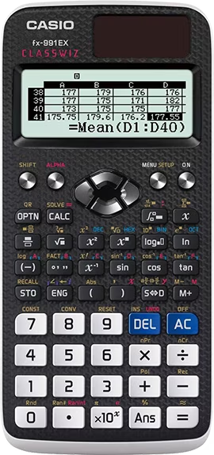
Successful Outcomes Using the Calculator
nCr
n = number of trials
r = required number of success

Slide 11
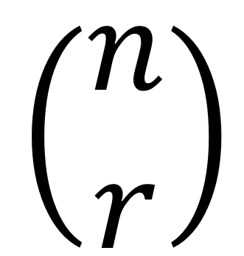

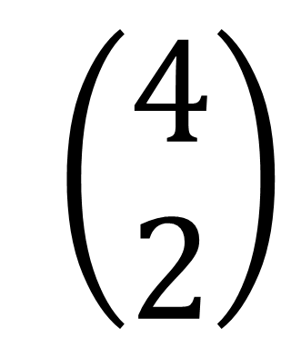
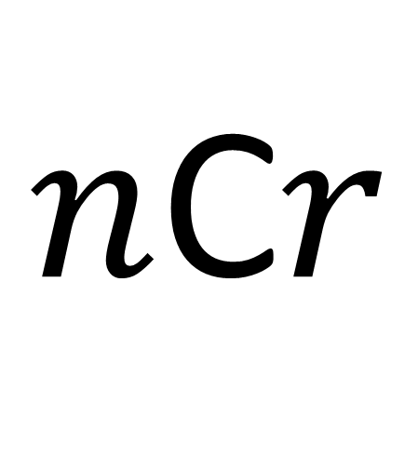
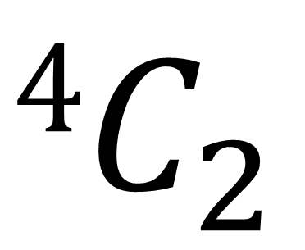
$n$C$r$ Notation
$$\left(\begin{matrix}n \\ r\end{matrix}\right)$$
$n$C$r$
$$\left(\begin{matrix}4 \\ 2\end{matrix}\right)$$
$$4C_{2}$$

Slide 12
Total Trials | Successful Outcomes Required | Combinations
2 | 1
3 | 2
4 | 2
²C₁ = 2
³C₂ = 3
⁴C₂ = 6

Slide 13

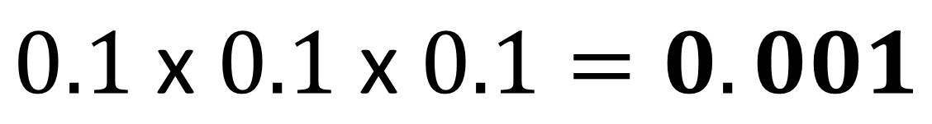
The probability that a person is left-handed is 0.1.
There are 3 people in a room.
What is the probability that everyone is left-handed?
$$0.1 \text{x} 0.1 \text{x} 0.1=0.001$$

Slide 14

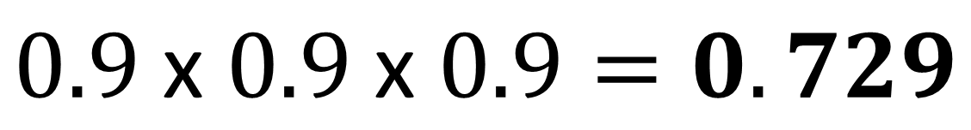
The probability that a person is left-handed is 0.1.
There are 3 people in a room.
What is the probability that no one is left-handed?
$$0.9 \text{x} 0.\text{9 }\text{x} 0.9=0.729$$

Slide 15
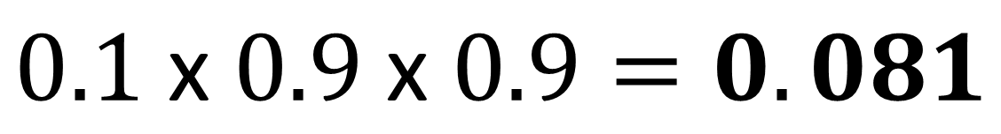
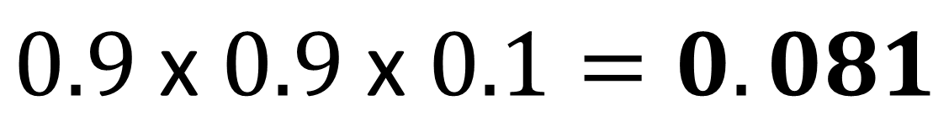
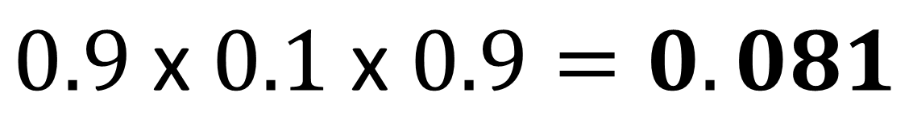
The probability that a person is left-handed is 0.1.
0.243
There are 3 people in a room.
What is the probability that only one person is left-handed?
$$0.1 \text{x} 0.\text{9 }\text{x} 0.9=0.081$$
$$0.9 \text{x} 0.\text{1 }\text{x} 0.9=0.081$$
$$0.9 \text{x} 0.\text{9 }\text{x} 0.1=0.081$$

Slide 16
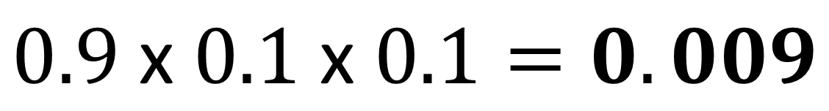
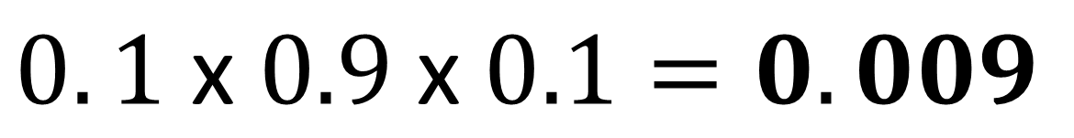
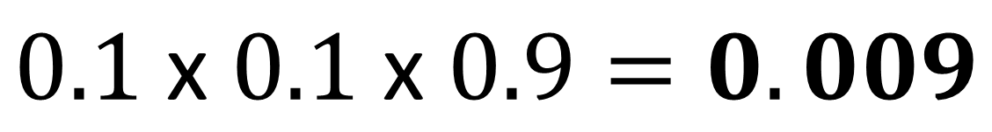
The probability that a person is left-handed is 0.1.
0.027
There are 3 people in a room.
What is the probability that only two people are left-handed?
$$0.9 \text{x} 0.\text{1 }\text{x} 0.1=0.009$$
$$0.1 \text{x} 0.\text{1 }\text{x} 0.9=0.009$$
$$0. \text{1 }\text{x} 0.\text{9 }\text{x} 0.1=0.009$$

Slide 17
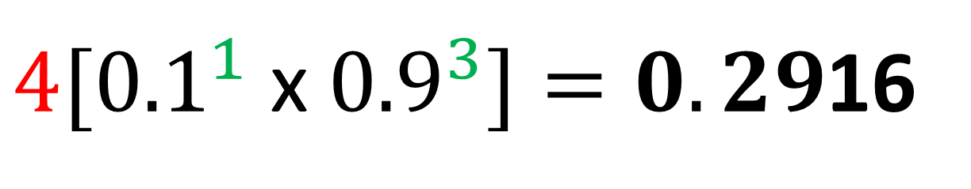
The probability that a person is left-handed is 0.1.
There are 4 people in a room.
What is the probability that one person is left-handed?
$4[{0.1}^{1} \text{x} {0.9}^{3}]=0.29$16

Slide 18
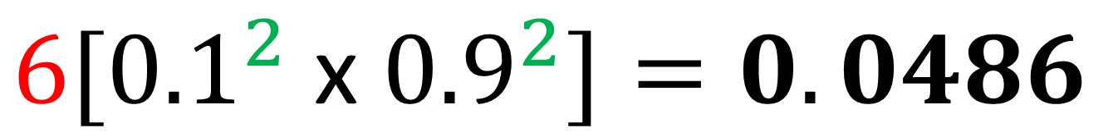
The probability that a person is left-handed is 0.1.
There are 4 people in a room.
What is the probability that two people are left-handed?
$$6[{0.1}^{2} \text{x} {0.9}^{2}]=0.0486$$

Slide 19

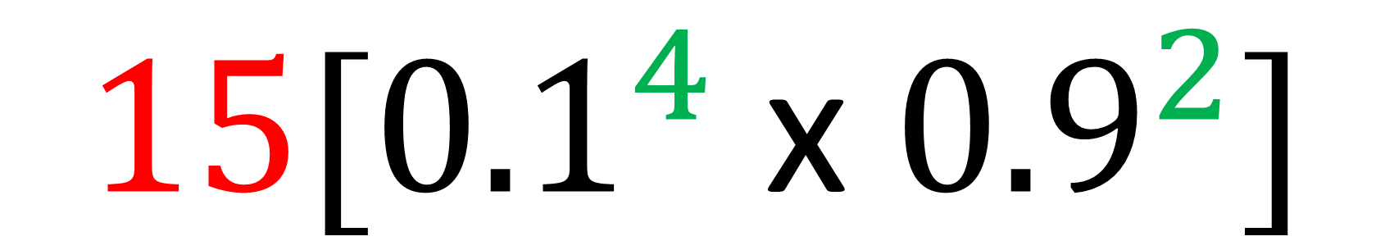
The probability that a person is left-handed is 0.1.
There are 6 people in a room.
What is the probability that 4 people are left-handed?
$$15[{0.1}^{4} \text{x} {0.9}^{2}]$$
$$=0.001215$$

Slide 20
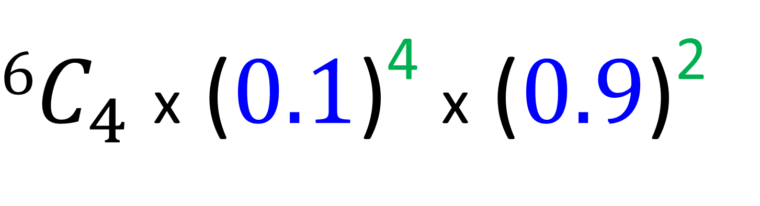
The Binomial Distribution
Number of success
Number of failures
$6C_{4}$ x ($0.1$)⁴ x ($0.9$)²
Possible
Successful Outcomes
Probability of success
Probability of failure

Slide 21
The Binomial Distribution Formula
P(X = x) = ^{n}C_{x} (p)^{x}(1-p)^{n-x}
n = number of trials
p = probability of success
x = number of success needed

Slide 22
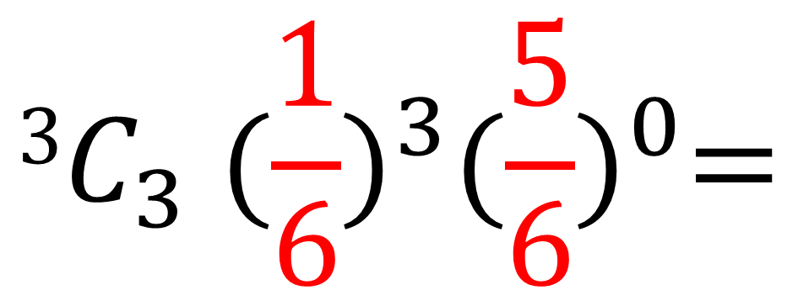
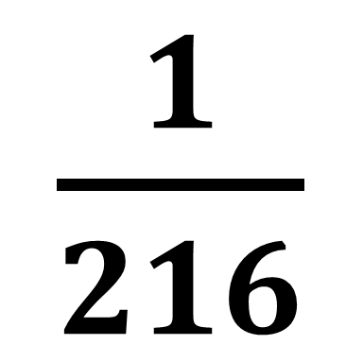
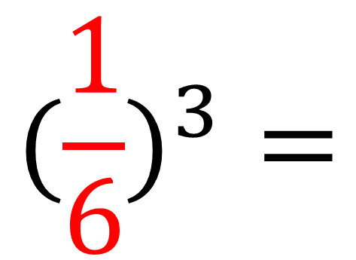
What is the probability of rolling
3 sixes from 3 rolls of a dice?
$$3C_{3} ({\frac{1}{6})}^{3}{(\frac{5}{6})}^{0}=$$
$$({\frac{1}{6})}^{3}=$$
$\frac{1}{216}$

Slide 23

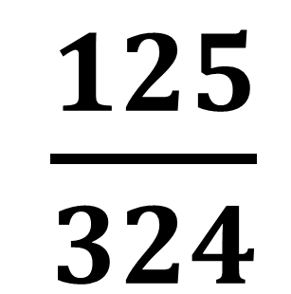
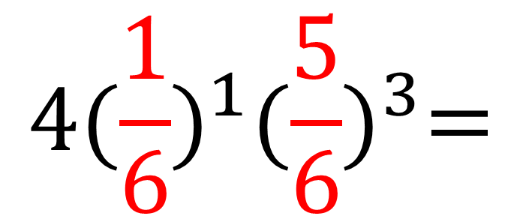
What is the probability of rolling
1 six from 4 rolls of a dice?
What is the probability of
rolling 1 six from 3 rolls of a dice?
$$4({\frac{1}{6})}^{1}{(\frac{5}{6})}^{3}=$$
$\frac{125}{324}$
$$4C_{1} ({\frac{1}{6})}^{1}{(\frac{5}{6})}^{3}=$$

Slide 24

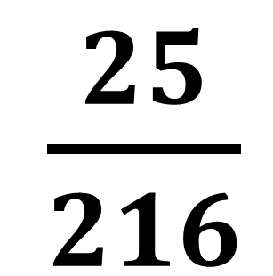
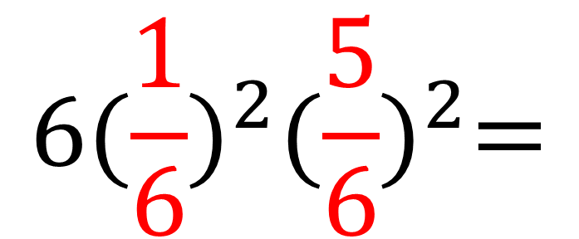
What is the probability of rolling
2 six from 4 rolls of a dice?
$$6({\frac{1}{6})}^{2}{(\frac{5}{6})}^{2}=$$
$\frac{25}{216}$
$$4C_{2} ({\frac{1}{6})}^{2}{(\frac{5}{6})}^{2}=$$

Slide 25
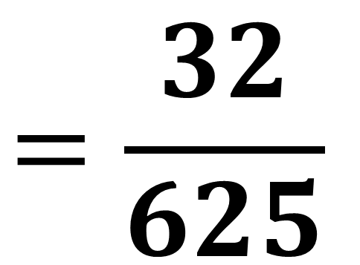
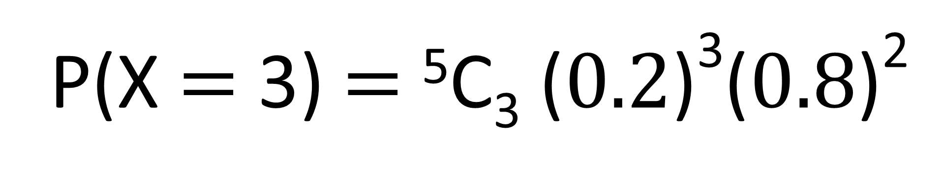
A biased coin is flipped 5 times.
The probability of get a head is 0.2.
What is the probability of getting a head exactly 3 times?
P(X $=$ 3) $=$ ⁵C₃ ($0.2$)³($0.8$)²
$$=\frac{32}{625}$$

Slide 26
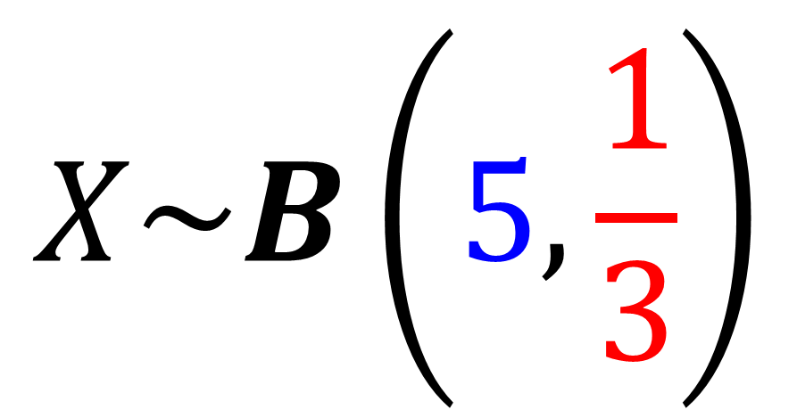
Binomial Distribution Notation
Binomial Distribution
$$X\sim B\left(5, \frac{1}{3}\right)$$
Number of Trials
Probability of success

Slide 27
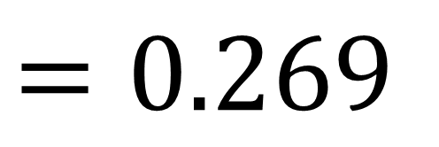
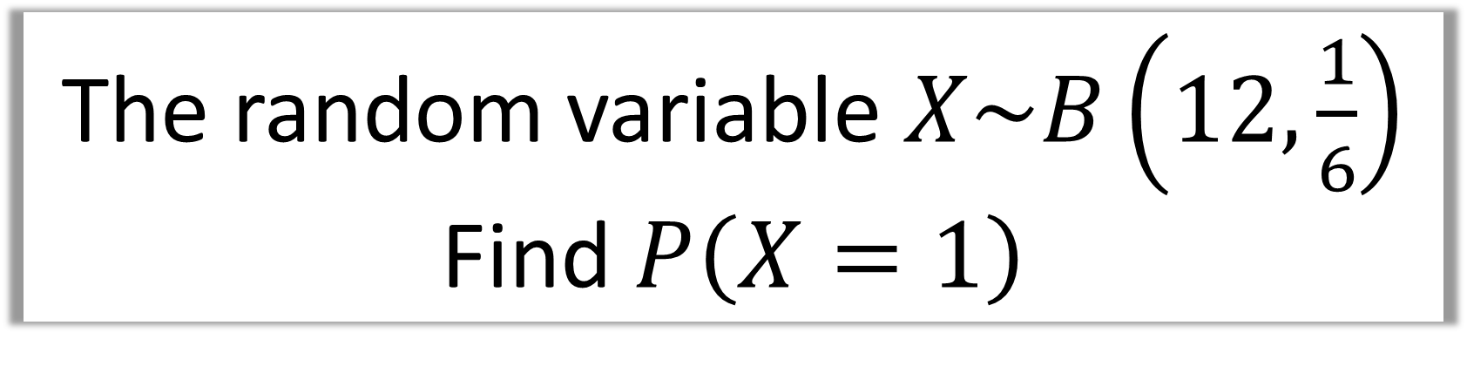
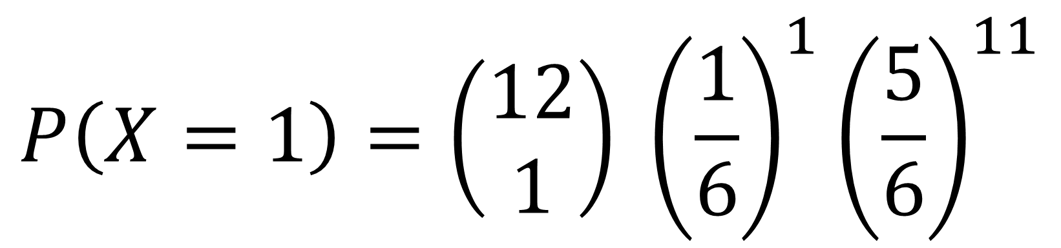
The random variable $X\sim B\left(12,\frac{1}{6}\right)$
Find $P\left(X=1\right)$
$$P\left(X=1\right)=\left(\begin{matrix}12 \\ 1\end{matrix}\right) {\left(\frac{1}{6}\right)}^{1}{\left(\frac{5}{6}\right)}^{11}$$
$$=0.269$$

Slide 28
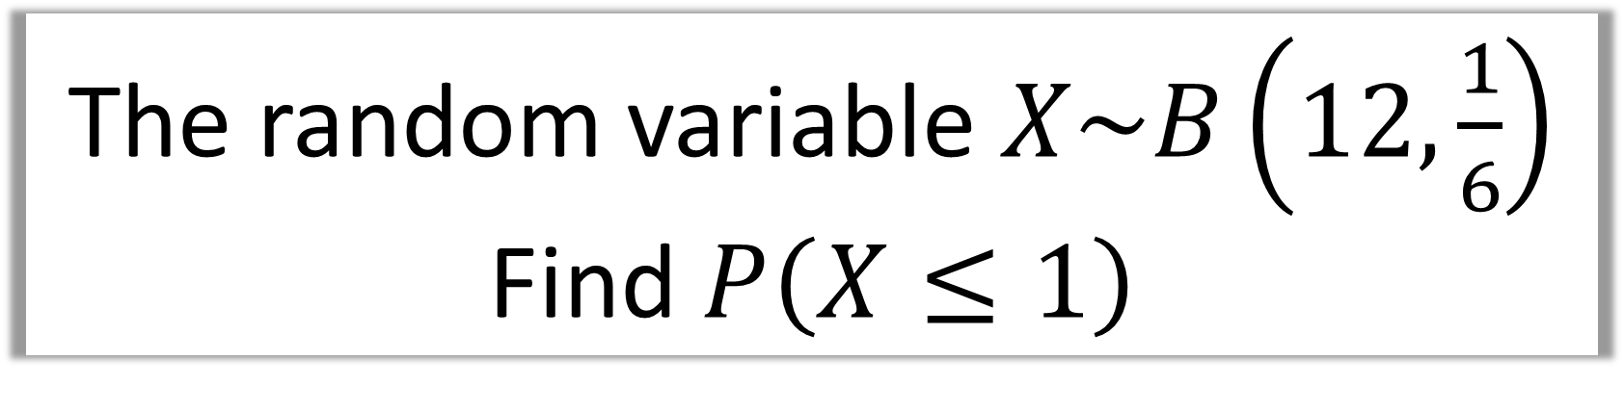
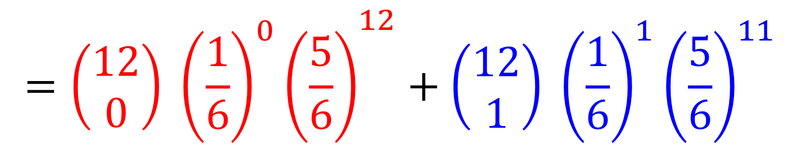
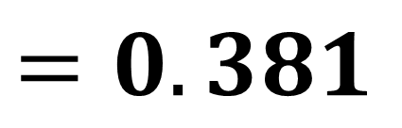
The random variable $X\sim B\left(12,\frac{1}{6}\right)$
Find $P\left(X≤1\right)$
$$P\left(X≤1\right)=P\left(X=0\right)+P\left(X=1\right)$$
$$={\left(\begin{matrix}12 \\ 0\end{matrix}\right) {\left(\frac{1}{6}\right)}^{0}\left(\frac{5}{6}\right)}^{12}+\left(\begin{matrix}12 \\ 1\end{matrix}\right) {\left(\frac{1}{6}\right)}^{1}{\left(\frac{5}{6}\right)}^{11}$$
$$=0.381$$

Slide 29
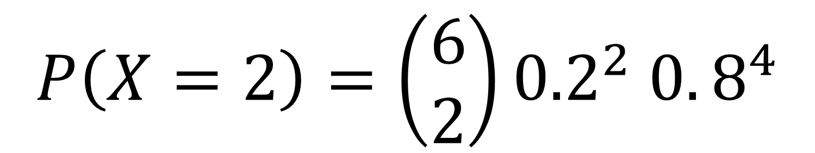
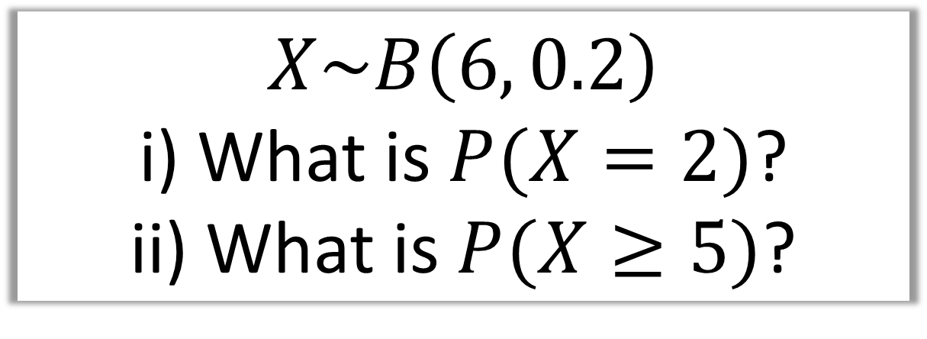
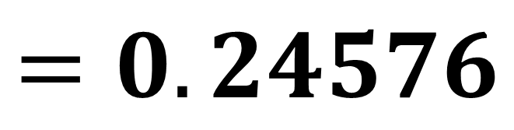
$$X\sim B\left(6, 0.2\right)$$
i) What is $P(X=2)$?
ii) What is $P(X≥5)$?
$$P\left(X=2\right)=\left(\begin{matrix}6 \\ 2\end{matrix}\right){0.2}^{2} 0.8^{4}$$
i
$$=0.24576$$

Slide 30


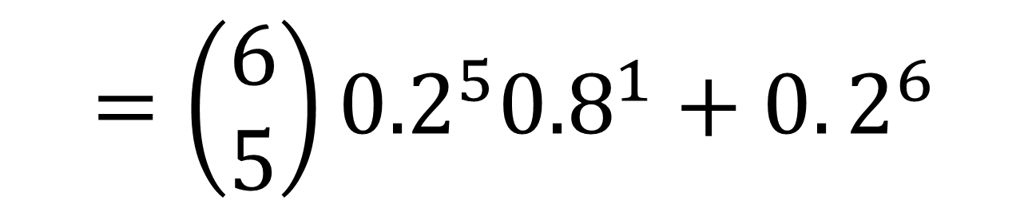
$$X\sim B\left(6, 0.2\right)$$
i) What is $P(X=2)$?
ii) What is $P(X≥5)$?
ii
$$P\left(X≥5\right)=P\left(X=5\right)+P\left(X=6\right)$$
$$=\left(\begin{matrix}6 \\ 5\end{matrix}\right){0.2}^{5}{0.8}^{1}+0.2^{6}$$
$$=0.0016$$

Slide 31
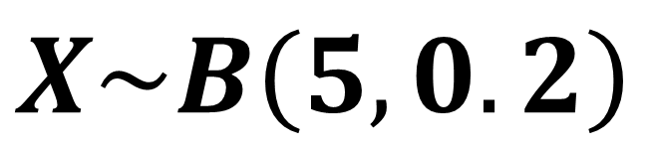
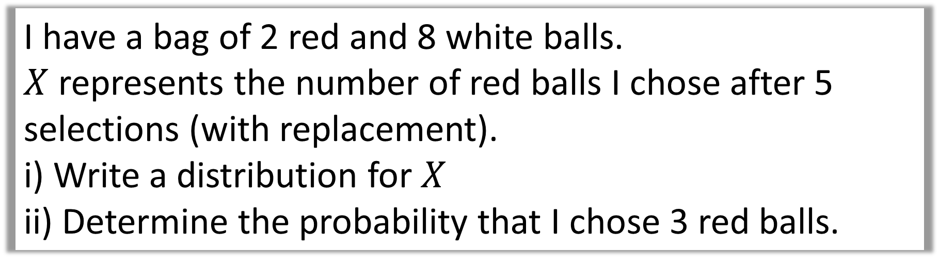
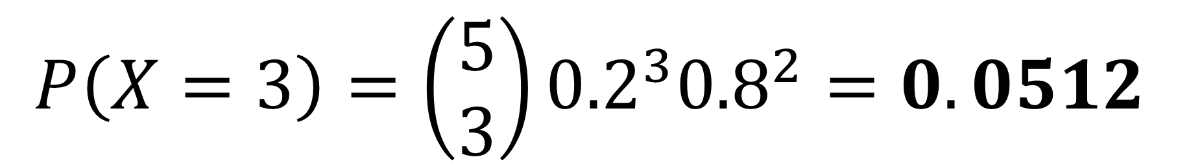
I have a bag of 2 red and 8 white balls.
$X$ represents the number of red balls I chose after 5 selections (with replacement).
i) Write a distribution for $X$
ii) Determine the probability that I chose 3 red balls.
i
$$X\sim B\left(5,0.2\right)$$
$$P\left(X=3\right)=\left(\begin{matrix}5 \\ 3\end{matrix}\right){0.2}^{3}{0.8}^{2}=0.0512$$
ii

Slide 32

A company claims that a quarter of the bolts sent to them are faulty. To test this claim the number of faulty bolts in a random sample of 50 is recorded.
Give two reasons why a binomial distribution may be a suitable model for the number of faulty bolts in the sample.

Slide 33
The Binomial Distribution
Terms and Conditions
Only 2 outcomes (Success or Fail)
Constant Probability of Success
Each trial is independent
Fixed number of Trials

