Slide 1
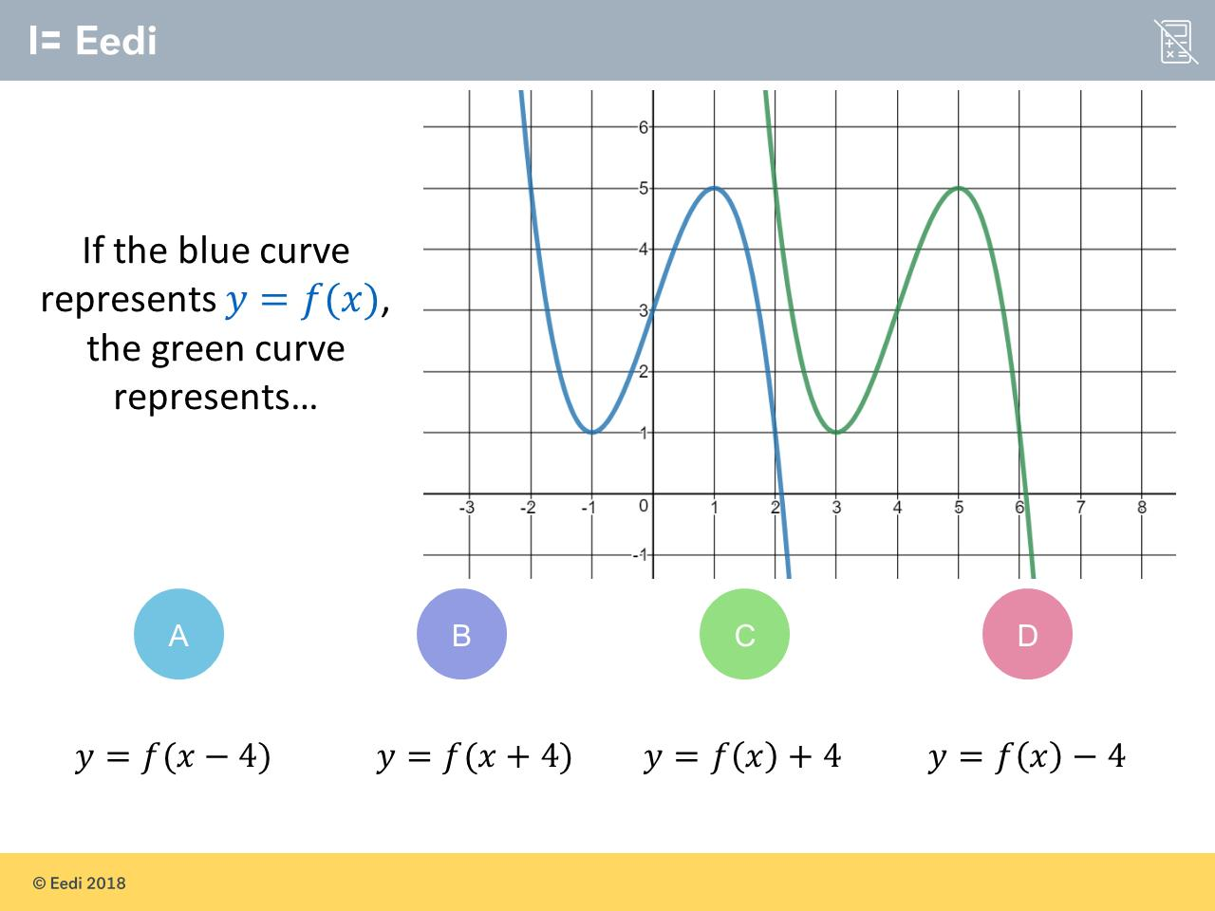
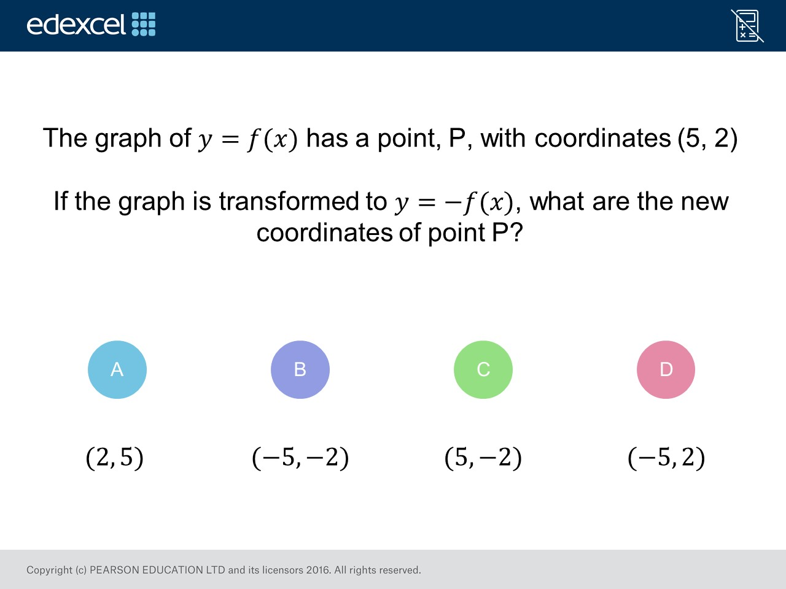
Worst answered question?
Most common wrong answer?

Slide 2
ANSWERS

Slide 3
Worst answered question?

Slide 4
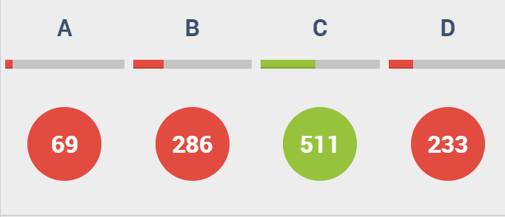
B
The student has incorrectly reversed both the 𝑥 and 𝑦

Slide 5
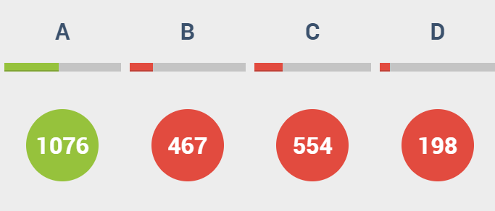
C
The student has translated up, instead of right.

