Slide 1
Momentum and Impulse
Momentum and Impulse
Chapter 1
(Part 1 of 3)

Slide 2
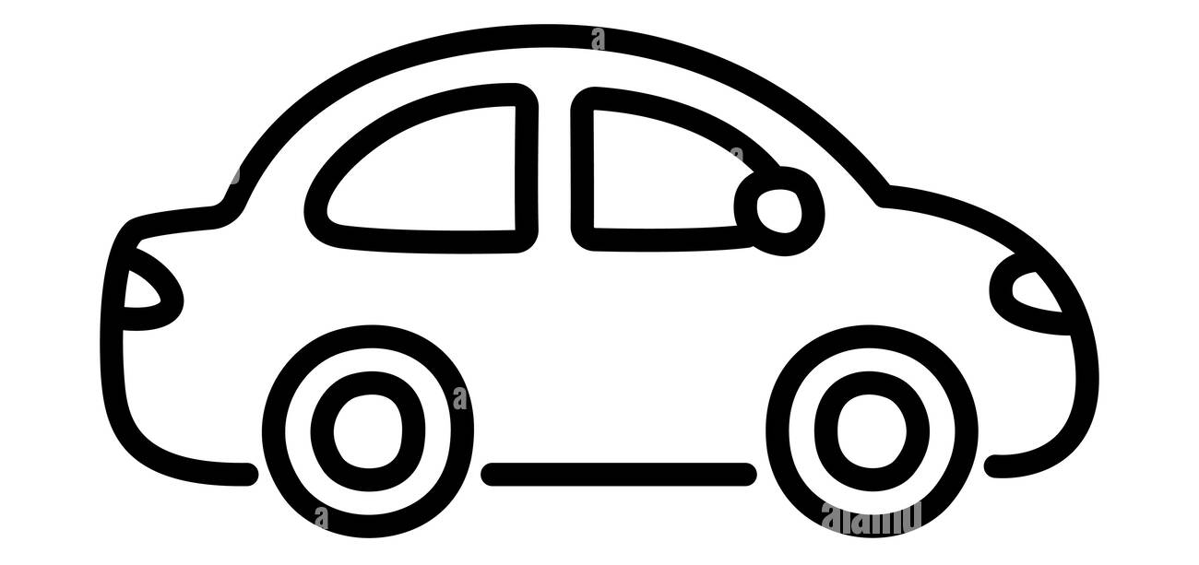
Two identical cars.
Which has greater momentum?
100 km/h
30 km/h
The 100 km/h car.
Higher speeds are associated with higher momentum

Slide 3
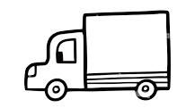
A car and the lorry are driving at 50 km/h. Which has greater momentum?
50 km/h
50 km/h
The Lorry.
Greater mass is associated with greater momentum

Slide 4
What is momentum?
Momentum is
the product of
the mass and velocity
of an object.

Slide 5
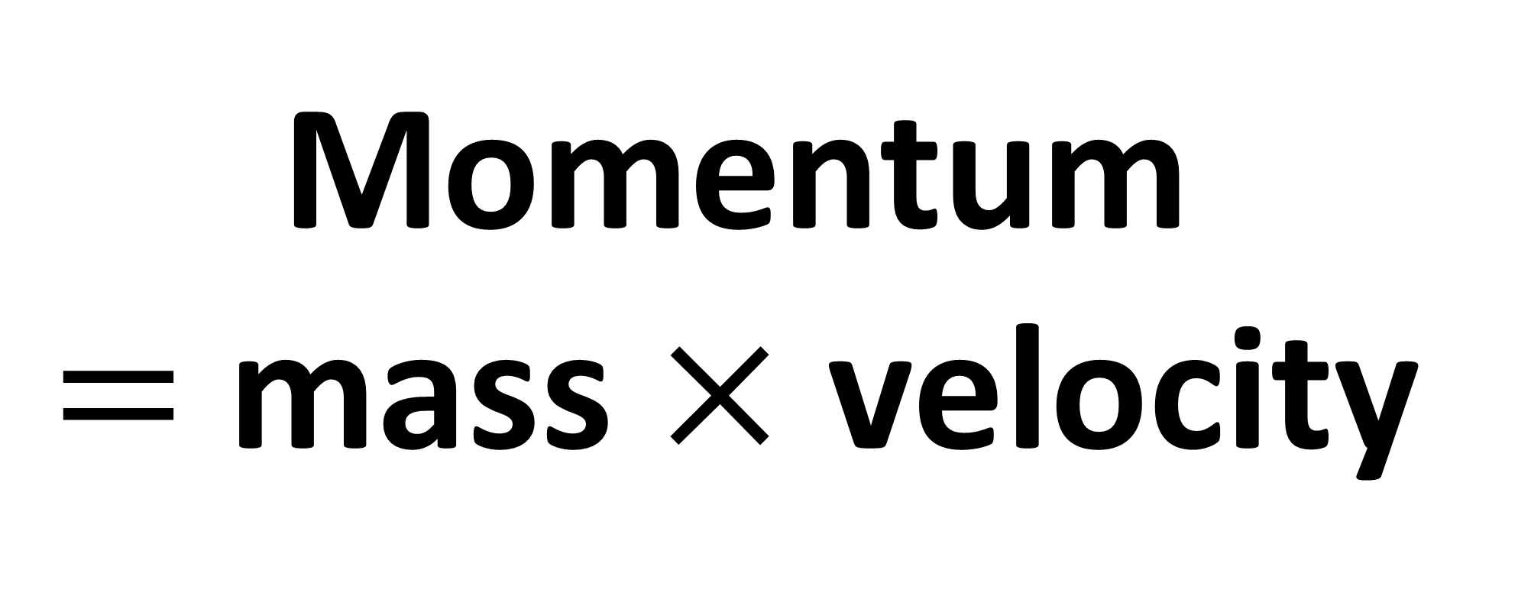
Momentum
$=$ mass $×$ velocity
Units: kgms⁻¹ or Ns

Slide 6
Mass | Velocity | Momentum
6 kg | 5 m/s
30 Ns

Slide 7
Mass | Velocity | Momentum
 | 13 ms⁻¹ | 65 kgms⁻¹
5 kg

Slide 8
Mass | Velocity | Momentum
523 kg
0 m/s
0 Ns

Slide 9
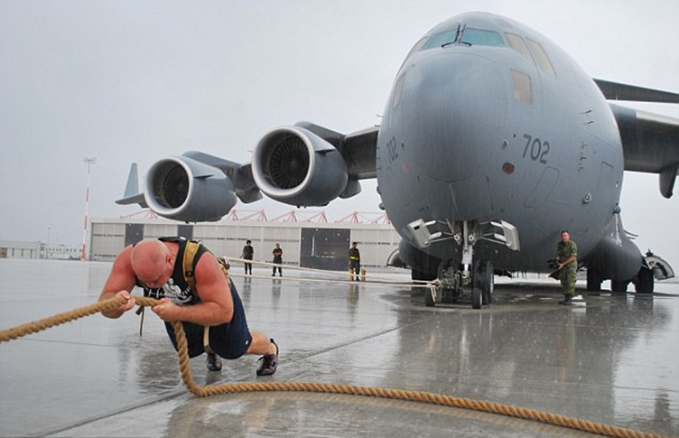
The momentum gained by
the aeroplane depends on what?
How hard the man pulls (Force)
How long he pulls for (Time)

Slide 10

What do we understand by Impulse?
If a constant force is exerted
on an object for a given time then
Impulse $=$ Force $×$ Time

Slide 11
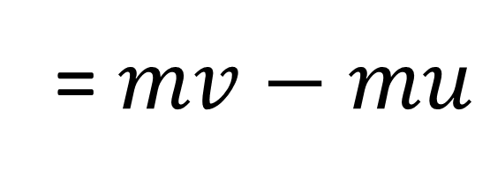
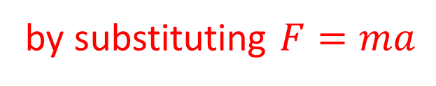
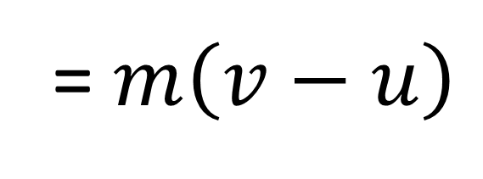

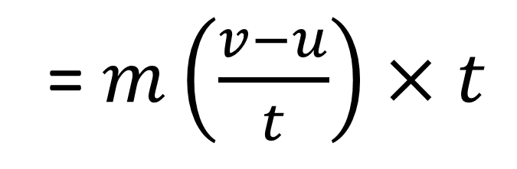
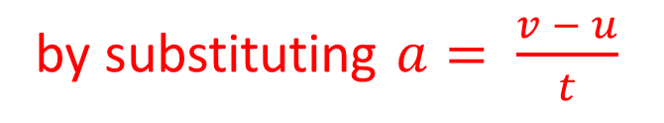
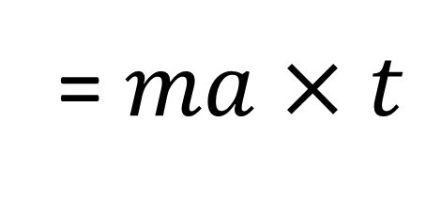
Impulse = Force $×$ time
Proof
= $ma$ $×$ $t$
by substituting $F=ma$
= $m\left(\frac{v−u}{t}\right)×$ $t$
by substituting $a= \frac{v − u}{t}$
= $m\left(v−u\right)$
= $mv−mu$
= momentum after – momentum before

Slide 12

Often an impulse is the result of a very large force acting for very short time (e.g. a bat hitting a ball).
In these cases, it is easier to
calculate the change in momentum.
Impulse = Change of Momentum
Impulse = $mv−mu$

Slide 13
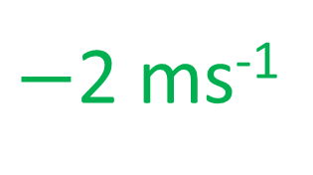
Beware of signs!
Define one direction as positive and all velocities in the other direction are negative.
5 ms⁻¹
$−$2 ms⁻¹

Slide 14
Calculated the impulse exerted
on the object in the follow case:
A force of 30N is exerted on
an object for 0.5s
30 x 0.5 = 15 Ns

Slide 15
Calculated the impulse exerted
on the object in the follow case:
A ball of mass 3kg was travelling at 10m/s is hit and slows to 6m/s without changing direction.
30 – 18 = 12 Ns

Slide 16
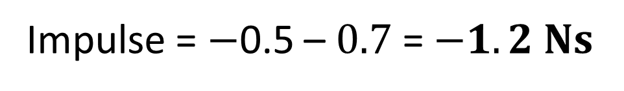
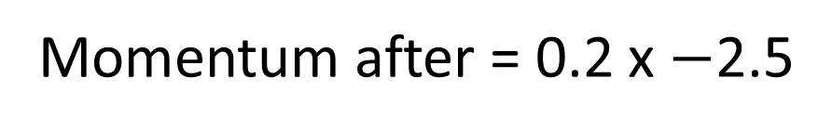
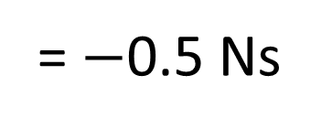
A ball of mass 0.2 kg hits a vertical wall at right angles with a speed of 3.5 ms⁻¹.
The ball rebounds with speed 2.5 ms⁻¹.
Find the magnitude of the impulse exerted on the wall by the ball.
Momentum before = 0.2 x 3.5
3.5 ms⁻¹
= 0.7 Ns
Momentum after = 0.2 x $−$2.5
= $−$0.5 Ns
Impulse = $−$0.5 – $0.7$ = $−1.2 Ns$
2.5 ms⁻¹
Impulse of 1.2 Ns away from the wall

Slide 17
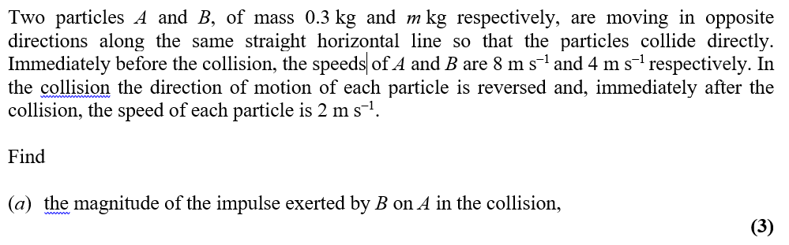
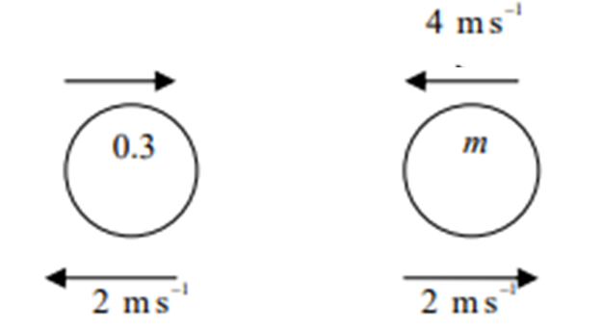
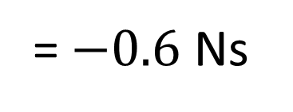
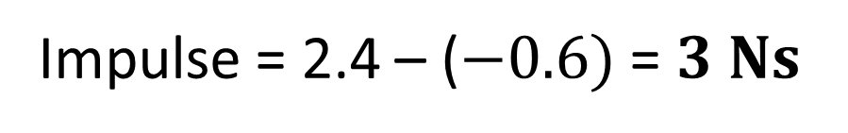
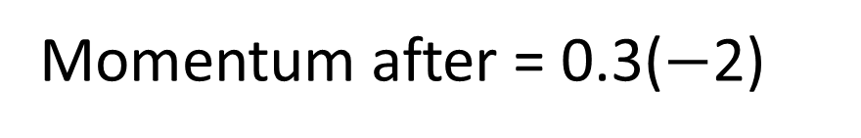

Momentum before = 0.3(8)
$$8 {ms}^{−1}$$
= 2.4 Ns
Momentum after = 0.3($−$2)
= $−0.6$ Ns
Impulse = 2.4 – ($−0.6)$ = $3 Ns$

