Slide 1
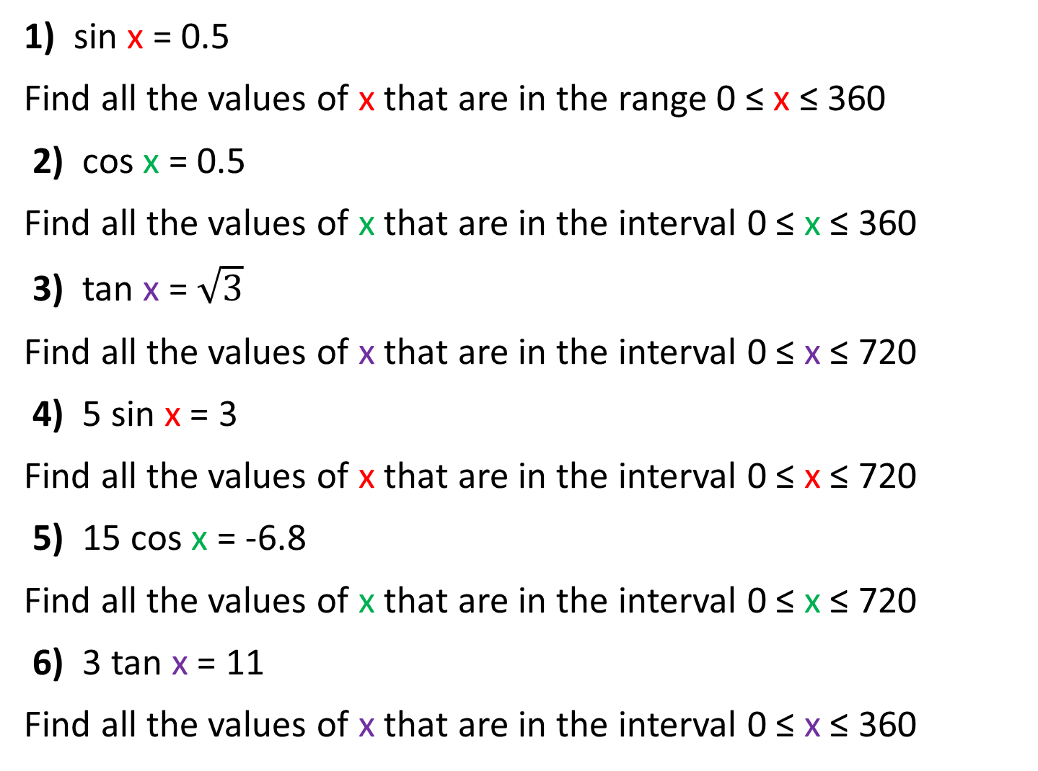
1) sin x = 0.5
Find all the values of x that are in the range 0 ≤ x ≤ 360
2) cos x = 0.5
Find all the values of x that are in the interval 0 ≤ x ≤ 360
3) tan x = $\sqrt{3}$
Find all the values of x that are in the interval 0 ≤ x ≤ 720
4) 5 sin x = 3
Find all the values of x that are in the interval 0 ≤ x ≤ 720
5) 15 cos x = -6.8
Find all the values of x that are in the interval 0 ≤ x ≤ 720
6) 3 tan x = 11
Find all the values of x that are in the interval 0 ≤ x ≤ 360

Slide 2
ANSWERS

Slide 3
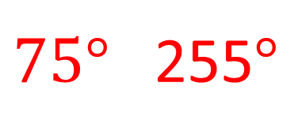
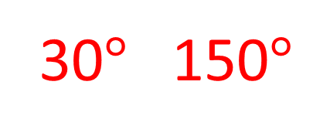
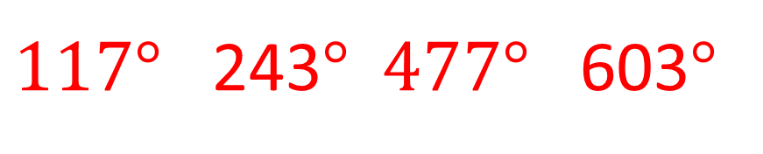
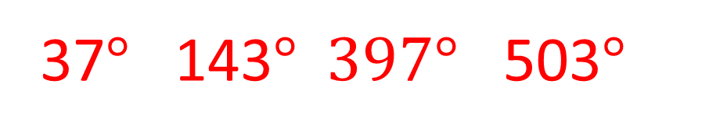
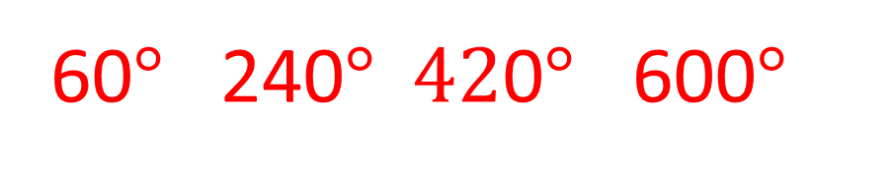
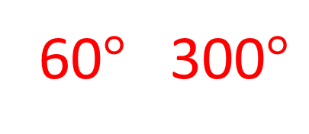
30$°$ 150$°$
1) sin x = 0.5
Find all the values of x that are in the range 0 ≤ x ≤ 360
2) cos x = 0.5
Find all the values of x that are in the interval 0 ≤ x ≤ 360
3) tan x = $\sqrt{3}$
Find all the values of x that are in the interval 0 ≤ x ≤ 720
4) 5 sin x = 3
Find all the values of x that are in the interval 0 ≤ x ≤ 720
5) 15 cos x = -6.8
Find all the values of x that are in the interval 0 ≤ x ≤ 720
6) 3 tan x = 11
Find all the values of x that are in the interval 0 ≤ x ≤ 360
60$°$ 300$°$
60$°$ 240$° \text{42}\text{0}° \text{60}\text{0}°$
37$°$ 143$° \text{397}° \text{503}°$
$117°$ 243$° \text{4}77° \text{603}°$
$75°$ 255$°$

