Slide 1


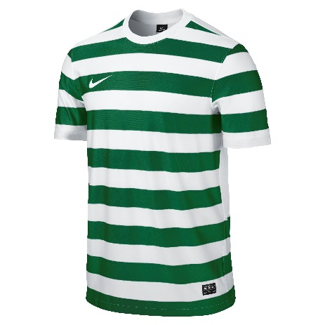
Goals, Goals. Goals.
Below are 3 tables containing the data for 3 football teams and how many goals they scored in each game of the season.
Team 1:
Goals | 0 | 1 | 2 | 3 | 4
Frequency | 4 | 7 | 4 | 3 | 2
Team 2:
Goals | 0 | 1 | 2 | 3 | 4 | 5 |  | 6
Frequency | 2 | 3 | 5 | 3 | 4 | 0 |  | 3
Team3:
Goals | 1 | 2 | 3
Frequency | 5 | 7 | 8
Below are some cards that go with each table.
Try to match them up with the tables.
Mean is 2.8 goals per game | Mode is 3 goals per game | Range is 6 goals
Mean is 1.6 goals per game | Mode is 2 goals per game | Range is 4 goals
Mean is 2.15 goals per game | Mode is 1 goal per game | Range is 2 goals
Extension:
Write down 3 sentences comparing the 3 teams.

Slide 2
Answers

Slide 3
Team 1:
Goals | 0 | 1 | 2 | 3 | 4
Frequency | 4 | 7 | 4 | 3 | 2
Team 2:
Goals | 0 | 1 | 2 | 3 | 4 | 5 |  | 6
Frequency | 2 | 3 | 5 | 3 | 4 | 0 |  | 3
Team3:
Goals | 1 | 2 | 3
Frequency | 5 | 7 | 8
Mean is 2.8 goals per game | Mode is 3 goals per game | Range is 6 goals
Mean is 1.6 goals per game | Mode is 2 goals per game | Range is 4 goals
Mean is 2.15 goals per game | Mode is 1 goal per game | Range is 2 goals
1
4
7
2
5
8
3
6
9

