Slide 1
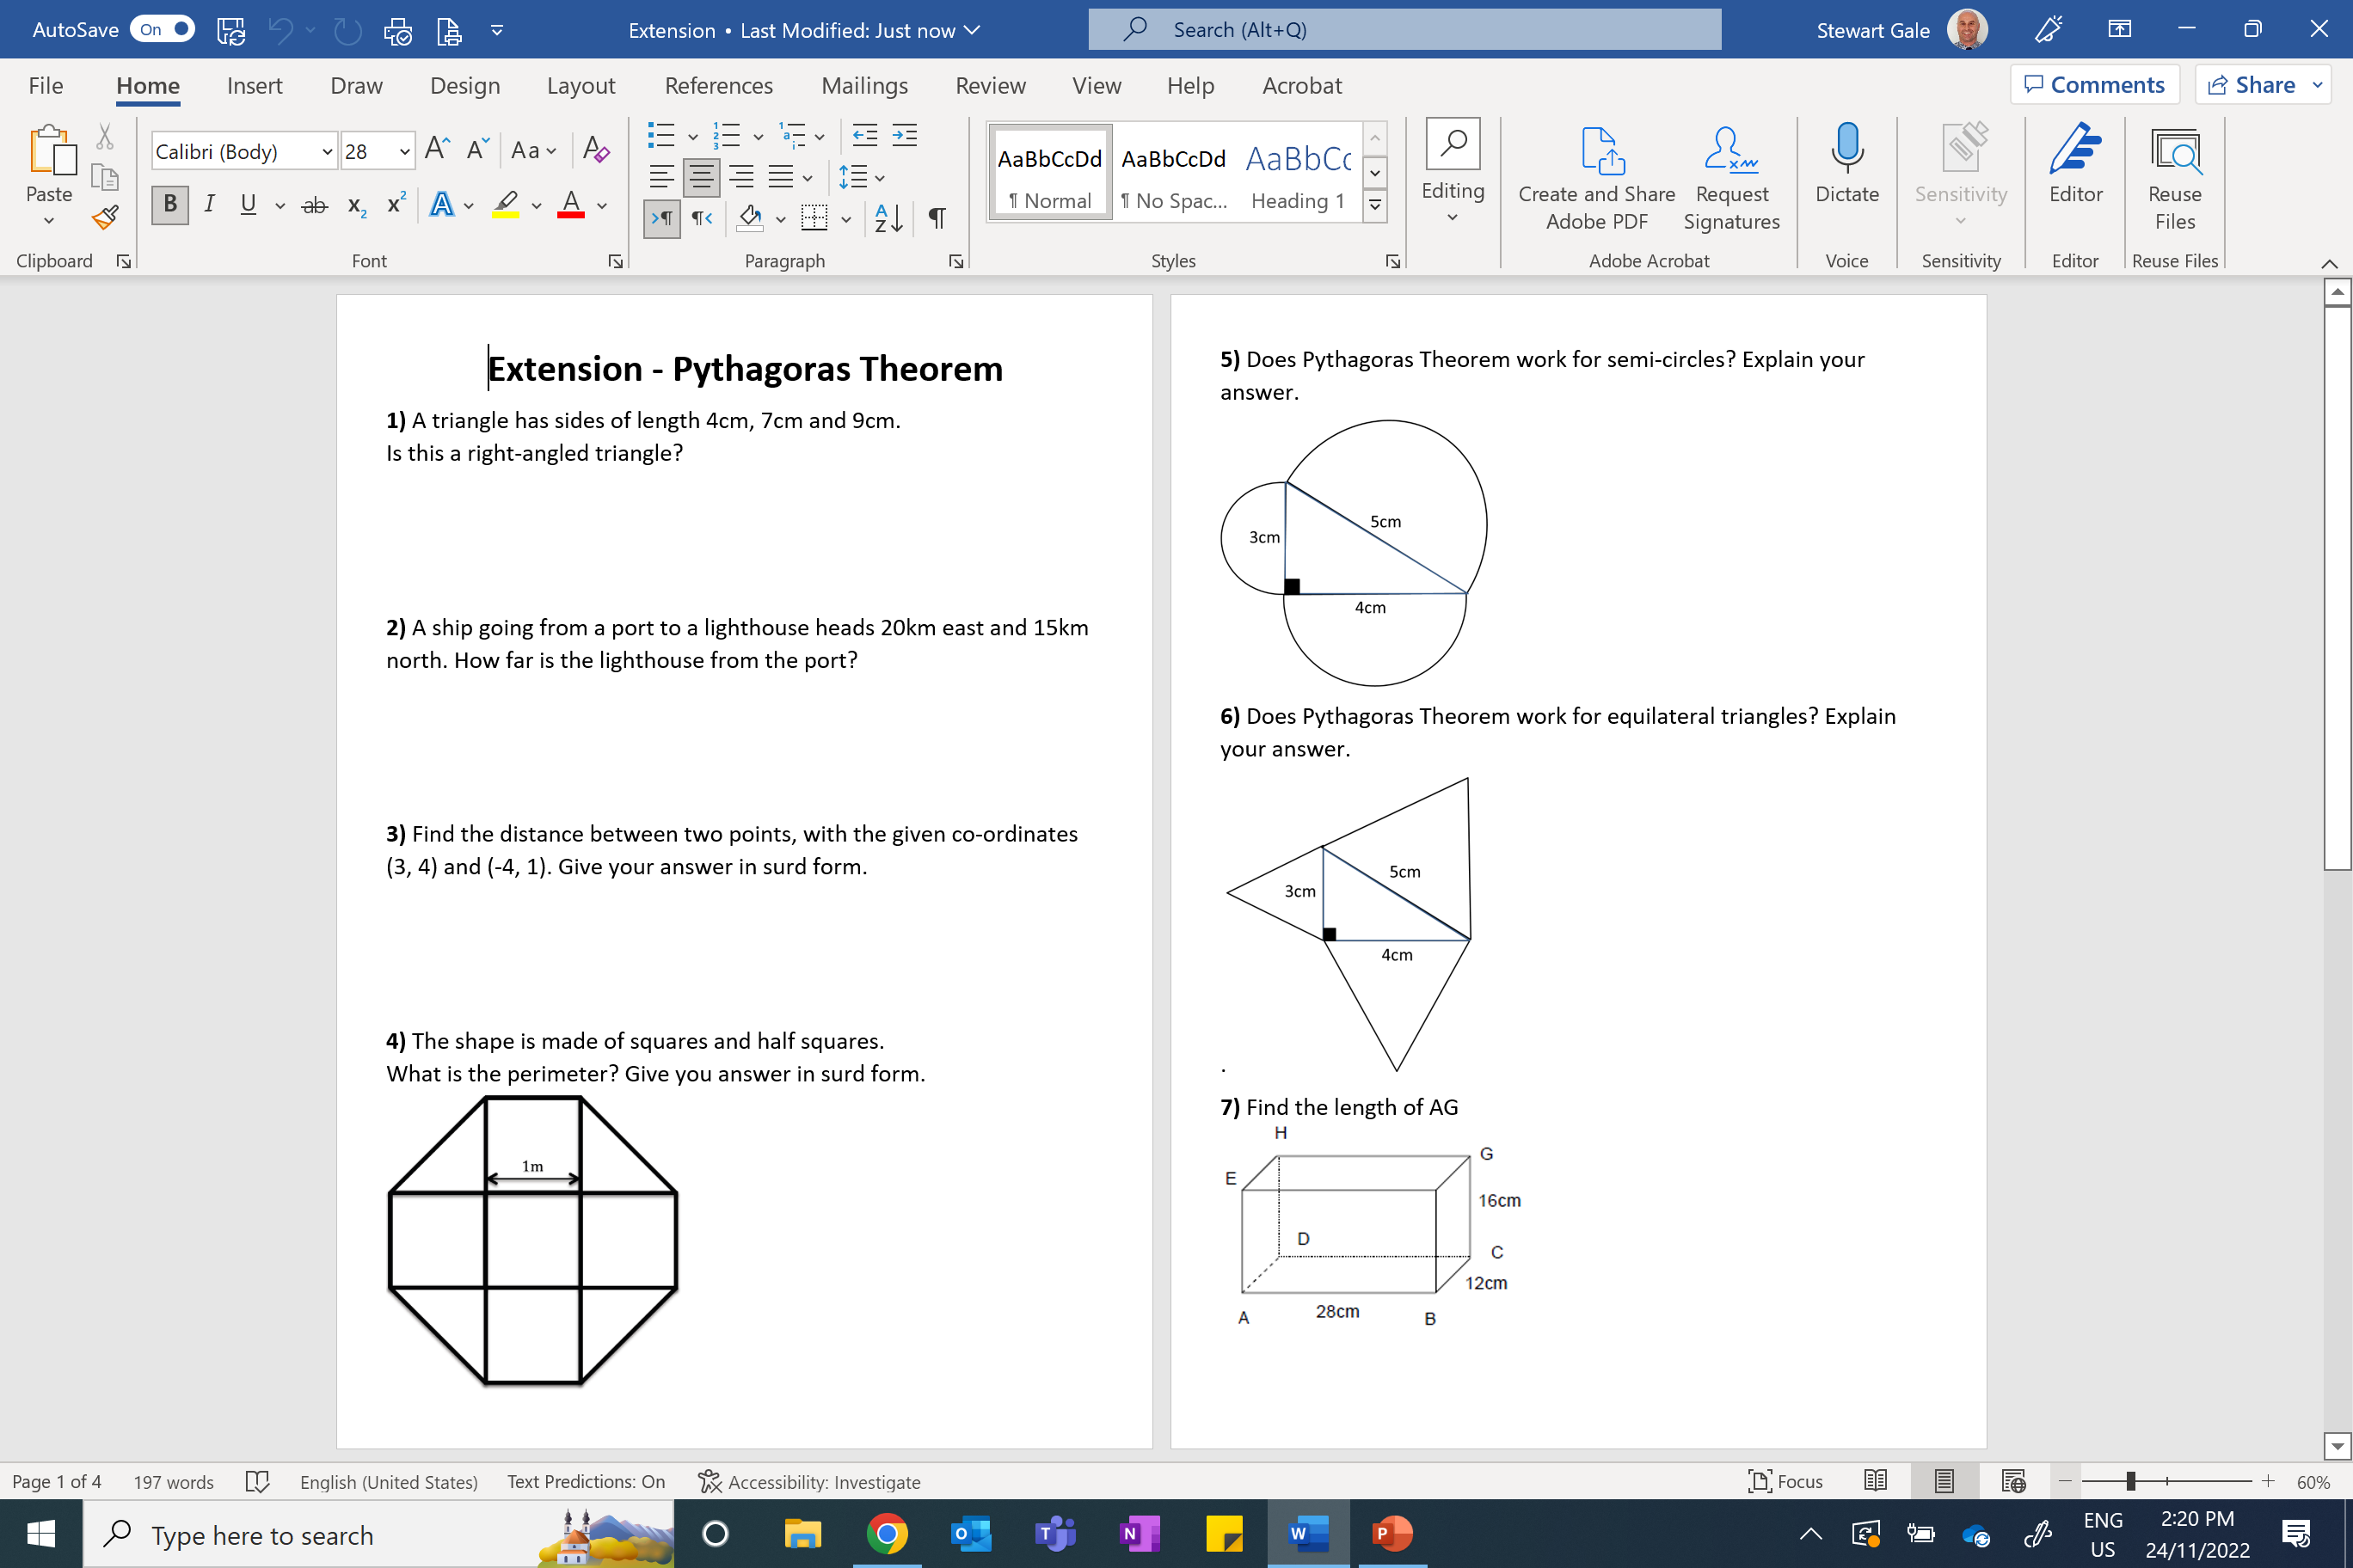

Slide 2
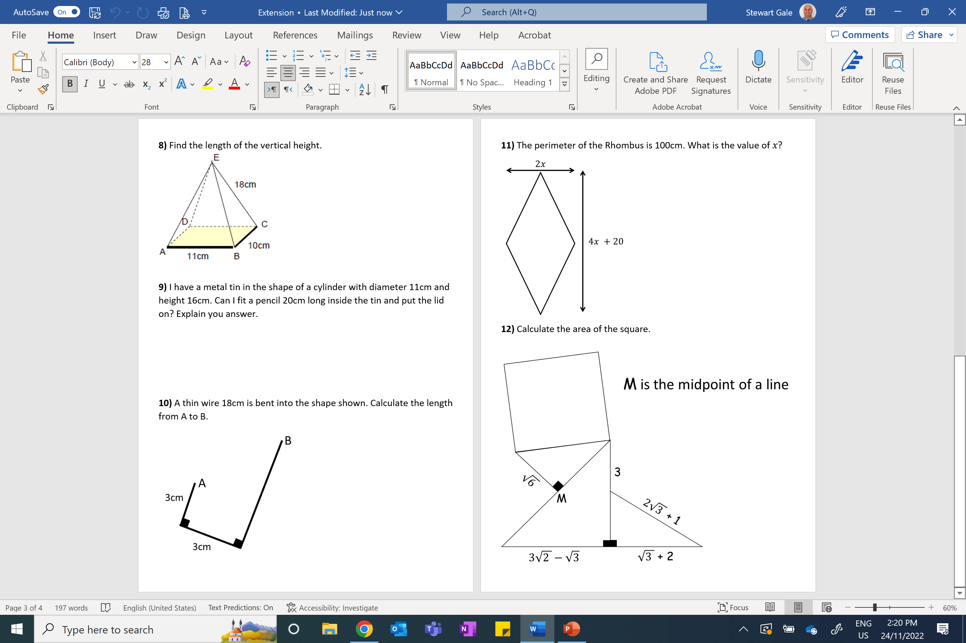

Slide 3
ANSWERS

Slide 4
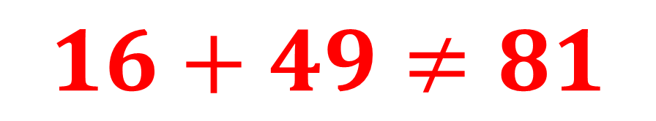
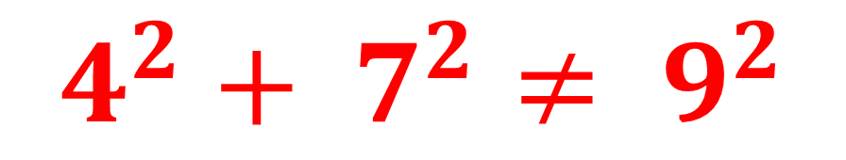
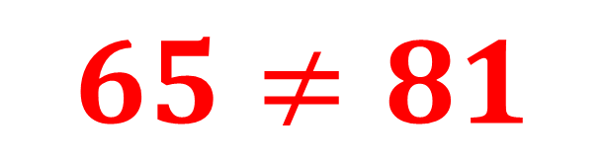
1) A triangle has sides of length 4cm, 7cm and 9cm. Is this a right-angled triangle?
$$4^{2}+ 7^{2}≠ 9^{2}$$
$$16+49≠81$$
$$65≠81$$

Slide 5
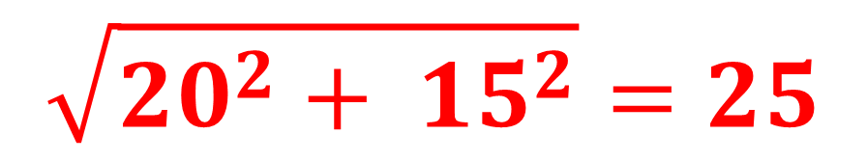
2) A ship going from a port to a lighthouse heads 20km east and 15km north.
How far is the lighthouse from the port?
$$\sqrt{{20}^{2}+ {15}^{2}}=25$$
15
20

Slide 6
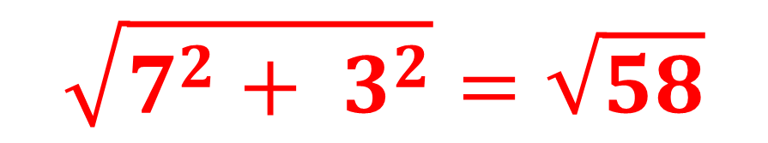
3) Find the distance between two points, with the given co-ordinates (3, 4) and (-4, 1).
Give your answer in surd form.
$$\sqrt{7^{2}+ 3^{2}}=\sqrt{58}$$
3
7

Slide 7
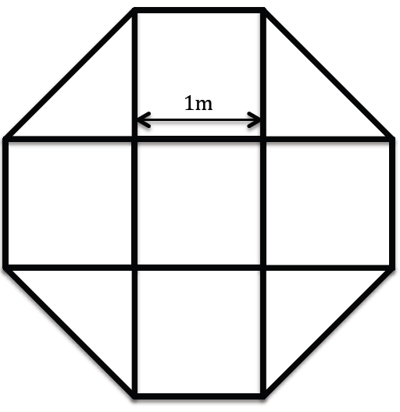
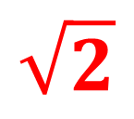
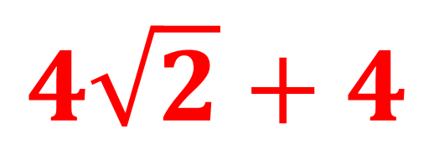
4) The shape is made of squares and half squares.
What is the perimeter? Give you answer in surd form.
$$\sqrt{2}$$
1
1
$$4\sqrt{2}+4$$

Slide 8
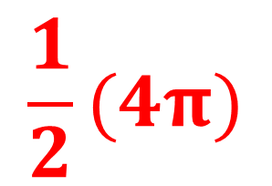
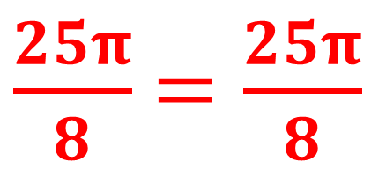
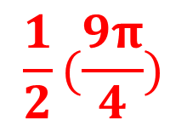
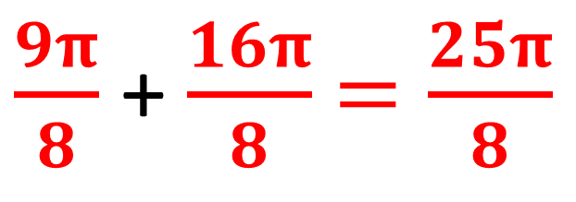
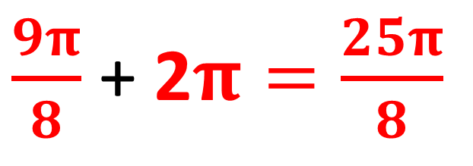
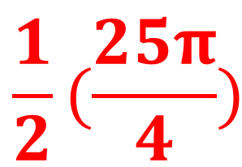
5) Does the Pythagoras work semi-circles?
$$\frac{1}{2}(\frac{25π}{4})$$
$\frac{9π}{8}$ + 2$π=\frac{25π}{8}$
$$\frac{1}{2}(\frac{9π}{4})$$
5cm
$\frac{9π}{8}$ + $\frac{16π}{8}$ $=\frac{25π}{8}$
3cm
4cm
$\frac{25π}{8}$ $=\frac{25π}{8}$
$$\frac{1}{2}(4π)$$
YES

Slide 9
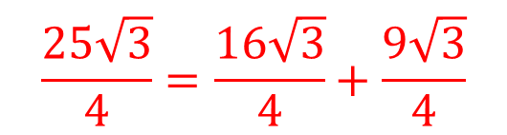

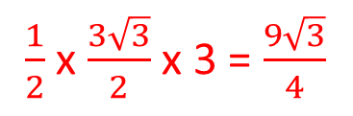

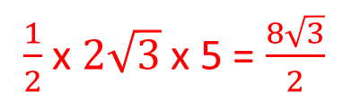
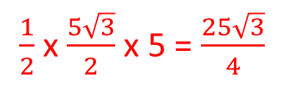

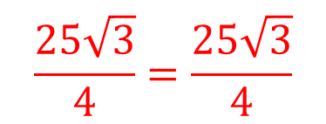
6) Does the Pythagoras work equilateral triangles?
5
$$\frac{5\sqrt{3}}{2}$$
4
3
$$2\sqrt{3}$$
$$\frac{3\sqrt{3}}{2}$$
2.5
2
1.5
5cm
3cm
$\frac{1}{2}$x $\frac{5\sqrt{3}}{2}$ x 5 = $\frac{25\sqrt{3}}{4}$
$$\frac{25\sqrt{3}}{4}=\frac{16\sqrt{3}}{4}+\frac{9\sqrt{3}}{4}$$
4cm
$\frac{1}{2}$x $2\sqrt{3}$ x 5 = $\frac{8\sqrt{3}}{2}$
$$\frac{25\sqrt{3}}{4}=\frac{25\sqrt{3}}{4}$$
$\frac{1}{2}$x $\frac{3\sqrt{3}}{2}$ x 3 = $\frac{9\sqrt{3}}{4}$
YES

Slide 10
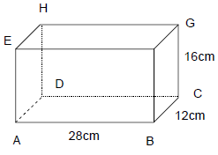


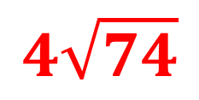
7) Find the length of AG
$$4\sqrt{58}$$
12
28
$$4\sqrt{74}$$
16
$$4\sqrt{58}$$

Slide 11
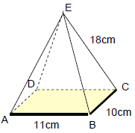
8) Find the length of the vertical height.
$$4\sqrt{58}$$
12
28
$$4\sqrt{74}$$
16
$$4\sqrt{58}$$

Slide 12
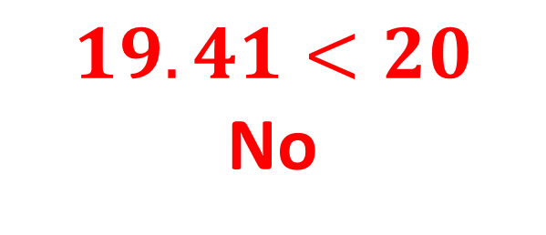
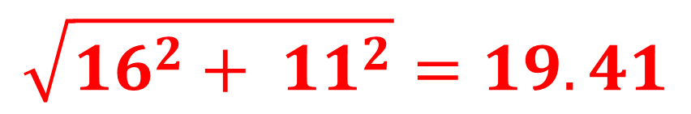
9) I have a metal tin in the shape of a cylinder with diameter 11cm and height 16cm. Can I fit a pencil 20cm long inside the tin and put the lid on?
$$\sqrt{{16}^{2}+ {11}^{2}}=19.41$$
16
$$19.41<20$$
No
11

Slide 13
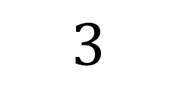
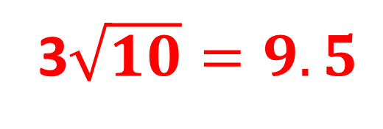
10) A thin wire 18cm is bent into the shape shown. Calculate the length from A to B.
B
9
A
3$\sqrt{10}=9.5$
3cm
9
3
12
$$3$$
3cm

Slide 14


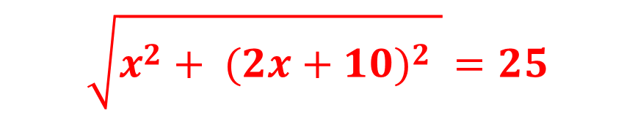

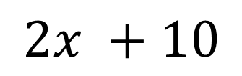
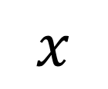

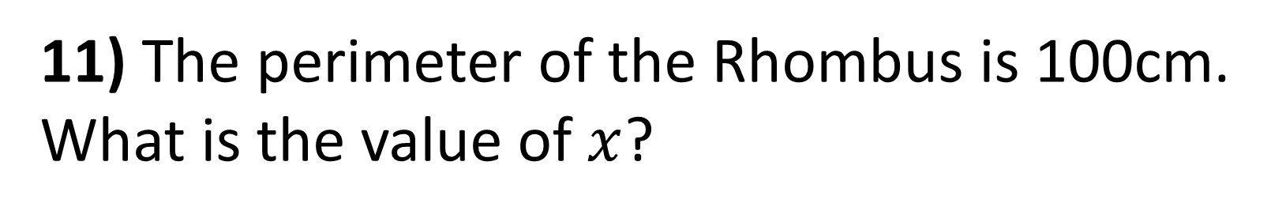

11) The perimeter of the Rhombus is 100cm.
What is the value of $x$?
$$x$$
$$2x$$
$$2x +10$$
$$\sqrt{x^{2}+ {(2x+10)}^{2} }=25$$
$$4x +20$$
$$x^{2}+ {(2x+10)}^{2}=625$$
$${5x}^{2}+40+100=625$$
$${5x}^{2}+40−105=0$$
x = 7

Slide 15
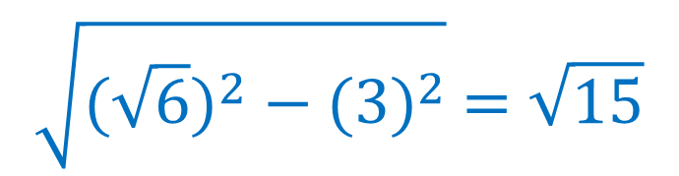

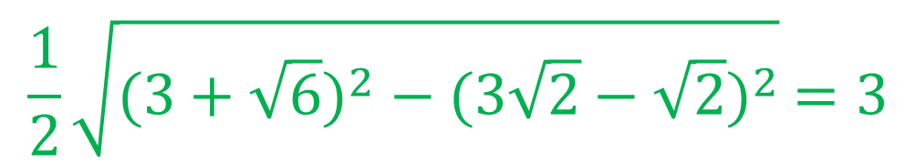
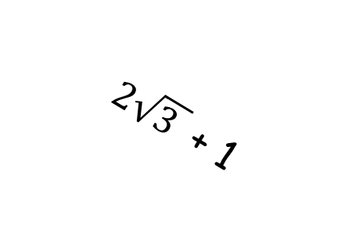
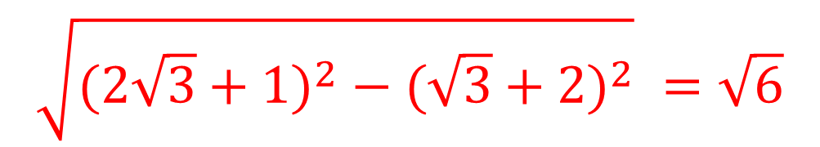
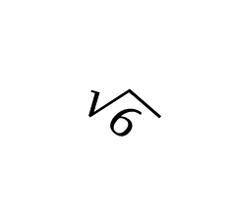

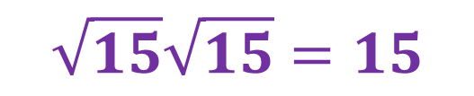
12) Calculate the area of the square.
M is the midpoint of a line
$$\sqrt{{(2\sqrt{3}+1)}^{2} −{ (\sqrt{3}+2)}^{2}} =\sqrt{6}$$
$$\frac{1}{2}\sqrt{{(3+\sqrt{6})}^{2} − {(3\sqrt{2}−\sqrt{2})}^{2}} =3$$
3
$\sqrt{6 }$
$$\sqrt{{(\sqrt{6})}^{2} − {(3)}^{2}} =\sqrt{15}$$
M
$2\sqrt{3 }$ + 1
$$\sqrt{15}\sqrt{15}=15$$
$$3\sqrt{2 }−\sqrt{3}$$
$\sqrt{3 }$ + 2

