Slide 1
Trigonometric Ratios
Trigonometric Waves
Chapter 9
(Part 2 of 2)

Slide 2
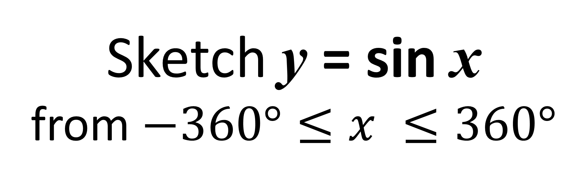
Sin Graphs
Sketch y = sin x
from $−360°≤x ≤360°$

Slide 3
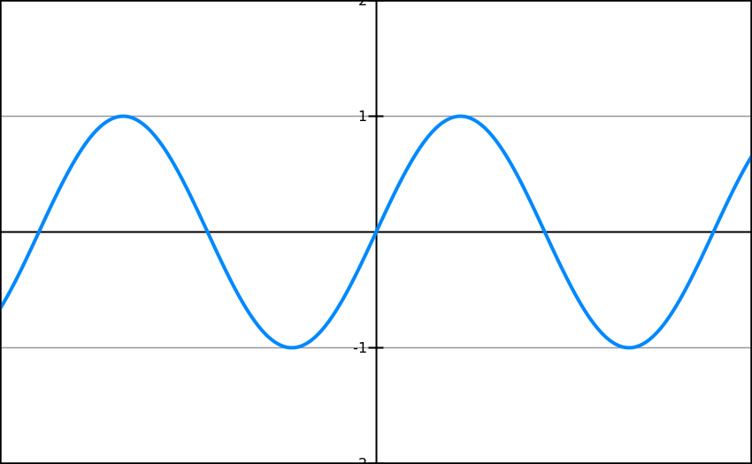
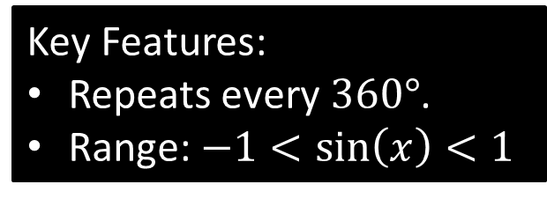
Sin Graph
Key Features:
Repeats every $360°$.
Range: $−1<\sin\left(x\right)<1$
-360
-270
-180
-90
90
180
270
360

Slide 4
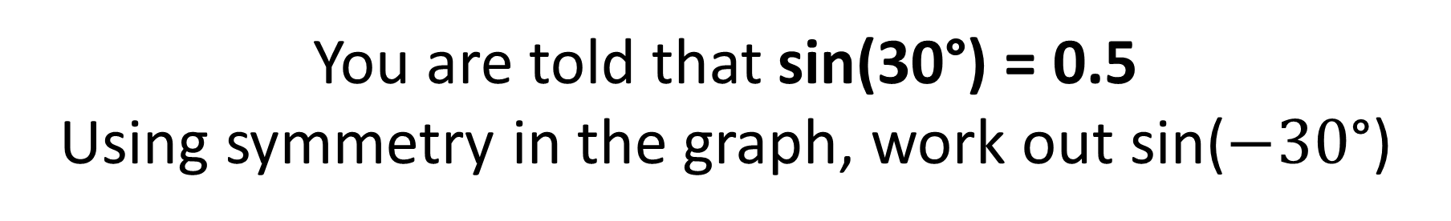

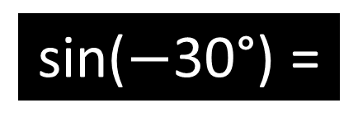
You are told that sin(30°) = 0.5
Using symmetry in the graph, work out sin($−30$°)
sin($−$30°) =
$$−0.5$$
-360
-270
-180
-90
0
90
180
270
360

Slide 5
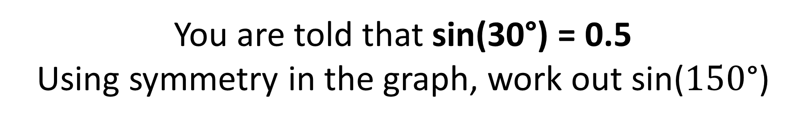

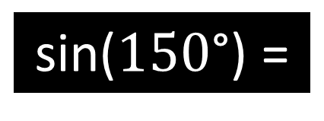
You are told that sin(30°) = 0.5
Using symmetry in the graph, work out sin($150$°)
sin($150$°) =
$$0.5$$
-360
-270
-180
-90
0
90
180
270
360

Slide 6
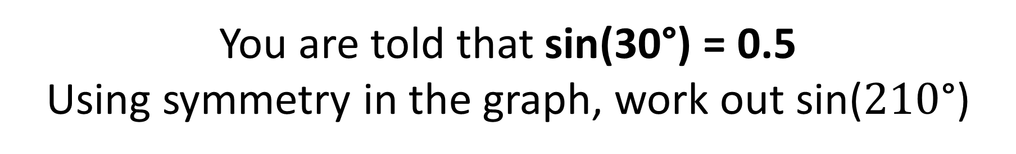

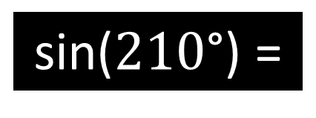
You are told that sin(30°) = 0.5
Using symmetry in the graph, work out sin($210$°)
sin($210$°) =
$$−0.5$$
-360
-270
-180
-90
0
90
180
270
360

Slide 7
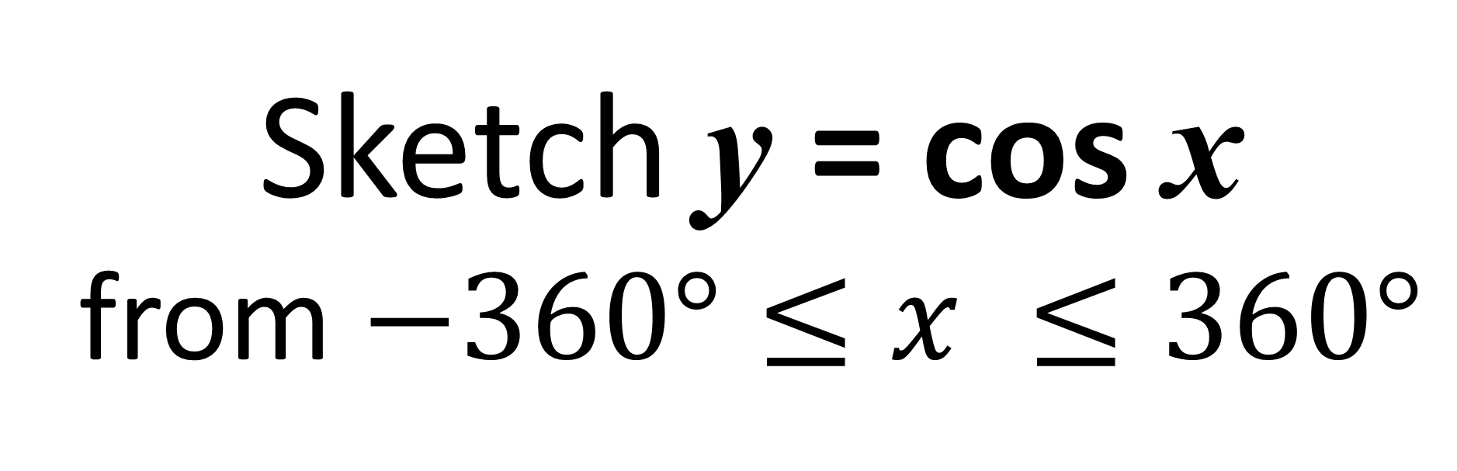
Cosine Graphs
Sketch y = cos x
from $−360°≤x ≤360°$

Slide 8
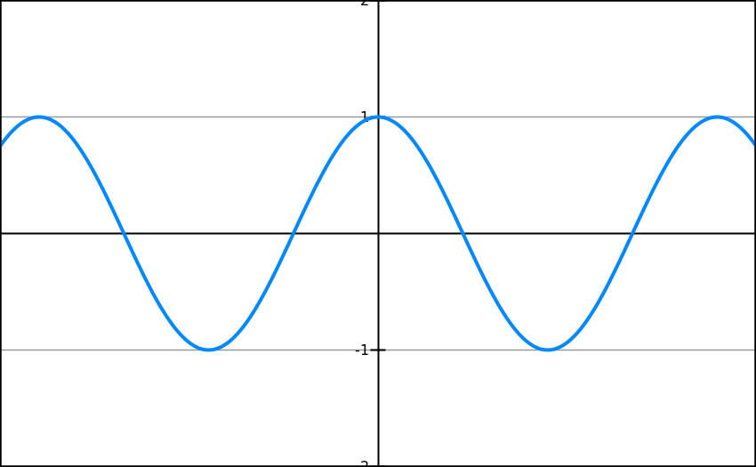

Cosine Graph
Key Features:
Repeats every $360°$.
Range: $−1<\cos\left(x\right)<1$
-360
-270
-180
-90
0
90
180
270
360

Slide 9
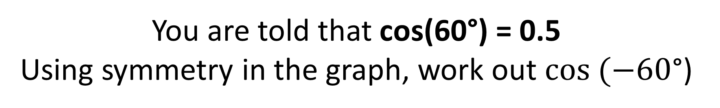

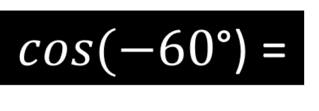
You are told that cos(60°) = 0.5
Using symmetry in the graph, work out $cos (−60$°)
$cos(−60$°) =
$$0.5$$
-360
-270
-180
-90
0
90
180
270
360

Slide 10
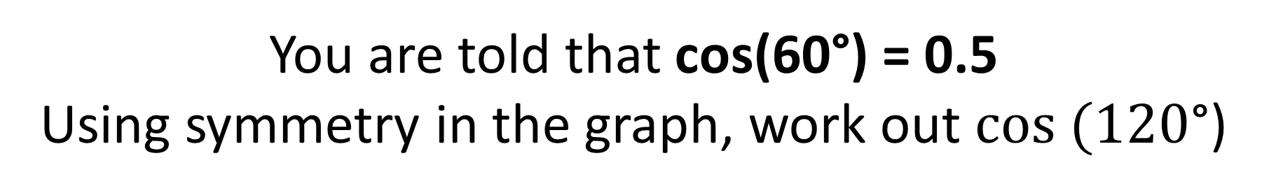

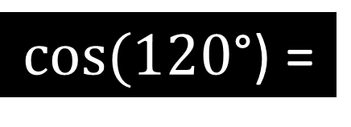
You are told that cos(60°) = 0.5
Using symmetry in the graph, work out $cos (120$°)
$cos⁡(120$°) =
$$−0.5$$
-360
-270
-180
-90
0
90
180
270
360

Slide 11
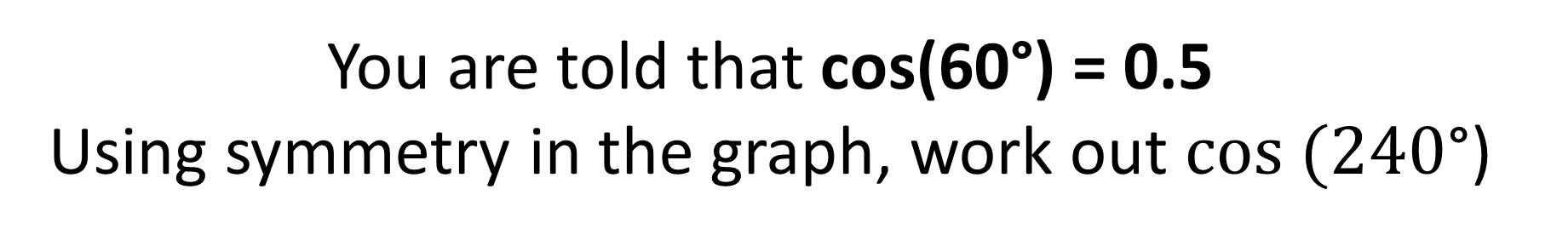

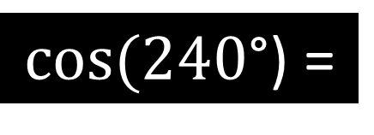
You are told that cos(60°) = 0.5
Using symmetry in the graph, work out $cos (240$°)
$cos⁡(240$°) =
$$−0.5$$
-360
-270
-180
-90
0
90
180
270
360
-0.5

Slide 12
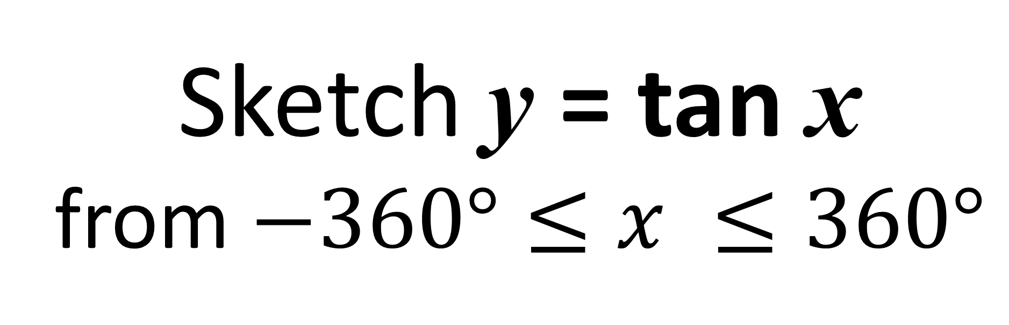
Tangent Graphs
Sketch y = tan x
from $−360°≤x ≤360°$

Slide 13
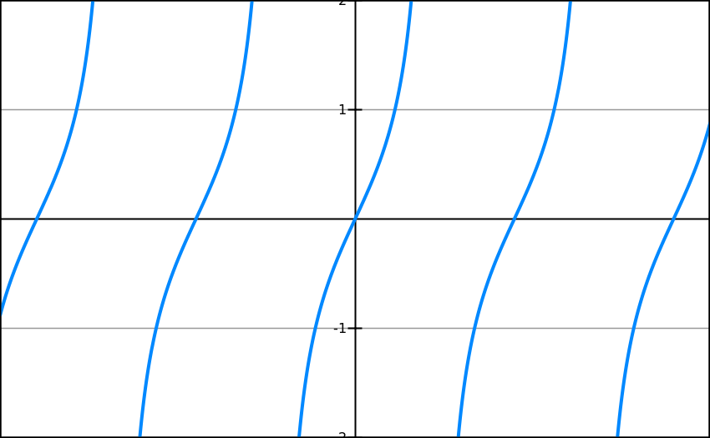
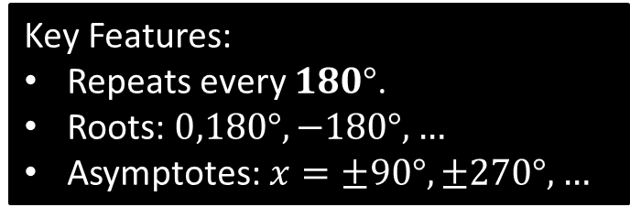
Tan Graph
Key Features:
Repeats every $180°$.
Roots: $0,180°,−180°, …$
Asymptotes: $x=±90°, ±270°,…$
-360
-270
-180
-90
90
180
270
360

Slide 14

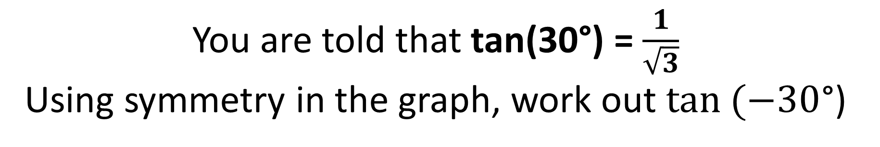

You are told that tan(30°) = $\frac{1}{\sqrt{3}}$
Using symmetry in the graph, work out $tan (−30$°)
$$\tan\left(−30°\right)=$$
$$−\frac{1}{\sqrt{3}}$$
-360
-270
-180
-90
90
180
270
360

Slide 15

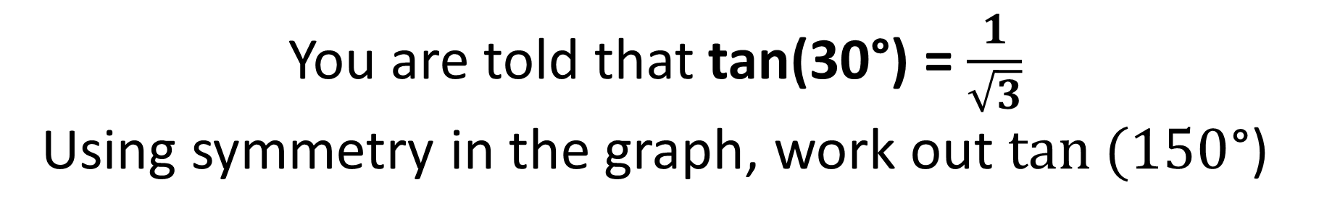
You are told that tan(30°) = $\frac{1}{\sqrt{3}}$
Using symmetry in the graph, work out $tan (150$°)
$$\tan\left(150°\right)=$$
$$−\frac{1}{\sqrt{3}}$$
-360
-270
-180
-90
90
180
270
360

Slide 16
Transforming
Trigonometric Graphs
When transforming graphs
always think about
the basic sin, cos and tan waves
as your starting position.

Slide 17
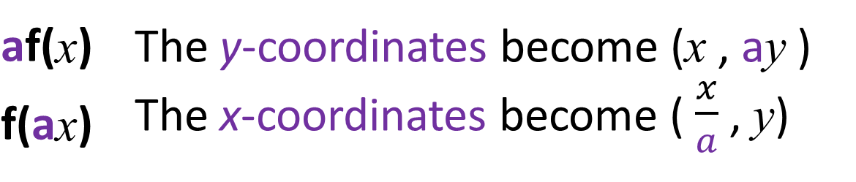
Transforming Trigonometric Graphs
f(x) + a | The graph moves up
f(x) – a | The graph moves down
f(x + a) |  | The graph moves left
f(x – a) |  | The graph moves right
af(x) | The y-coordinates become (x , ay )
f(ax) | The x-coordinates become ( $\frac{x}{a}$ , y)
–f(x) | The graph is reflected in the x axis
f(–x) | The graph is reflected in the y axis

Slide 18

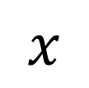

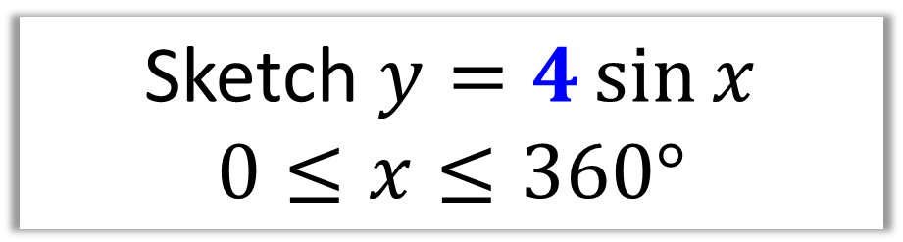

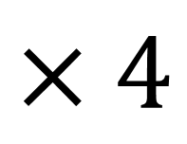


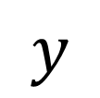

Sketch $y=4\sin{x}$
$$0≤x≤360°$$
af(x) | The y-coordinates become (x , ay )
$$y$$
$$×4$$
$$4$$
$$x$$
$$90°$$
$$180°$$
$$270°$$
$$360°$$
$$−4$$

Slide 19




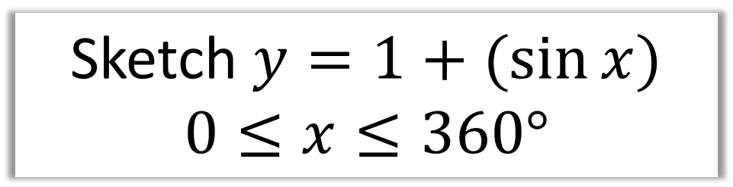






Sketch $y=1+(sin{x)}$
$$0≤x≤360°$$
f(x) – a | The graph moves down
$$y$$
$$2$$
$$+ 1$$
$$1$$
$$0$$
$$x$$
$$90°$$
$$180°$$
$$270°$$
$$360°$$

Slide 20



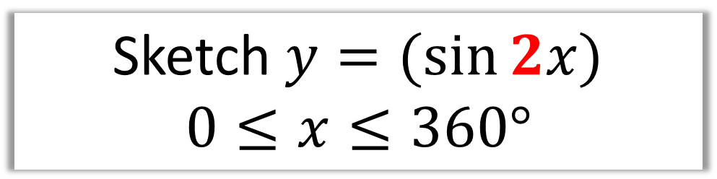

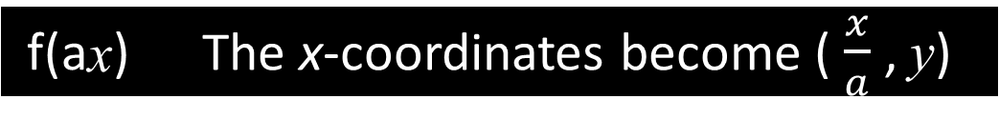




Sketch $y=(sin{2x)}$
$$0≤x≤360°$$
f(ax) | The x-coordinates become ( $\frac{x}{a}$ , y)
$$y$$
2 cycles completed in 360˚
$$1$$
$$x$$
$$90°$$
$$180°$$
$$270°$$
$$360°$$
$$−1$$

Slide 21



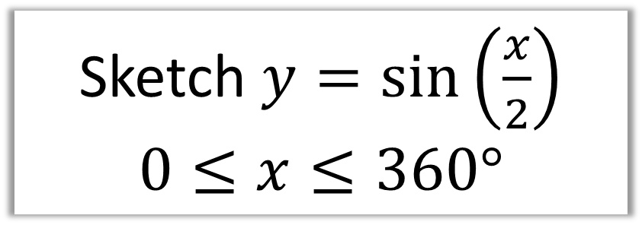






Sketch $y=\sin\left(\frac{x}{2}\right)$
$$0≤x≤360°$$
af(x) | The y-coordinates become (x , ay )
$$y$$
$$×2$$
$$1$$
$$x$$
$$90°$$
$$180°$$
$$270°$$
$$360°$$
$$−1$$

Slide 22



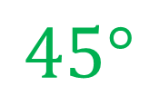
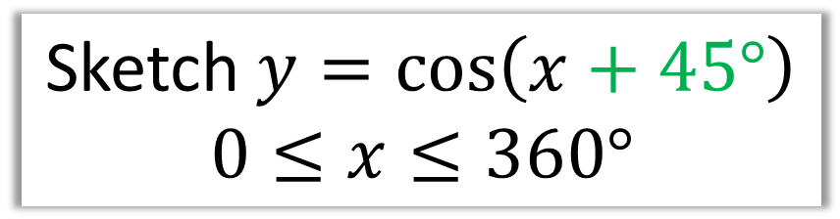






Sketch $y=\cos\left(x+45°\right)$
$$0≤x≤360°$$
f(x + a) | The graph moves left
$$y$$
$$45°$$
$$1$$
$$x$$
$$−90°$$
$$90°$$
$$180°$$
$$270°$$
$$360°$$
$$−1$$

Slide 23



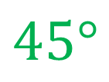
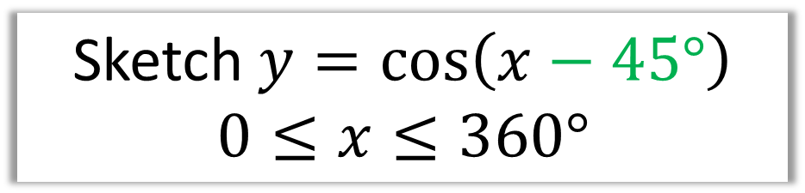






Sketch $y=\cos\left(x−45°\right)$
$$0≤x≤360°$$
f(x) – a | The graph moves down
$$y$$
$$45°$$
$$1$$
$$x$$
$$−90°$$
$$90°$$
$$180°$$
$$270°$$
$$360°$$
$$−1$$

Slide 24



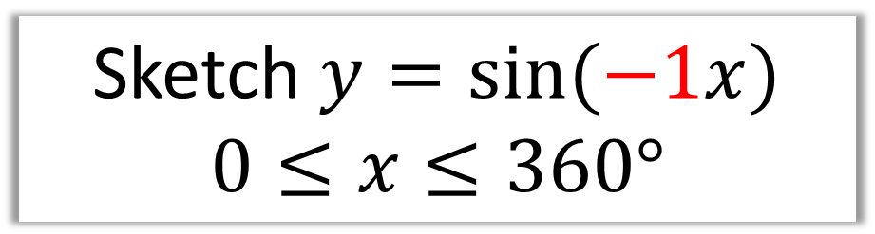

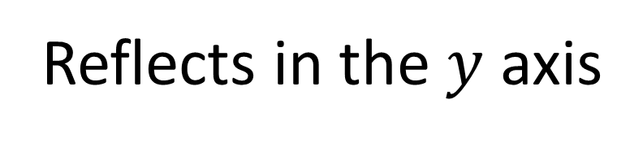




Sketch $y=\sin{(−1x)}$
$$0≤x≤360°$$
f(–x) | The graph is reflected in the y axis
$$y$$
Reflects in the $y$ axis
$$1$$
$$x$$
$$90°$$
$$180°$$
$$270°$$
$$360°$$
$$−1$$

Slide 25



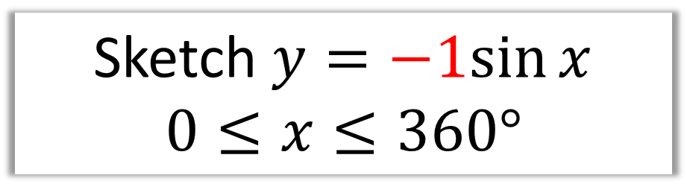

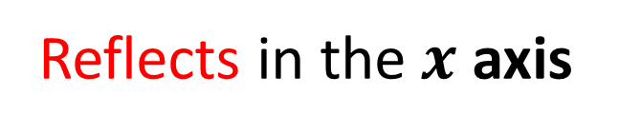




Sketch $y=−1sin{x}$
$$0≤x≤360°$$
–f(x) | The graph is reflected in the x axis
$$y$$
Reflects in the $x$ axis
$$1$$
$$x$$
$$90°$$
$$180°$$
$$270°$$
$$360°$$
$$−1$$

Slide 26



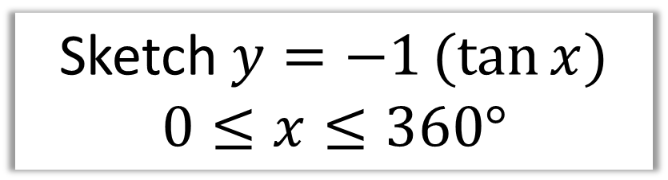



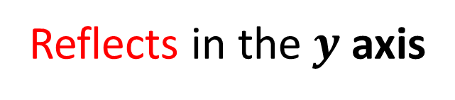
Sketch $y=−1(tan{x)}$
$$0≤x≤360°$$
–f(x) | The graph is reflected in the x axis
$$y$$
$$x$$
$$90°$$
$$180°$$
$$270°$$
$$360°$$
Reflects in the $y$ axis

