Slide 1
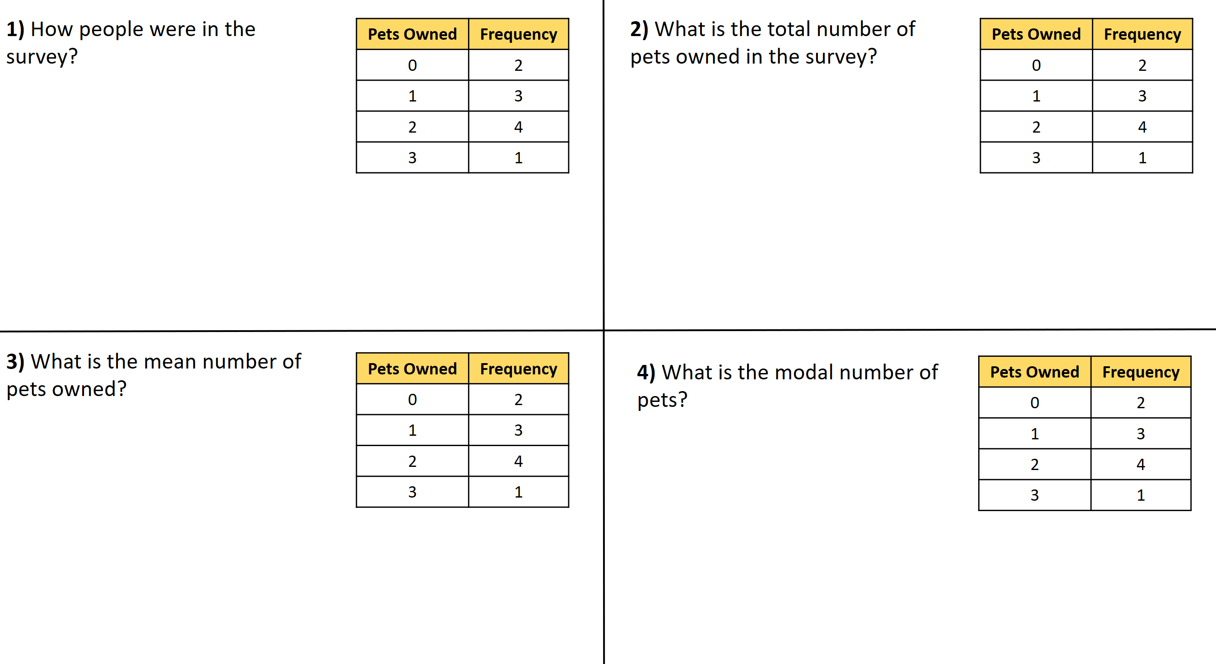
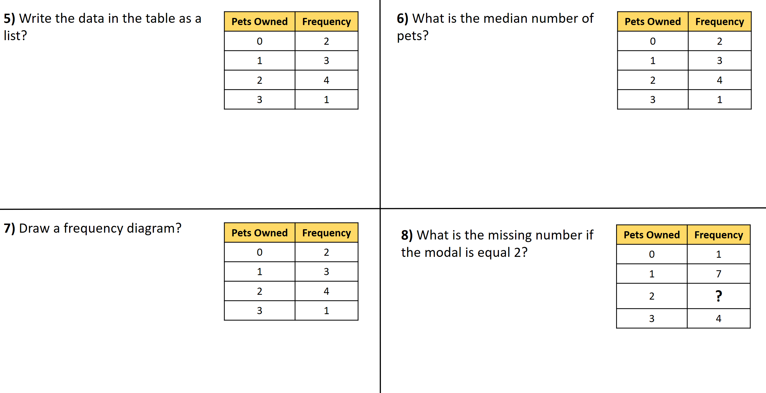

Slide 2
ANSWERS

Slide 3
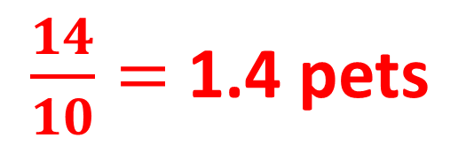
1) How people were in the survey?
Pets Owned | Frequency
0 | 2
1 | 3
2 | 4
3 | 1
2) What is the total number of pets owned in the survey?
Pets Owned | Frequency
0 | 2
1 | 3
2 | 4
3 | 1
10 people
14 pets
3) What is the mean number of pets owned?
Pets Owned | Frequency
0 | 2
1 | 3
2 | 4
3 | 1
4) What is the modal number of pets?
Pets Owned | Frequency
0 | 2
1 | 3
2 | 4
3 | 1
2 pets
$\frac{14}{10}=$1.4 pets

Slide 4
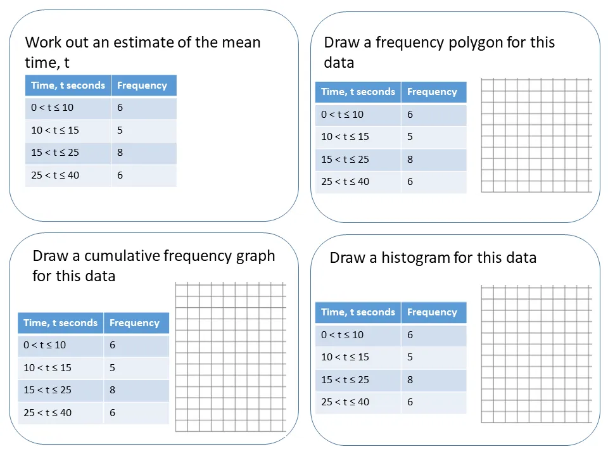
5) Write the data in the table as a list?
Pets Owned | Frequency
0 | 2
1 | 3
2 | 4
3 | 1
6) What is the median number of pets?
Pets Owned | Frequency
0 | 2
1 | 3
2 | 4
3 | 1
0, 0, 1, 1, 1, 2, 2, 2, 2, 3
0, 0, 1, 1, 1, 2, 2, 2, 2, 3
1.5 pets
7) Draw a frequency diagram?
Pets Owned | Frequency
0 | 2
1 | 3
2 | 4
3 | 1
8) What is the missing number if the modal is equal 2?
Pets Owned | Frequency
0 | 1
1 | 7
2 | ?
3 | 4
4
Frequency
3
Any number greater than 7
2
1
0
Pets Owned
0
1
2
3

