Slide 1
LO: Reading Pie Chart

Slide 2
The pie chart represents 50 people.
How many chose purple?
50
Notes:
2

Slide 3
The pie chart represents 42 people.
How many chose pink?
0
Notes:
3

Slide 4
The pie chart represents 18 people.
How many chose purple?
9
Notes:
4

Slide 5
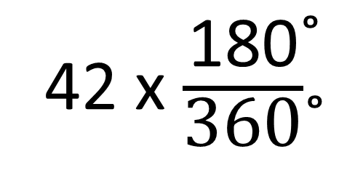
The pie chart represents 42 people.
How many chose purple?
42 x $\frac{\text{180}\text{˚}}{\text{360}\text{˚}}$
21
180˚
Notes:
5

Slide 6
The pie chart represents 20 people.
How many chose green?
5
Notes:
6

Slide 7
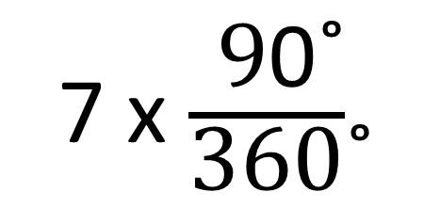
The pie chart represents 28 people.
How many chose green?
7 x $\frac{\text{9}\text{0}\text{˚}}{\text{360}\text{˚}}$
7
90˚
Notes:
7

Slide 8
The pie chart represents 39 people.
How many chose red?
13
Notes:
8

Slide 9
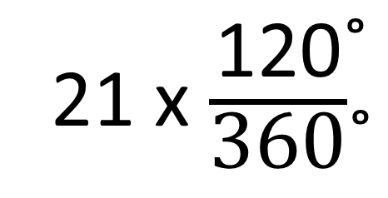
The pie chart represents 21 people.
How many chose red?
21 x $\frac{\text{120}\text{˚}}{\text{360}\text{˚}}$
7
120˚
Notes:
9

Slide 10

The pie chart represents 48 people.
How many chose black?
6
Notes:
10

Slide 11
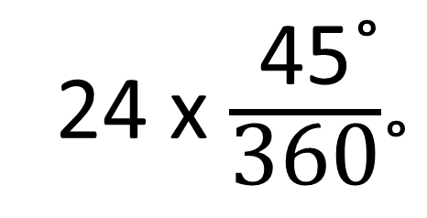
The pie chart represents 24 people.
How many chose black?
45˚
3
24 x $\frac{\text{45}\text{˚}}{\text{360}\text{˚}}$
Notes:
11

Slide 12
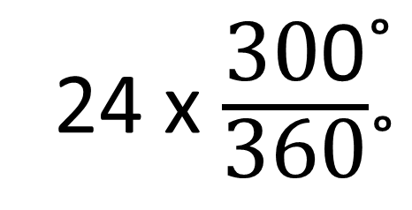
The pie chart represents 24 people.
How many chose yellow?
24 x $\frac{\text{30}\text{0}\text{˚}}{\text{360}\text{˚}}$
20
300˚
Notes:
12

Slide 13
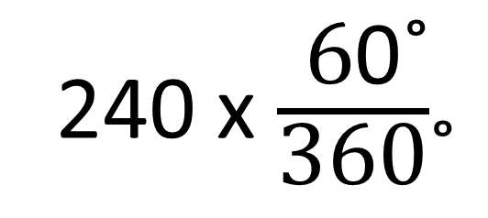
The pie chart represents 240 people.
How many chose PE?
Drama
240 x $\frac{\text{6}\text{0}\text{˚}}{\text{360}\text{˚}}$
40
Art
60˚
PE
Notes:
13

Slide 14
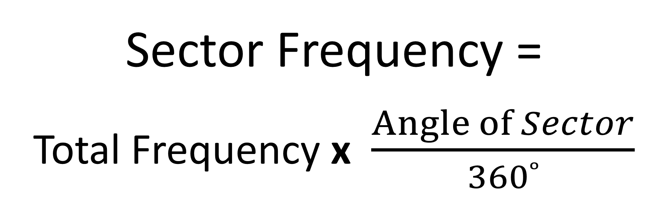
Sector Frequency =
Total Frequency x $\frac{Angle of Sector}{360˚}$

Slide 15
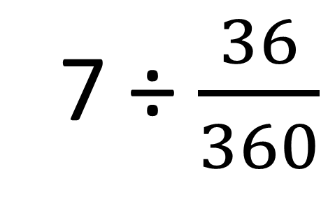
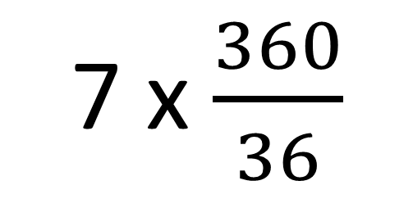
7 people choose PE.
How many people in the survey?
7 ÷ $\frac{36}{360}$
Drama
70
Art
OR
36˚
7 x $\frac{360}{36}$
PE
Notes:
15

Slide 16
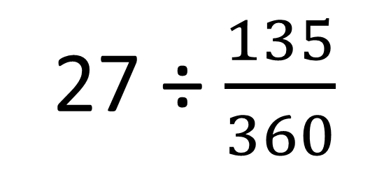
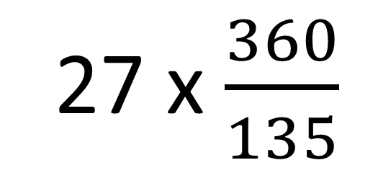
27 people choose Coke.
How many people in the survey?
27 ÷ $\frac{135}{360}$
Pepsi
Fanta
72
OR
135˚
Coke
7UP
27 x $\frac{360}{135}$
Notes:
16

Slide 17
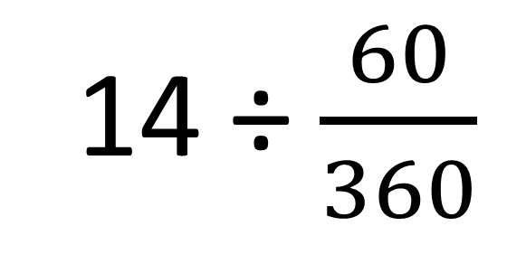
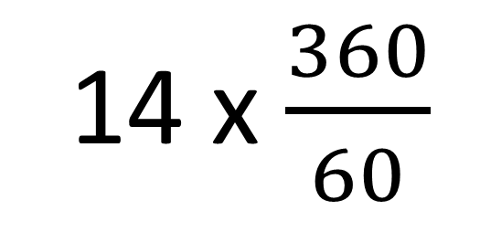
14 people choose KFC.
How many people in the survey?
14 ÷ $\frac{60}{360}$
KFC
60˚
84
Nando’s
McDonalds
OR
Burger King
14 x $\frac{360}{60}$
Notes:
17

Slide 18
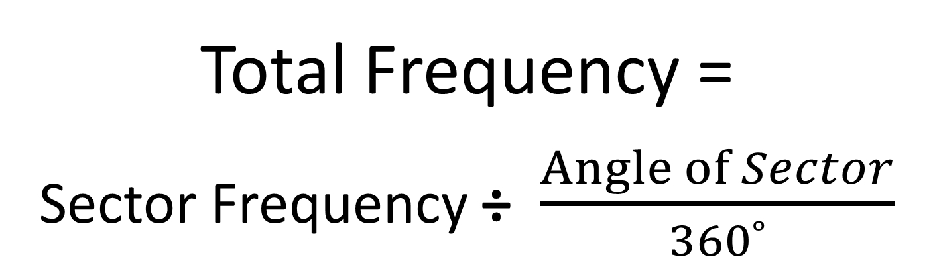
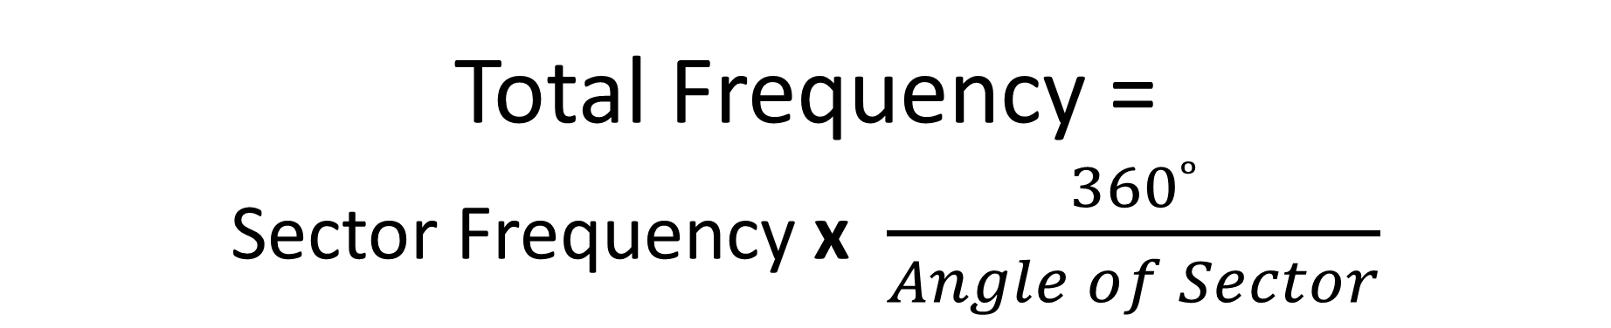
Total Frequency =
Sector Frequency x $\frac{360˚}{Angle of Sector}$
OR
Total Frequency =
Sector Frequency ÷ $\frac{Angle of Sector}{360˚}$

