Slide 1
LO: Rationalise
the Denominator

Slide 2
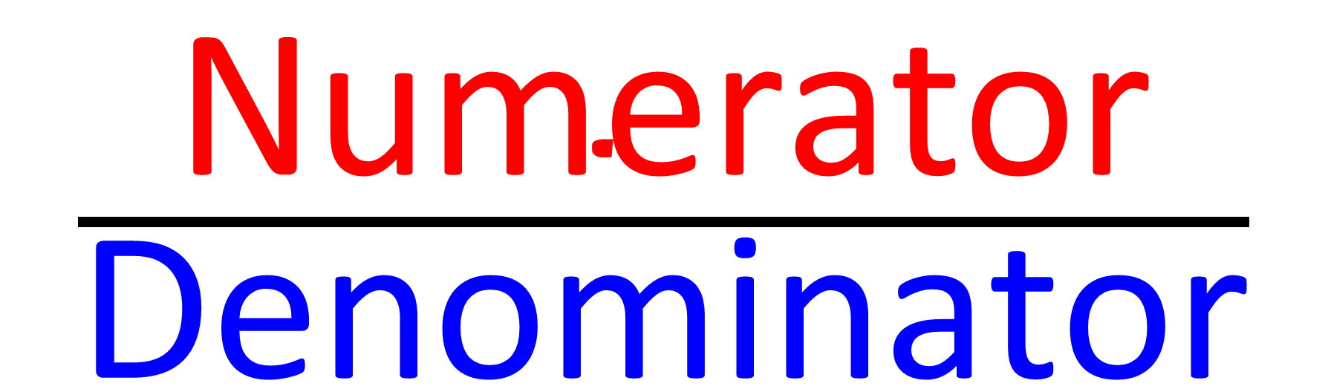
$$\frac{\text{Numerator}}{\text{Denominator}}$$

Slide 3
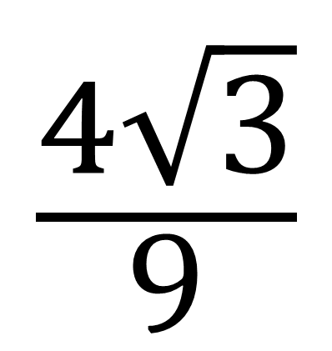
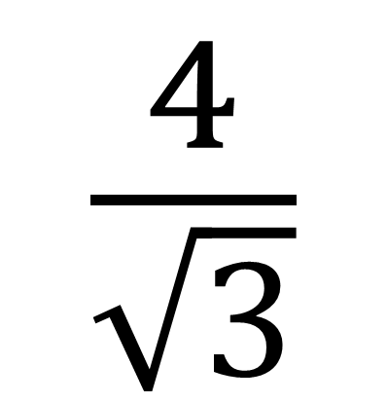
To rationalise the denominator
you make sure the denominator
does not contain a surd.
Not Rationalised
Rationalised
$$\frac{4}{\sqrt{3}}$$
$$\frac{4\sqrt{3}}{9}$$

Slide 4
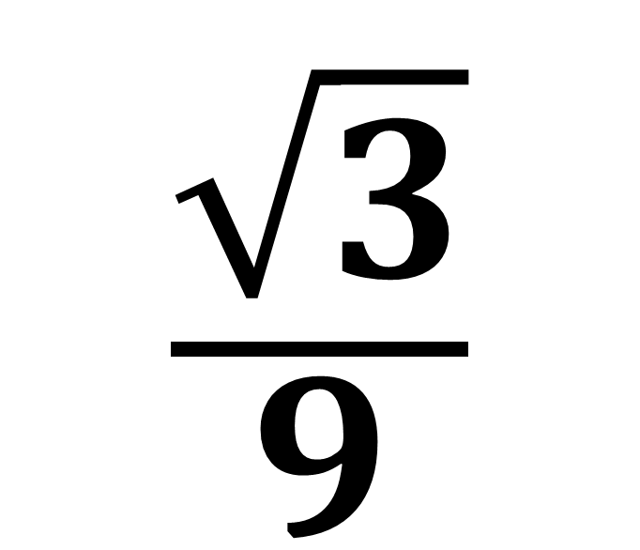
Rationalised or Not?
$$\frac{\sqrt{3}}{9}$$
Rationalised

Slide 5
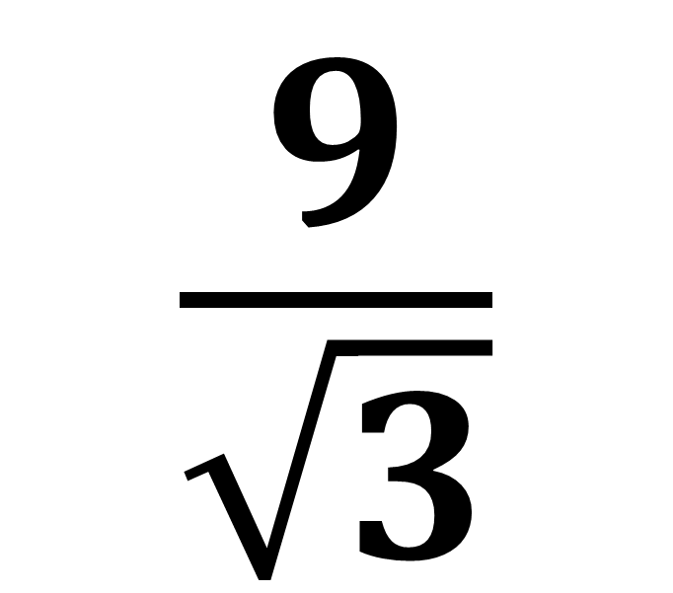
Rationalised or Not?
$$\frac{9}{\sqrt{3}}$$
Not Rationalised

Slide 6
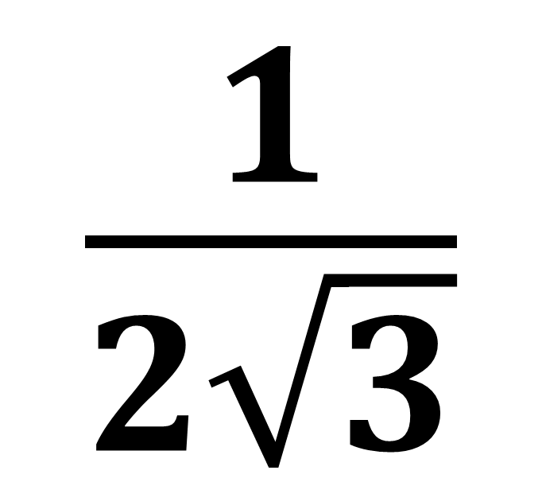
Rationalised or Not?
$$\frac{1}{2\sqrt{3}}$$
Not Rationalised

Slide 7
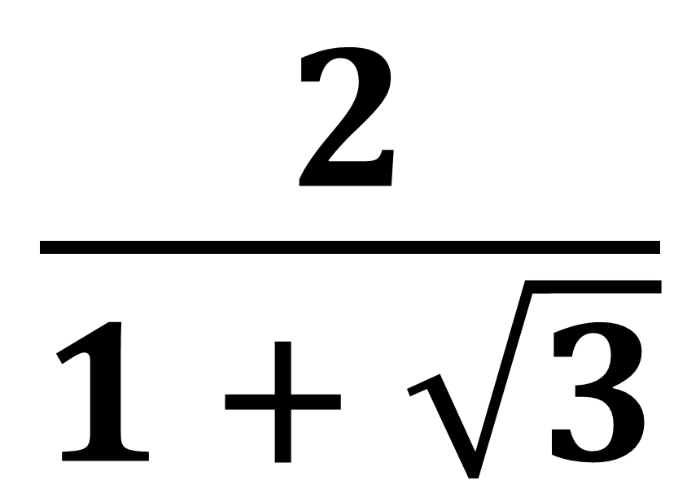
Rationalised or Not?
$$\frac{2}{1 + \sqrt{3}}$$
Not Rationalised

Slide 8
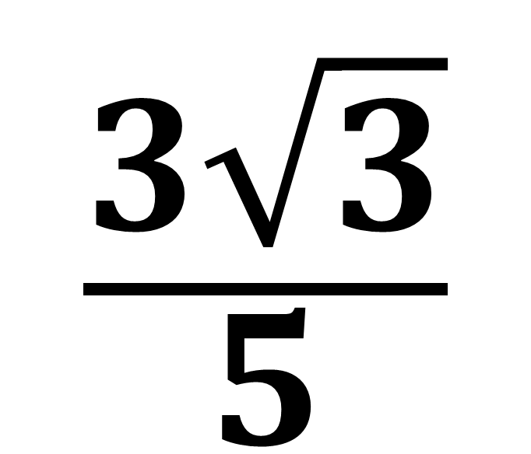
Rationalised or Not?
$$\frac{3\sqrt{3}}{5}$$
Rationalised

Slide 9
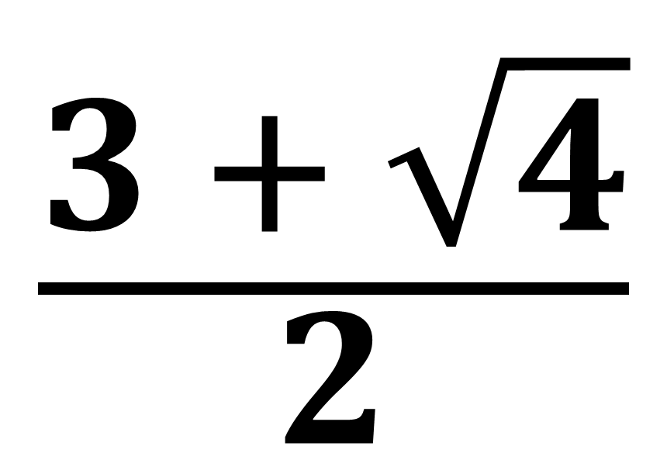
Rationalised or Not?
$$\frac{3 + \sqrt{4}}{2}$$
Rationalised

Slide 10
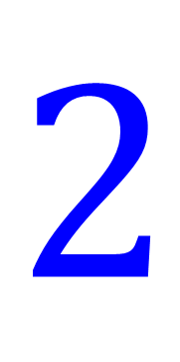
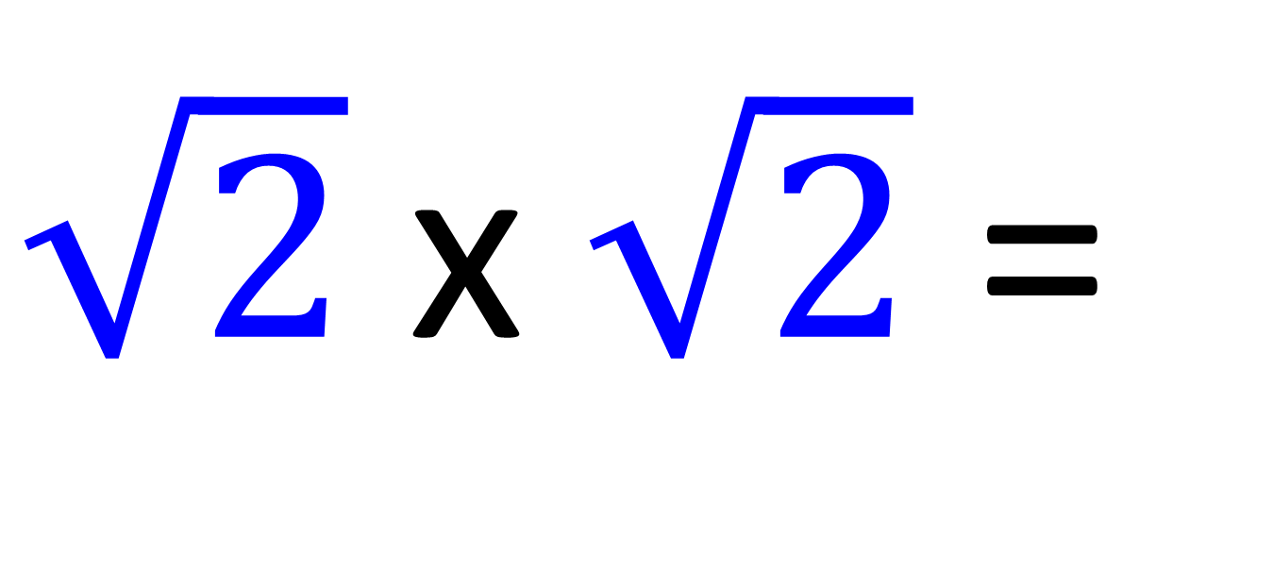
The key to making a surd disappear!
$\sqrt{2} \text{x} \sqrt{2}$ =
$$2$$
Multiply a surd by itself.

Slide 11
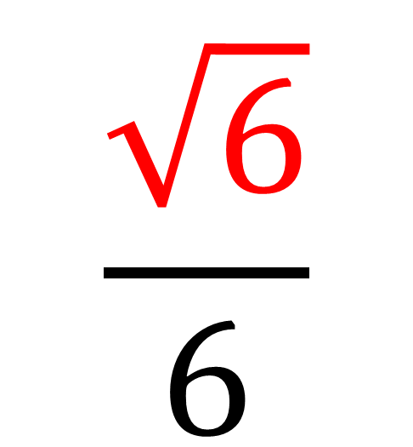
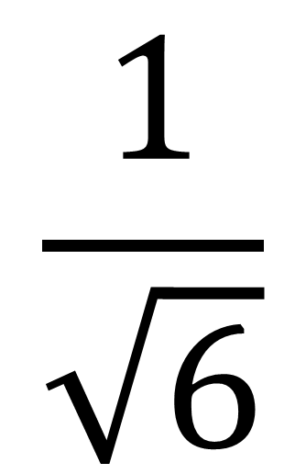
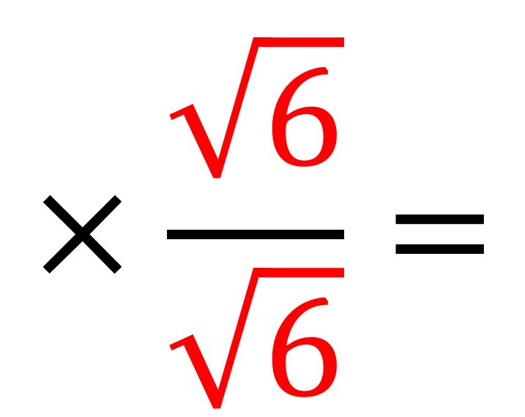
Multiply the fractions together.
$$×\frac{\sqrt{6}}{\sqrt{6}}=$$
$$\frac{\sqrt{6}}{6}$$
$$\frac{1}{\sqrt{6}}$$

Slide 12

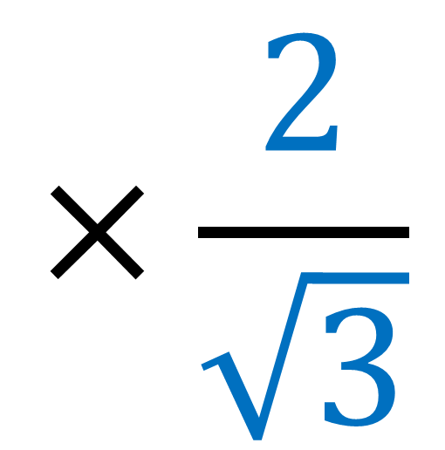
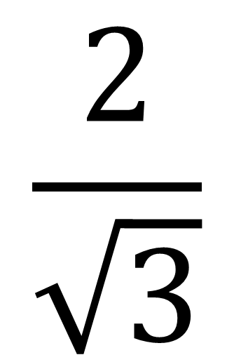
Is this the correct multiplier
to rationalise the denominator?
$$\frac{2}{\sqrt{3}}$$
$$×\frac{2}{\sqrt{3}}$$

Slide 13

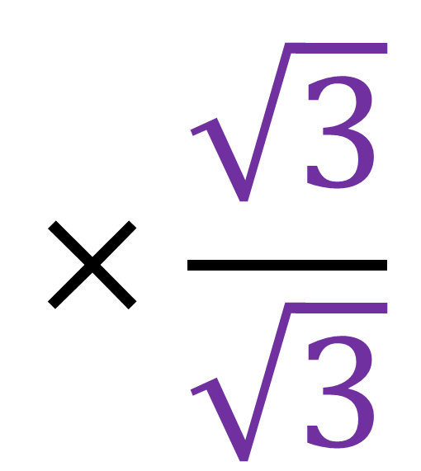
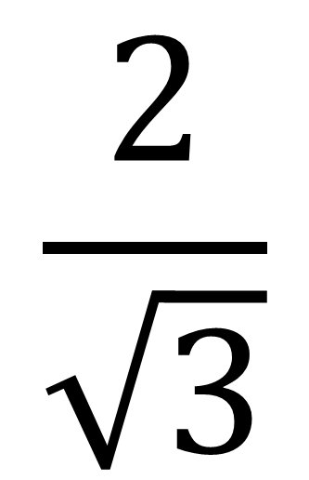
Is this the correct multiplier
to rationalise the denominator?
$$×\frac{\sqrt{3}}{\sqrt{3}}$$
$$\frac{2}{\sqrt{3}}$$

Slide 14
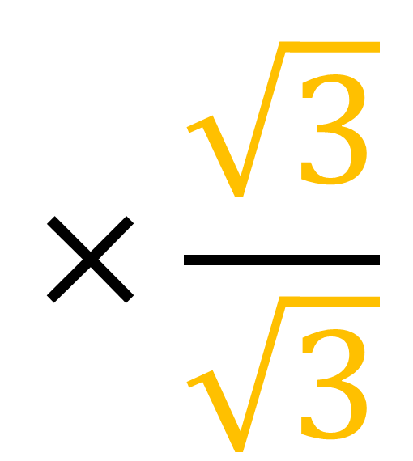
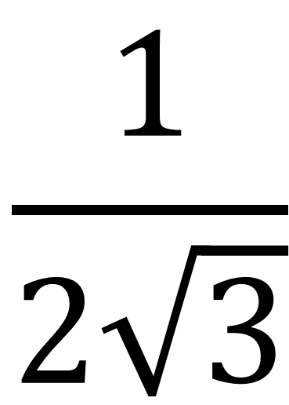
Is this the correct multiplier
to rationalise the denominator?
$$×\frac{\sqrt{3}}{\sqrt{3}}$$
$$\frac{1}{2\sqrt{3}}$$

Slide 15
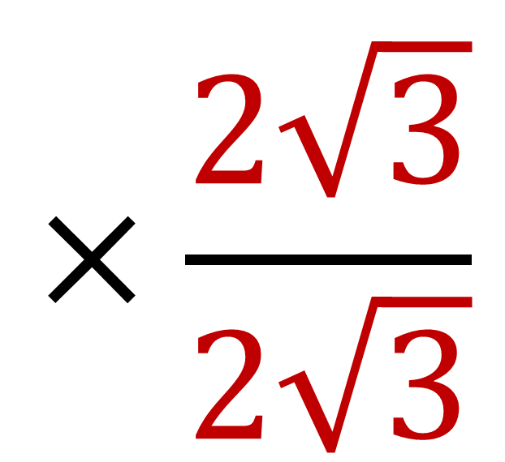
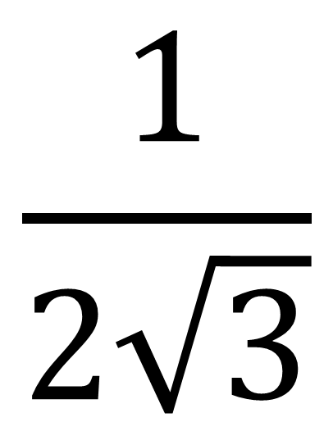
Is this the correct multiplier
to rationalise the denominator?
$$×\frac{2\sqrt{3}}{2\sqrt{3}}$$
$$\frac{1}{2\sqrt{3}}$$

Slide 16
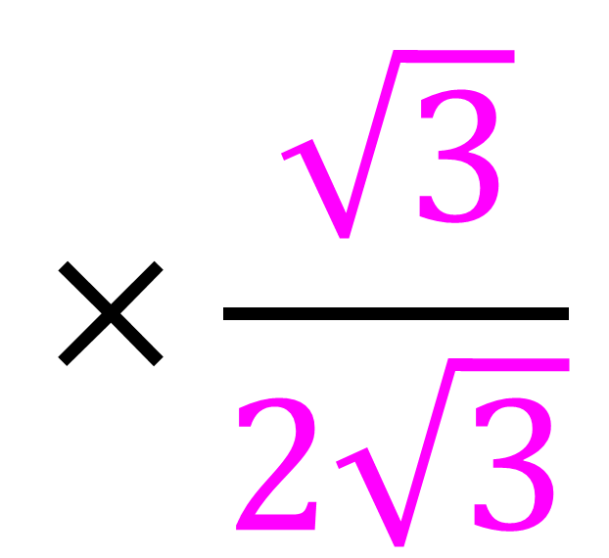
Is this the correct multiplier
to rationalise the denominator?
$$×\frac{\sqrt{3}}{2\sqrt{3}}$$
$$\frac{1}{2\sqrt{3}}$$

Slide 17

Rationalise the Denominator
$$×\frac{\sqrt{6}}{\sqrt{6}}=$$
$$\frac{\sqrt{6}}{6}$$
$$\frac{1}{\sqrt{6}}$$

Slide 18
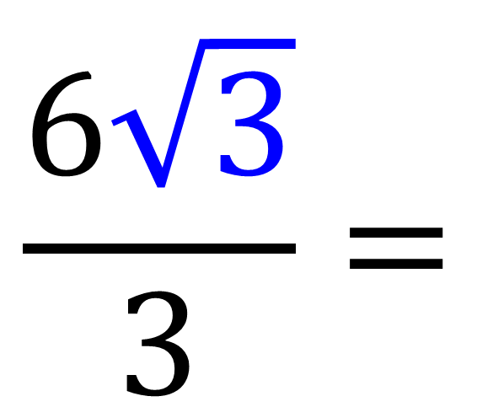
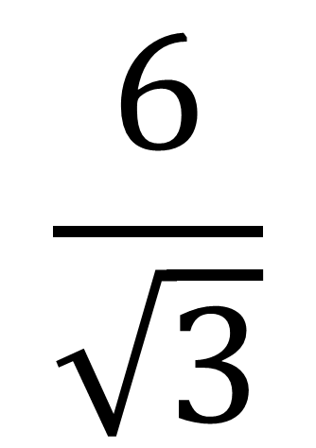
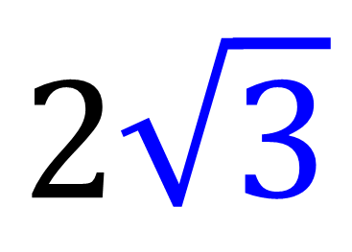
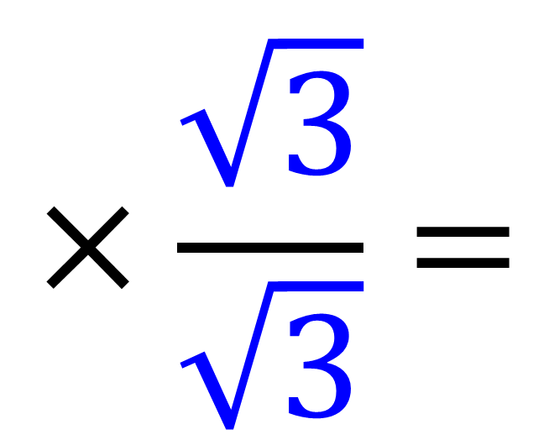
Rationalise the Denominator
$$×\frac{\sqrt{3}}{\sqrt{3}}=$$
$$\frac{6\sqrt{3}}{3}=$$
$$\frac{6}{\sqrt{3}}$$
$$2\sqrt{3}$$

Slide 19
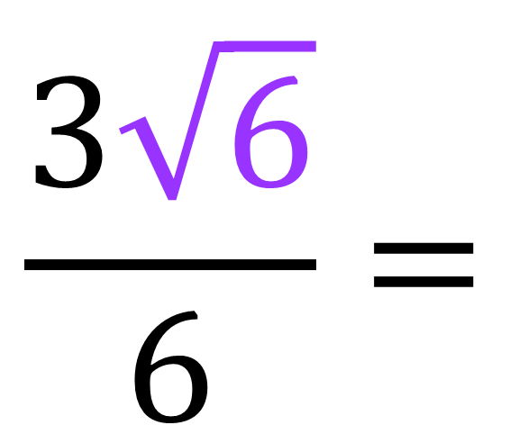
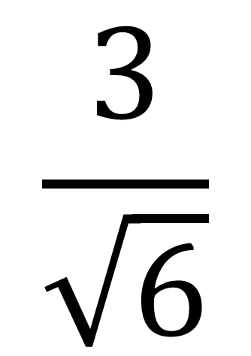
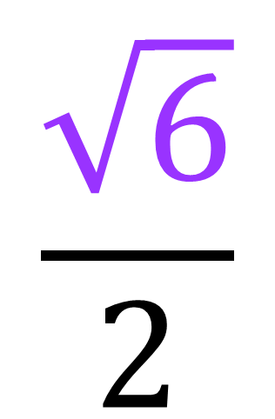
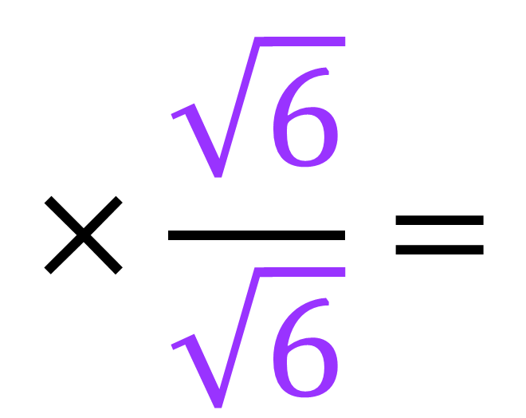
Rationalise the Denominator
$$×\frac{\sqrt{6}}{\sqrt{6}}=$$
$$\frac{3\sqrt{6}}{6}=$$
$$\frac{\sqrt{6}}{2}$$
$$\frac{3}{\sqrt{6}}$$

Slide 20
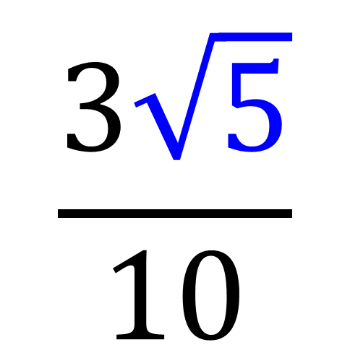
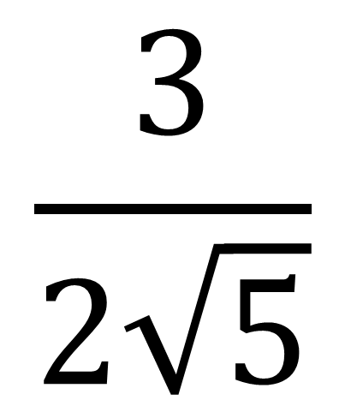
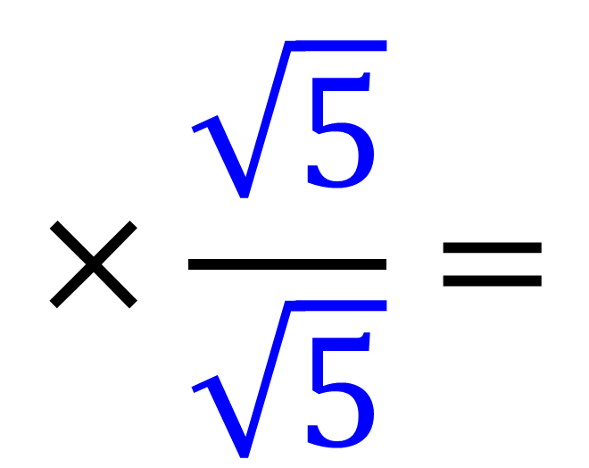
Rationalise the Denominator
$$×\frac{\sqrt{5}}{\sqrt{5}}=$$
$$\frac{3\sqrt{5}}{10}$$
$$\frac{3}{2\sqrt{5}}$$

Slide 21
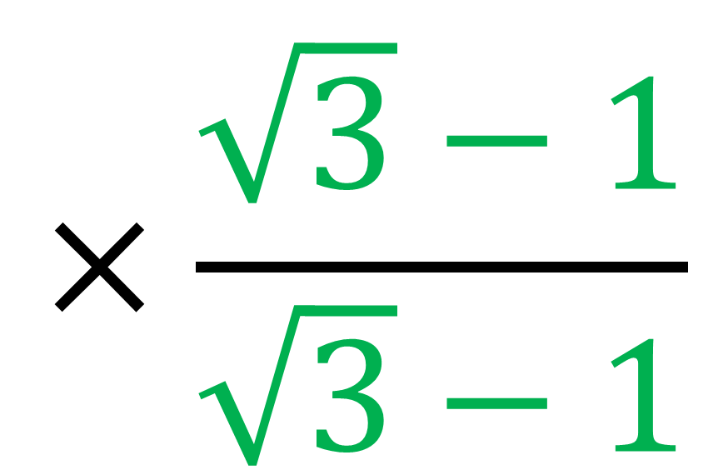
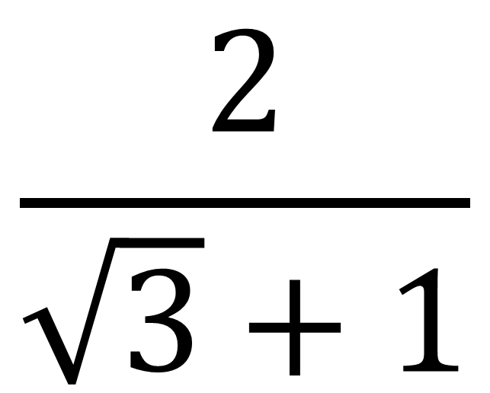
What is the multiplier
for a fraction like this?
$$×\frac{\sqrt{3}−1}{\sqrt{3}−1}$$
$$\frac{2}{\sqrt{3}+1}$$

Slide 22
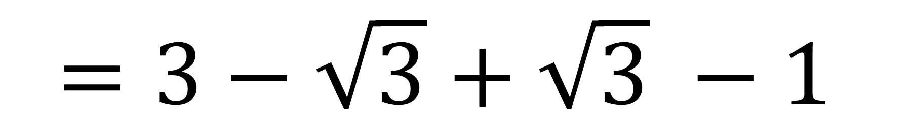
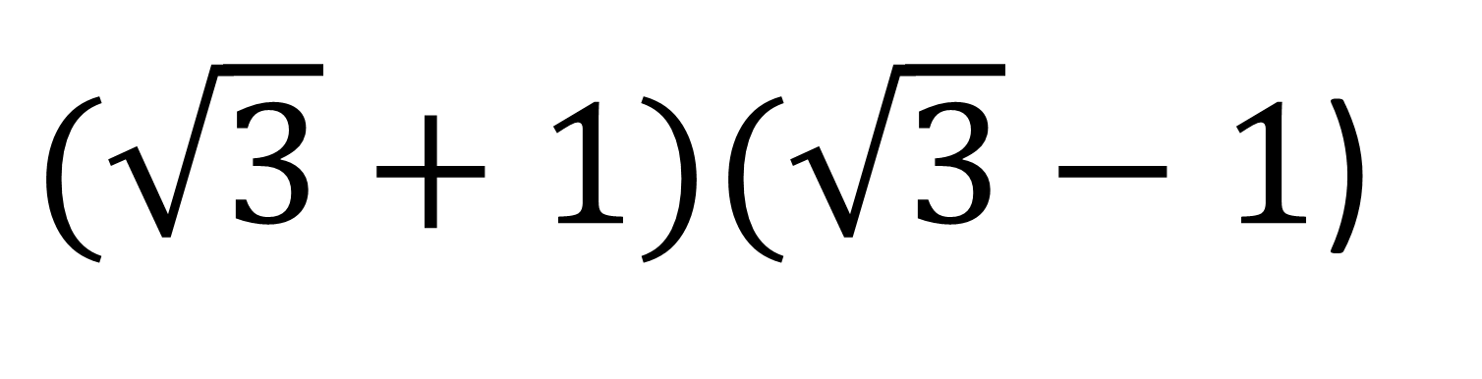
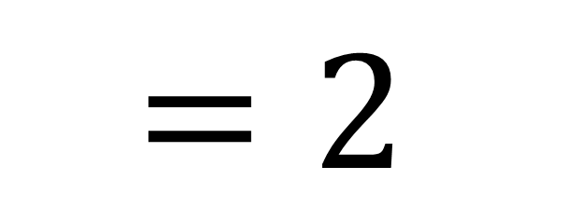
The key to making surds disappear!
$(\sqrt{3}+1)(\sqrt{3}−1$)
$$=3−\sqrt{3}+\sqrt{3} −1$$
$$=2$$
The surds have disappeared!

Slide 23
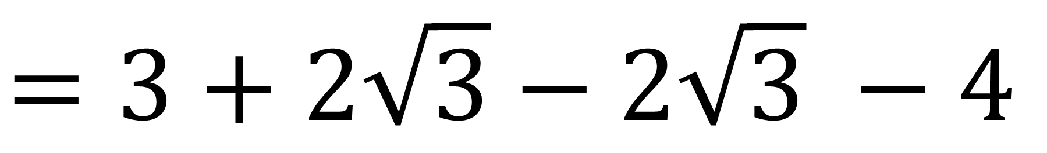
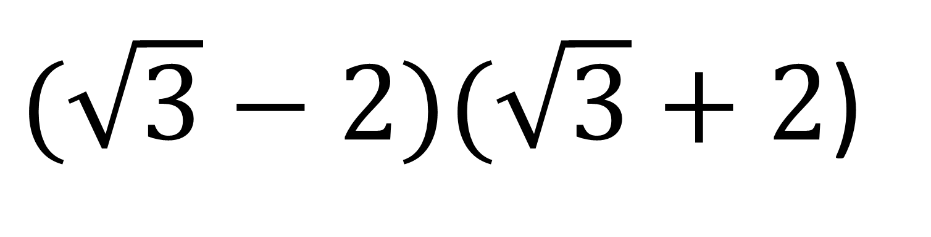
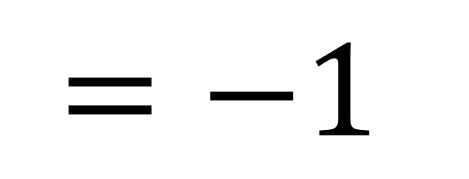
The key to making a surds disappear!
$(\sqrt{3}−2)(\sqrt{3}+2$)
$$=3+2\sqrt{3}−2\sqrt{3} −4$$
$$=−1$$
The surds have disappeared!

Slide 24
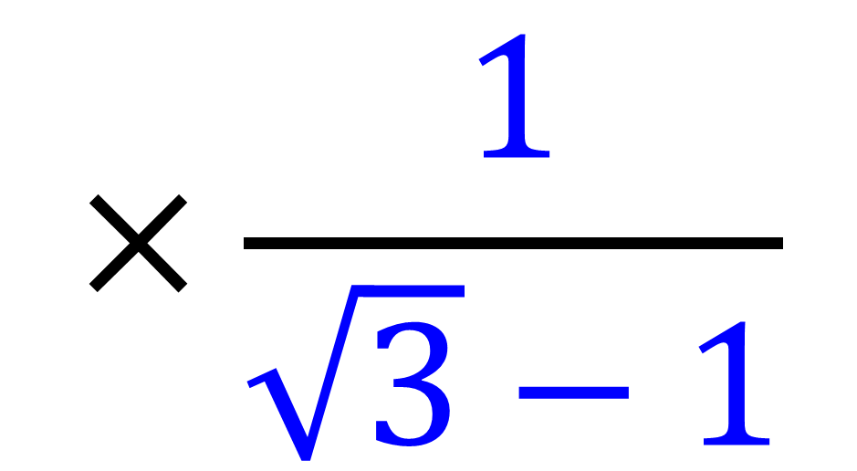
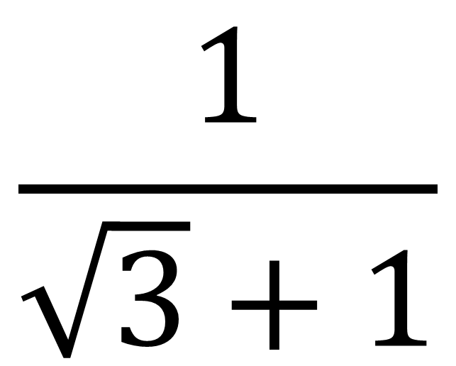
Is this the correct multiplier
to rationalise the denominator?
$$\frac{1}{\sqrt{3}+1}$$
$$×\frac{1}{\sqrt{3}−1}$$

Slide 25
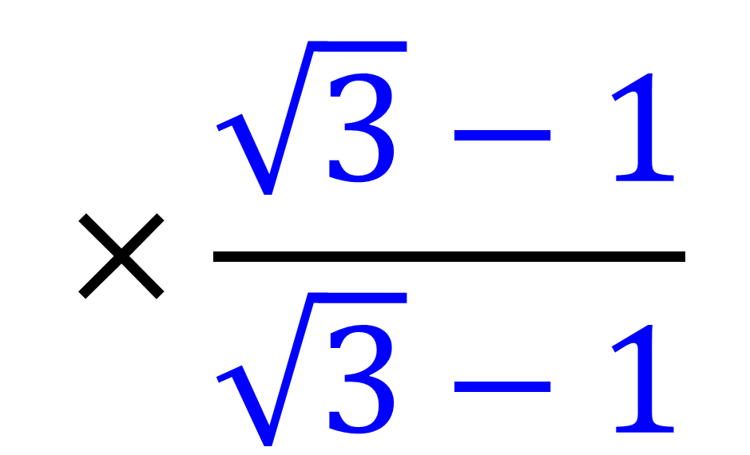
Is this the correct multiplier
to rationalise the denominator?
$$×\frac{\sqrt{3}−1}{\sqrt{3}−1}$$
$$\frac{1}{\sqrt{3}+1}$$

Slide 26
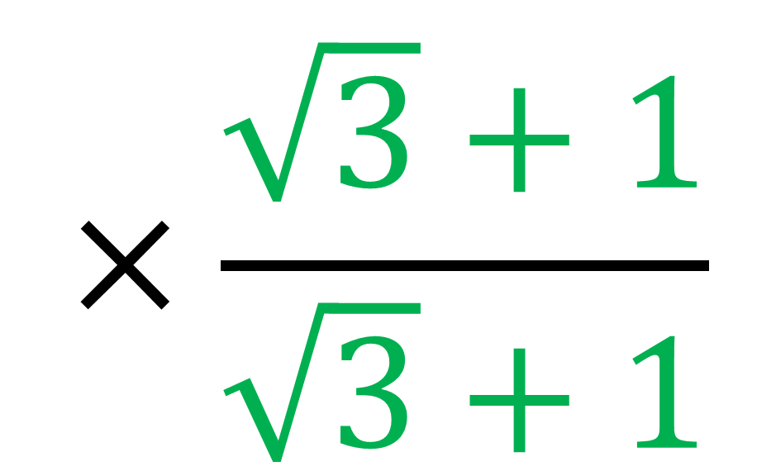
Is this the correct multiplier
to rationalise the denominator?
$$×\frac{\sqrt{3}+1}{\sqrt{3}+1}$$
$$\frac{1}{\sqrt{3}+1}$$

Slide 27
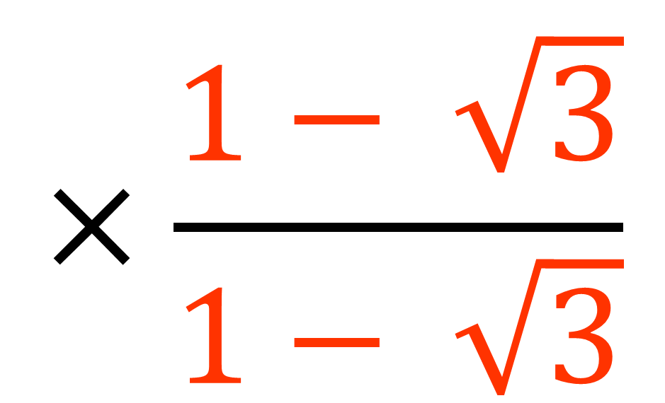
Is this the correct multiplier
to rationalise the denominator?
$$×\frac{1− \sqrt{3}}{1− \sqrt{3}}$$
$$\frac{1}{\sqrt{3}+1}$$

Slide 28


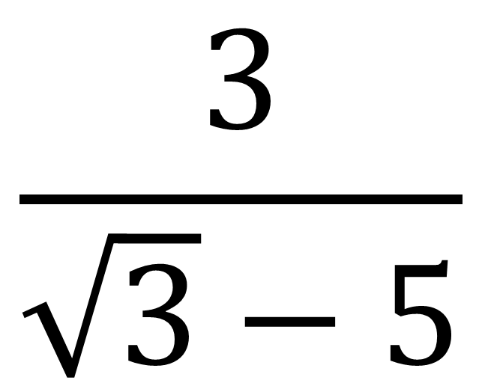
Is this the correct multiplier
to rationalise the denominator?
$$×\frac{\sqrt{3}+5}{\sqrt{3}+5}$$
$$\frac{3}{\sqrt{3}−5}$$

Slide 29
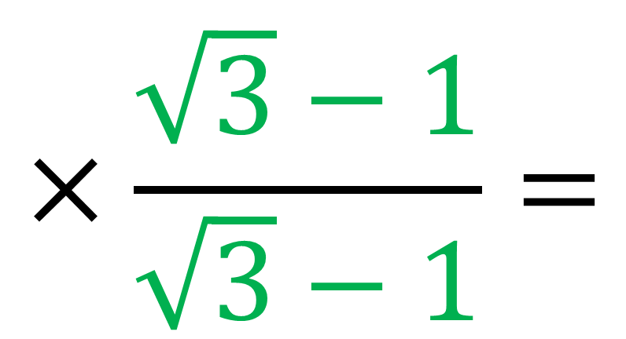
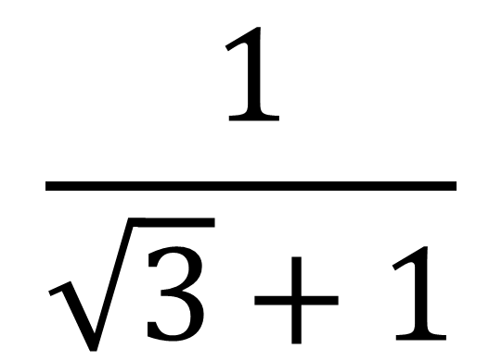

Rationalise the Denominator
$$\frac{1}{\sqrt{3}+1}$$
$$×\frac{\sqrt{3}−1}{\sqrt{3}−1}=$$
$$\frac{\sqrt{3}−1}{2}$$

Slide 30




Rationalise the Denominator
$$\frac{2}{\sqrt{3}−1}$$
$$×\frac{\sqrt{3}+1}{\sqrt{3}+1}=$$
$$\frac{2\sqrt{3} + 2}{2}$$
$$=\sqrt{3} +1$$

Slide 31




Rationalise the Denominator
$$\frac{4}{\sqrt{3}−3}$$
$$×\frac{\sqrt{3}+3}{\sqrt{3}+3}=$$
$$\frac{4(\sqrt{3}+3)}{−6}$$
$$=\frac{2(\sqrt{3}+3)}{−3}$$

