Slide 1
LO: Nets of
3D Shapes

Slide 2
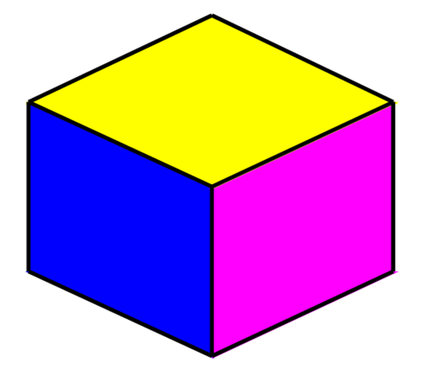
How many edges does
a cube have?

Slide 3
How many vertices does
a cube have?

Slide 4
How many faces does
a cube have?

Slide 5
What is a net of 3D Shape?

Slide 6
The 2D shapes that fold together
to make a 3D shape are called nets.

Slide 7
What 3D shape does the following net make?
Cube

Slide 8
What 3D shape does the following net make?
Triangular Prism

Slide 9
What 3D shape does the following net make?
Square Based Pyramids

Slide 10
Net of a Cube or Not?
NOT

Slide 11
Net of a Cube or Not?
YES

Slide 12
Net of a Cube or Not?
NOT

Slide 13
Net of a Cube or Not?
YES

Slide 14
Are these different nets of a cube?
NO

Slide 15
Are these different nets of a cube?
YES

Slide 16
Produce as many of the 11 different versions of a net for a cube as possible. (Use colour fill to produce the nets)
 |  |  | `
 |  |  |  |  |  |  |  |  |  |  |  |  |  |  |  |  |  |  |  | ☺ |  |  |  |  |  | ☺

Slide 17
