Slide 1
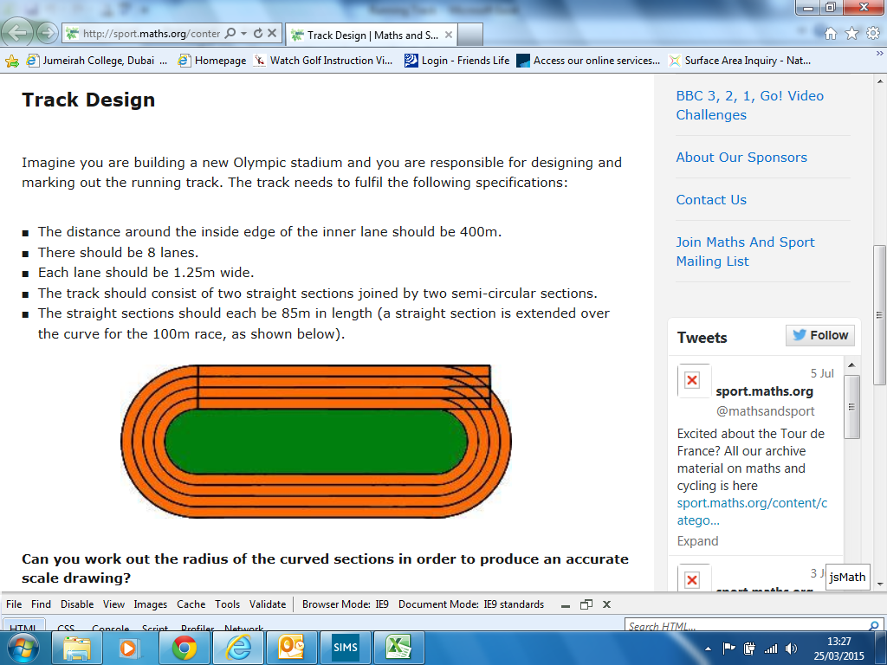
TRACK DESIGN
Work out the length of each of the arcs
for each lane (inside line of the lane).

Slide 2
ANSWER

