Slide 1

Intermediate Challenge 1
SILVER

Slide 2
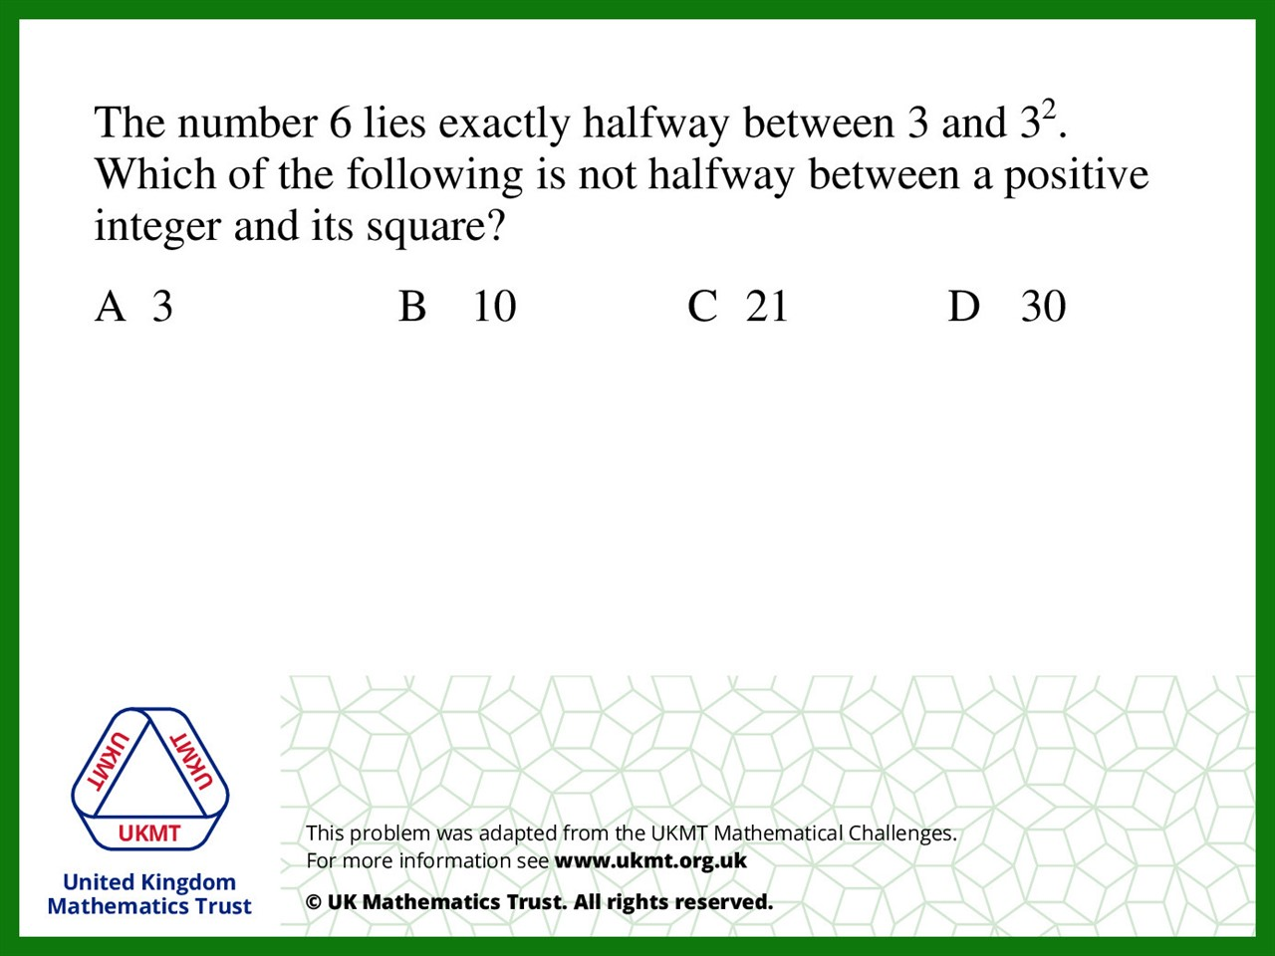
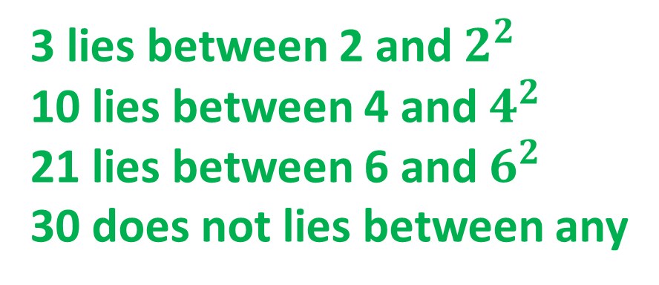
Q1.
3 lies between 2 and $2^{2}$
10 lies between 4 and $4^{2}$
21 lies between 6 and $6^{2}$
30 does not lies between any

Slide 3
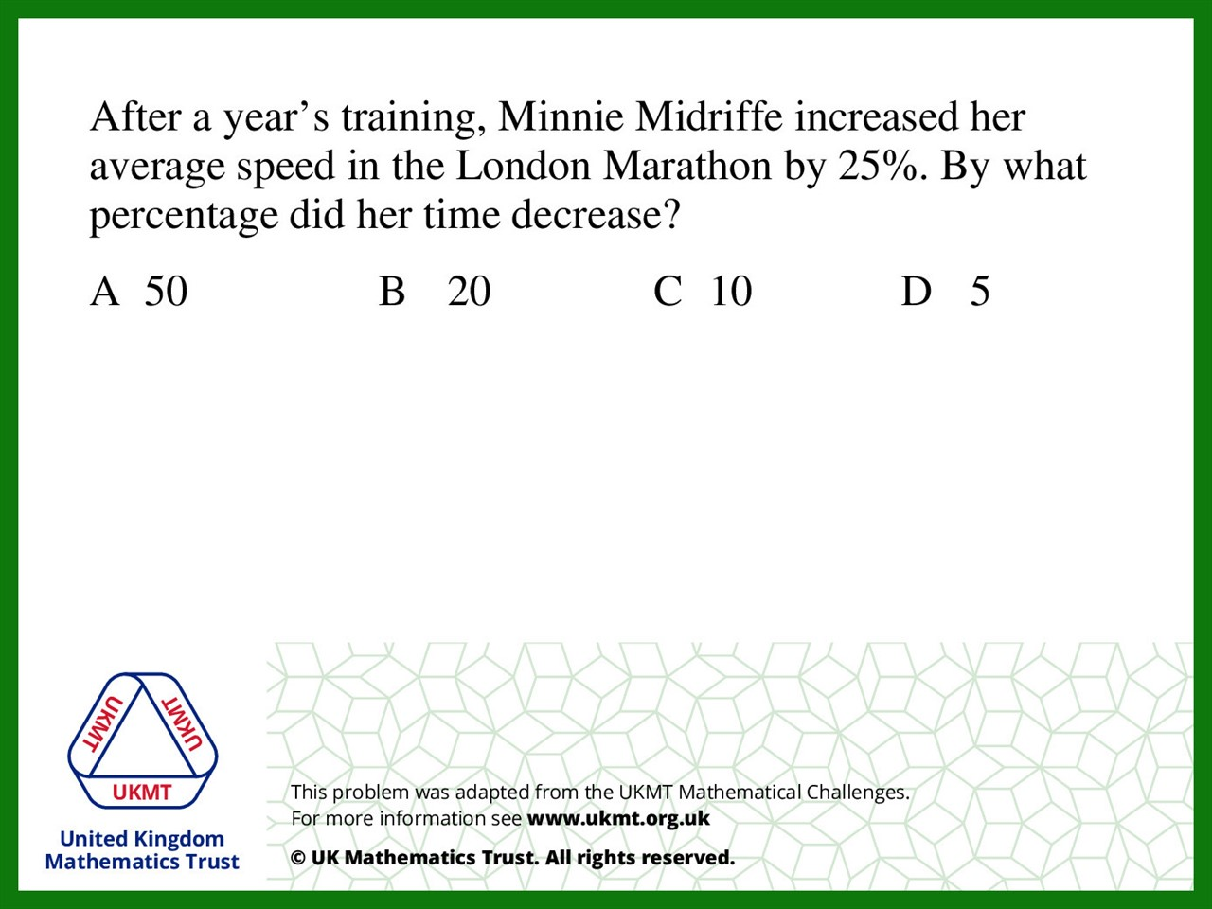
Q2.
If she travelled 100km at 20kmph, (5 hours)
Then increased by 25%
She now would now travel 100km at 25kmph, (4 hours)
decrease by 20%

Slide 4
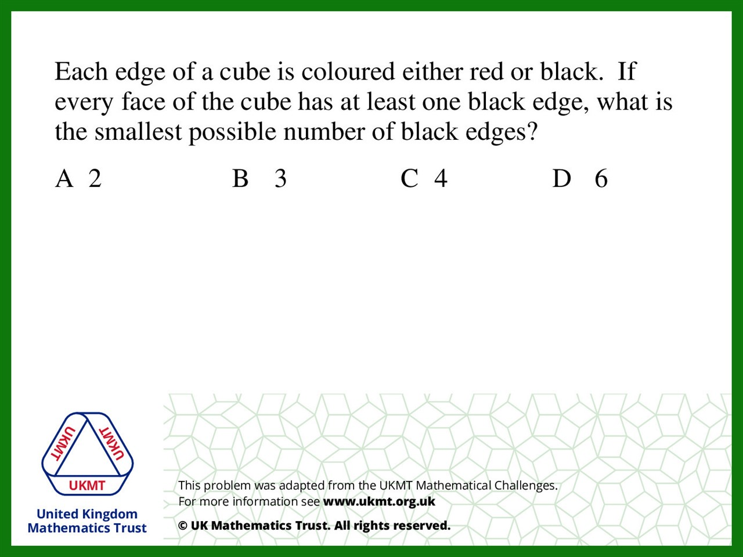
Q3.
Cube has 6 faces and 12 edges. If each face has at least one black edge, the minimum firstly would not be 6, because if an edge is covered, another face's edge will be covered too. There are 3 places to cover the edge (as a minimum) which covers all faces.

Slide 5
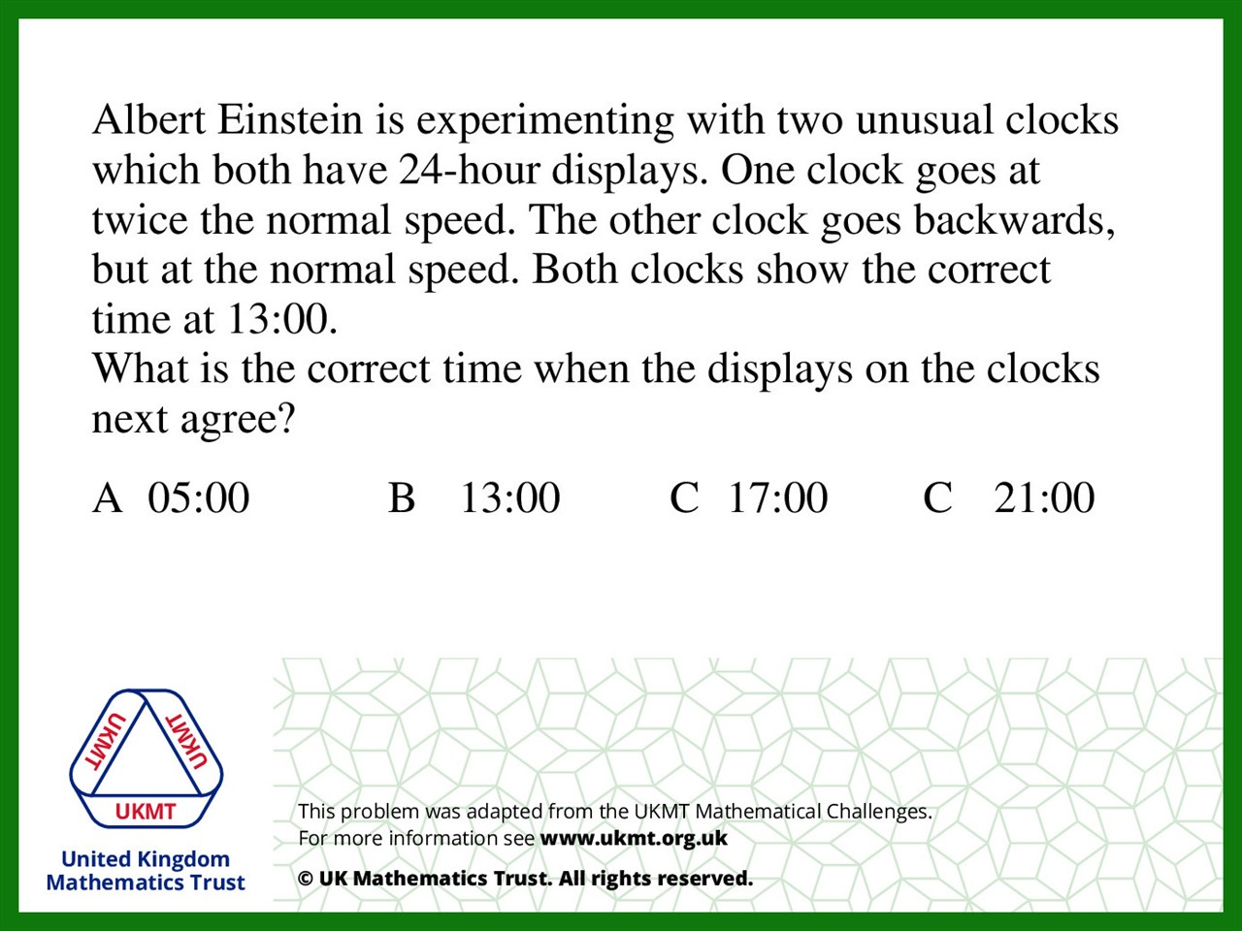
Q4.
Ratio 2:1 so 24 ÷ 3 = 8
13:00 + 8hrs = 21:00

Slide 6
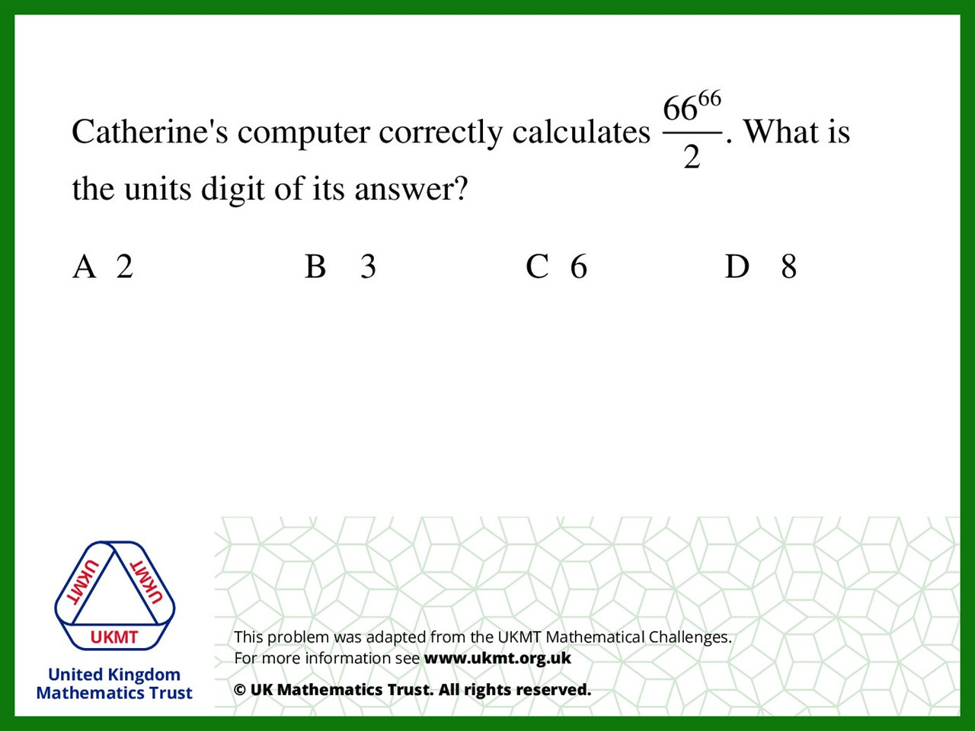
Q5.
The units digit will always be 6 as any number ending in six
multiplied by any number ending in 6 will always have a 6 in the units.
We also know that the number will have an odd tens number
So last two digits will be 16, or 36 or 56……
Divide 16 by 2 will give 8

