Slide 1
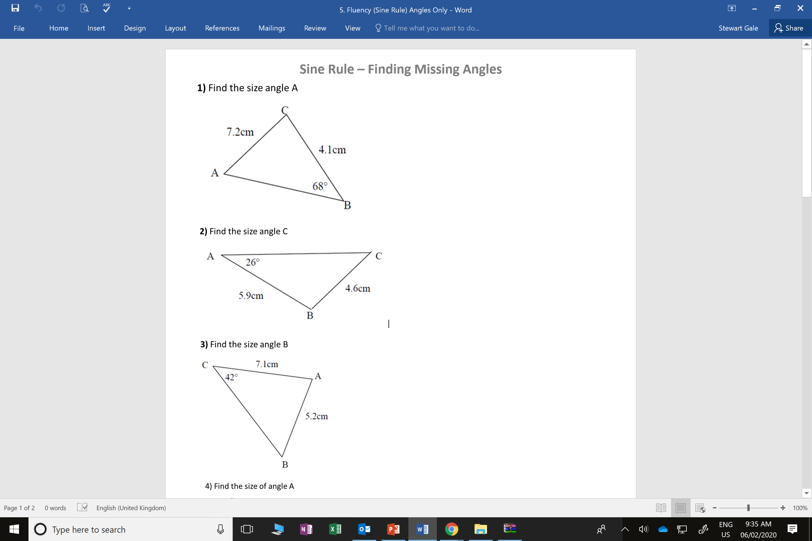
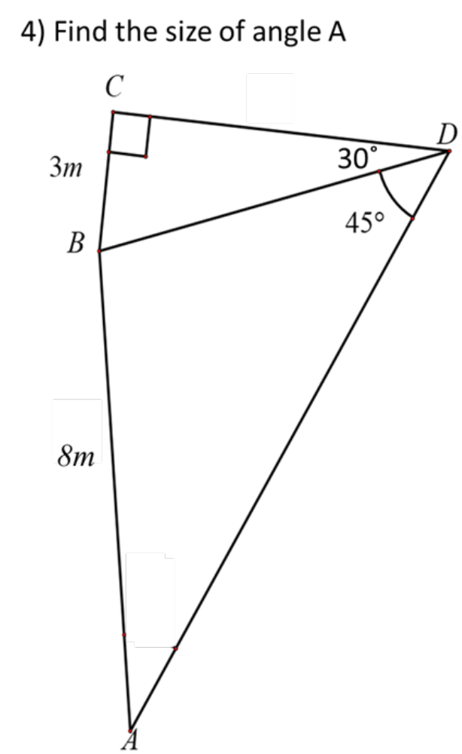

Slide 2
ANSWERS

Slide 3
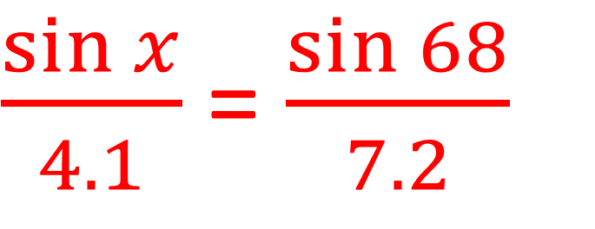
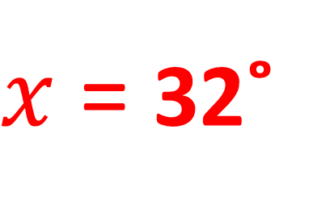
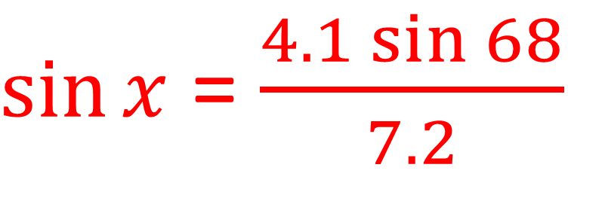
$\frac{\sin{x}}{4.1}$ = $\frac{\sin{68}}{7.2}$
$\sin{x}$ = $\frac{4.1\sin{68}}{7.2}$
$x$ = 32˚

Slide 4
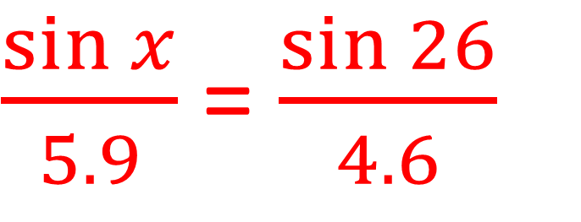
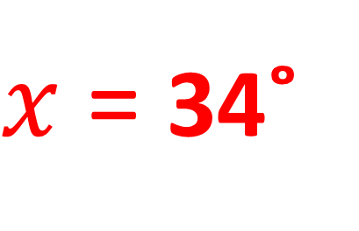
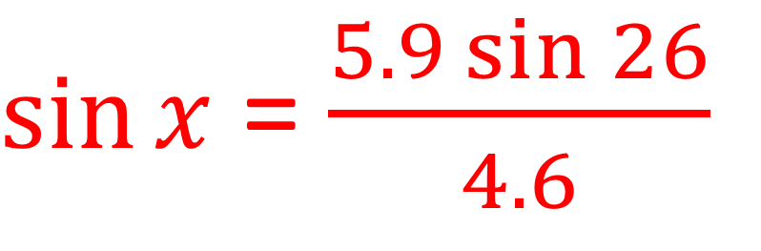
$\frac{\sin{x}}{5.9}$ = $\frac{\sin{26}}{4.6}$
$\sin{x}$ = $\frac{5.9\sin{26}}{4.6}$
$x$ = 34˚

Slide 5
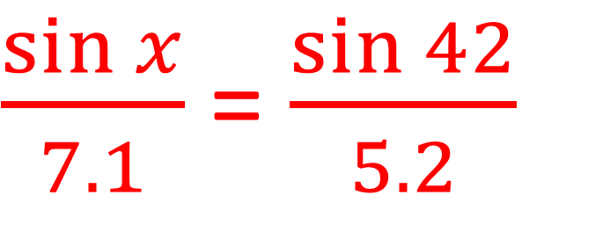
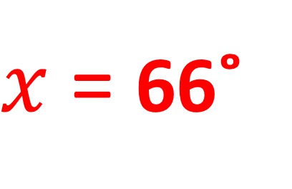
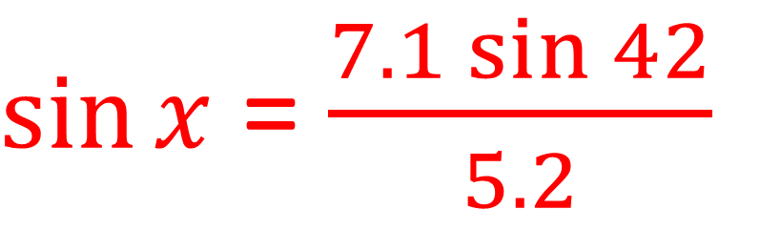
$\frac{\sin{x}}{7.1}$ = $\frac{\sin{42}}{5.2}$
$\sin{x}$ = $\frac{7.1\sin{42}}{5.2}$
$x$ = 66˚

Slide 6
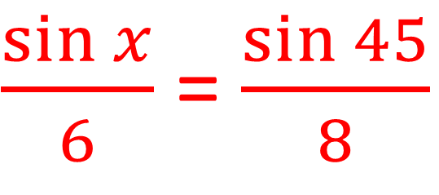
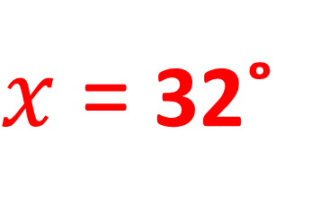
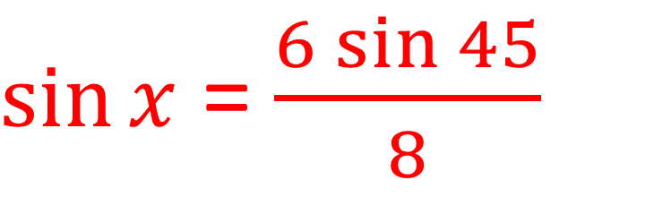
BD = 3 ÷ sin 30 = 6
$\frac{\sin{x}}{6}$ = $\frac{\sin{45}}{8}$
$\sin{x}$ = $\frac{6\sin{45}}{8}$
$x$ = 32˚

