Slide 1

Diagnostic Assessment .Delta 2
Unit 10
Plotting Linear Graphs
Gradient
y = mx + c
Parallel and Perpendicular Lines
Inverse Functions

Slide 2
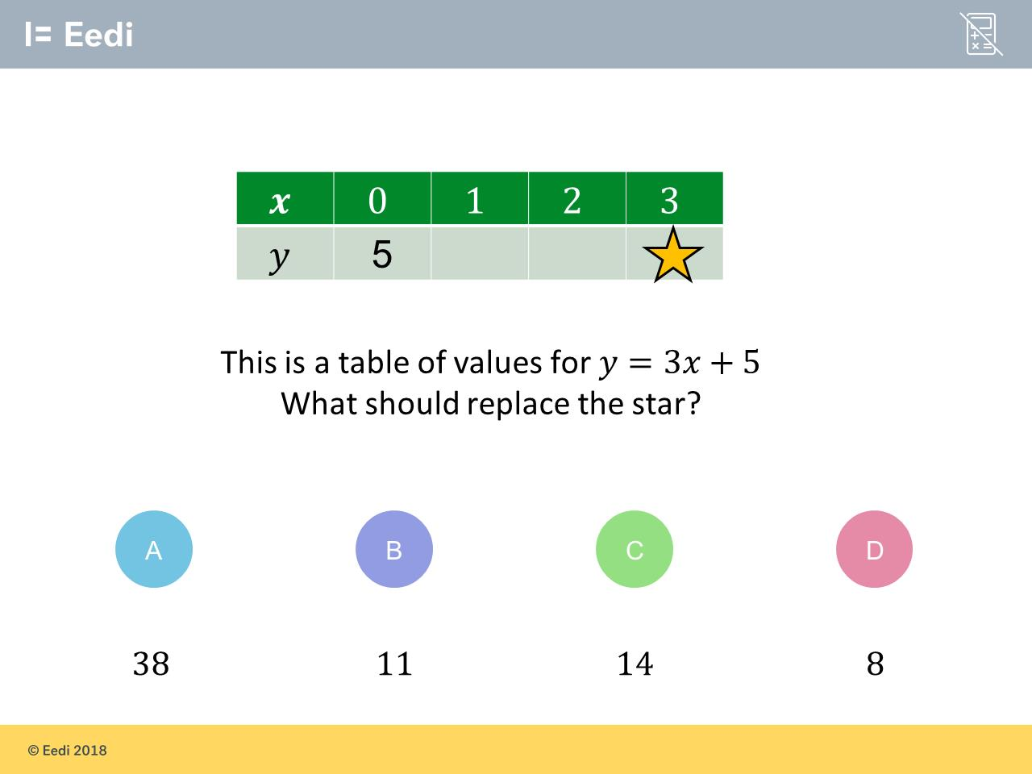
Question 1 – Plotting Linear Graphs

Slide 3
Answer 1 – Plotting Linear Graphs
CORRECT ANSWER | CORRECT EXPLANATION
14 | 3 ✕ 3 + 5 = 14 when substituting in 𝑥 = 3
COMMON MISTAKES | WHAT MIGHT BE YOUR MISTAKE
38 | The student thinks that you just need to insert the 𝑥 in 3𝑥 rather than multiplying
11 | The student thinks that 3𝑥 means 3 + 𝑥
8 | The student may have ignored the 𝑥 and just done 3 + 5

Slide 4
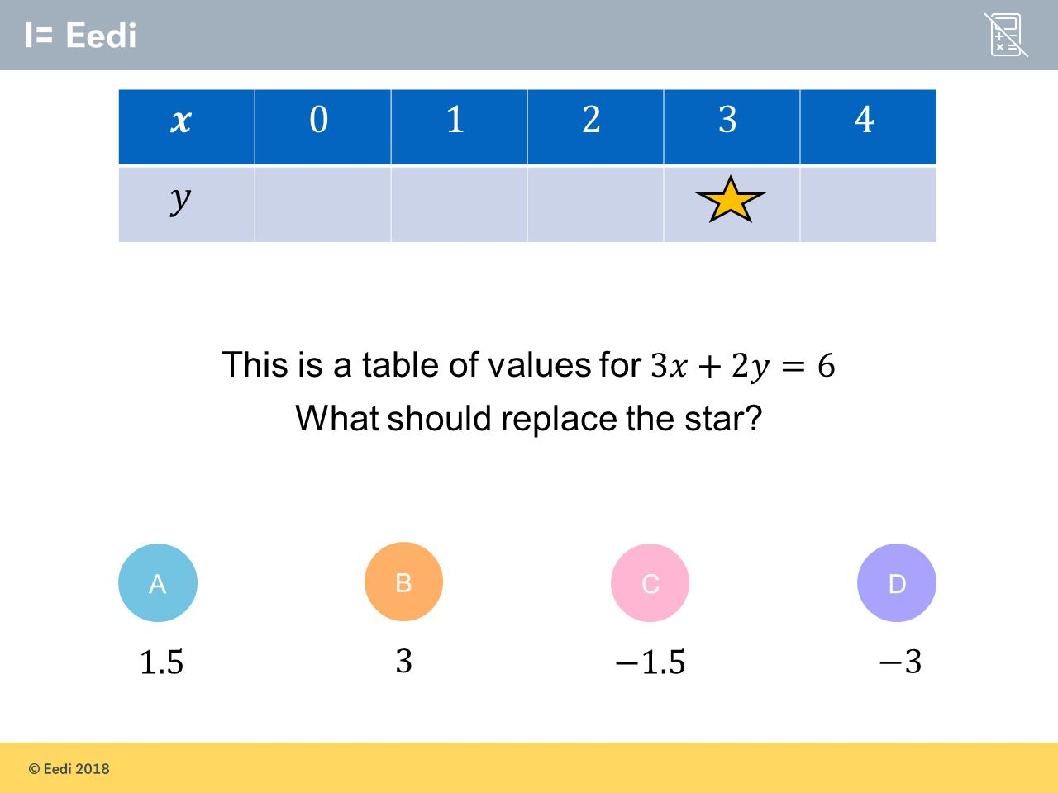
Question 2 – Plotting Linear Graphs

Slide 5
Answer 2 – Plotting Linear Graphs
CORRECT ANSWER | CORRECT EXPLANATION
-1.5 | If you substitute x = 3 into the equation you get 3(3) + 2y = 6. This gives you 9 + 2y = 6. Which gives you 2y = -3. Which gives y = -1.5
COMMON MISTAKES | WHAT MIGHT BE YOUR MISTAKE
1.5 | The student as not accounted for the fact the value of 2y needs to be negative
3 | The student has not accounted for the fact the value of 2y needs to be negative and interpreted it as just y
-3 | The student may have found the answer for 2y and forgotten to divide by 2

Slide 6
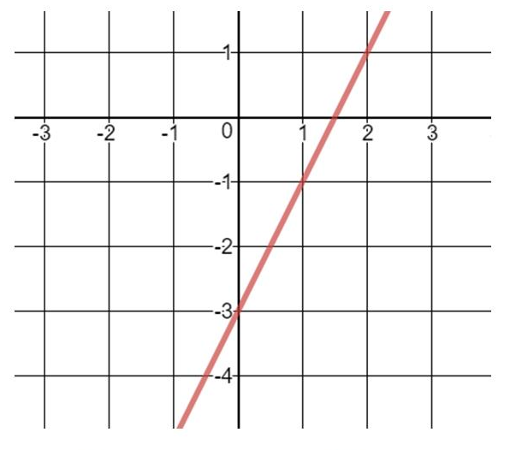
Question 3 – Gradient
What is the gradient of the line?

Slide 7
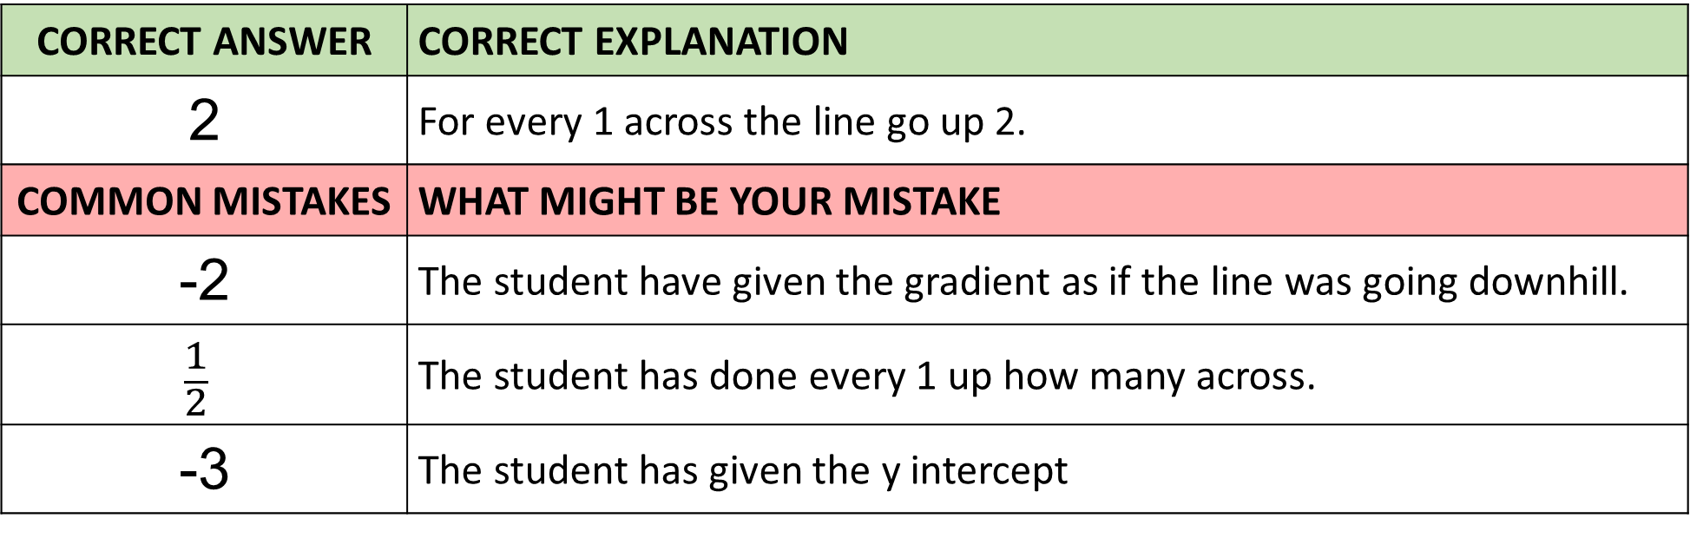
Answer 3 – Gradient
What is the gradient of the line?
CORRECT ANSWER | CORRECT EXPLANATION
2 | For every 1 across the line go up 2.
COMMON MISTAKES | WHAT MIGHT BE YOUR MISTAKE
-2 | The student have given the gradient as if the line was going downhill.
$$\frac{1}{2}$$ | The student has done every 1 up how many across.
-3 | The student has given the y intercept

Slide 8
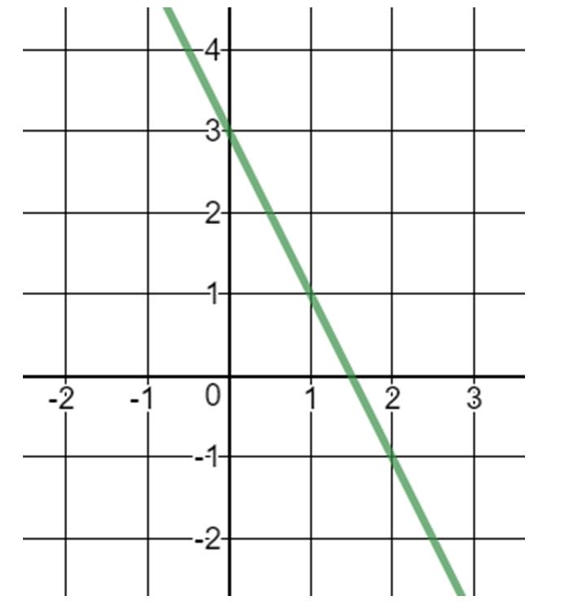
Question 4 – Gradient
What is the gradient of the line?

Slide 9
Answer 4 – Gradient
What is the gradient of the line?
CORRECT ANSWER | CORRECT EXPLANATION
-2 | For each unit across you move, you move down 2.
COMMON MISTAKES | WHAT MIGHT BE YOUR MISTAKE
1.5 | The student has written the 𝑥 intercept
2 | The student has ignored the negative sign on the gradient. It is going downhill so needs to be a negative gradient.
3 | The student has written the 𝑦 intercept rather than m (the gradient)

Slide 10
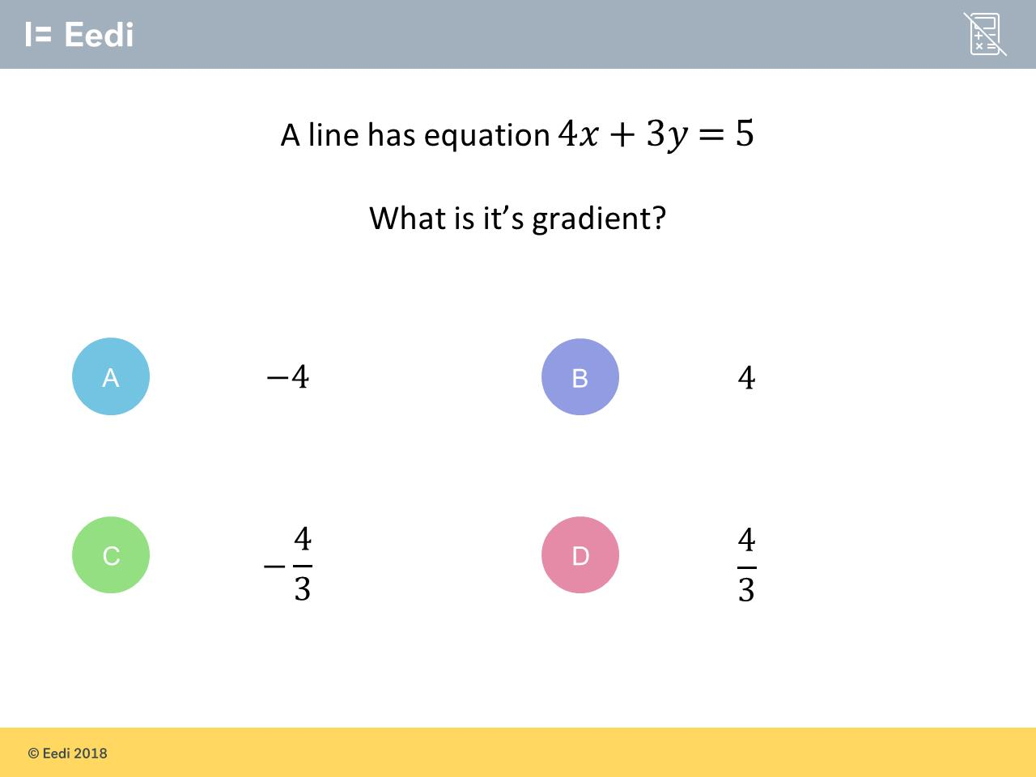
Question 5 – Gradient

Slide 11
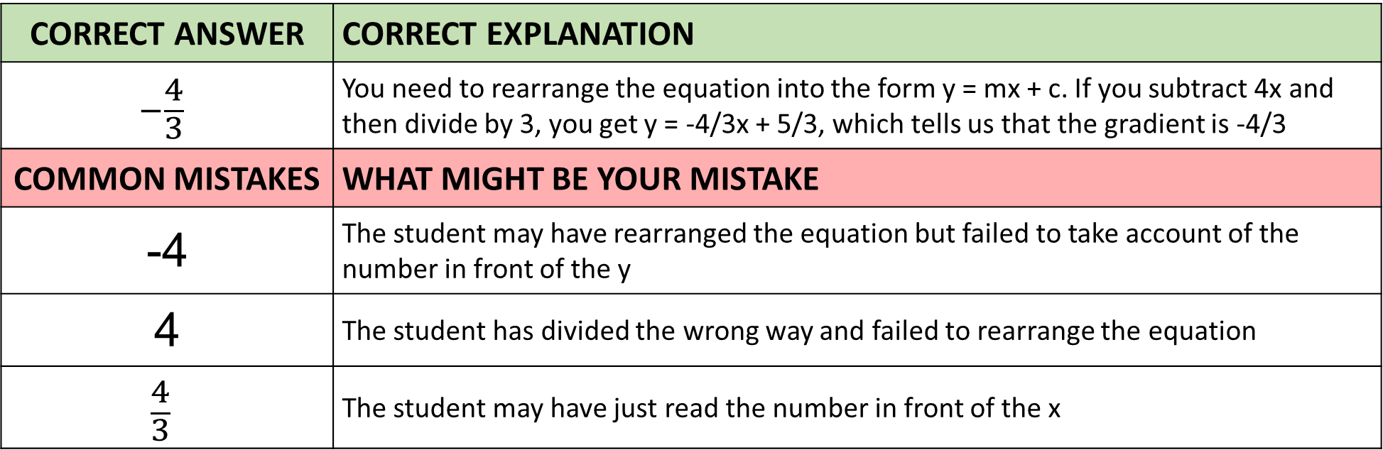
Answer 5 – Gradient
CORRECT ANSWER | CORRECT EXPLANATION
$$−\frac{4}{3}$$ | You need to rearrange the equation into the form y = mx + c. If you subtract 4x and then divide by 3, you get y = -4/3x + 5/3, which tells us that the gradient is -4/3
COMMON MISTAKES | WHAT MIGHT BE YOUR MISTAKE
-4 | The student may have rearranged the equation but failed to take account of the number in front of the y
4 | The student has divided the wrong way and failed to rearrange the equation
$$\frac{4}{3}$$ | The student may have just read the number in front of the x

Slide 12
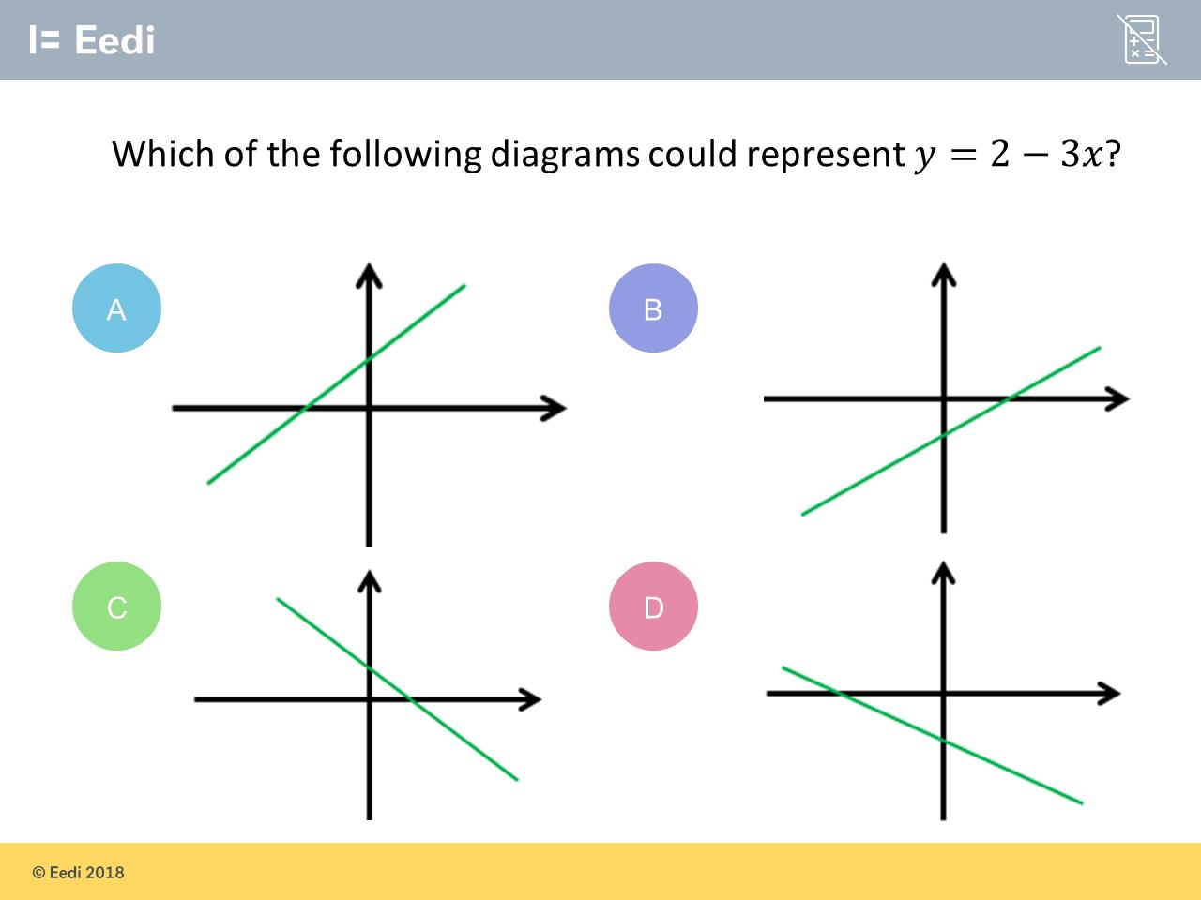
Question 6 – y = mx + c

Slide 13
Answer 6 – y = mx + c
CORRECT ANSWER | CORRECT EXPLANATION
C | There is a positive c and a negative gradient, giving a downhill graph crossing the 𝑦 axis above the 𝑥 axis
COMMON MISTAKES | WHAT MIGHT BE YOUR MISTAKE
A | The student may have ignored the negative gradient
B | The student may have the gradient and 𝑦 intercept the wrong way around
D | The student may have made the 𝑦 intercept negative

Slide 14
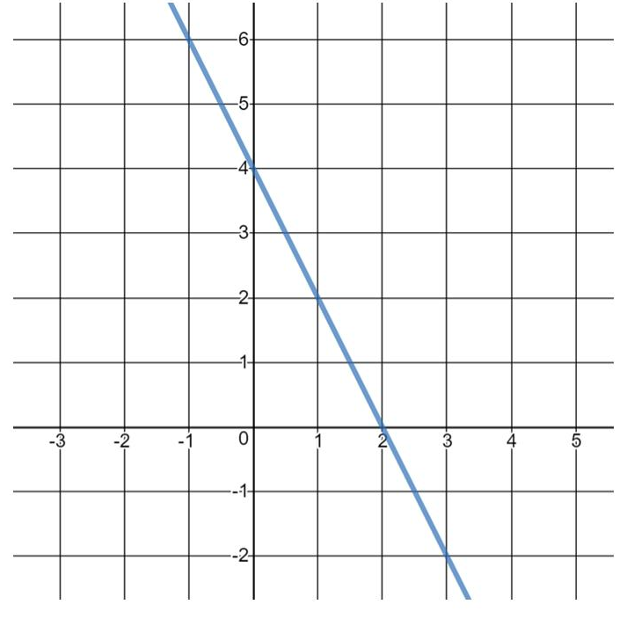
Question 7 – y = mx + c
What is the equation of the line?

Slide 15
Answer 7 – y = mx + c
What is the equation of the line?
CORRECT ANSWER | CORRECT EXPLANATION
y = -2x + 4 | The line has y-intercept 4 and gradient (4 - 0)(0 - 2) = -2, so the equation of the line is y = -2x + 4.
COMMON MISTAKES | WHAT MIGHT BE YOUR MISTAKE
y = -x + 4 | The student has miscalculated the gradient.
y = 2x + 4 | The student has given the wrong sign on the gradient.
y = -4x + 2 | The student has mixed up the gradient and y-intercept.

Slide 16
Question 8 – y = mx + c
What is the co-ordinate where the following graph will cross the y axis?
y = 5 – 3x

Slide 17
Answer 8 – y = mx + c
What is the co-ordinate where the following graph will cross the y axis?
y = 5 – 3x
CORRECT ANSWER | CORRECT EXPLANATION
(0,5) | The y-intercept is where x = 0, so we would have y = 5 - 3(0) = 5.
COMMON MISTAKES | WHAT MIGHT BE YOUR MISTAKE
(0,-3) | The student has confused the gradient and the y-intercept.
(-3,0) | The student has confused the gradient and the y-intercept.
(5,0) | The student has written the coordinates the wrong way around.

Slide 18
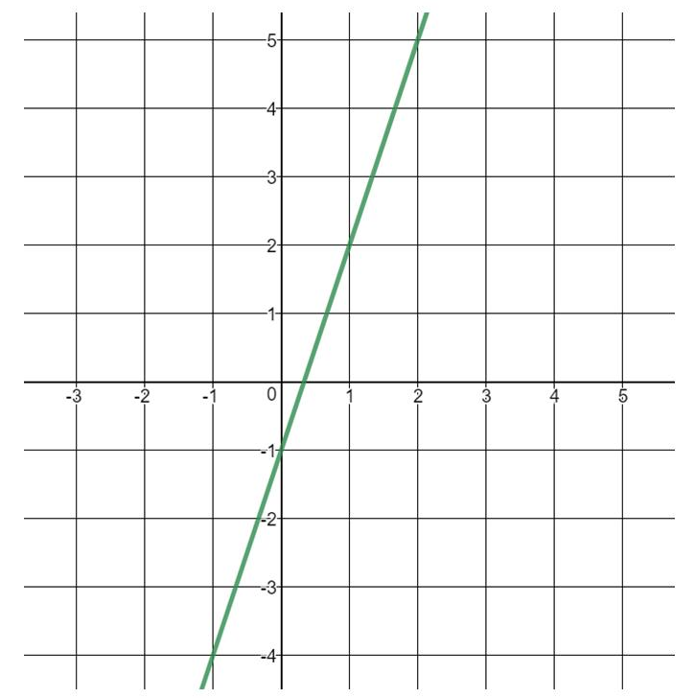
Question 9 – y = mx + c
What is the equation of the line?

Slide 19
Answer 9 – y = mx + c
What is the equation of the line?
CORRECT ANSWER | CORRECT EXPLANATION
y = 3x – 1 | The gradient is 3/1 = 3, and the y intercept is -1, so the equation is y = 3x - 1.
COMMON MISTAKES | WHAT MIGHT BE YOUR MISTAKE
y = 3 – x | The student may have mixed up the gradient and intercept in the equation.
y = 2x – 1 | The student has calculated the gradient incorrectly.
y = x | The student may only recognise y = x as an equation.

Slide 20
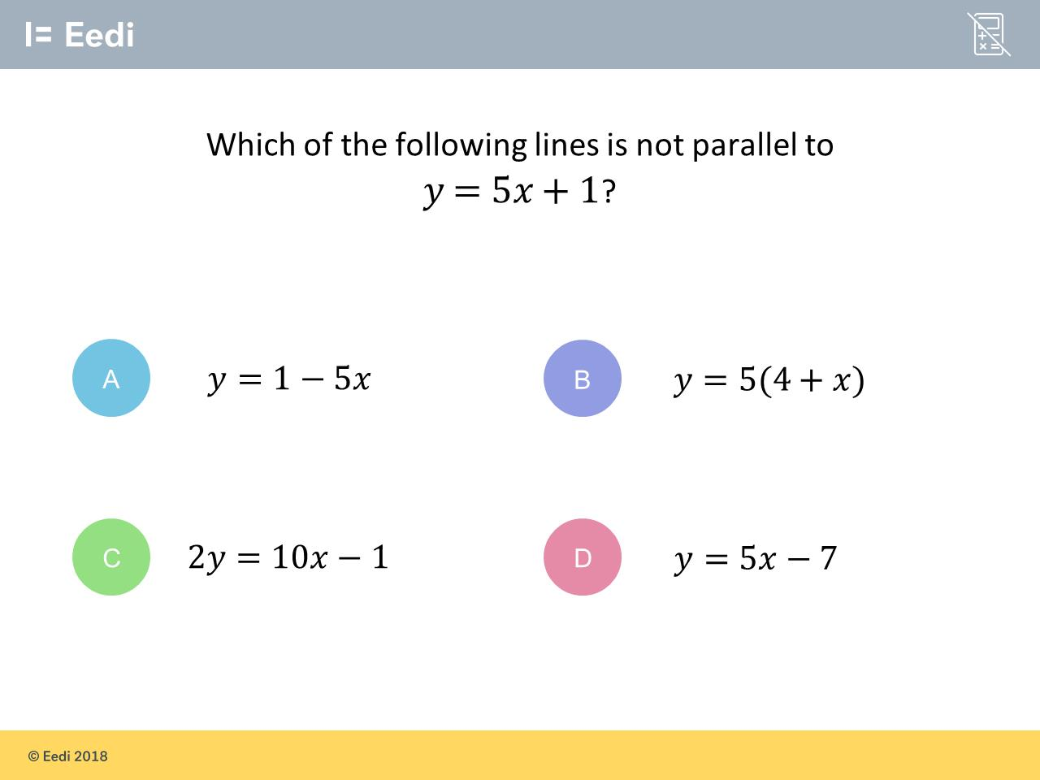
Question 10 – Parallel and Perpendicular Lines

Slide 21
Answer 10 – Parallel and Perpendicular Lines
CORRECT ANSWER | CORRECT EXPLANATION
A | The equation in the question has a gradient of 5, so for a line to be parallel we also need a gradient of 5. The line y = 1 - 5x has a gradient of -5, and so is not parallel
COMMON MISTAKES | WHAT MIGHT BE YOUR MISTAKE
B | The student may have not expanded the bracket, or is confused about the x term not coming first
C | The student may have ignored the fact that the line is not in the form y = mx + c
D | The student may be confusing gradient and y intercept

Slide 22
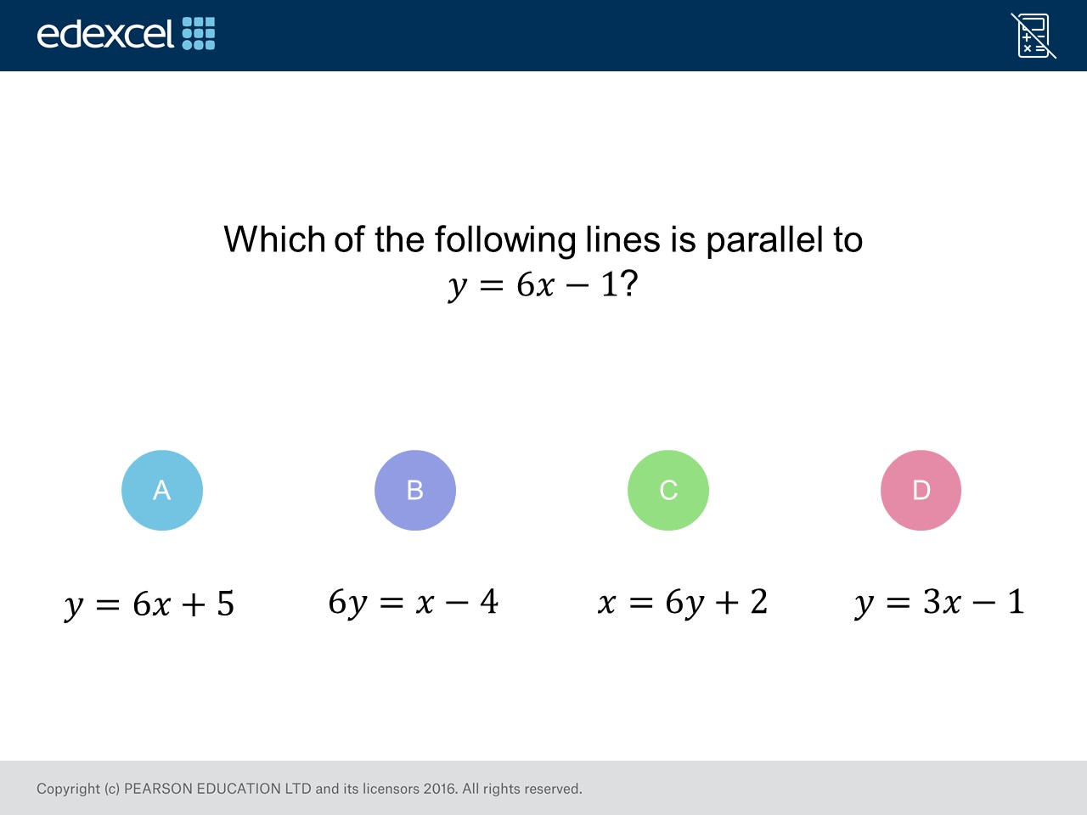
Question 11 – Parallel and Perpendicular Lines

Slide 23
Answer 11 – Parallel and Perpendicular Lines
CORRECT ANSWER | CORRECT EXPLANATION
A | The equation has the same coefficient of 𝑥 when in the form 𝑦=m𝑥+ c
COMMON MISTAKES | WHAT MIGHT BE YOUR MISTAKE
B | The student has put the 6 before the 𝑦 rather than the 𝑥 thinking this means they are parallel
C | The student may have found a line which is perpendicular
D | The student has found a line with the same c rather than same gradient

Slide 24
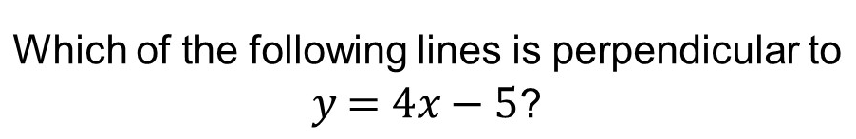
Question 12 – Parallel and Perpendicular Lines

Slide 25
Answer 12 – Parallel and Perpendicular Lines
CORRECT ANSWER | CORRECT EXPLANATION
C | Perpendicular lines have gradients that are the negative reciprocals of each other. A line perpendicular to 𝑦 = 4𝑥 - 5 needs to have a gradient of -1/4 = -¼. Line A may be rearranged to give 𝑦 = ¼𝑥 - ¾, it has a gradient of ¼. Line B has a gradient of 4. Line C may be rearranged to give 𝑦 = -¼𝑥 + 7, it had a gradient of -¼. Line D has a gradient of ¼.
COMMON MISTAKES | WHAT MIGHT BE YOUR MISTAKE
A | The student may have swapped the 𝑥 and 𝑦 around
B | The student may be confusing parallel and perpendicular. This line would be parallel to 𝑦 = 4𝑥 - 5 rather than perpendicular
D | The student may not have released the perpendicular line needs a gradient of -¼ rather than ¼

Slide 26
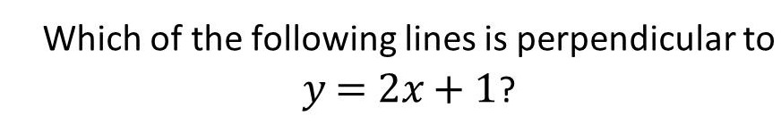
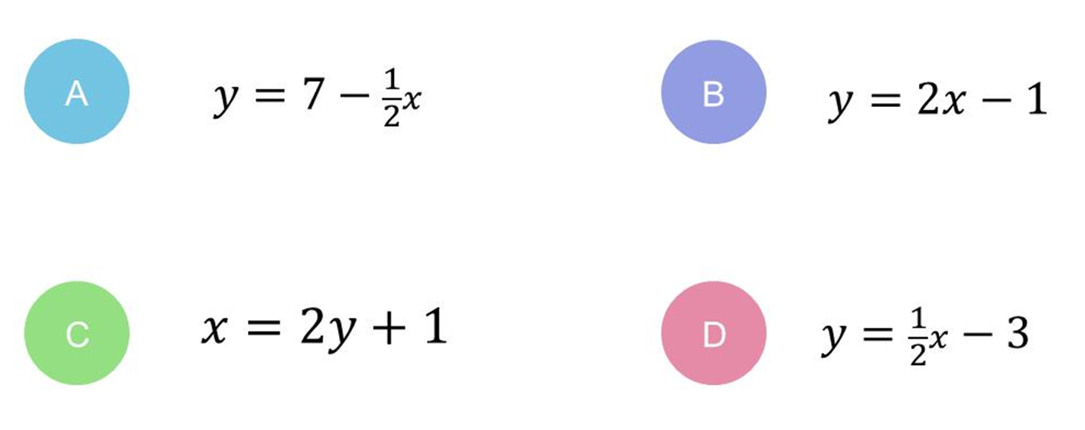
Question 13 – Parallel and Perpendicular Lines

Slide 27
Answer 13 – Parallel and Perpendicular Lines
CORRECT ANSWER | CORRECT EXPLANATION
A | The equation in the question has a gradient of 2, so for a line to be perpendicular we are looking for a gradient of -1/2. That is exactly what the gradient of y = 7 - 1/2x has.
COMMON MISTAKES | WHAT MIGHT BE YOUR MISTAKE
B | The student may be confusing parallel and perpendicular
C | The student has swapped the x and y around
D | The student has worked out the reciprocal of the gradient, but has not changed the sign

Slide 28
Question 14 – Inverse Functions
What is the function of
f(x) = 3x + 2

Slide 29
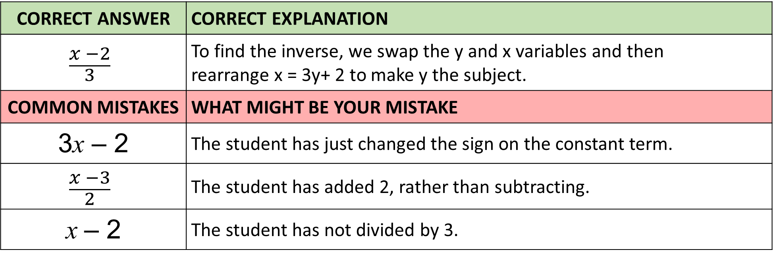
Answer 14 – Inverse Functions
What is the function of
f(x) = 3x + 2
CORRECT ANSWER | CORRECT EXPLANATION
$$\frac{x −2}{3}$$ | To find the inverse, we swap the y and x variables and then rearrange x = 3y+ 2 to make y the subject.
COMMON MISTAKES | WHAT MIGHT BE YOUR MISTAKE
3x – 2 | The student has just changed the sign on the constant term.
$$\frac{x −3}{2}$$ | The student has added 2, rather than subtracting.
x – 2 | The student has not divided by 3.

Slide 30
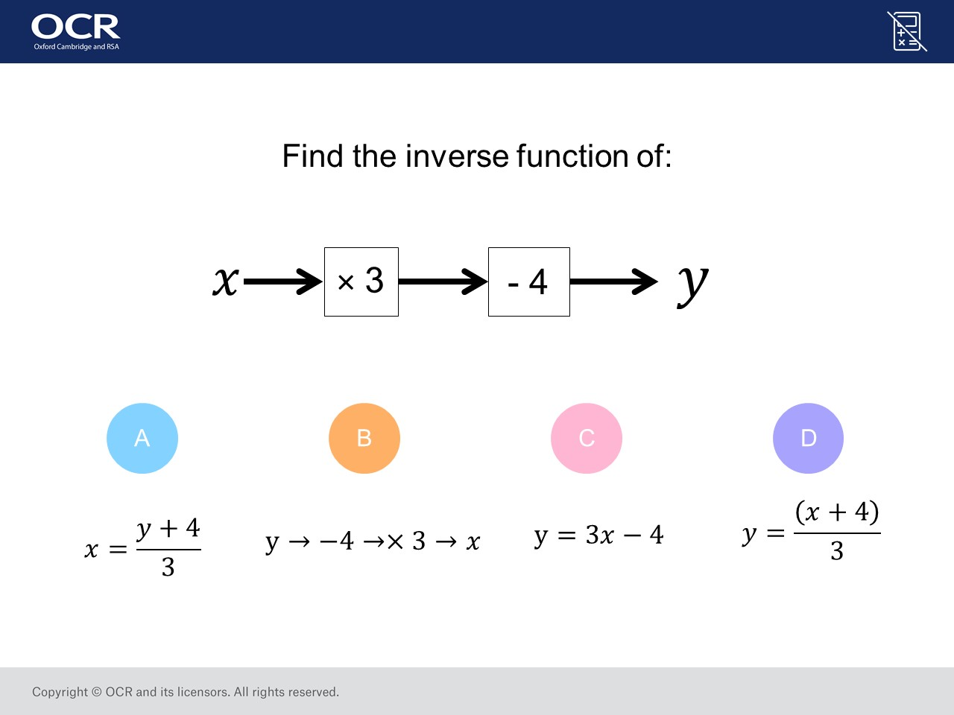
Question 15 – Inverse Functions

Slide 31
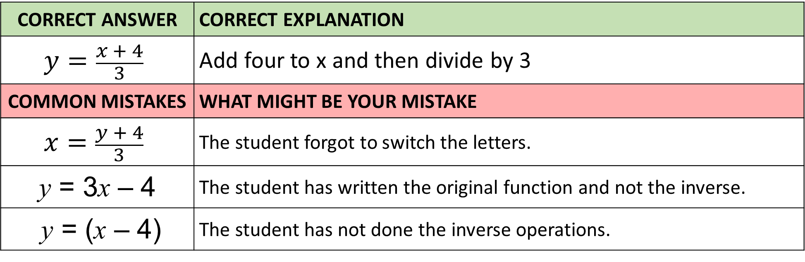
Answer 15 – Inverse Functions
CORRECT ANSWER | CORRECT EXPLANATION
$$y=\frac{x + 4}{3}$$ | Add four to x and then divide by 3
COMMON MISTAKES | WHAT MIGHT BE YOUR MISTAKE
$$x=\frac{y + 4}{3}$$ | The student forgot to switch the letters.
y = 3x – 4 | The student has written the original function and not the inverse.
y = (x – 4) | The student has not done the inverse operations.

