Slide 1
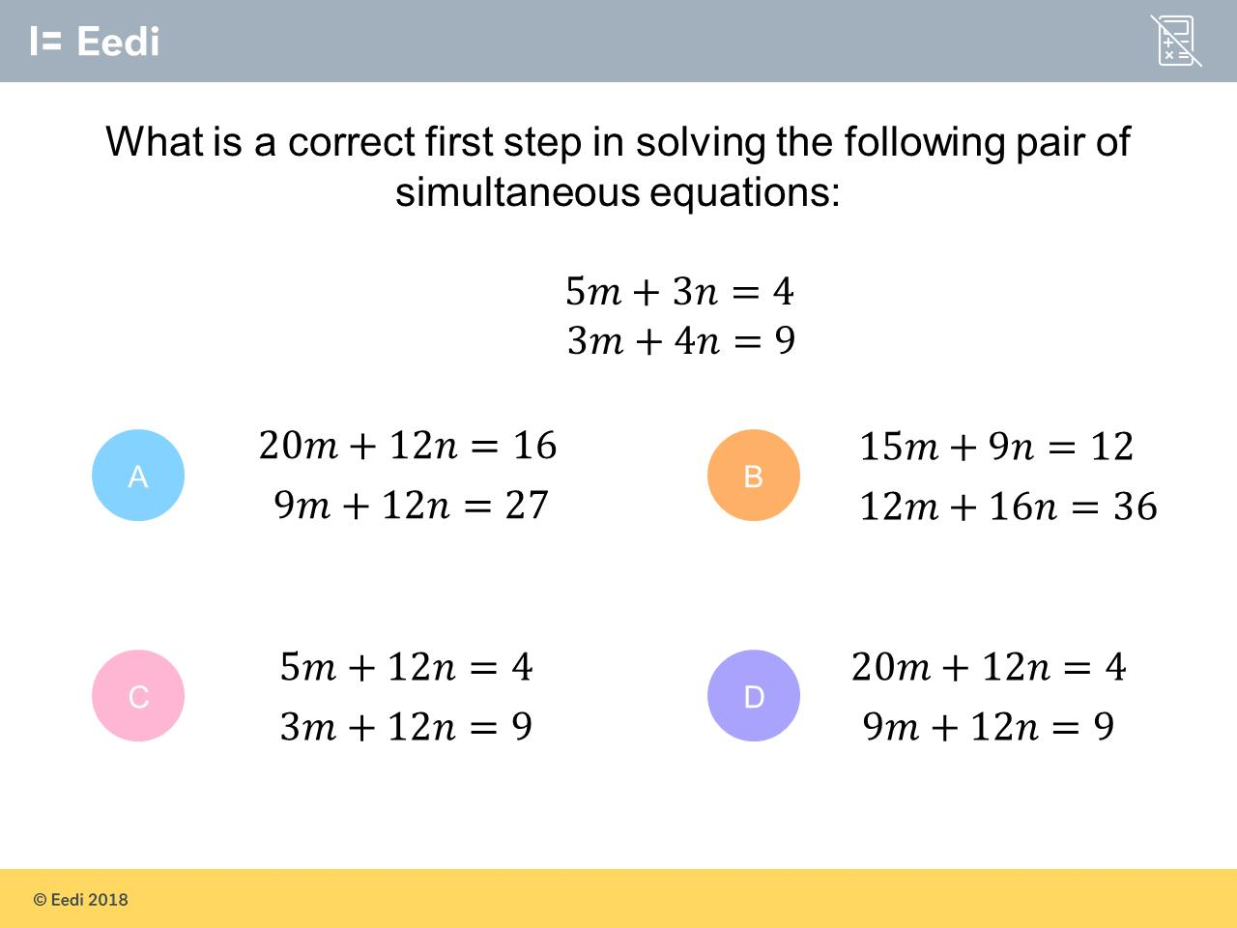
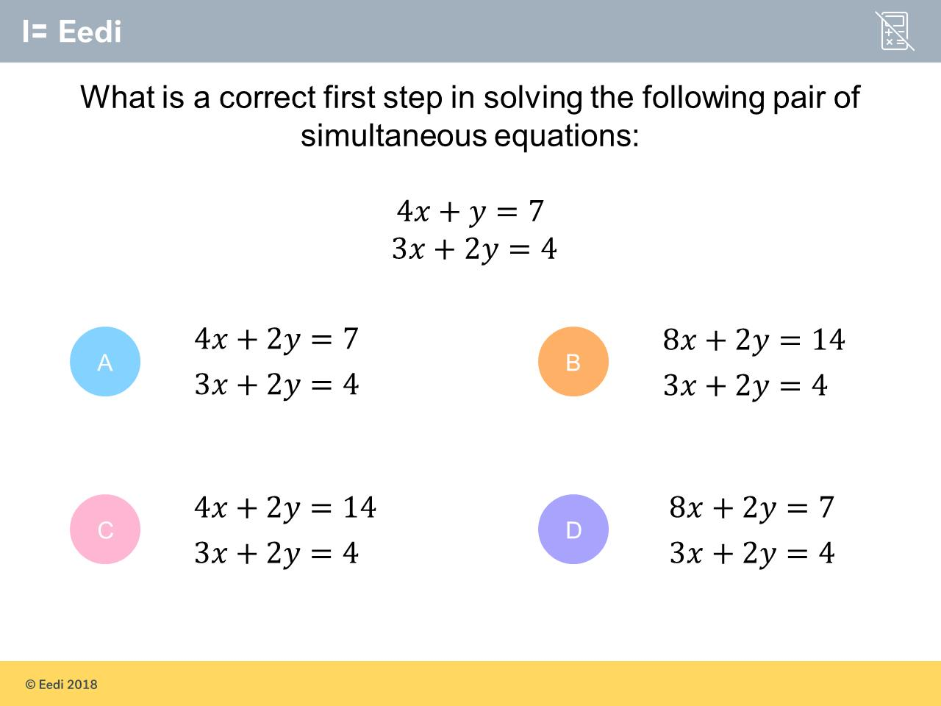
Worst answered question?
Most common wrong answer?

Slide 2
ANSWERS

Slide 3
Worst answered question?

Slide 4

B
There are no values the same and therefore neither variable can be eliminated.

Slide 5

A
They did not multiply
the 4x and 7
by 2.

