Slide 1
Functions and Graphs
Modulus
Pure 2 Chapter 2
(Part 1 of 6)

Slide 2
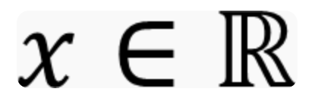

Slide 3
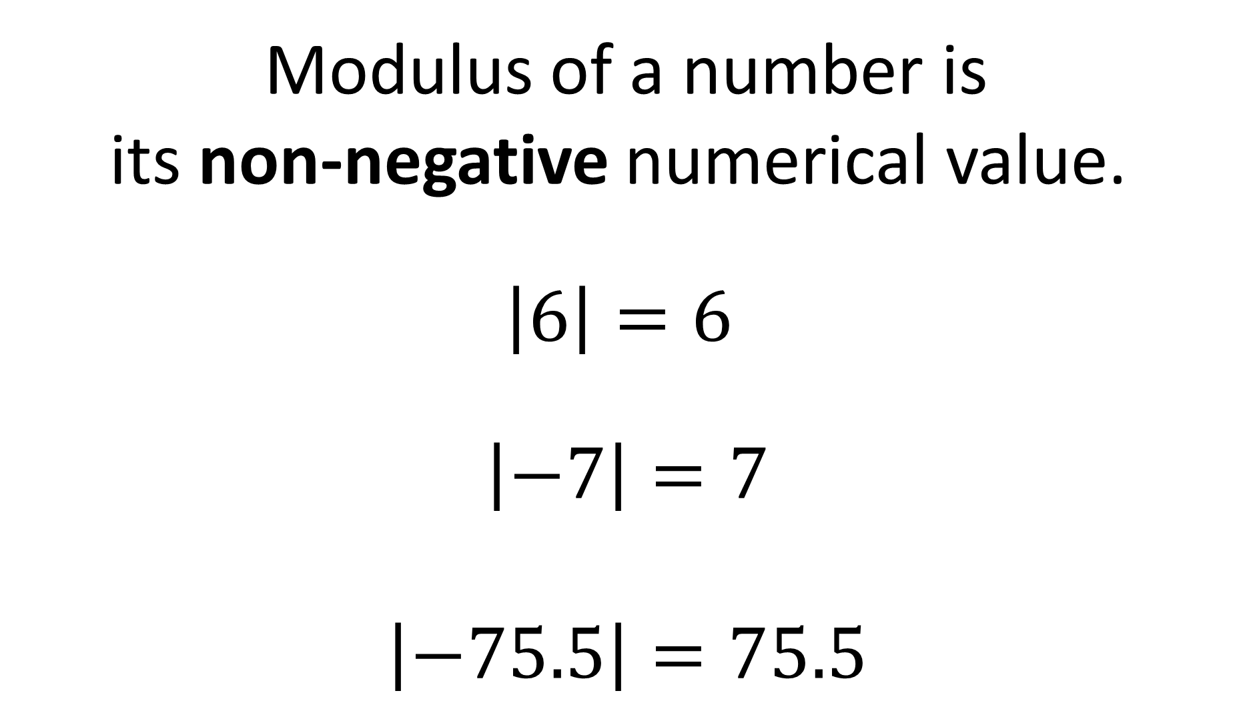
Modulus of a number is
its non-negative numerical value.
$\left|6\right|=6$
$\left|−7\right|=7$
$\left|−75.5\right|=75.5$

Slide 4
The modulus function is particularly useful in expressing a difference.
The modulus of a value gives us the ‘magnitude’
i.e. size such as distances and speeds.

Slide 5
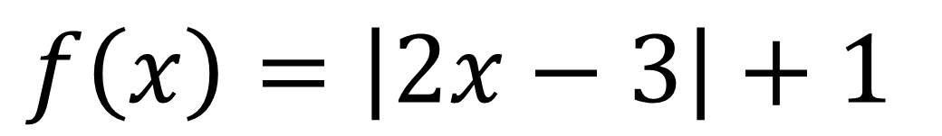
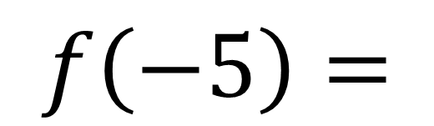
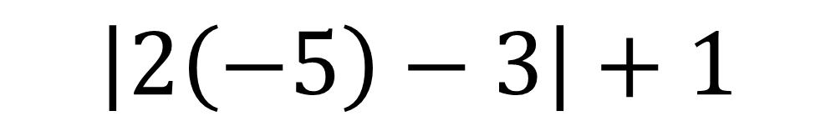
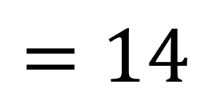
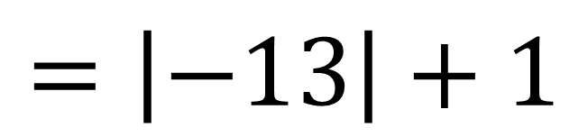
Functions can contain a modulus.
$$f\left(x\right)=\left|2x−3\right|+1$$
$$f\left(−5\right)=$$
$$\left|2\left(−5\right)−3\right|+1$$
$$=\left|−13\right|+1$$
$$=14$$

Slide 6
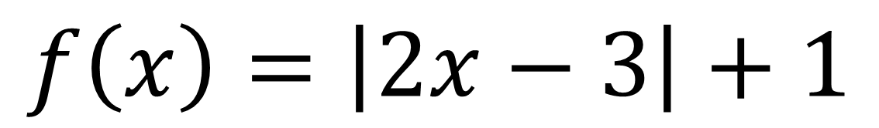
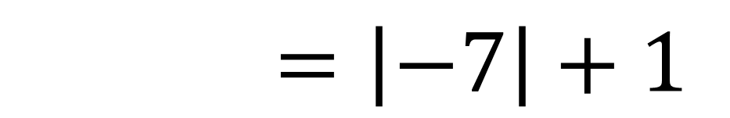
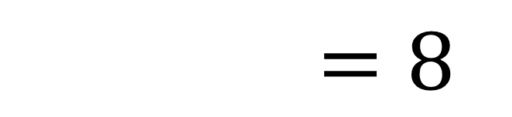
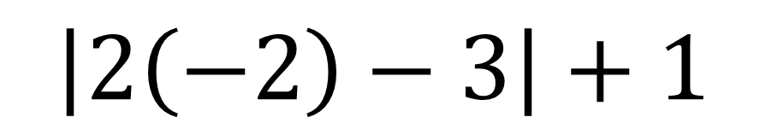
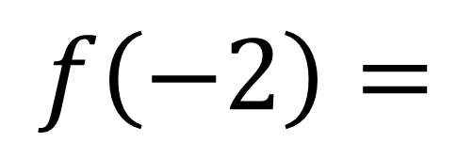
$$f\left(x\right)=\left|2x−3\right|+1$$
$$f\left(−2\right)=$$
$$\left|2\left(−2\right)−3\right|+1$$
$$f\left(−2\right)=\left|−7\right|+1$$
$$f\left(−2\right)=8$$

Slide 7
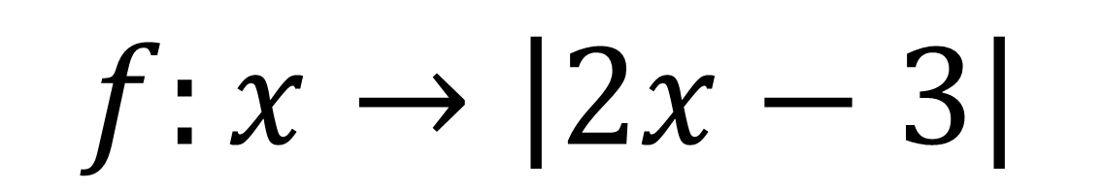
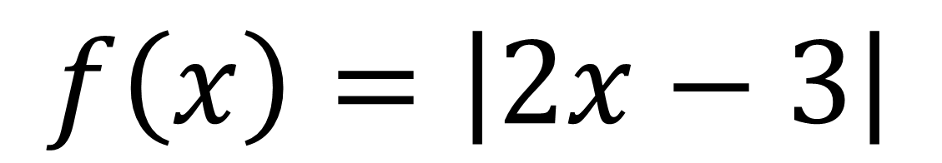
Possible Notation
$$f\left(x\right)=\left|2x−3\right|$$
$$f:x→\left|2x−3\right|$$

Slide 8


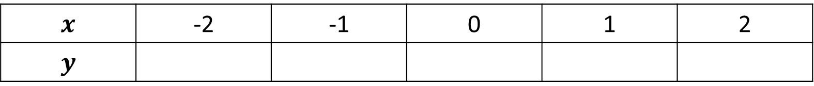

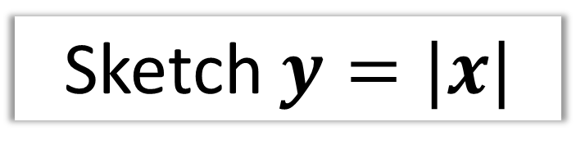

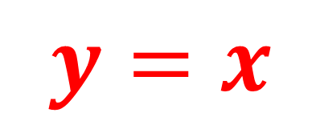


Modulus Graphs
Sketch $y=|x|$
$$x$$ | -2 | -1 | 0 | 1 | 2
$$y$$
2 | 1 | 0 | 1 | 2
$$(−2,2)$$
$$(2,2)$$
$$y=x$$
$$(−1,1)$$
$$(1,1)$$
$$(0,0)$$
Reflect up any section below the $x$-axis.

Slide 9

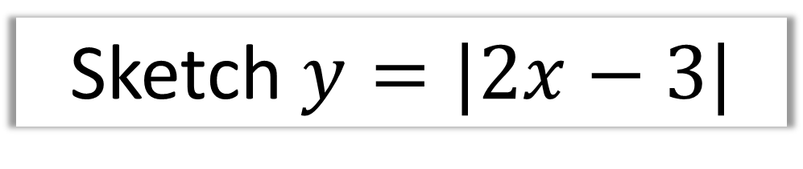
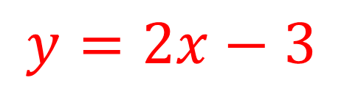
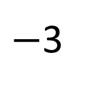
Sketch $y=|2x−3|$
y
$$y=2x−3$$
3
x
$$\frac{3}{2}$$
$−$3

Slide 10

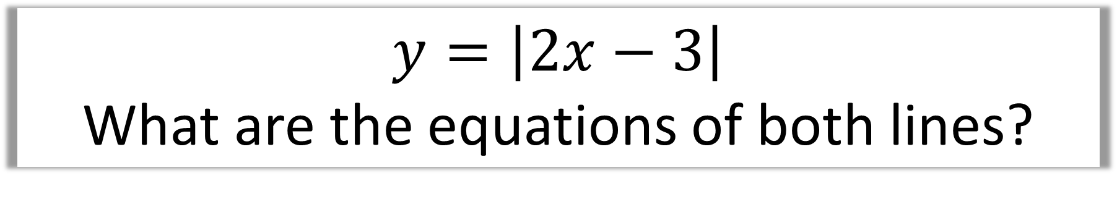
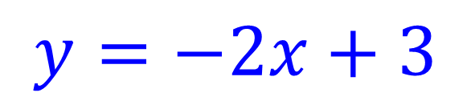
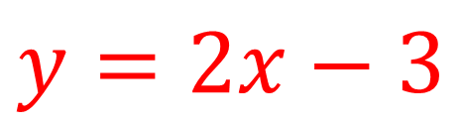
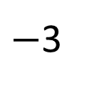
$$y=\left|2x−3\right|$$
What are the equations of both lines?
y
$$y=−2x+3$$
$$y=2x−3$$
3
x
$$\frac{3}{2}$$
$−$3

Slide 11

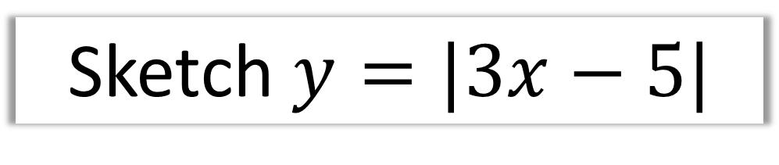
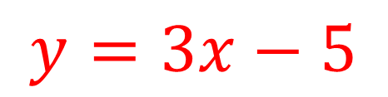

Sketch $y=|3x−5|$
y
$$y=3x−5$$
5
x
$$\frac{5}{3}$$
$$−5$$

Slide 12


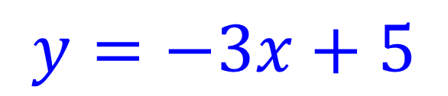
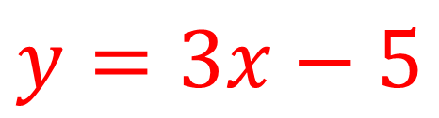

$$y=\left|3x−5\right|$$
What are the equations of both lines?
y
$$y=−3x+5$$
$$y=3x−5$$
5
x
$$\frac{5}{3}$$
$$−5$$

Slide 13

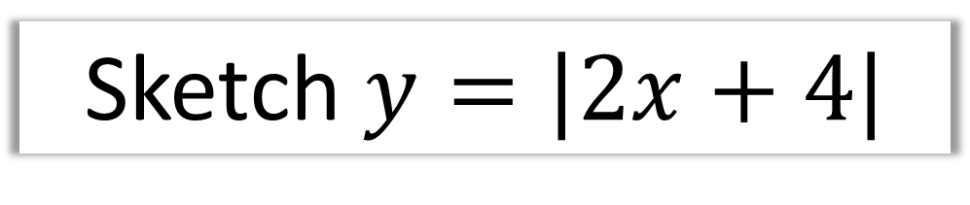
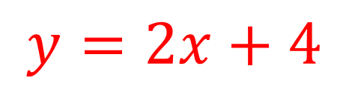


Sketch $y=|2x+4|$
y
$$y=2x+4$$
$$4$$
$$−2$$
x
$$−4$$

Slide 14

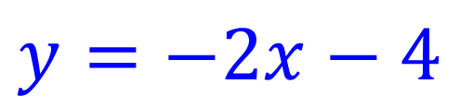

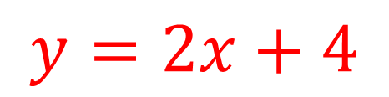

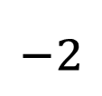
Sketch $y=\left|2x+4\right|$
What are the equations of both lines?
y
$$y=2x+4$$
$$y=−2x−4$$
$$4$$
$$−2$$
x
$$−4$$

Slide 15

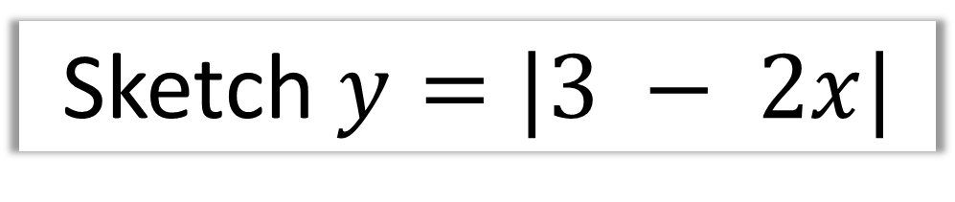
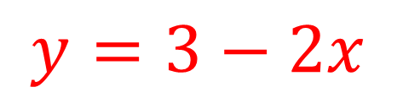

Sketch $y=|3 − 2x|$
y
$$3$$
x
$$\frac{3}{2}$$
$$y=3−2x$$

Slide 16
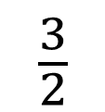
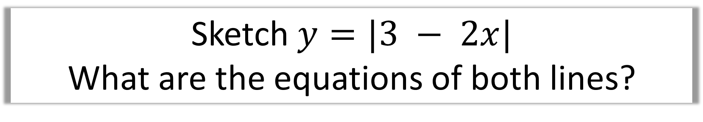
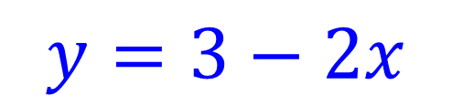
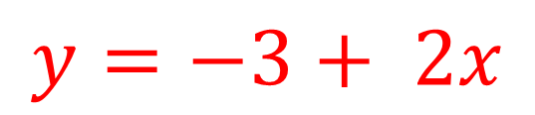

Sketch $y=|3 − 2x|$
What are the equations of both lines?
y
$$y=3−2x$$
$$y=−3+ 2x$$
$$3$$
x
$$\frac{3}{2}$$

Slide 17
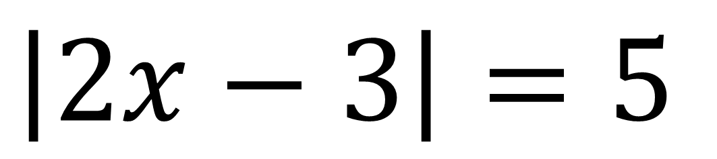
Solving Equations with Modulus
When solving equations involving a modulus it will help to sketch a graph.
$$\left|2x−3\right|=5$$

Slide 18
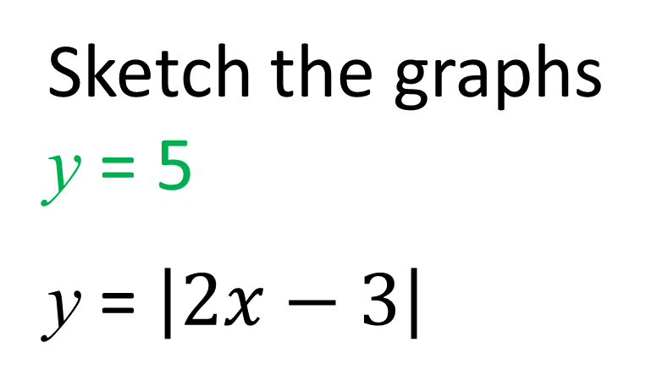
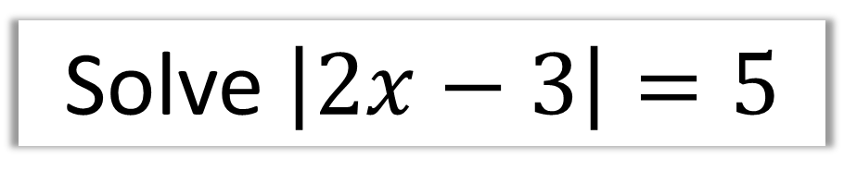


Solve $\left|2x−3\right|=5$
y
Sketch the graphs
y = 5
y = $\left|2x−3\right|$
$$5$$
B
A
$$3$$
x

Slide 19

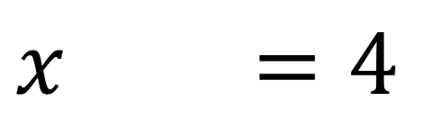
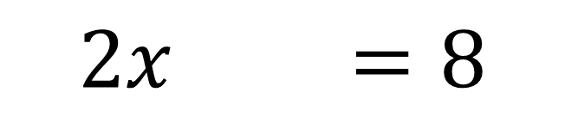
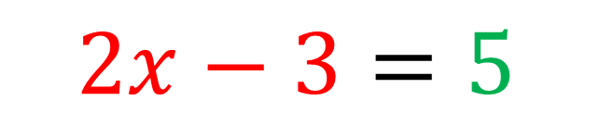
Solve $\left|2x−3\right|=5$
y
Solve for solution A
$$5$$
$$2x−3=5$$
B
A
$2x+3=8$
$$x+3=4$$
x

Slide 20
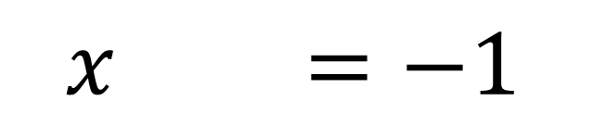
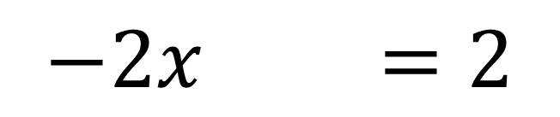

Solve $\left|2x−3\right|=5$
y
Solve for solution B
$$5$$
$$−2x+3=5$$
B
A
$−2x+3=2$
$$x+3=−1$$
x

Slide 21




Solve $\left|3x−5\right|=2−\frac{1}{2}x$
y
Sketch the graphs
$$y=2−\frac{1}{2}x$$
$y=\left|3x−5\right|$
$$5$$
B
$$2$$
A
x

Slide 22






Solve $\left|3x−5\right|=2−\frac{1}{2}x$
y
Solve for solution A
$$3x−5=2−\frac{1}{2}x$$
$$5$$
B
$\frac{7}{2}x=7$
$$2$$
A
x
$$x=2$$

Slide 23



Solve $\left|3x−5\right|=2−\frac{1}{2}x$
Solve for solution B
y
$$−3x+5=2−\frac{1}{2}x$$
$$5$$
$−\frac{5}{2}x=−3$
B
$$2$$
A
$$x=\frac{6}{5}$$
x

Slide 24


Solve $\left|x+1\right|=2x+5$
Inequality
Solve $\left|4x−1\right|<2x$

Slide 25










Solve $\left|x+1\right|=2x+5$
There is only one point of intersection.
$$y$$
A
$$−x−1=2x+5$$
$$5$$
$$3x=−6$$
$$x=−2$$
$$1$$
A
$$x+1=2x+5$$
B
$$x$$
$$x=−4$$
B
This point of intersection
does not happen.

Slide 26










Inequality
Solve $\left|4x−1\right|<2x$
$$y$$
A
$$4x−1=2x$$
$$x=\frac{1}{2}$$
A
B
$$1−4x=2x$$
$$1$$
B
$$x=\frac{1}{6}$$
$$x$$
$$\frac{1}{4}$$
$$\frac{1}{6}<x<\frac{1}{2}$$

