Slide 1
Simultaneous
Equations with
3 Unknowns

Slide 2
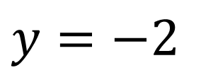
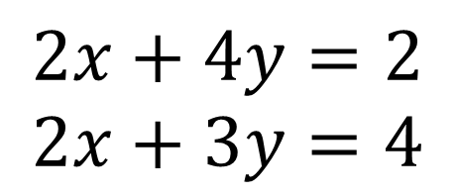

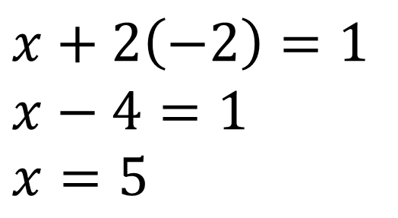
Solve the following linear simultaneous equations by
$$x+2y=1 \\ 2x+3y=4$$
$$2x+4y=2 \\ 2x+3y=4$$
1
2
$$y=−2$$
1
2
$$x+2\left(−2\right)=1 \\ x−4=1 \\ x=5$$

Slide 3
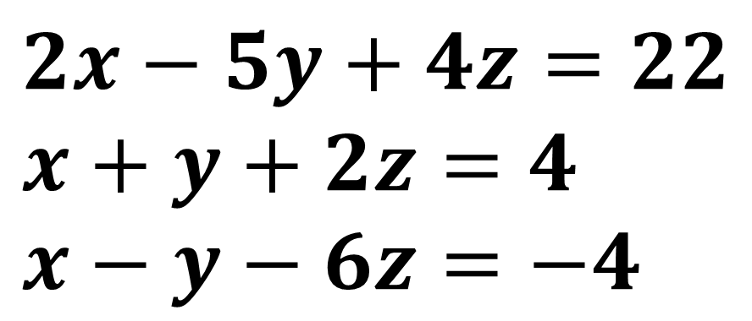
Sometimes you may have 3 equations
with 3 unknowns!
$$2x−5y+4z=22 \\ x+y+2z=4 \\ x−y−6z=−4$$
First eliminate one of the variables to leave
2 equations with two unknowns.

Slide 4
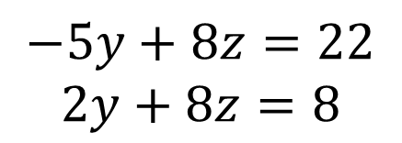
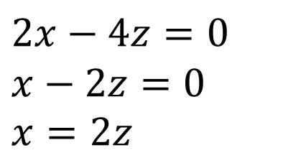

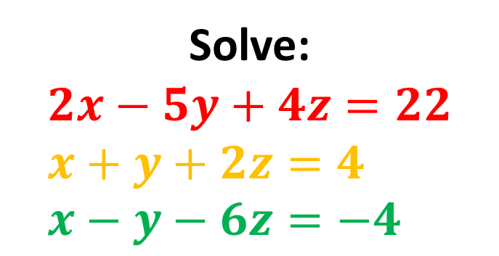
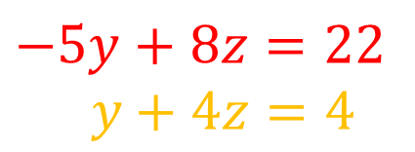


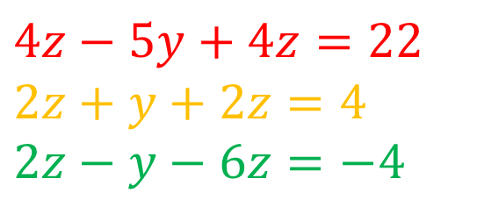
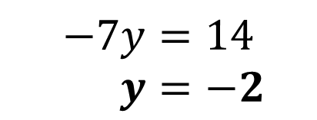
Solve:
$$2x−5y+4z=22 \\ x+y+2z=4 \\ x−y−6z=−4$$
Let’s add the last two equations:
Solve these equations in normal way:
$$2x−4z=0 \\ x−2z=0 \\ x=2z$$
$$−5y+8z=22 \\ y+4z=4$$
$$−5y+8z=22$$
$2y+8z=8$
Eliminate $x$ by substituting into other equations:
$$4z−5y+4z=22 \\ 2z+y+2z=4 \\ 2z−y−6z=−4$$
$$−7y=14$$
$y=−2$
$$z=1.5$$
$$x=3$$

Slide 5
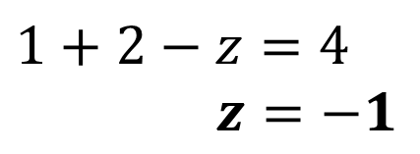
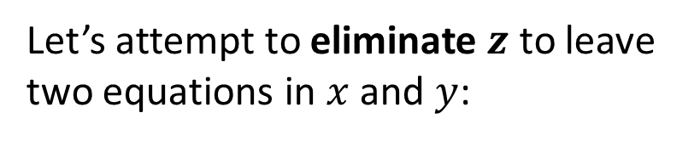
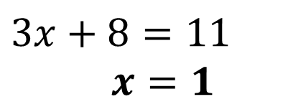
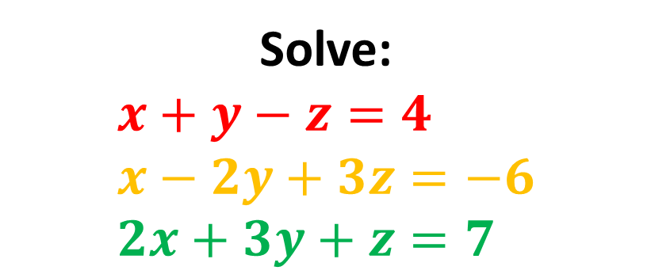
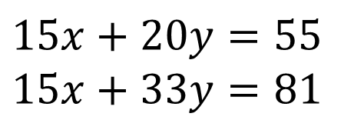
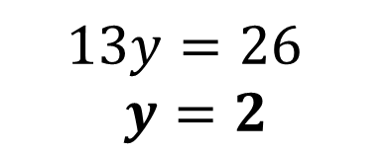

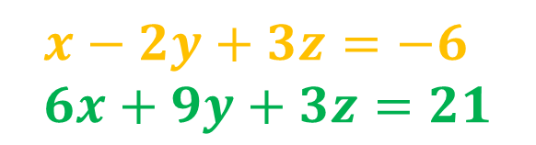

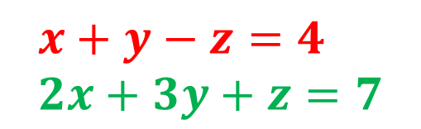
Solve:
$$x+y−z=4 \\ x−2y+3z=−6 \\ 2x+3y+z=7$$
2
3
Let’s attempt to eliminate $z$ to leave two equations in $x$ and $y$:
Solve in usual way:
$$15x+20y=55 \\ 15x+33y=81$$
$$x+y−z=4 \\ 2x+3y+z=7$$
$13y=26$
$$y=2$$
$$3x+4y=11$$
$$x−2y+3z=−6 \\ 6x+9y+3z=21$$
$$3x+8=11$$
$x=1$
$$5x+11y=27$$
$$1+2−z=4$$
$z=−1$

Slide 6
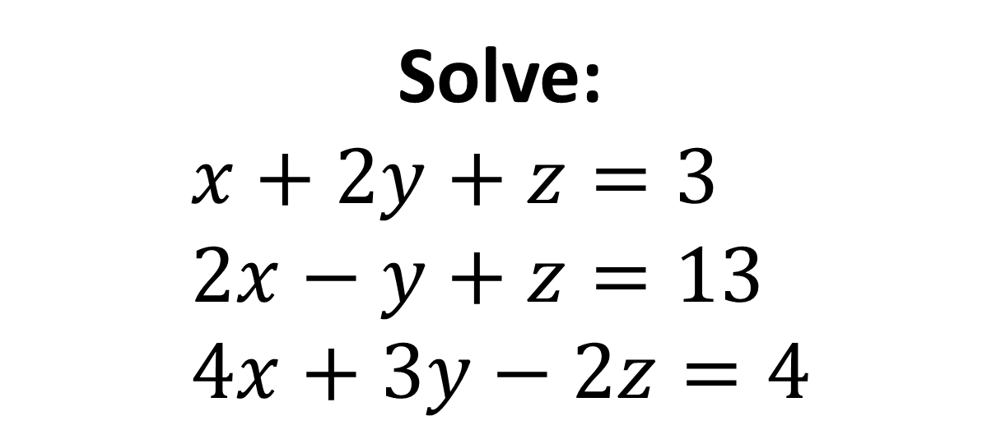
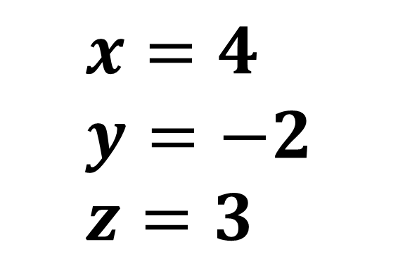
Solve:
$$x+2y+z=3 \\ 2x−y+z=13 \\ 4x+3y−2z=4$$
1
2
3
$$x=4 \\ y=−2 \\ z=3$$

Slide 7
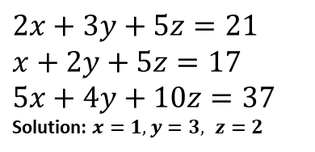
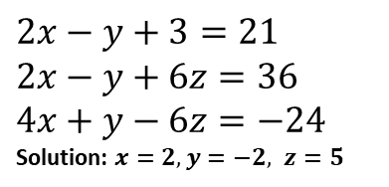
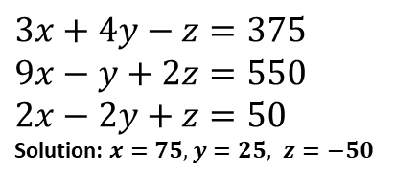
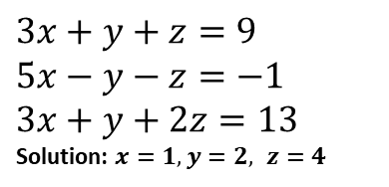
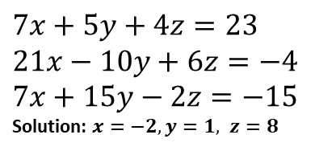
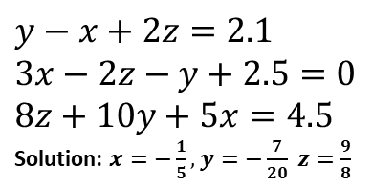
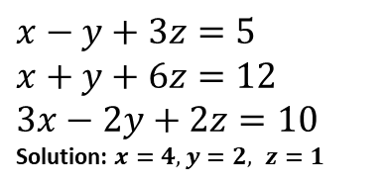
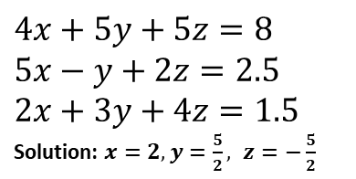
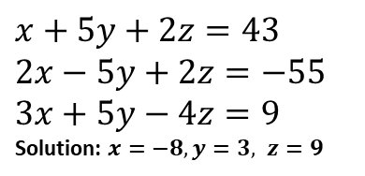
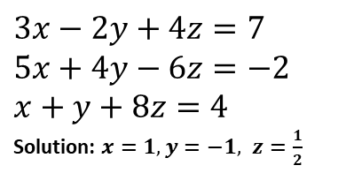
Exercise
Solve the following.
1
$$3x+y+z=9 \\ 5x−y−z=−1 \\ 3x+y+2z=13$$
Solution: $x=1, y=2, z=4$
5
$$7x+5y+4z=23 \\ 21x−10y+6z=−4 \\ 7x+15y−2z=−15$$
Solution: $x=−2, y=1, z=8$
8
$$3x−2y+4z=7 \\ 5x+4y−6z=−2 \\ x+y+8z=4$$
Solution: $x=1, y=−1, z=\frac{1}{2}$
?
?
?
2
$$2x−y+3=21 \\ 2x−y+6z=36 \\ 4x+y−6z=−24$$
Solution: $x=2, y=−2, z=5$
6
$$3x+4y−z=375 \\ 9x−y+2z=550 \\ 2x−2y+z=50$$
Solution: $x=75, y=25, z=−50$
9
$$4x+5y+5z=8 \\ 5x−y+2z=2.5 \\ 2x+3y+4z=1.5$$
Solution: $x=2, y=\frac{5}{2}, z=−\frac{5}{2}$
?
?
?
3
$$x+5y+2z=43 \\ 2x−5y+2z=−55 \\ 3x+5y−4z=9$$
Solution: $x=−8, y=3, z=9$
7
$$2x+3y+5z=21 \\ x+2y+5z=17 \\ 5x+4y+10z=37$$
Solution: $x=1, y=3, z=2$
10
$$y−x+2z=2.1 \\ 3x−2z−y+2.5=0 \\ 8z+10y+5x=4.5$$
Solution: $x=−\frac{1}{5}, y=−\frac{7}{20} z=\frac{9}{8}$
?
?
?
4
$$x−y+3z=5 \\ x+y+6z=12 \\ 3x−2y+2z=10$$
Solution: $x=4, y=2, z=1$
N
[Hamilton 2006 Q3] James, Alison and Vivek go into a shop to buy some sweets. James spends £1 on four Fudge Bars, a Sparkle and a Chomper. Alison spends 70p on three Chompers, two Fudge Bars and a Sparkle. Vivek spends 50p on two Sparkles and a Fudge Bar. What is the cost of a Sparkle?
Solution: 15p
?
?
(With thanks to my colleague Ms Sarma for the questions)

