Slide 1
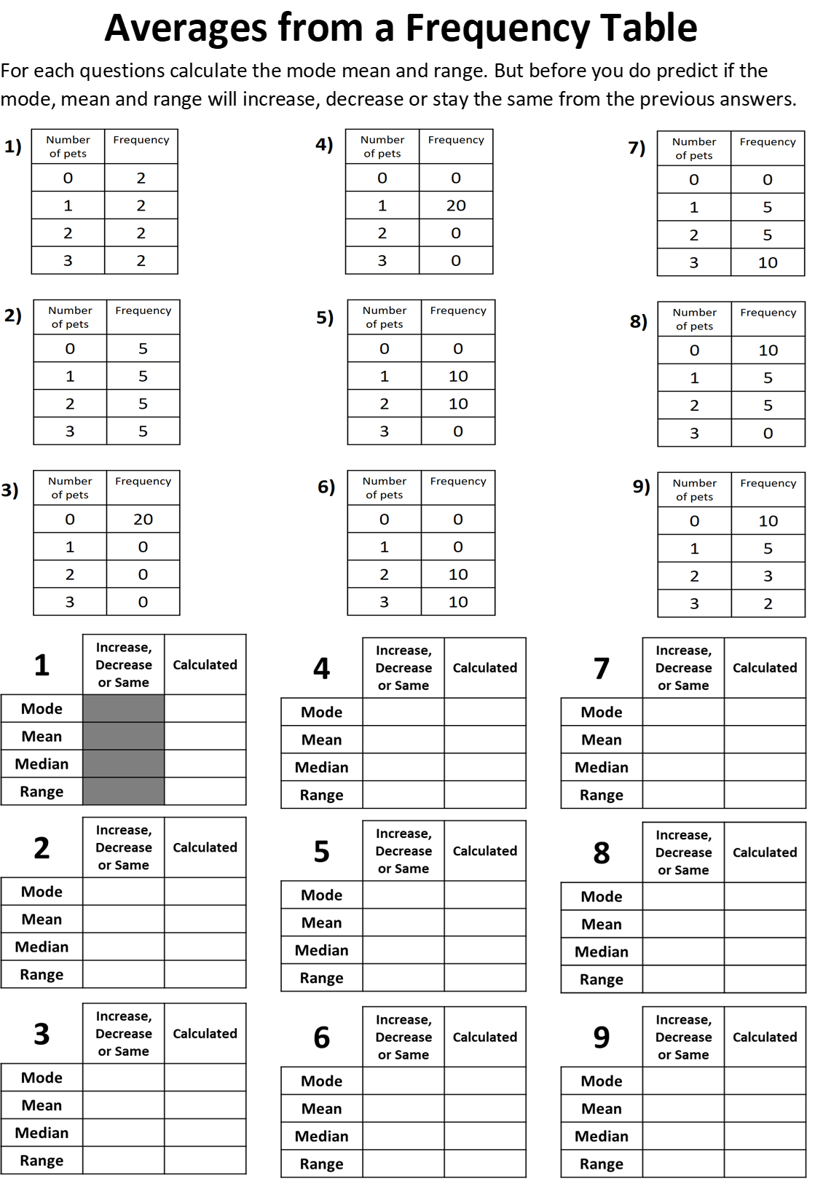


Slide 2
ANSWERS

Slide 3
None
1
3
1.5
1
2.25
1.5
1
2.5
3
0
2
None
1 and 2
0
1.5
1.5
0.75
1.5
1.5
0.5
3
1
2
0
2 and 3
0
0
2.5
0.85
0
2.5
0.5
0
1
3

