Slide 1
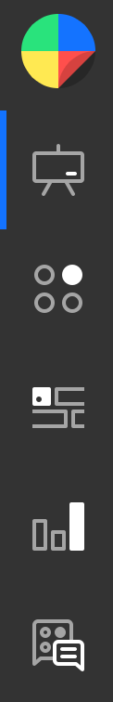
Direct Proportion
(with powers)
https://diagnosticquestions.com/Quizzes/Go#/142381

