Slide 1
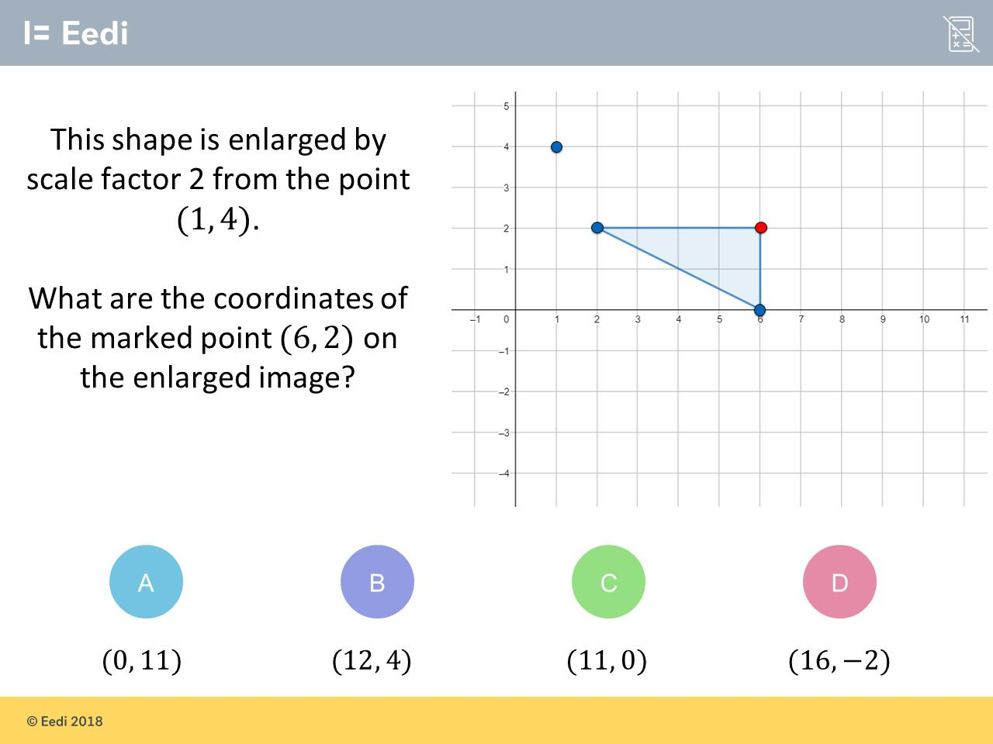
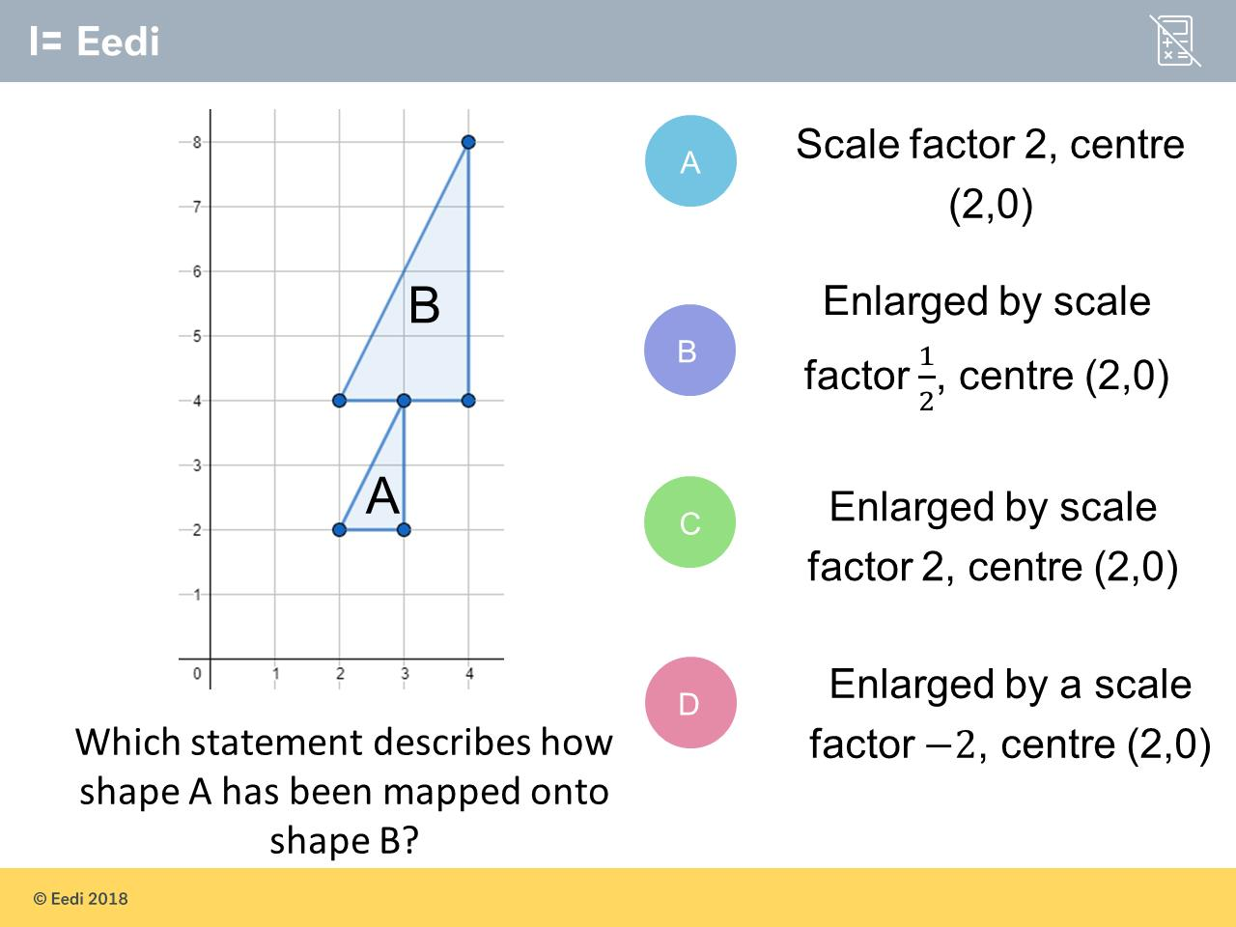
Hardest question?
Most common wrong answer?

Slide 2
ANSWERS

Slide 3
Hardest question?

Slide 4
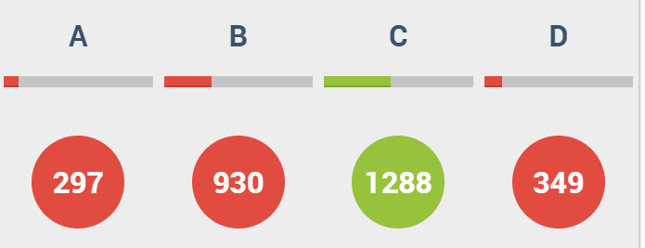
B
The student has doubled the original
co-ordinates.

Slide 5
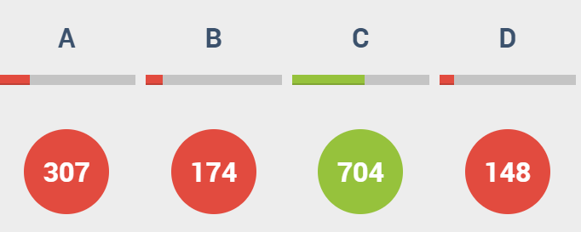
A
The student has missed out the type of transformation.

