Slide 1
Elastic, Strings and Springs
Hooke’s Law - Combining
Chapter 3
(Part 2 of 5)

Slide 2
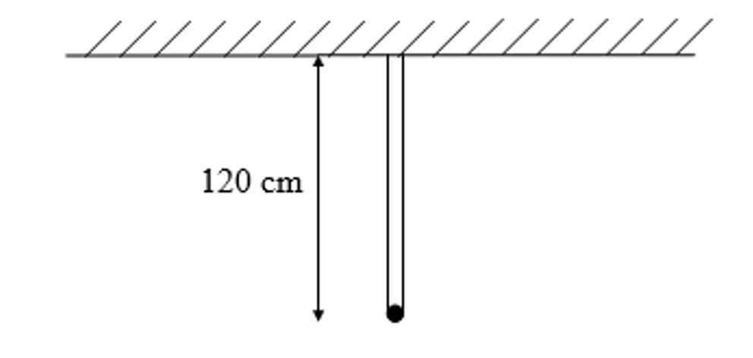
How do these statements change
how your approach the question?
A particle is attached to one end of two light elastic strings
A particle is attached to one light elastic strings that is threaded through the particle

Slide 3
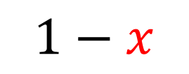

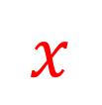





Identify the Distances
A particle Q is attached to two separate springs.
he spring PQ has natural length 1.6m
The spring QR has natural length 1.4m
The ends P and R, stretched 4m apart.
P
Q
R
$$iii$$
$$i$$
$$ii$$
$$iv$$
$$x$$
$$1.6$$
$$1.4$$
$$1−x$$

Slide 4
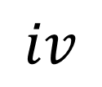





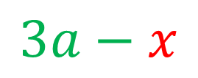
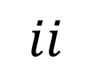
Identify the Distances
B
An elastic spring has natural length 2a.
$$iii$$
$$x$$
A particle of mass m is attached to the midpoint of the spring.
One end of the spring, A, is attached to the floor of a room of height 5a and the other end is attached to the ceiling of the room at a point B vertically above A.
$$i$$
$$a$$
$$ii$$
$$a$$
The spring is modelled as light.
$$iv$$
$$3a−x$$
A

Slide 5
Example A: Horizontal
The elastic springs PQ and QR are joined together at Q to form one long spring.
The spring PQ has natural length 1.6m and modulus of elasticity 20N.
The spring QR has natural length 1.4m and modulus of elasticity 28N.
The ends P and R, of the long string are attached to two fixed points which are
4m apart on the same horizontal plane.
[Assume Q is at rest and in equilibrium]. Find the Tension in the combined spring.

Slide 6


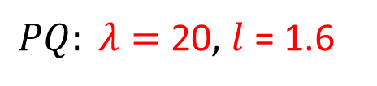



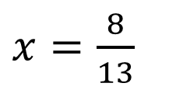



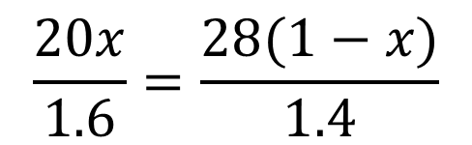

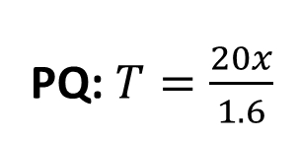
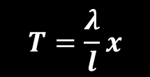
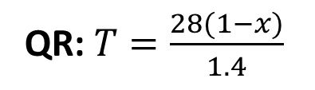
The elastic springs PQ and QR are joined together at Q to form one long spring.
The spring PQ has natural length 1.6m and modulus of elasticity 20N.
The spring QR has natural length 1.4m and modulus of elasticity 28N.
The ends P and R, of the long string are attached to two fixed points which are 4m apart
on the same horizontal plane.
[Assume Q is at rest and in equilibrium]. Find the Tension in the combined spring.
PQ: $T=\frac{20x}{1.6}$
$$T=\frac{λ}{l}x$$
QR: $T=\frac{28(1−x)}{1.4}$
$PQ: λ=$ 20, $l$ = 1.6
$QR:λ=$28, $l$= 1.4
P
Q
R
As Q is at rest:
$$T_{QP}=T_{QR}$$
$$T$$
$$T$$
$$\frac{20x}{1.6}=\frac{28(1−x)}{1.4}$$
$$x$$
$$1.6$$
$$1.4$$
$$1−x$$
$x=\frac{8}{13}$
Total Extension =
4 – (1.6 + 1.4)
= 1m
$$T=7.69N$$

Slide 7
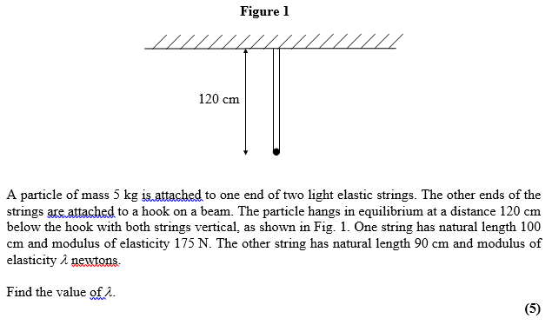
Example B: Vertical

Slide 8

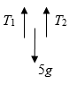
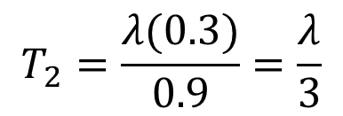
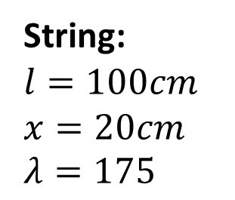

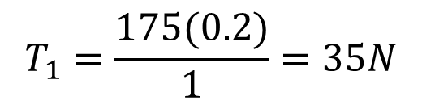

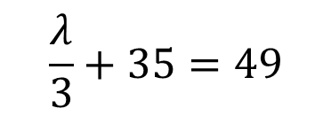
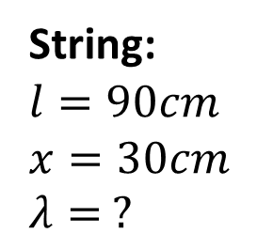
String:
$$l=100cm$$
$$x=20cm$$
$$λ=175$$
$$T_{1}=\frac{175(0.2)}{1}=35N$$
String:
$$l=90cm$$
$$x=30cm$$
$$λ= ?$$
$$T_{2}=\frac{λ(0.3)}{0.9}=\frac{λ}{3}$$
$$T_{1}+T_{2}=5g$$
$$\frac{λ}{3}+35=49$$
$$λ=42$$

