Slide 1
LO: Loci

Slide 2
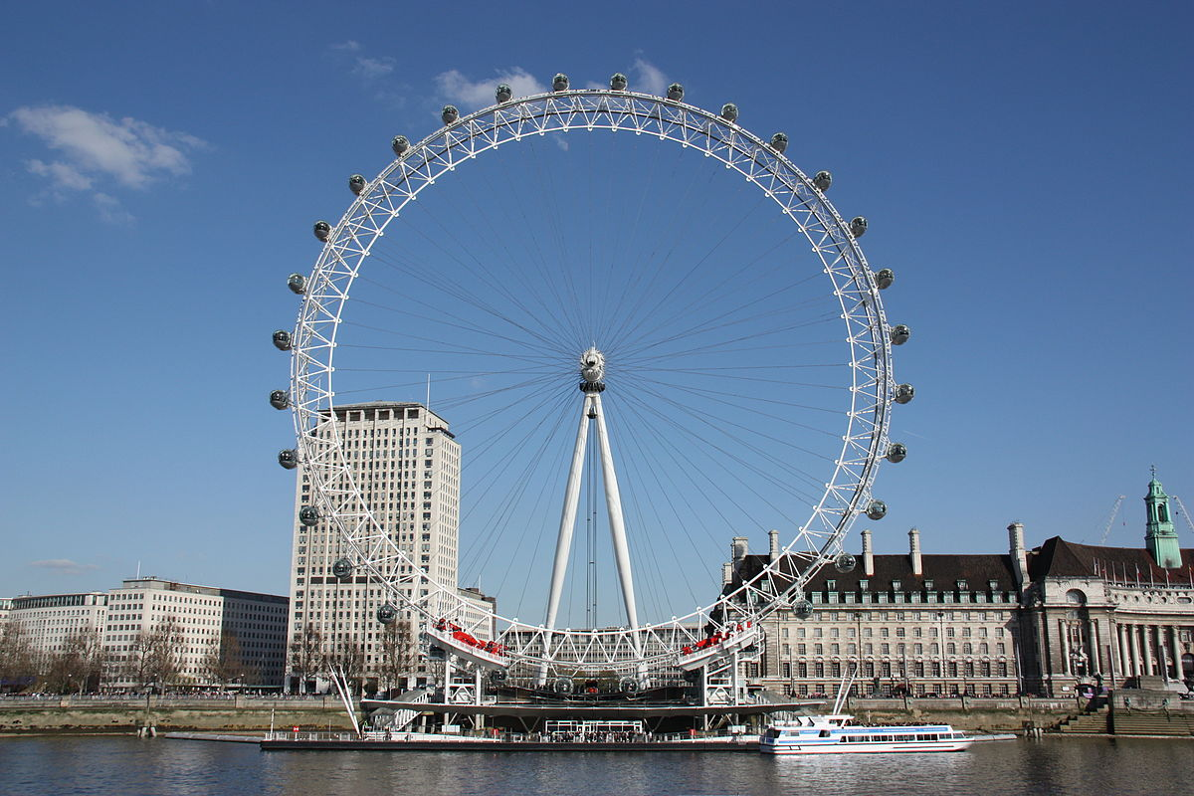
If you took a ride on the London Eye
what shape would you trace?

Slide 3
If you took a ride on the London Eye
what shape would you trace?

Slide 4
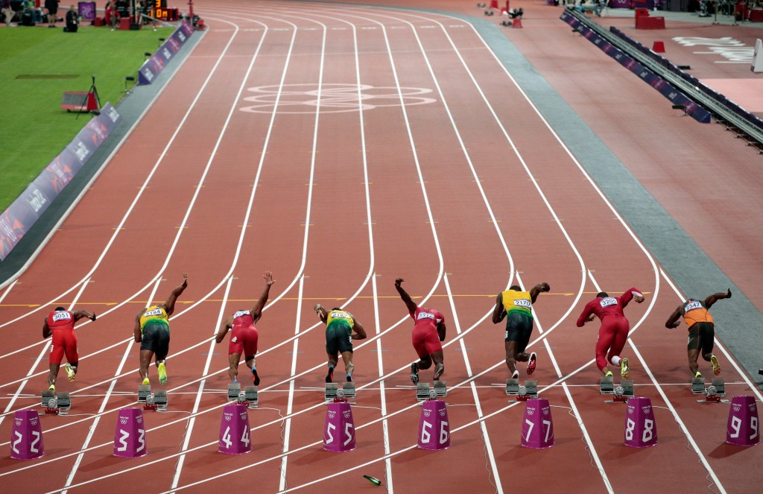
If you ran a one lap of the London Stadium what shape would you trace?

Slide 5
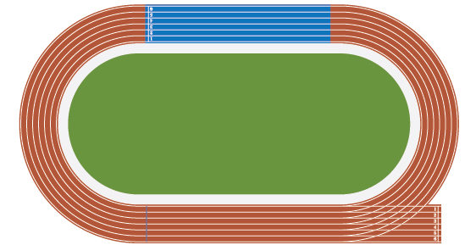
If you ran a one lap of the London Stadium what shape would you trace?

Slide 6
A locus is a path that follows a particular rule.
The plural of locus is loci.

Slide 7
Place all of your counters so that they are
8 cm away from the point A.
A

Slide 8
Real life loci – Home delivery.
3 miles

Slide 9
Place all of your counters so that they are
the same distance away from points B and C.
C
B

Slide 10
Place your counters so that they are
6 cm away from the Line DE.
D
E

Slide 11
Placed your counters so that they are
4 cm away from the Rectangle

Slide 12
Placed your counters so that they are
4 cm away from the L Shape.

Slide 13
Placed your counters so that they are
4 cm away from the T Shape.

Slide 14
Summary:
Always same distance from the shape
For an Internal Corner the Loci maps out a right angle.
For an External Corner the Loci maps out a quarter-circle.

Slide 15
Have you ever thought about how the markings of a football pitch are made?
How many different loci and constructions can you see?

Slide 16
The half way line is a perpendicular bisector of the rectangle.

Slide 17
The center circle is marked by drawing a locus from a fixed point.
10 yards

Slide 18
The two lines are always 6 and 18 yards from a fixed line.

Slide 19
The D is there to ensure the players are 10 yards from the penalty spot when a penalty is to be taken. The is drawn by marking a locus from a fixed point
10 yards

Slide 20
The corners are marked from a locus from a fixed point.
1 yard

Slide 21
