Slide 1
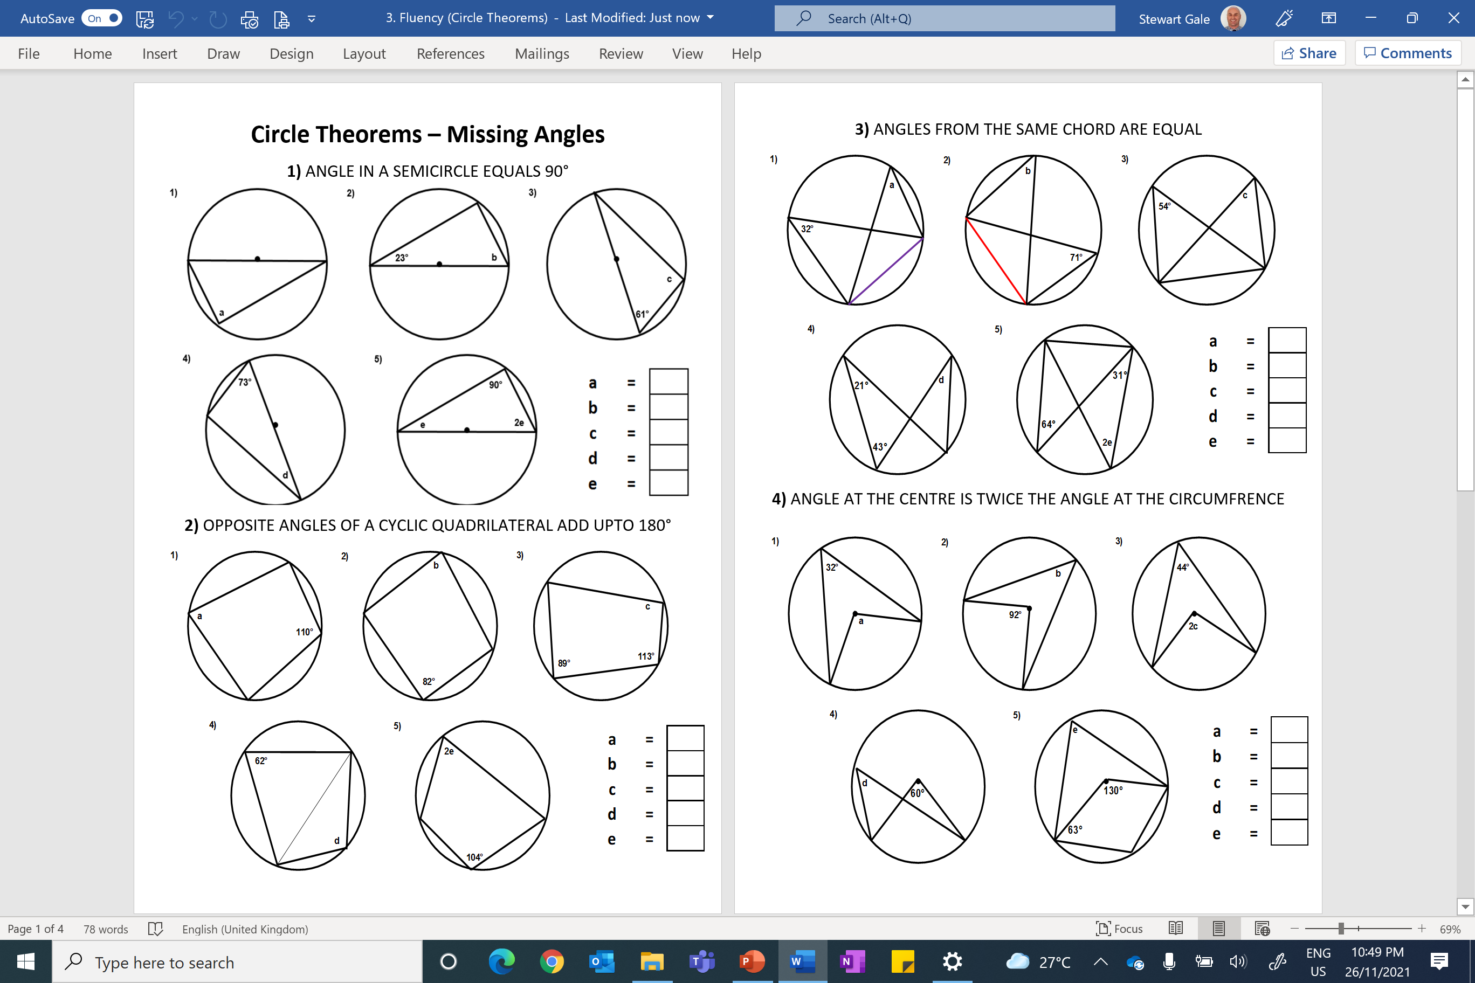

Slide 2
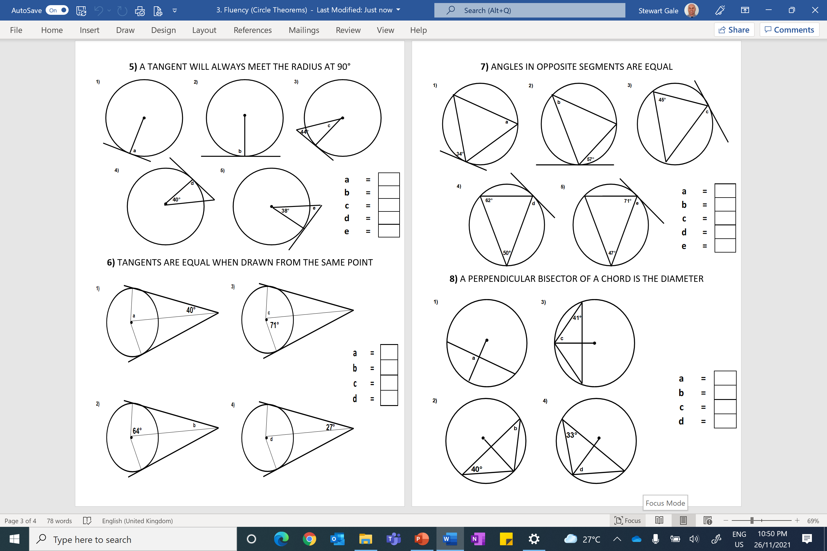

Slide 3
ANSWERS

Slide 4
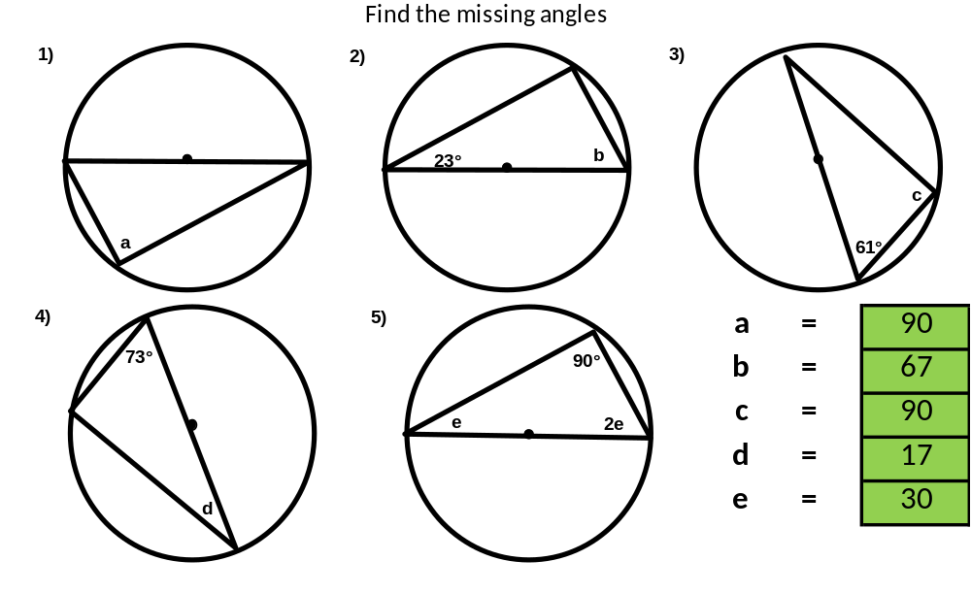
1) ANGLE IN A SEMICIRCLE EQUALS 90°

Slide 5
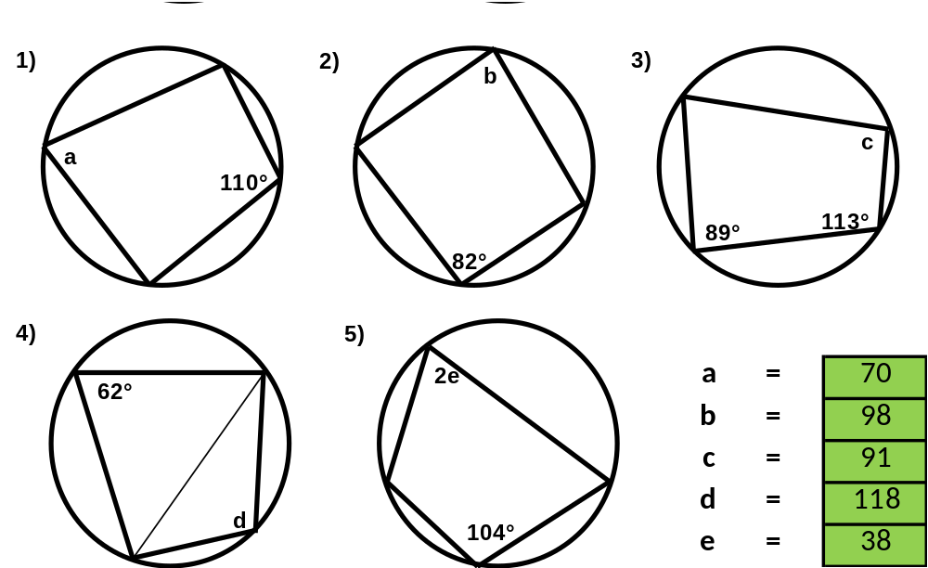
2) OPPOSITE ANGLES OF A CYCLIC QUADRILATERAL ADD UPTO 180°

Slide 6
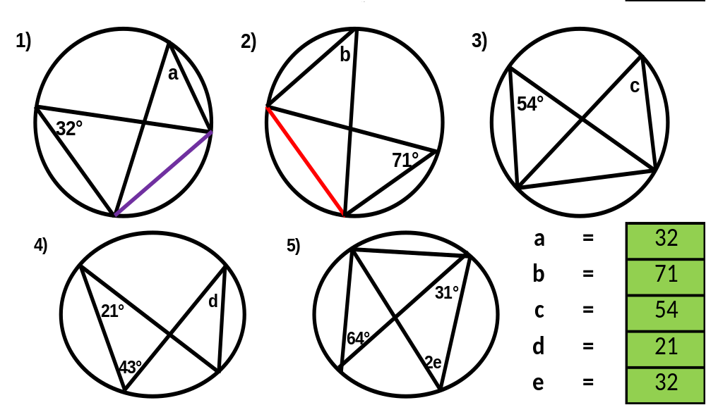
3) ANGLES FROM THE SAME CHORD ARE EQUAL

Slide 7
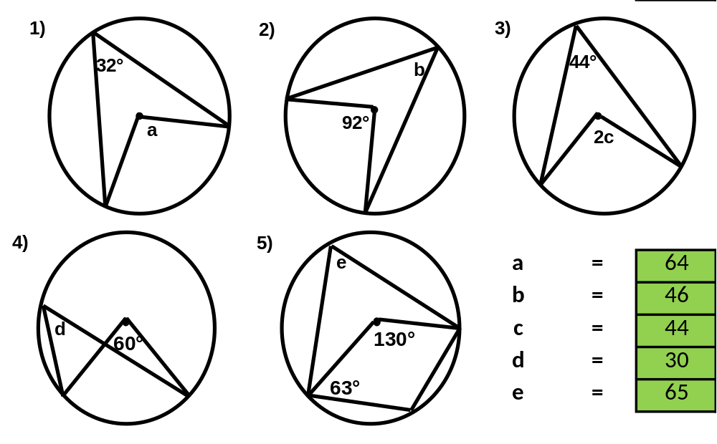
4) ANGLE AT THE CENTRE IS TWICE THE ANGLE AT THE CIRCUMFRENCE

Slide 8
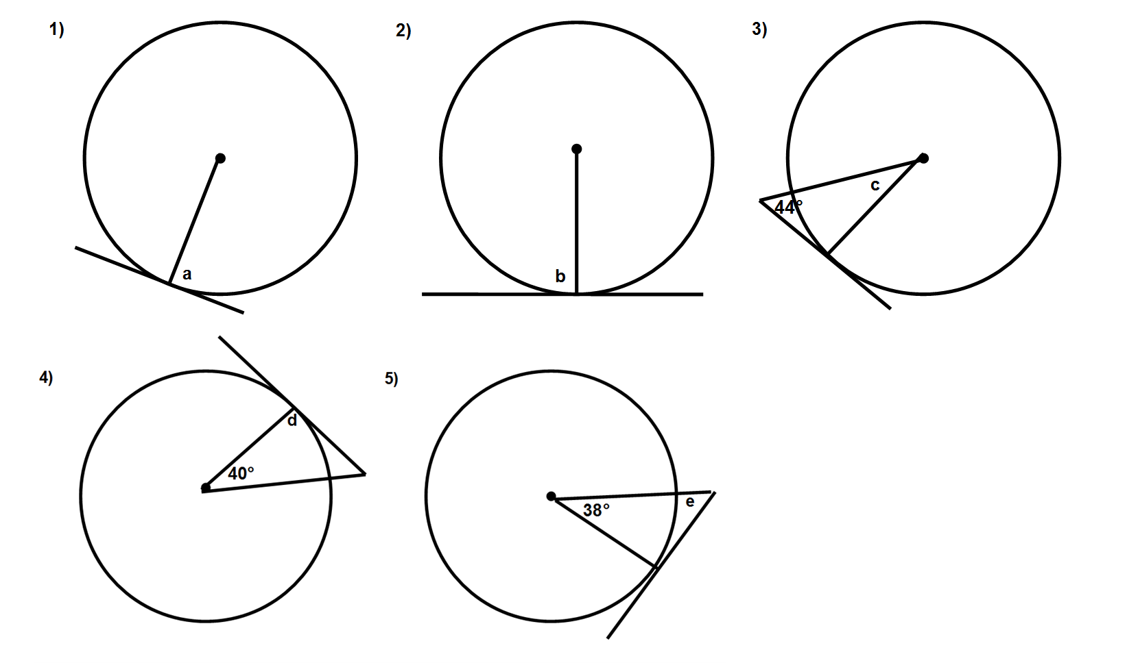
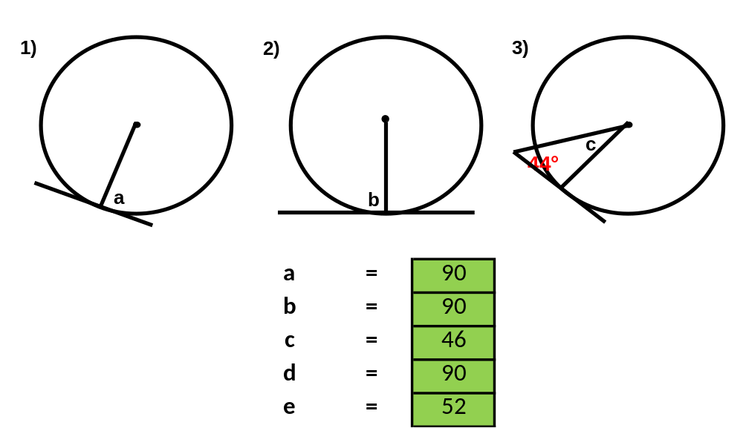
5) A TANGENT WILL ALWAYS MEET THE RADIUS AT 90°

Slide 9
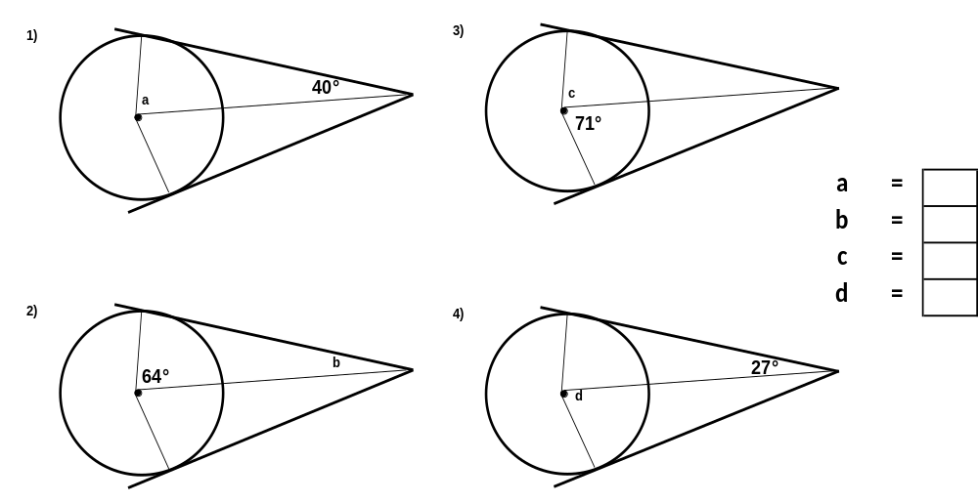
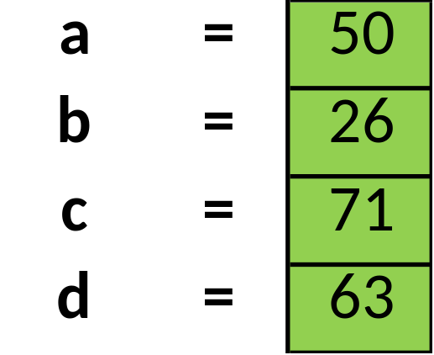
6) TANGENTS ARE EQUAL WHEN DRAWN FROM THE SAME POINT

Slide 10
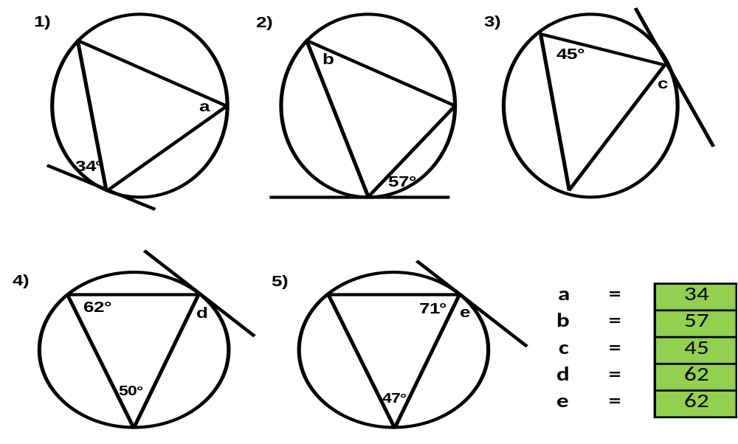
7) ANGLES IN OPPOSITE SEGMENTS ARE EQUAL

Slide 11
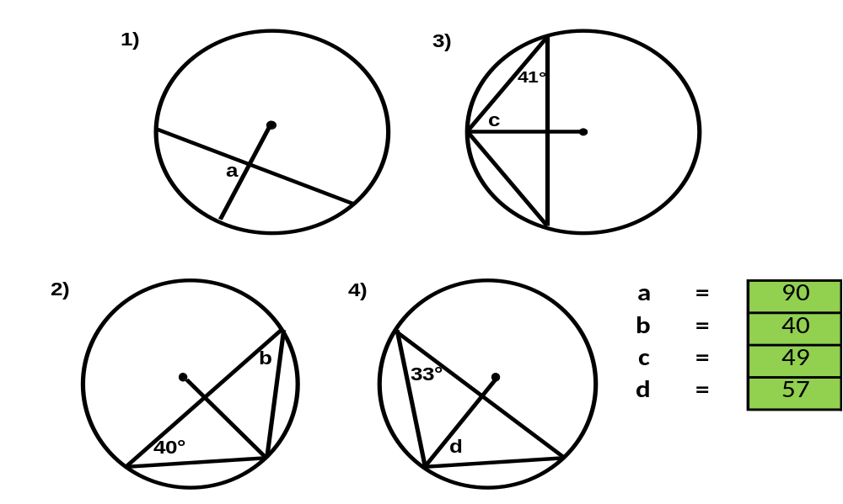
8) A PERPENDICULAR BISECTOR OF A CHORD IS THE DIAMETER

