Slide 1
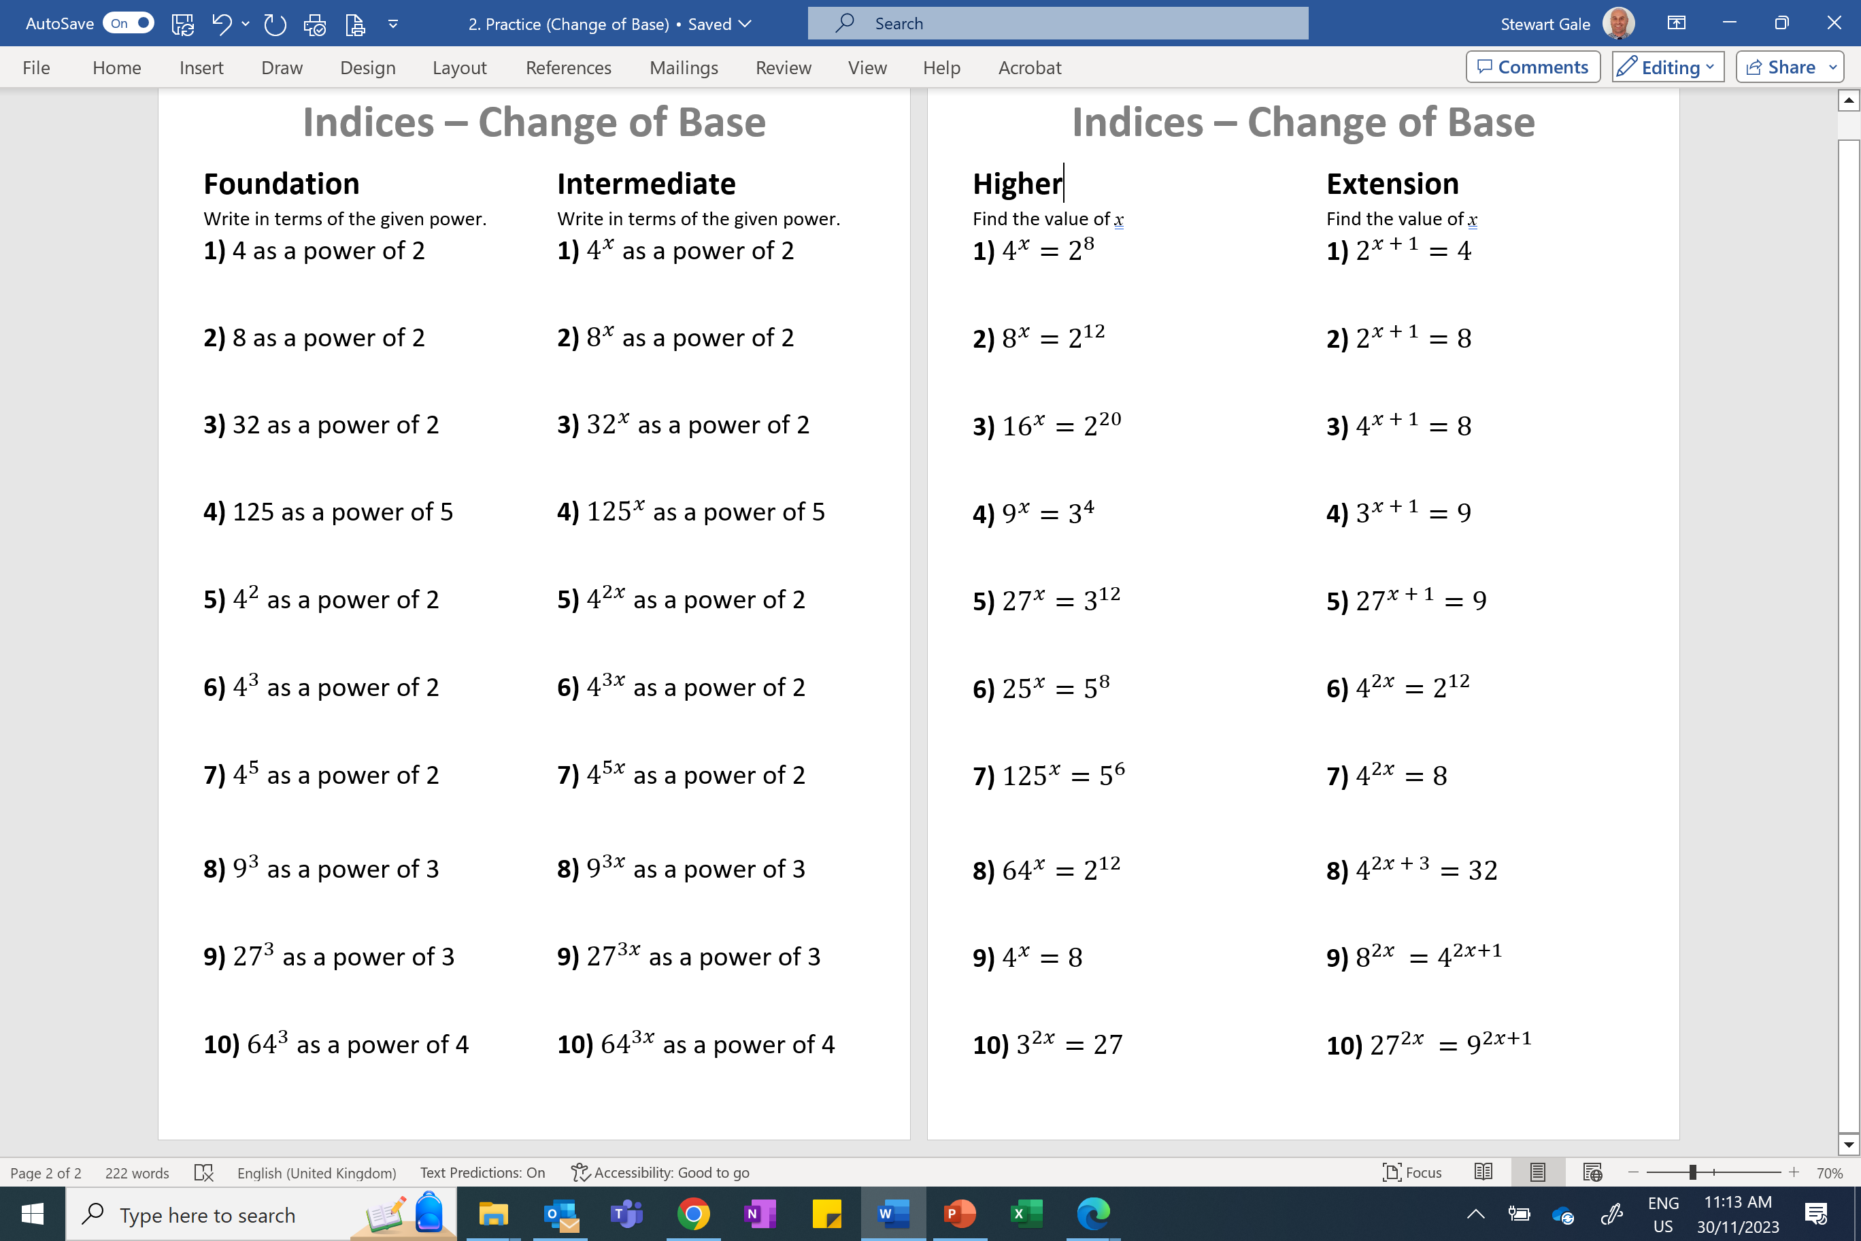

Slide 2
ANSWERS

Slide 3
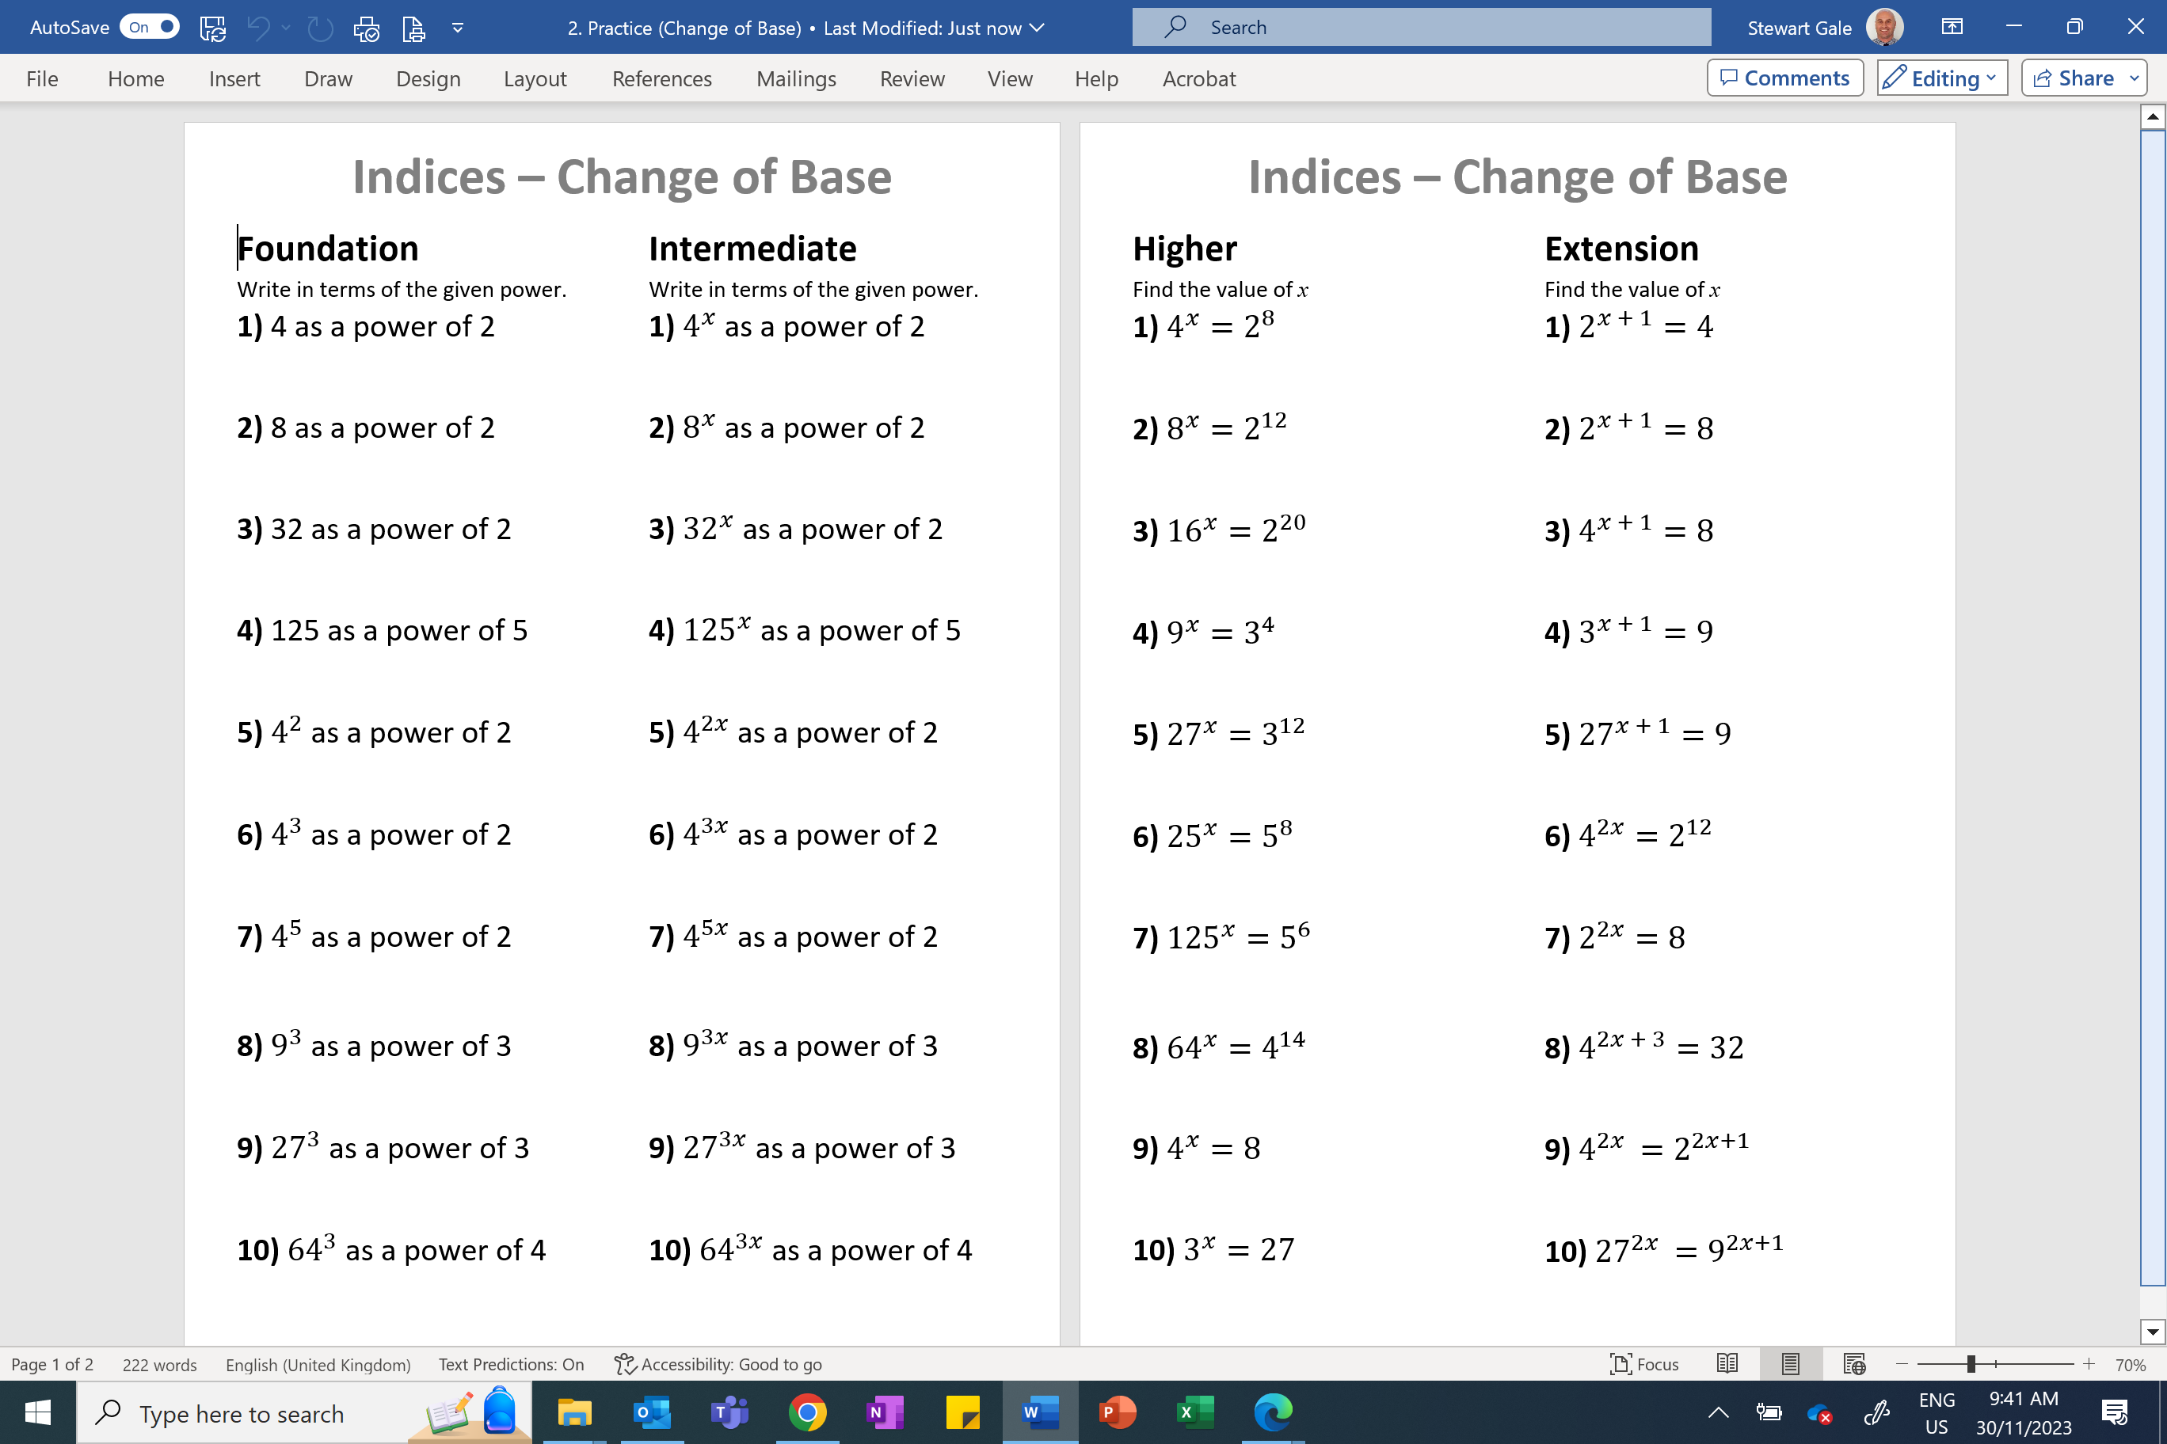
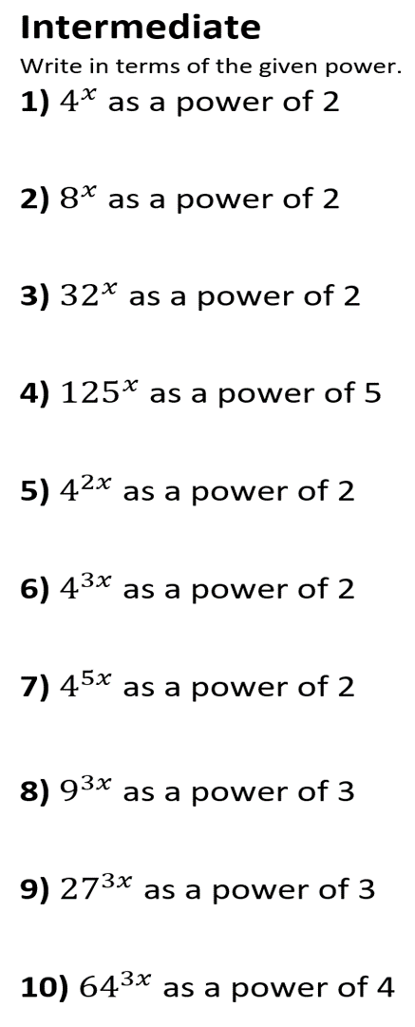




















$$2^{2}$$
$${{(2}^{2})}^{x}{=2}^{2x}$$
$$2^{3}$$
$${{(2}^{3})}^{x}{=2}^{3x}$$
$$2^{5}$$
$${{(2}^{5})}^{x}{=2}^{5x}$$
$$5^{3}$$
$${{(5}^{3})}^{x}{=5}^{3x}$$
$${{(2}^{2})}^{2}{=2}^{4}$$
$${{(2}^{2})}^{2x}{=2}^{4x}$$
$${{(2}^{2})}^{3}{=2}^{6}$$
$${{(2}^{2})}^{3x}{=2}^{6x}$$
$${{(2}^{2})}^{5}{=2}^{10}$$
$${{(2}^{2})}^{5x}{=2}^{10x}$$
$${{(3}^{2})}^{3}{=3}^{6}$$
$${{(3}^{2})}^{3x}{=3}^{6x}$$
$${{(3}^{3})}^{3}{=3}^{9}$$
$${{(3}^{3})}^{3x}{=3}^{9x}$$
$${{(4}^{3})}^{3}{=4}^{9}$$
$${{(4}^{3})}^{3x}{=4}^{9x}$$

Slide 4







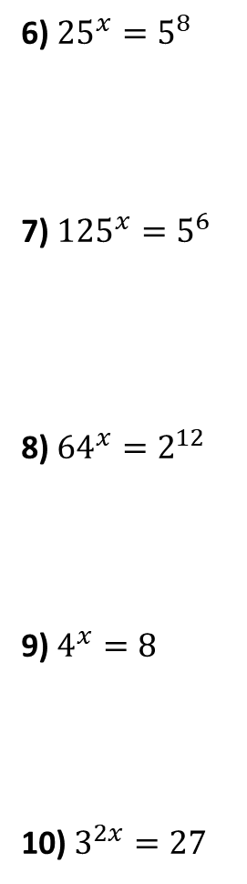





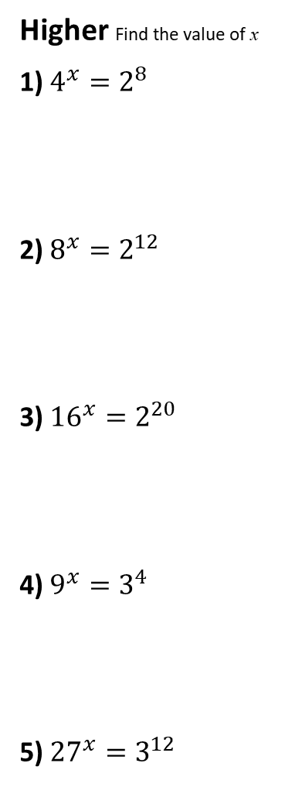



























Higher Find the value of x
1) $4^{x}=2^{8}$
2) $8^{x}=2^{12}$
3) ${16}^{x}=2^{20}$
4) $9^{x}=3^{4}$
5) ${27}^{x}=3^{12}$
6) ${25}^{x}=5^{8}$
7) ${125}^{x}=5^{6}$
8) ${64}^{x}=2^{12}$
9) $4^{x}=8$
10) $3^{2x}=27$
$${{(5}^{2})}^{x}{=5}^{8}$$
$${{(2}^{2})}^{x}{=2}^{8}$$
$$5^{2x}{=5}^{8}$$
$$2^{2x}{=2}^{8}$$
$$2x=8$$
$$2x=8$$
$$x=4$$
$${{(5}^{3})}^{x}{=5}^{6}$$
$$x=4$$
$${{(2}^{3})}^{x}{=2}^{12}$$
$$5^{3x}{=5}^{6}$$
$$2^{3x}{=2}^{12}$$
3$x=6$
3$x=12$
$$x=2$$
$${{(2}^{4})}^{x}{=2}^{20}$$
$$x=4$$
$${{(2}^{6})}^{x}{=2}^{12}$$
$$2^{4x}{=2}^{20}$$
$$2^{6x}{=2}^{12}$$
4$x=20$
6$x=12$
$$x=5$$
$${{(3}^{2})}^{x}{=3}^{4}$$
$$x=2$$
$${{(2}^{2})}^{x}{=2}^{3}$$
$$3^{2x}{=3}^{4}$$
$$2^{2x}{=2}^{3}$$
2$x=4$
2$x=3$
$${{(3}^{3})}^{x}{=3}^{12}$$
$$x=2$$
$$x=1.5$$
$$3^{3x}{=3}^{12}$$
$$3^{2x}{=3}^{3}$$
3$x=12$
2$x=3$
$$x=4$$
$$x=1.5$$

Slide 5








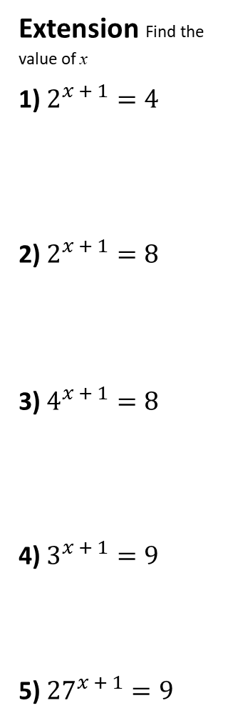







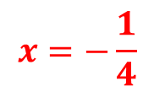


















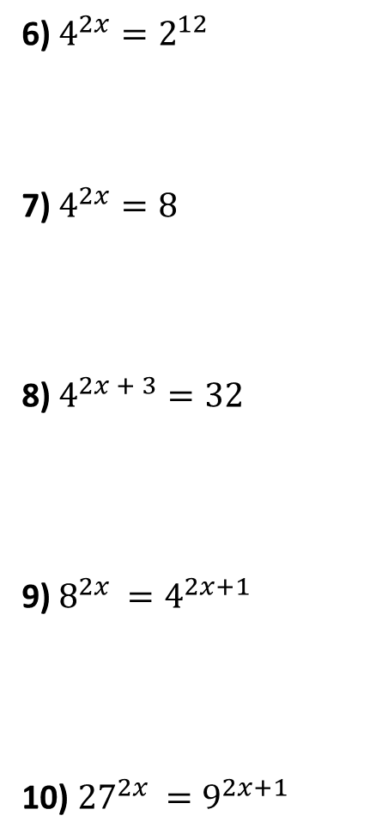





Extension Find the value of x
1) $2^{x + 1}=4$
2) $2^{x + 1}=8$
3) $4^{x + 1}=8$
4) $3^{x + 1}=9$
5) ${27}^{x + 1}=9$
$${{(2}^{2})}^{2x}{=2}^{12}$$
6) $4^{2x}=2^{12}$
7) $4^{2x}=8$
8) $4^{2x + 3}=32$
9) $8^{2x }=4^{2x+1}$
10) ${27}^{2x }=9^{2x+1}$
$$2^{4x}{=2}^{12}$$
$$2^{x + 1}{=2}^{2}$$
$$4x=12$$
$$x+1=2$$
$$x=1$$
$$x=3$$
$${{(2}^{2})}^{2x}{=2}^{3}$$
$$2^{4x}{=2}^{3}$$
$$2^{x + 1}{=2}^{3}$$
$$x+1=3$$
4$x=3$
$$x=0.75$$
$$x=2$$
$${{(2}^{2})}^{2x+3}{=2}^{5}$$
$${{(2}^{2})}^{x + 1}{=2}^{3}$$
$$2^{4x+6}{=2}^{5}$$
$$2^{2x + 2}{=2}^{3}$$
4$x+6=5$
$$x=−\frac{1}{4}$$
$$2x+2=3$$
$${{(2}^{3})}^{2x}{{=(2}^{2})}^{2x + 1}$$
$$x=0.5$$
$$3^{x +1}{=3}^{2}$$
$$2^{6x}{=2}^{4x + 2}$$
$${{(3}^{3})}^{2x}{{=(3}^{2})}^{2x + 1}$$
6$x=4x+2$
$$x+1=2$$
$${{(3}^{3})}^{x + 1}{=3}^{2}$$
$$3^{6x}{=3}^{4x + 2}$$
$$x=1$$
$$2x=2$$
$$3^{3x + 3}{=3}^{2}$$
6$x=4x+2$
$$x=1$$
3$x+3=2$
$$2x=2$$
$$x=−1/3$$
$$x=1$$

