Slide 1
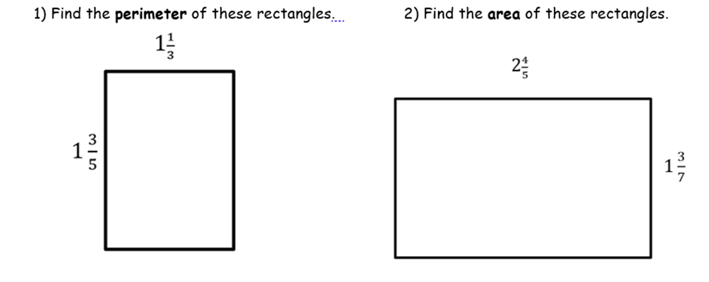
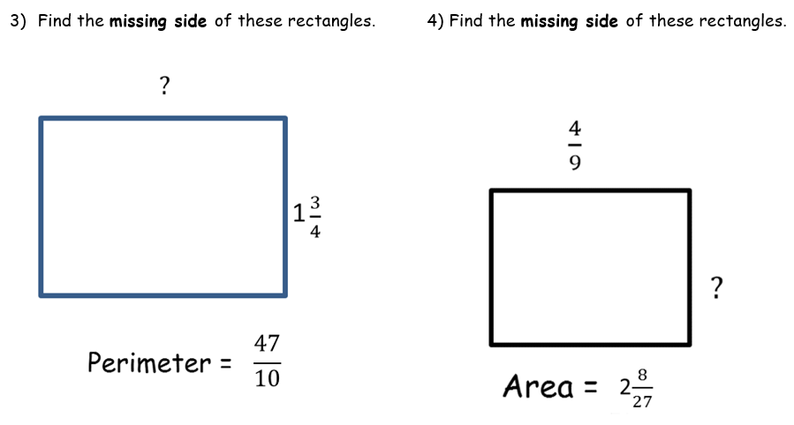
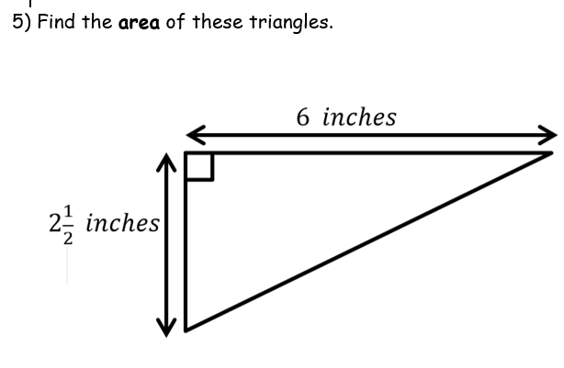

Slide 2
ANSWERS

Slide 3
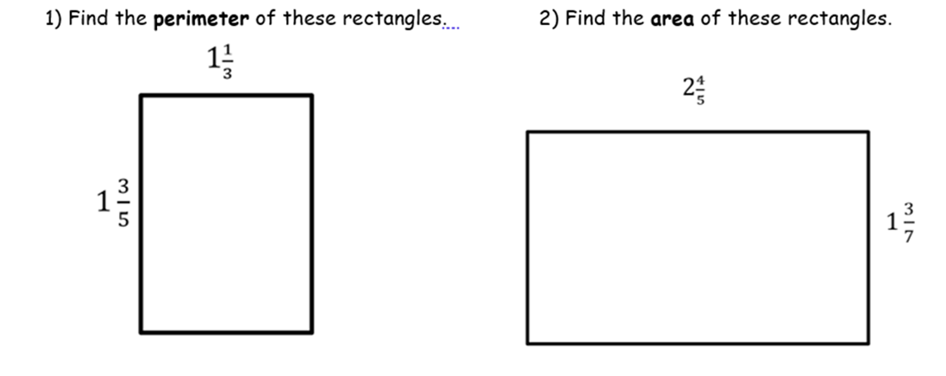
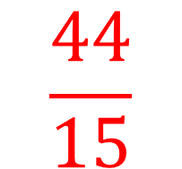
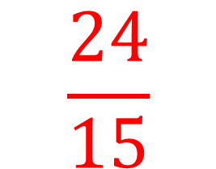
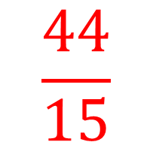
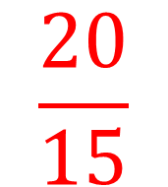
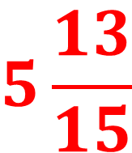
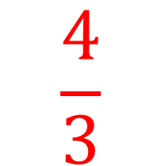
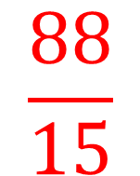
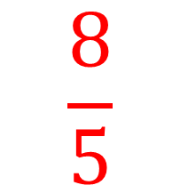

$$\frac{8}{5}$$
$$\frac{4}{3}$$
+
$$\frac{24}{15}$$
$$\frac{20}{15}$$
$$\frac{44}{15}$$
+
=
$$\frac{44}{15}$$
$$\frac{2}{1}$$
$$\frac{88}{15}$$
$$5\frac{13}{15}$$
x
=
=

Slide 4
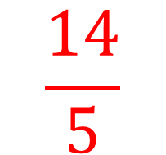
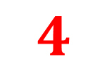
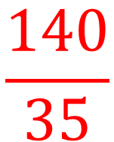

$$\frac{14}{5}$$
$$\frac{10}{7}$$
$$\frac{140}{35}$$
x
=
=
$$4$$

Slide 5
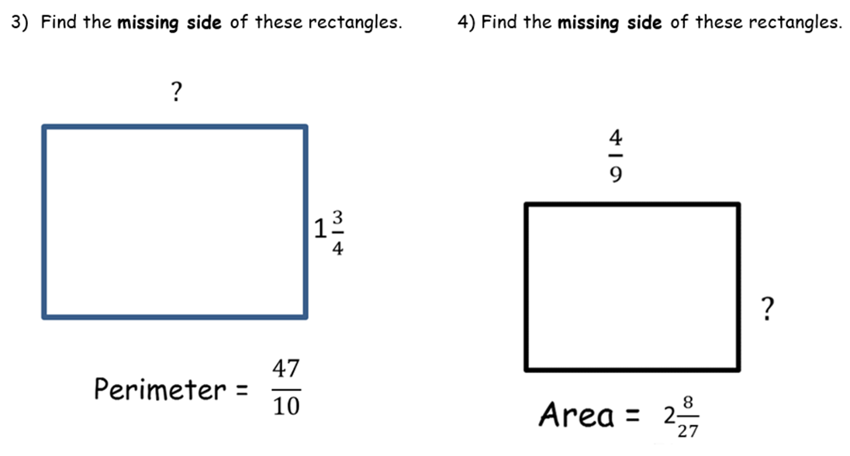
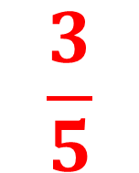
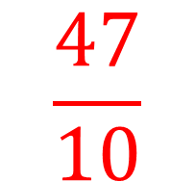
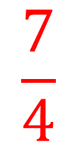
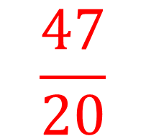
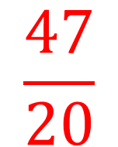

$$\frac{47}{10}$$
$$\frac{47}{20}$$
÷
=
$$2$$
$$\frac{47}{20}$$
$$\frac{7}{4}$$
$$\frac{3}{5}$$
-
=

Slide 6
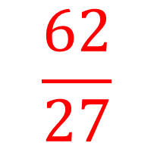
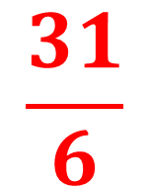
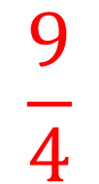

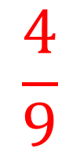
$$\frac{62}{27}$$
$$\frac{4}{9}$$
÷
$$\frac{62}{27}$$
$$\frac{9}{4}$$
$$\frac{31}{6}$$
x
=

Slide 7
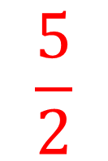
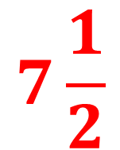
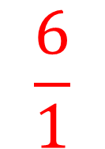
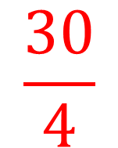

$$\frac{1}{2}$$
$$\frac{5}{2}$$
$$\frac{6}{1}$$
$$\frac{30}{4}$$
$$7\frac{1}{2}$$
x
x
=
=

