Slide 1
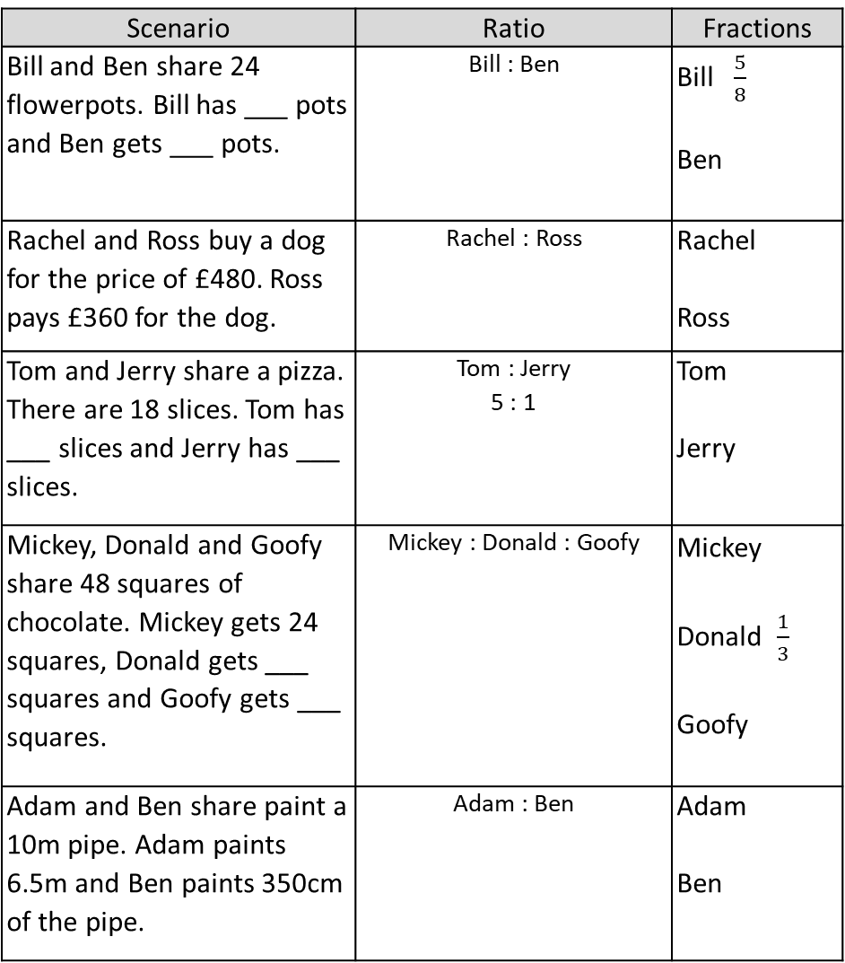
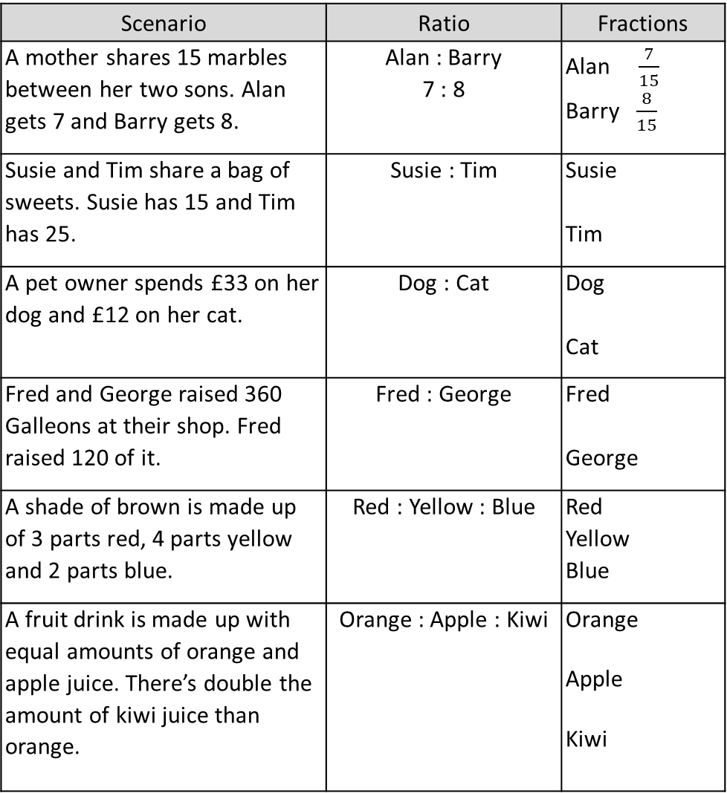
Scenario | Ratio | Fractions
A mother shares 15 marbles between her two sons. Alan gets 7 and Barry gets 8. | Alan : Barry 7 : 8 | Alan $\frac{7}{15}$ Barry $\frac{8}{15}$
Susie and Tim share a bag of sweets. Susie has 15 and Tim has 25. | Susie : Tim | Susie Tim
A pet owner spends £33 on her dog and £12 on her cat. | Dog : Cat | Dog Cat
Fred and George raised 360 Galleons at their shop. Fred raised 120 of it. | Fred : George | Fred George
A shade of brown is made up of 3 parts red, 4 parts yellow and 2 parts blue. | Red : Yellow : Blue | Red Yellow Blue
A fruit drink is made up with equal amounts of orange and apple juice. There’s double the amount of kiwi juice than orange. | Orange : Apple : Kiwi | Orange Apple Kiwi
Scenario | Ratio | Fractions
Bill and Ben share 24 flowerpots. Bill has ___ pots and Ben gets ___ pots. | Bill : Ben | Bill $\frac{5}{8}$ Ben
Rachel and Ross buy a dog for the price of £480. Ross pays £360 for the dog. | Rachel : Ross | Rachel Ross
Tom and Jerry share a pizza. There are 18 slices. Tom has ___ slices and Jerry has ___ slices. | Tom : Jerry 5 : 1 | Tom Jerry
Mickey, Donald and Goofy share 48 squares of chocolate. Mickey gets 24 squares, Donald gets ___ squares and Goofy gets ___ squares. | Mickey : Donald : Goofy | Mickey Donald $\frac{1}{3}$ Goofy
Adam and Ben share paint a 10m pipe. Adam paints 6.5m and Ben paints 350cm of the pipe. | Adam : Ben | Adam Ben

Slide 2
ANSWERS

Slide 3





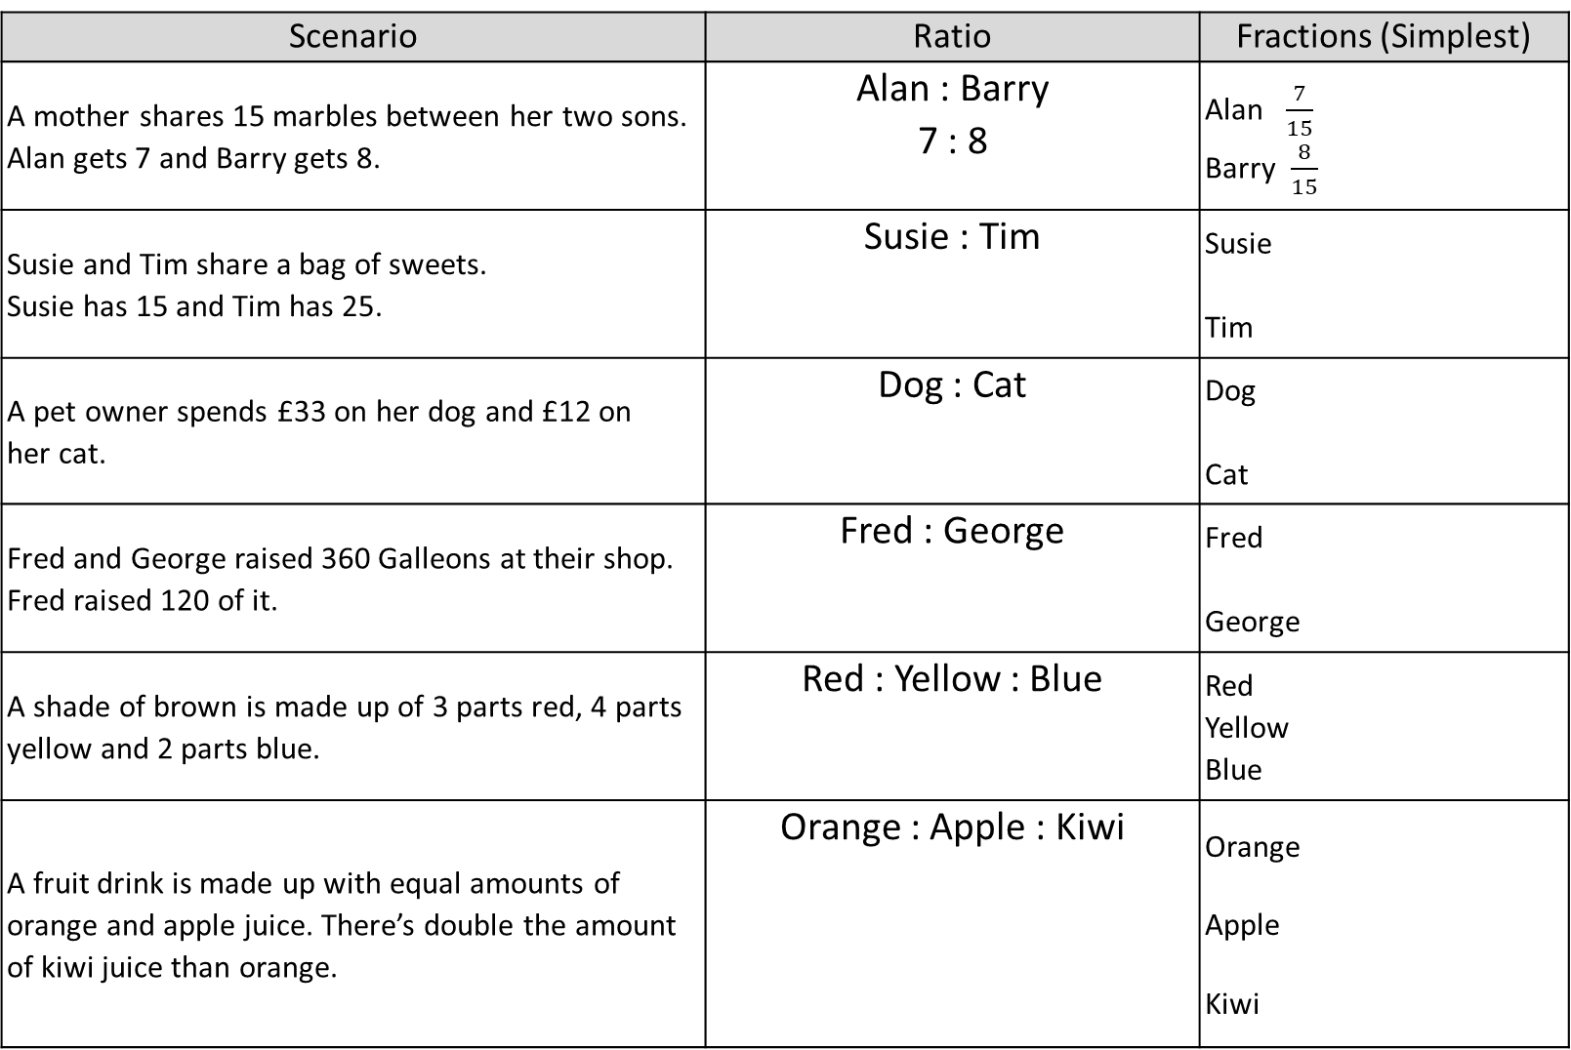







Scenario | Ratio | Fractions (Simplest)
A mother shares 15 marbles between her two sons. Alan gets 7 and Barry gets 8. | Alan : Barry 7 : 8 | Alan $\frac{7}{15}$ Barry $\frac{8}{15}$
Susie and Tim share a bag of sweets. Susie has 15 and Tim has 25. | Susie : Tim | Susie Tim
A pet owner spends £33 on her dog and £12 on her cat. | Dog : Cat | Dog Cat
Fred and George raised 360 Galleons at their shop. Fred raised 120 of it. | Fred : George | Fred George
A shade of brown is made up of 3 parts red, 4 parts yellow and 2 parts blue. | Red : Yellow : Blue | Red Yellow Blue
A fruit drink is made up with equal amounts of orange and apple juice. There’s double the amount of kiwi juice than orange. | Orange : Apple : Kiwi | Orange Apple Kiwi
$$\frac{3}{8}$$
15 : 25
3 : 5
$$\frac{5}{8}$$
$$\frac{11}{15}$$
33 : 12
11 : 4
$$\frac{4}{15}$$
$$\frac{1}{3}$$
240 : 120
1 : 2
$$\frac{2}{3}$$
$$\frac{1}{3}$$
$$\frac{4}{9}$$
3 : 4 : 2
$$\frac{2}{9}$$
$$\frac{1}{4}$$
1 : 1 : 2
$$\frac{1}{4}$$
$$\frac{1}{2}$$

Slide 4



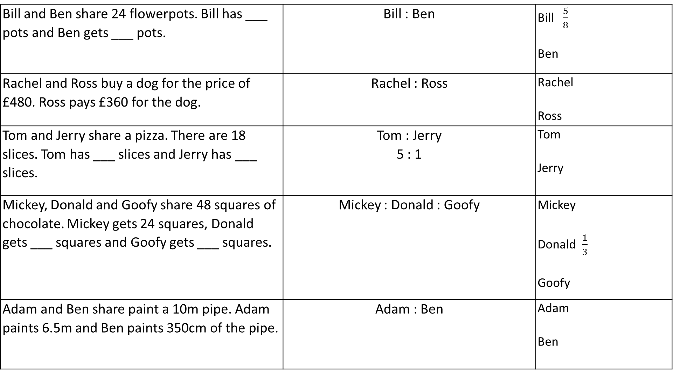




15
Bill and Ben share 24 flowerpots. Bill has ___ pots and Ben gets ___ pots. | Bill : Ben | Bill $\frac{5}{8}$ Ben
Rachel and Ross buy a dog for the price of £480. Ross pays £360 for the dog. | Rachel : Ross | Rachel Ross
Tom and Jerry share a pizza. There are 18 slices. Tom has ___ slices and Jerry has ___ slices. | Tom : Jerry 5 : 1 | Tom Jerry
Mickey, Donald and Goofy share 48 squares of chocolate. Mickey gets 24 squares, Donald gets ___ squares and Goofy gets ___ squares. | Mickey : Donald : Goofy | Mickey Donald $\frac{1}{3}$ Goofy
Adam and Ben share paint a 10m pipe. Adam paints 6.5m and Ben paints 350cm of the pipe. | Adam : Ben | Adam Ben
9
5 : 3
$$\frac{3}{8}$$
$$\frac{1}{4}$$
120 : 360
1 : 3
$$\frac{3}{4}$$
$$\frac{5}{6}$$
15
3
$$\frac{1}{6}$$
$$\frac{1}{2}$$
24 : 16 : 8
3 : 2 : 1
16
8
$$\frac{1}{6}$$
$$\frac{13}{20}$$
650 : 350
13 : 7
$$\frac{7}{20}$$

