Slide 1
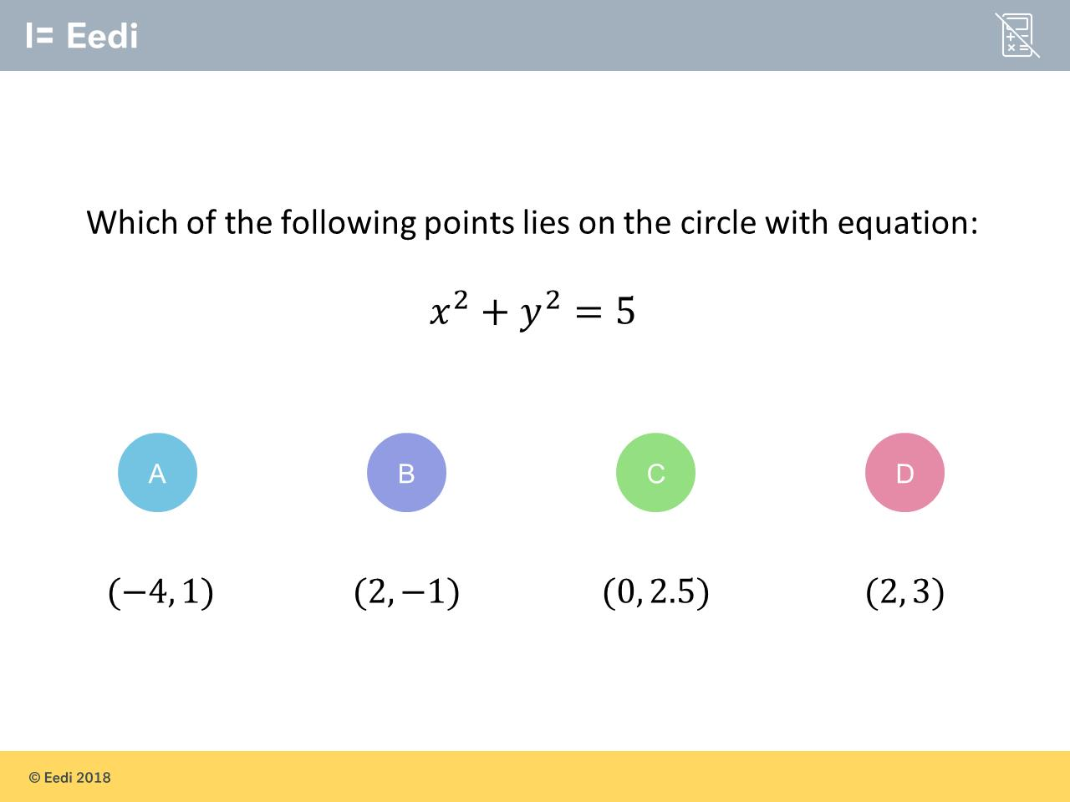
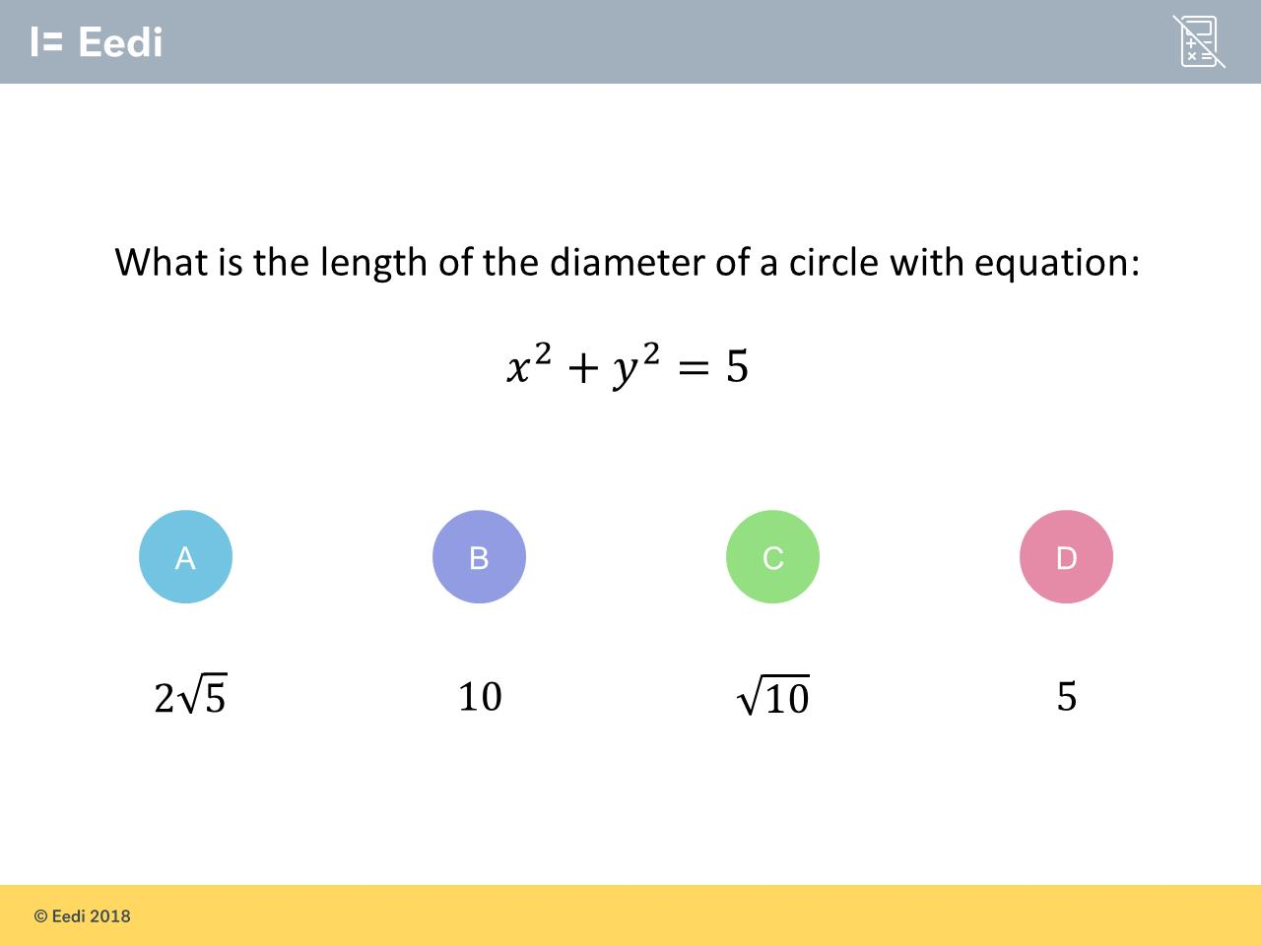
Worst answered question?
Most common wrong answer?

Slide 2
ANSWERS

Slide 3
Worst answered question?

Slide 4
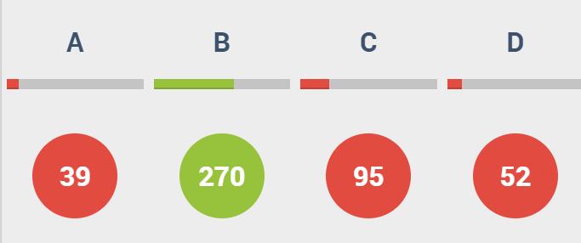
C
The student may have doubled the
y coordinate,
instead of squaring.

Slide 5
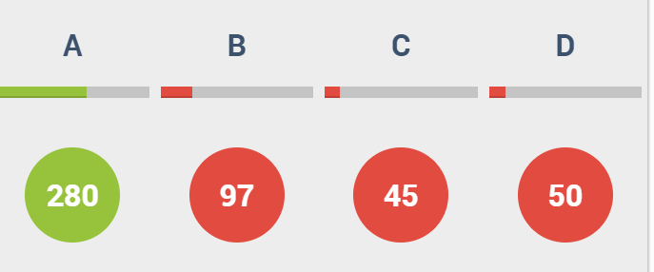
B
The student may think that the radius is 5.

