Slide 1
Integration
Finding Areas
Chapter 11
(Part 8 of 12)

Slide 2
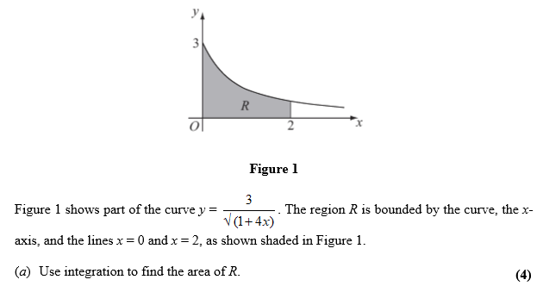

Slide 3
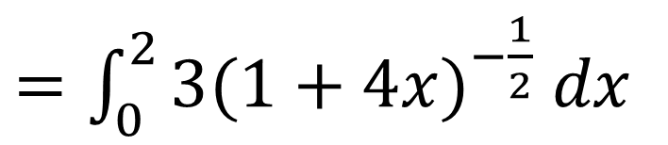
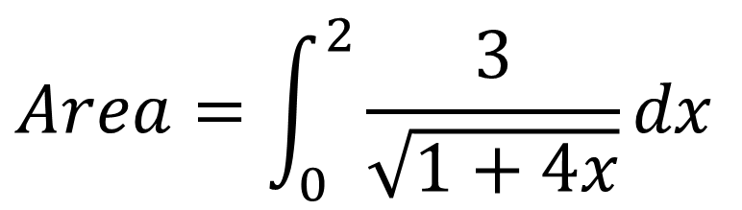
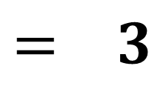
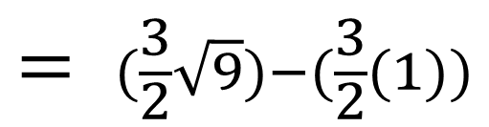
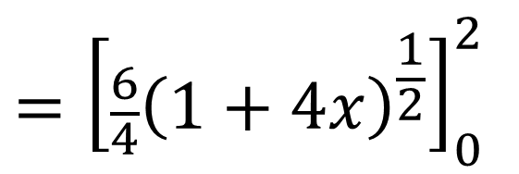
$$Area=\int_{0}^{2}{\frac{3}{\sqrt{1+4x}}dx}$$
$=\int_{0}^{2}{{3(1+4x)}^{−\frac{1}{2}}}$ $dx$
$$={\left[\frac{6}{4}{\left(1+4x\right)}^{\frac{1}{2}}\right]}_{0}^{2}$$
$$= (\frac{3}{2}\sqrt{9})−(\frac{3}{2}(1))$$
$$= 3$$

Slide 4
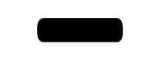




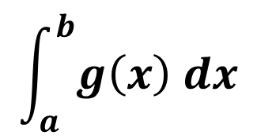





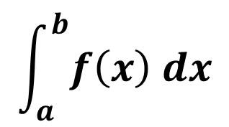









$$y$$
$$y=f\left(x\right)$$
$$R$$
Area between two curves
$$y=g\left(x\right)$$
$$x$$
-
$$a$$
$$b$$
$$y$$
$$y$$
$$y=f\left(x\right)$$
=
$$R$$
$$y=g\left(x\right)$$
$$x$$
$$x$$
$$a$$
$$b$$
$$a$$
$$b$$
$$\int_{a}^{b}{f\left(x\right) dx}$$
$$\int_{a}^{b}{g\left(x\right) dx}$$

Slide 5
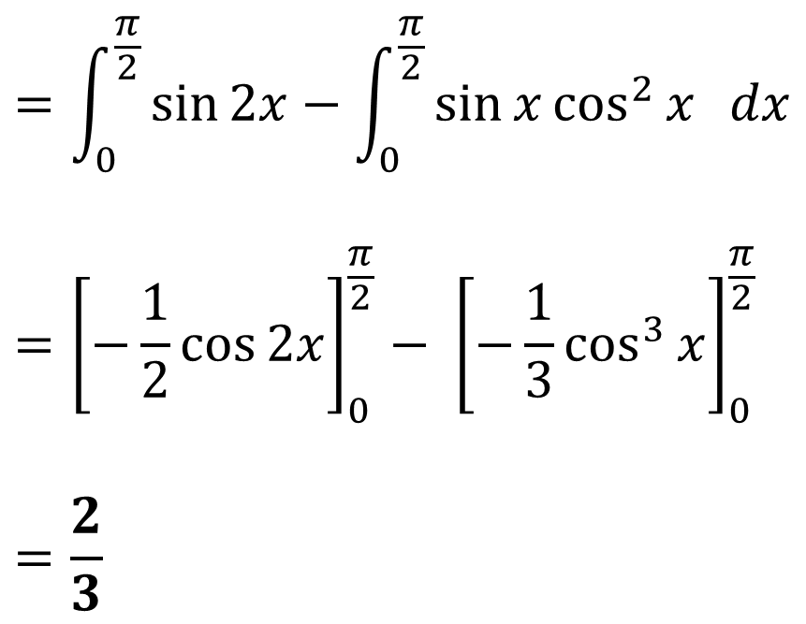
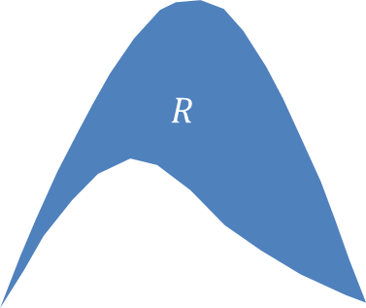

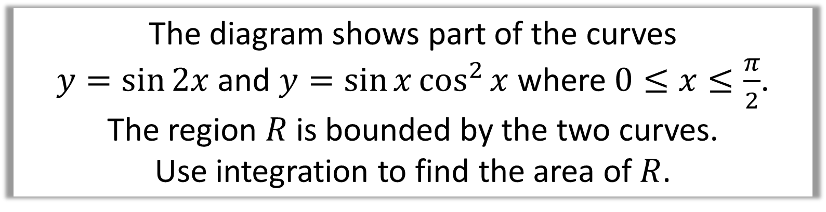
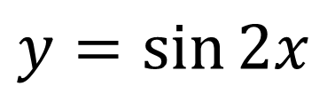


The diagram shows part of the curves
$y=\sin{2x}$ and $y=\sin{x}\cos^{2}{x}$ where $0≤x≤\frac{π}{2}$.
The region $R$ is bounded by the two curves.
Use integration to find the area of $R$.
$$y$$
$$=\int_{0}^{\frac{π}{2}}{\sin{2x}−\int_{0}^{\frac{π}{2}}{\sin{x}\cos^{2}{x} dx}}$$
$$={\left[−\frac{1}{2}\cos{2x}\right]}_{0}^{\frac{π}{2}}− {\left[−\frac{1}{3}\cos^{3}{x}\right]}_{0}^{\frac{π}{2}}$$
$$=\frac{2}{3}$$
$$y=\sin{2x}$$
$$R$$
$$y=\sin{x}\cos^{2}{x}$$
$$x$$

Slide 6
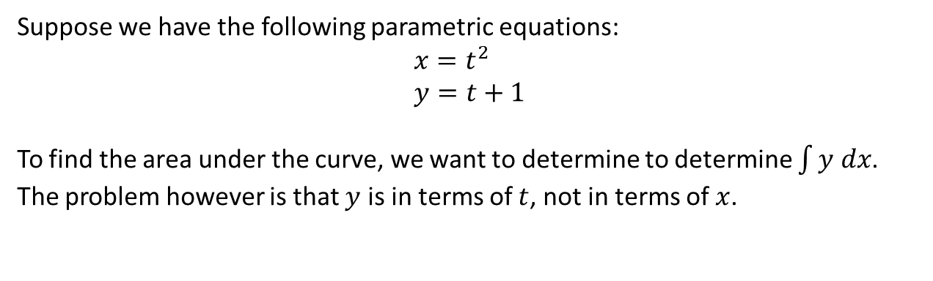

Integration with Parametric Equations
Suppose we have the following parametric equations:
$$x=t^{2} \\ y=t+1$$
To find the area under the curve, we want to determine to determine $\int{y dx}$. The problem however is that $y$ is in terms of $t$, not in terms of $x$.
Area: $\int{y dx}=\int{y\frac{dx}{dt} dt}$

Slide 7
Integration with Parametric Equations

Slide 8
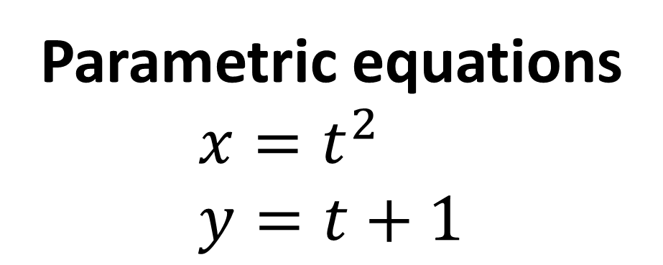
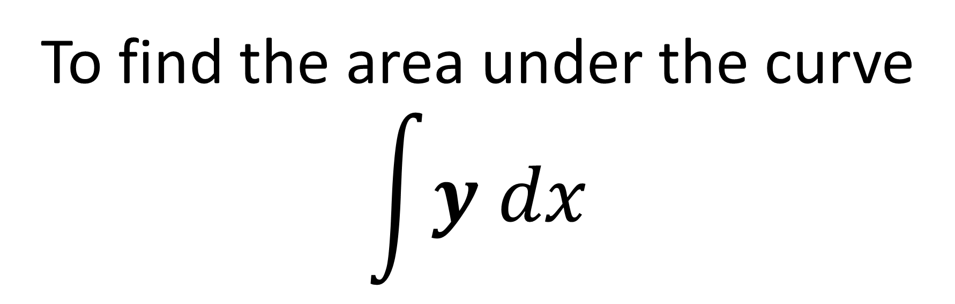
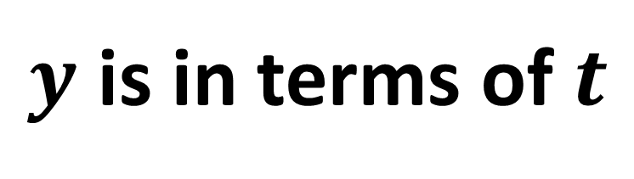
To find the area under the curve
$$\int{y dx}$$
Parametric equations
$$x=t^{2} \\ y=t+1$$
What is the problem?
$y$ is in terms of $t$

Slide 9
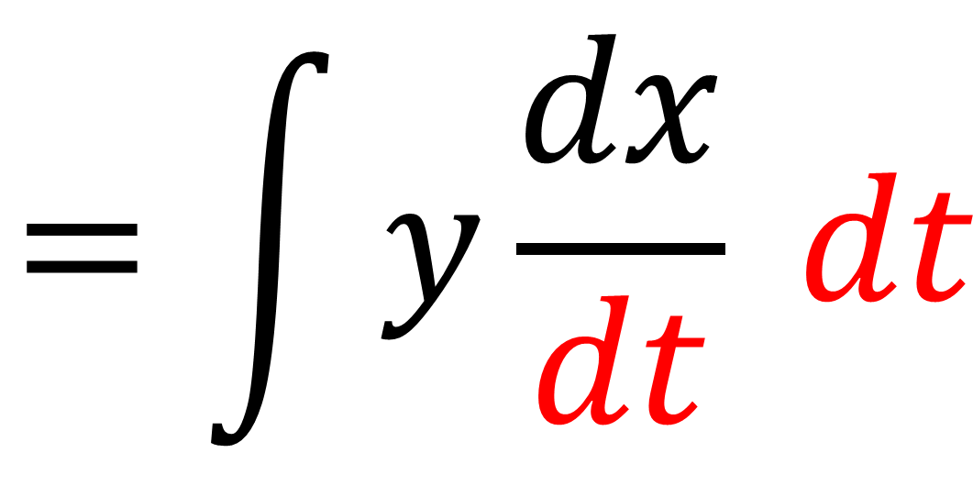
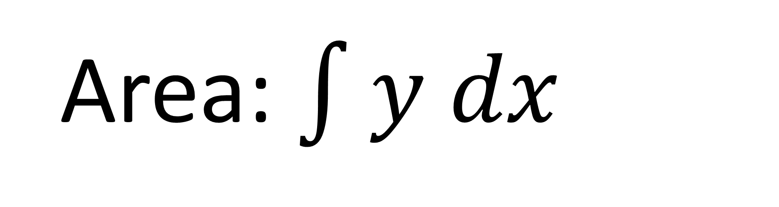
Limits are in terms of x
Area: $\int{y dx}$
Limits are in terms of t
$$=\int{y\frac{dx}{dt} dt}$$

Slide 10
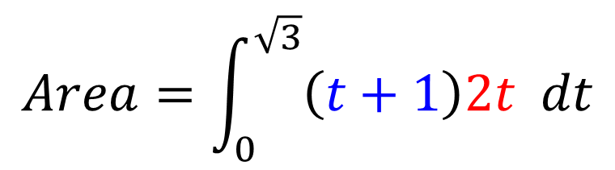
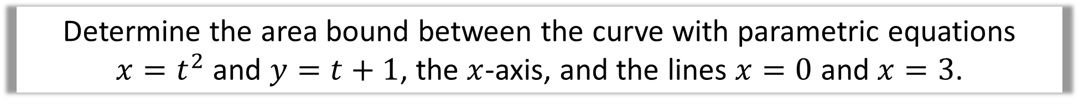

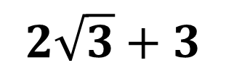
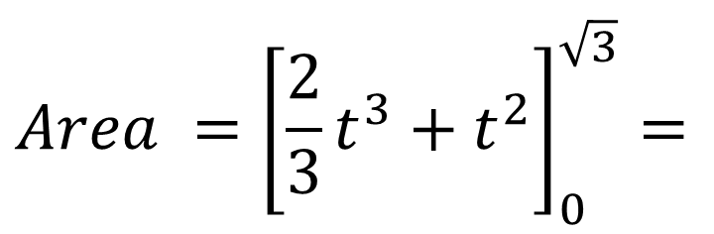
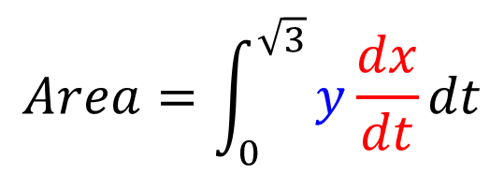
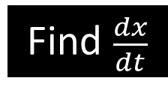
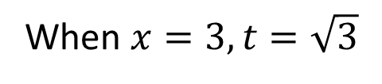
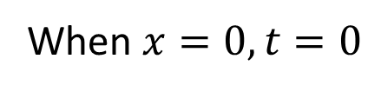
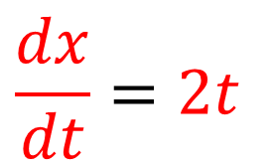
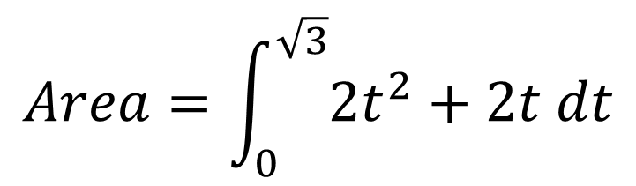
Determine the area bound between the curve with parametric equations
$x=t^{2}$ and $y=t+1$, the $x$-axis, and the lines $x=0$ and $x=3$.
Change Limits
Substitute
$$Area=\int_{0}^{\sqrt{3}}{\left(t+1\right)2t dt}$$
When $x=3, t=\sqrt{3}$
When $x=0, t=0$
$$Area=\int_{0}^{\sqrt{3}}{y\frac{dx}{dt}dt}$$
$$Area=\int_{0}^{\sqrt{3}}{2t^{2}+2t dt}$$
Find $\frac{dx}{dt}$
Integrate and Area
$$Area ={\left[\frac{2}{3}t^{3}+t^{2}\right]}_{0}^{\sqrt{3}}=$$
$$\frac{dx}{dt}=2t$$
$x=t^{2}$
$$2\sqrt{3}+3$$

Slide 11
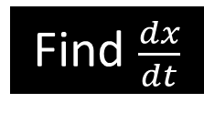

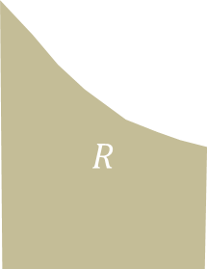
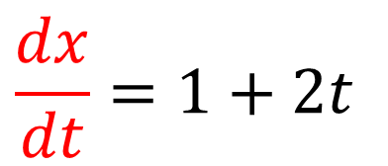
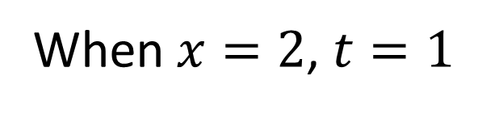
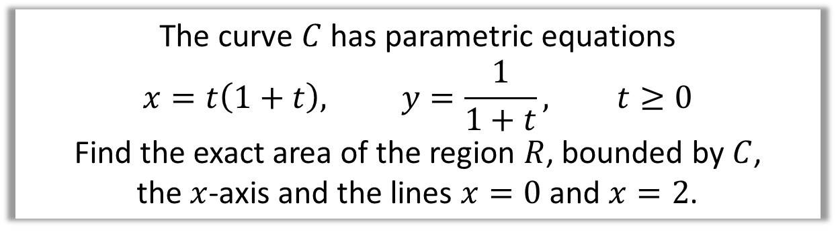
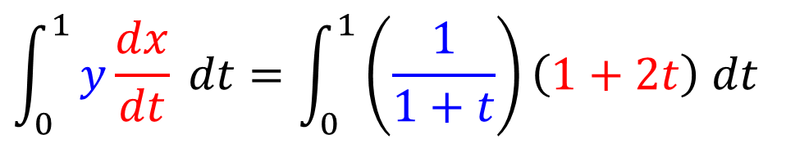
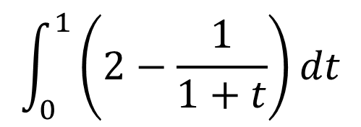
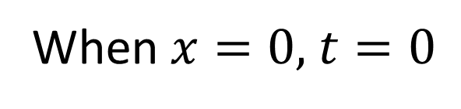
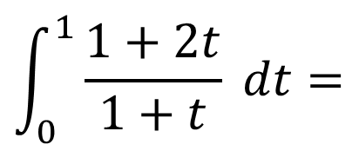


The curve $C$ has parametric equations
$$x=t\left(1+t\right), y=\frac{1}{1+t}, t≥0$$
Find the exact area of the region $R$, bounded by $C$,
the $x$-axis and the lines $x=0$ and $x=2$.
$$R$$
$$C$$
2
Change Limits
Substitute
When $x=0,$ $t=0$
$$\int_{0}^{1}{y\frac{dx}{dt} dt}=\int_{0}^{1}{\left(\frac{1}{1+t}\right)\left(1+2t\right) dt}$$
When $x=2$, $t=1$
$$\int_{0}^{1}{\frac{1+2t}{1+t} dt}=$$
$$\int_{0}^{1}{\left(2−\frac{1}{1+t}\right)dt}$$
Find $\frac{dx}{dt}$
$$\frac{dx}{dt}=1+2t$$
Integrate and Area
$${\left[2t−\ln\left|1+t\right|\right]}_{0}^{1}=$$
$$2−\ln{2}$$

Slide 12
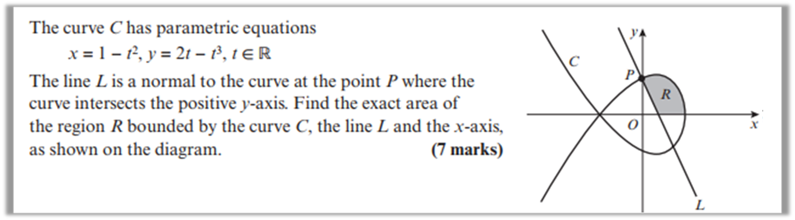
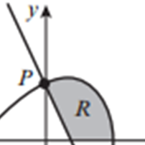
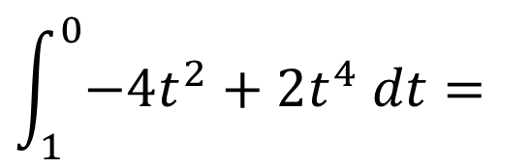

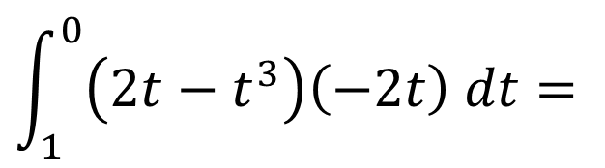
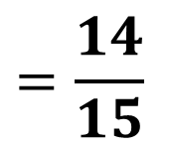
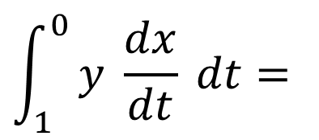
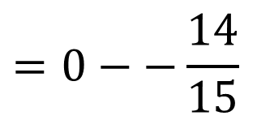

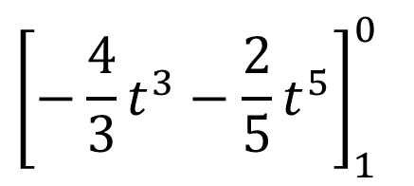

Area under the curve
$${\left[−\frac{4}{3}t^{3}−\frac{2}{5}t^{5}\right]}_{1}^{0}$$
$$\int_{1}^{0}{y \frac{dx}{dt} dt}=$$
$$x=0$$
$$t=1$$
$$=0−−\frac{14}{15}$$
$$\int_{1}^{0}{\left(2t−t^{3}\right)\left(−2t\right) dt=}$$
$$t=0$$
$$\int_{1}^{0}{−4t^{2}+2t^{4} dt=}$$
$$=\frac{14}{15}$$

Slide 13
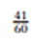
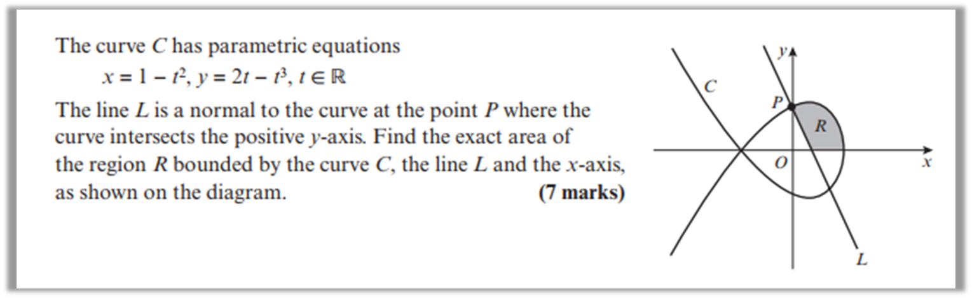
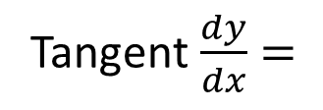

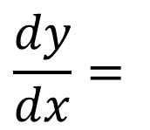










Find the equation of the linear line
When $t=1$
Tangent $\frac{dy}{dx}=$
$$\frac{1}{2}$$
$$\frac{dx}{dt}=$$
$$\frac{dy}{dt}=$$
$$−2t$$
$$2−3t^{2}$$
$$t=1$$
Normal $\frac{dy}{dx}=$
$$−2$$
$$\frac{dy}{dx}=$$
$$\frac{2−3t^{2}}{−2t}$$
$$y=−2x+1$$

Slide 14










Find the area of the triangle
$$y=−2x+1$$
$$y=1$$
$Area=1 \text{x} \frac{1}{2} \text{x} \frac{1}{2}=$ $\frac{1}{4}$
$$t=1$$
$$y=1$$
$$0=−2x+1$$
$$x=\frac{1}{2}$$
Find the area R
$$x=\frac{1}{2}$$
$R=\frac{56}{60}−\frac{1}{4}=$ $\frac{41}{60}$
$$y=0$$

