Slide 1
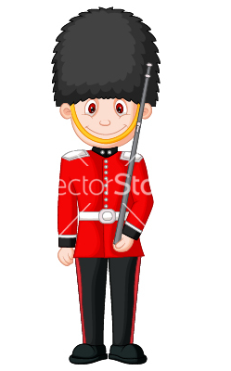
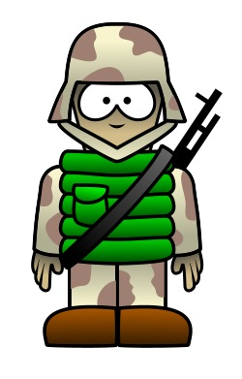

Build an Army and win the battle!

Slide 2


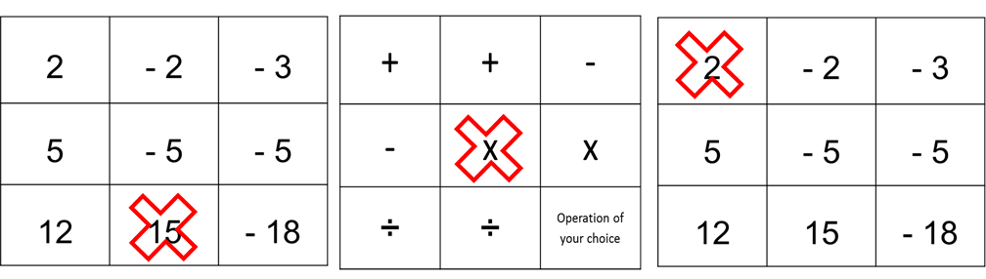
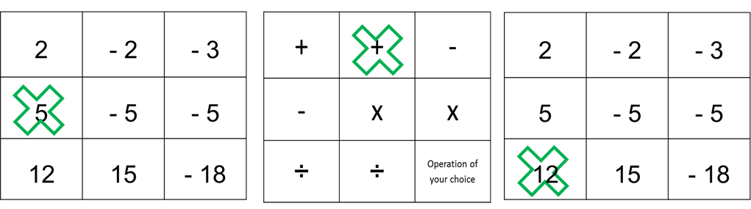

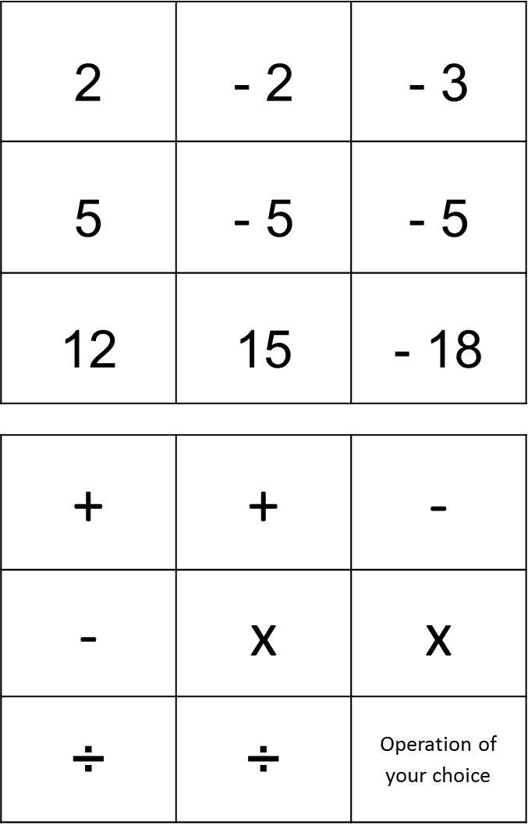


Example of a Battle
Player A and Player B pick two numbers and a operation
Player A and Player B revel their calculations at the same time.
Strength = 30
Strength = 17
Highest score win.
The person who wins the most battles (out of 9) wins the wars!
Once you have used a square you cannot use it again.

Slide 3
