Slide 1
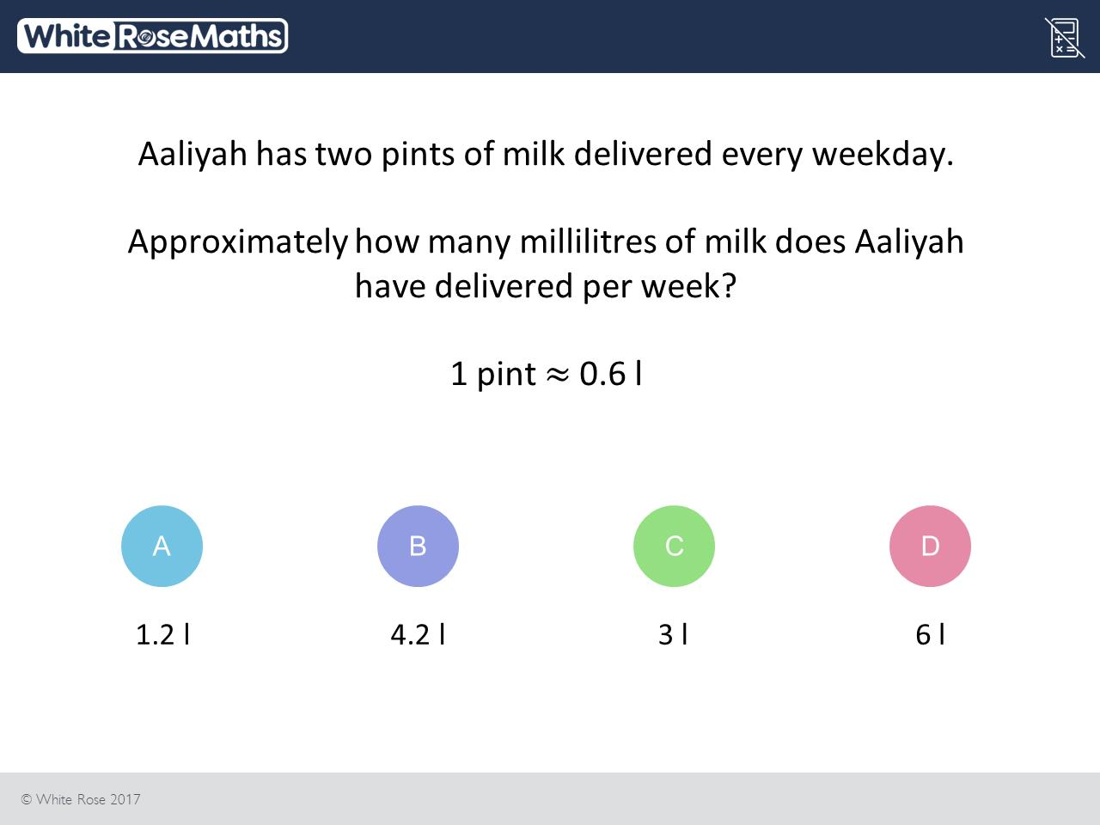
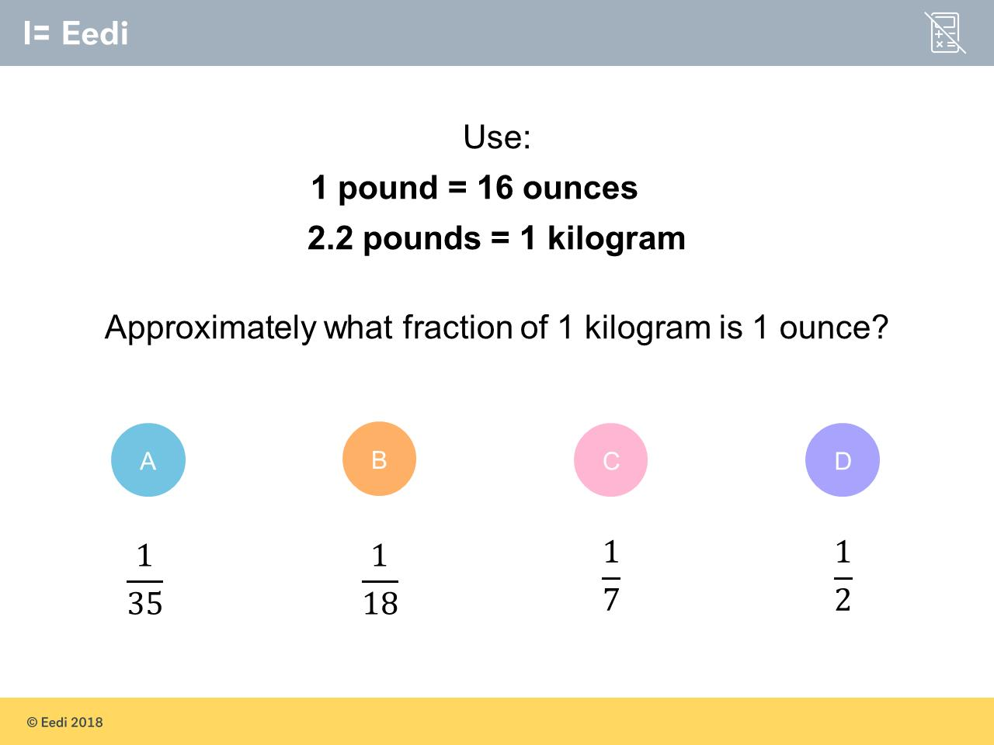
Worst answered question?
Most common wrong answer?

Slide 2
ANSWERS

Slide 3
Worst answered question?

Slide 4
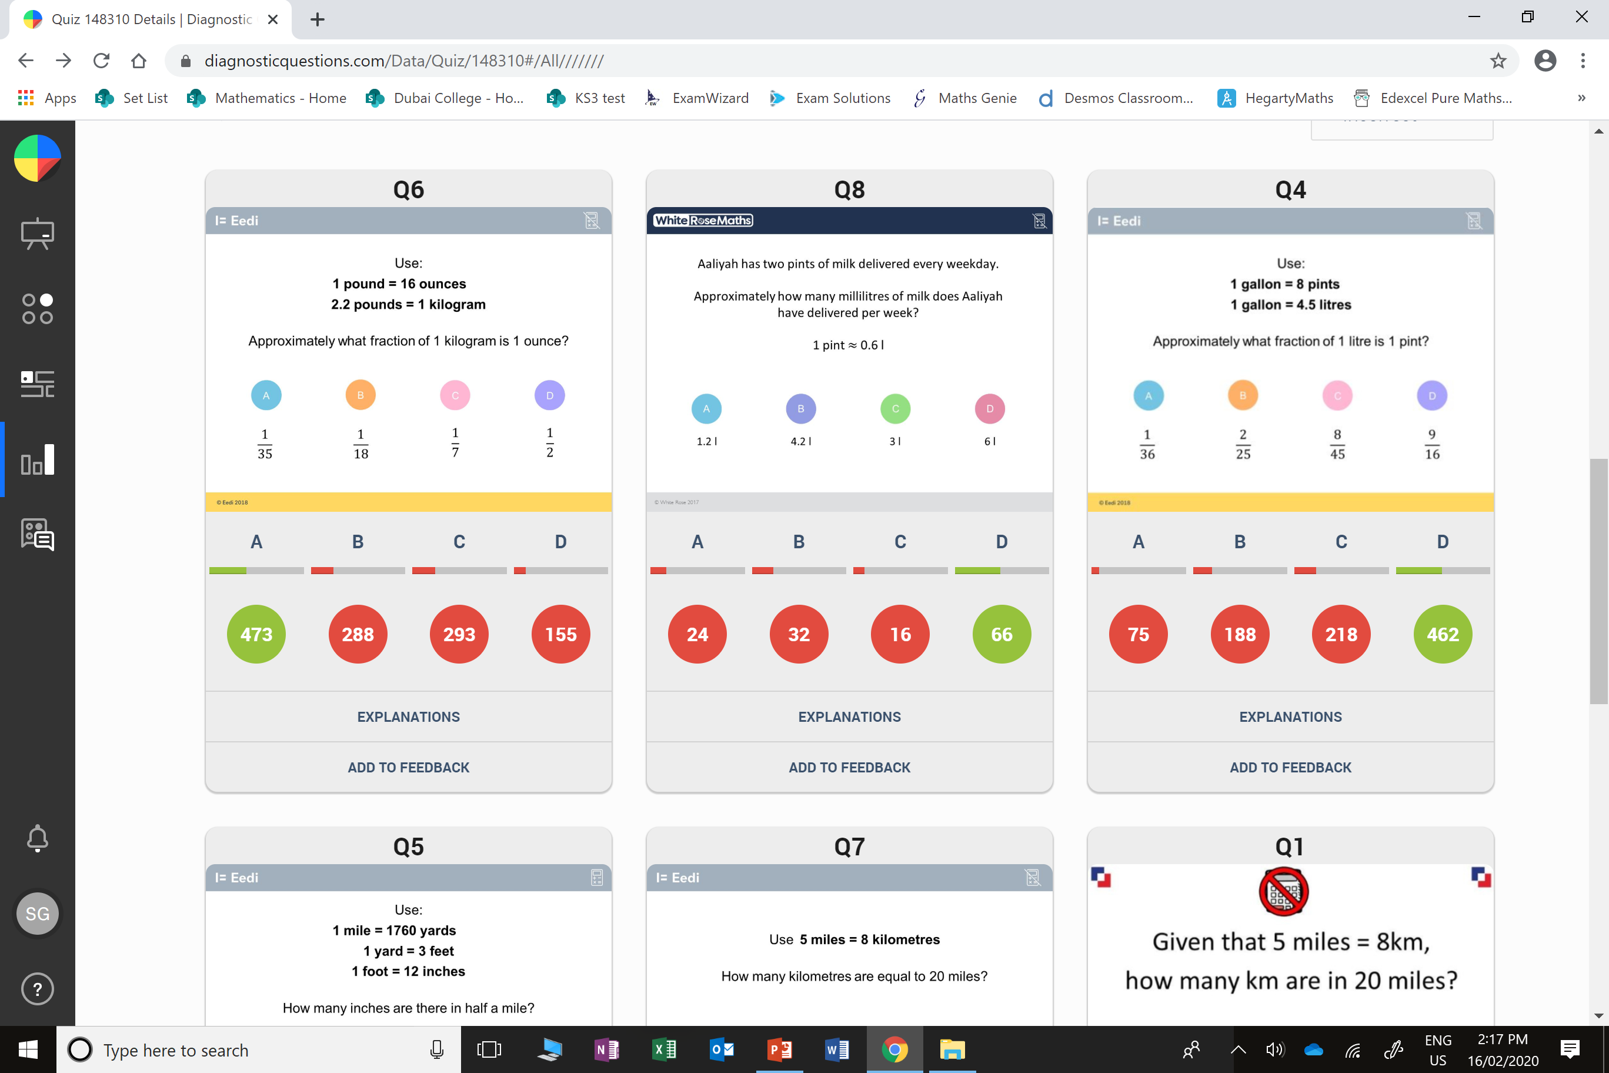
C
The student has divided 16 by 2.2, rather than multiplying.

Slide 5
B
They have done
7 days and
1 pint per day.

