Slide 1
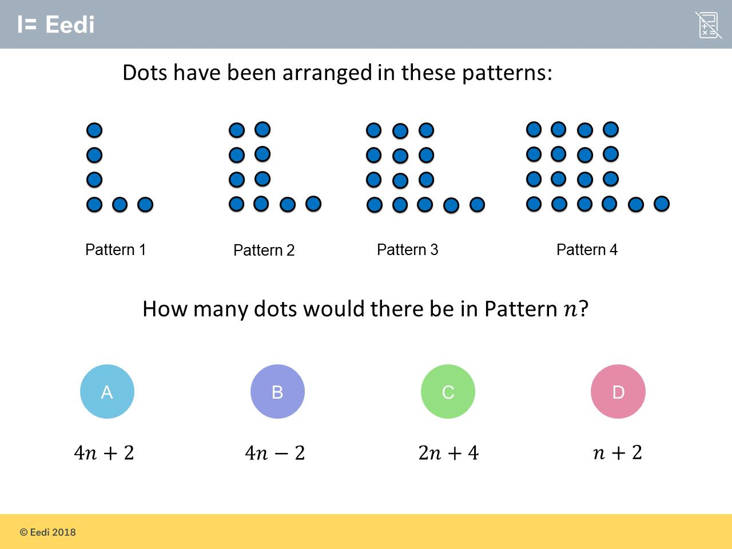
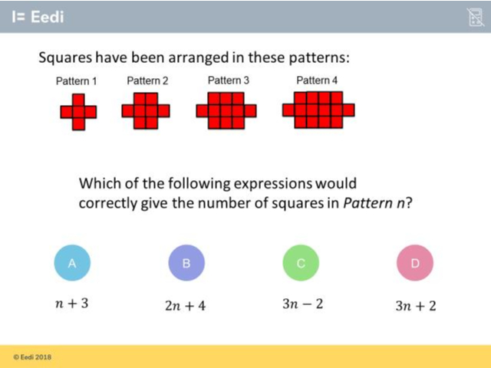
Worst answered question?
Most common wrong answer?

Slide 2
ANSWERS

Slide 3
Worst answered question?

Slide 4
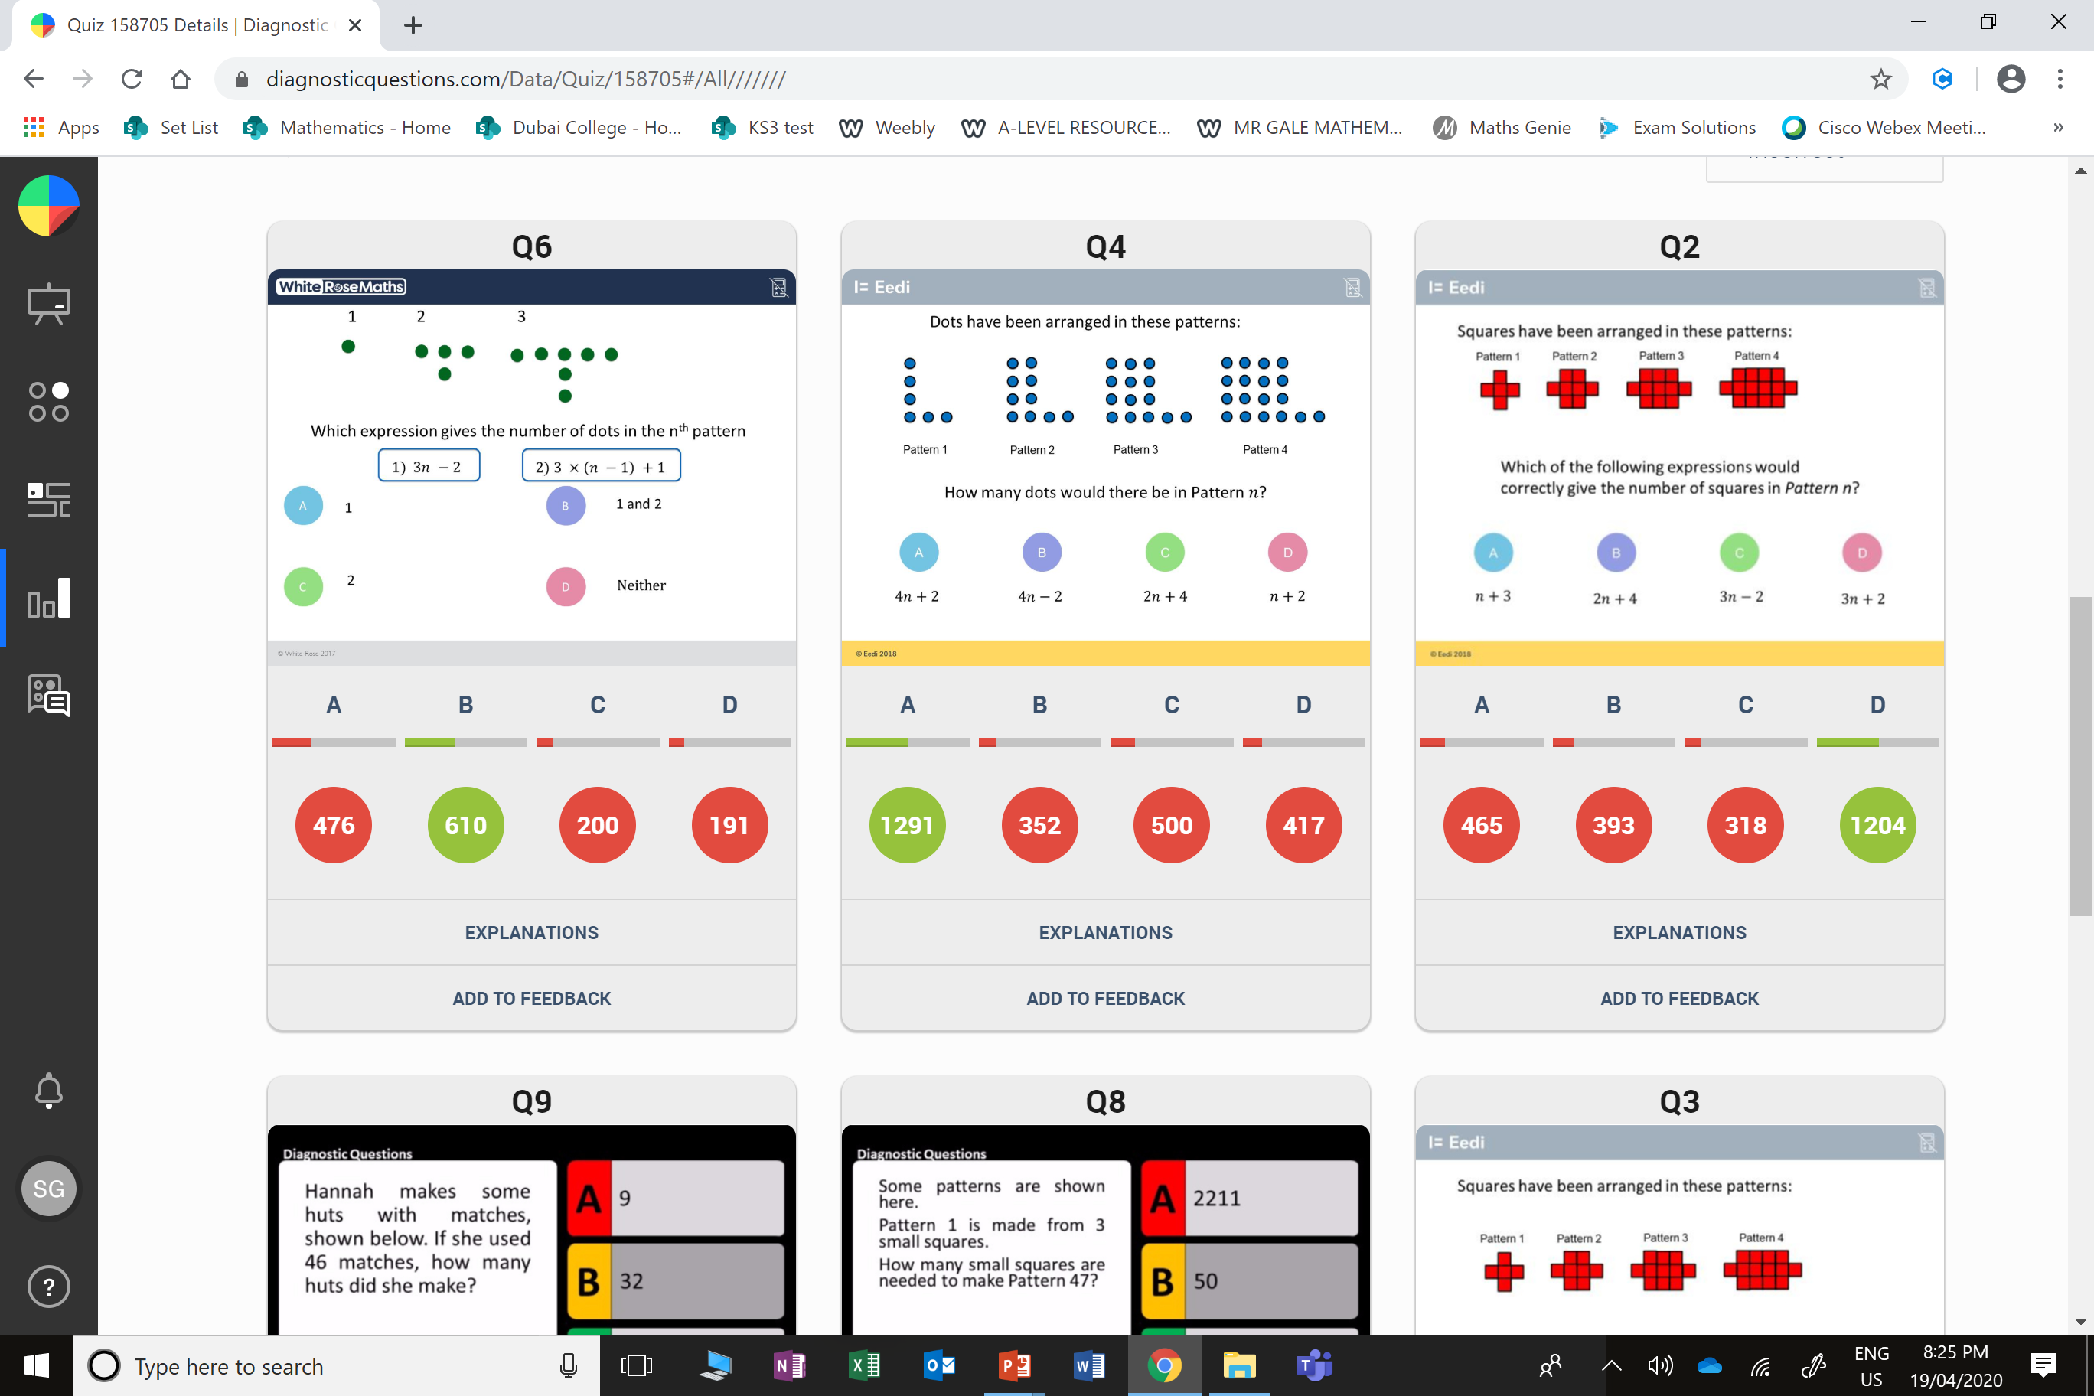
C
They got the multiplier and addition the wrong way round.

Slide 5
A
The student may just be thinking about the extra squares being added on.

