Slide 1
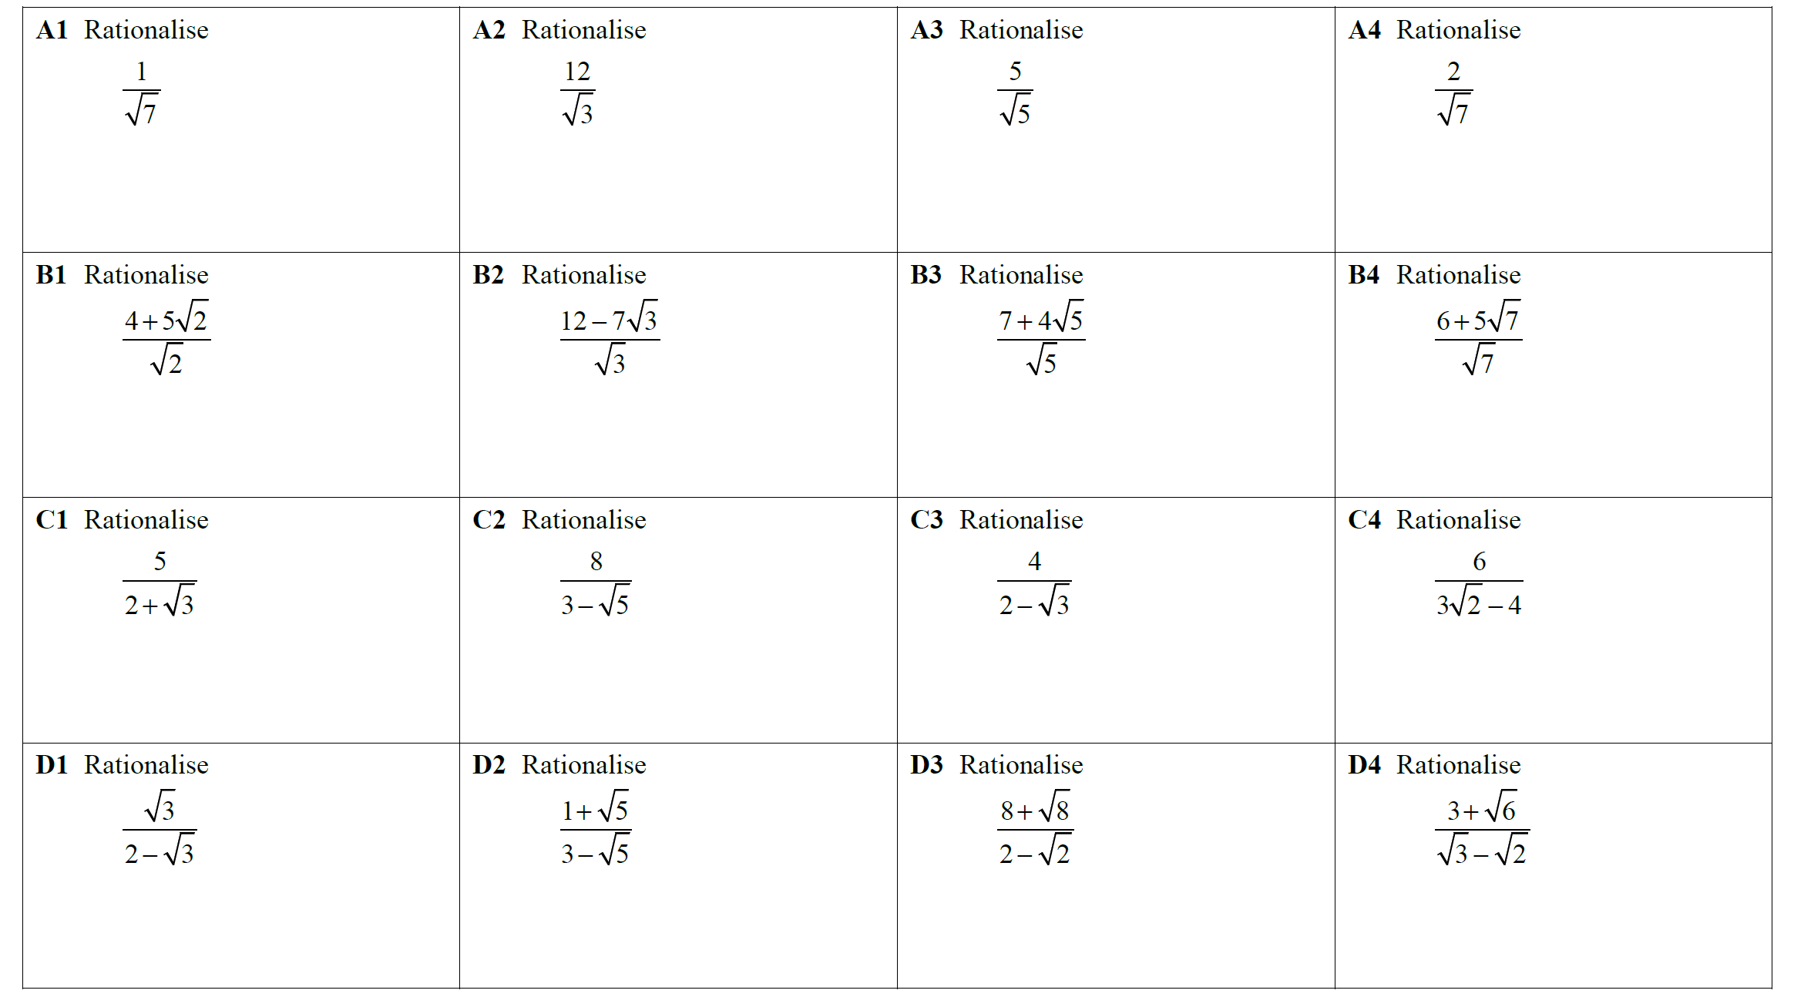


Slide 2
ANSWERS

Slide 3
