Slide 1

Diagnostic Assessment .Delta 2
Unit 7
Constructing Triangles
Bisecting Lines
and Angles
Loci

Slide 2
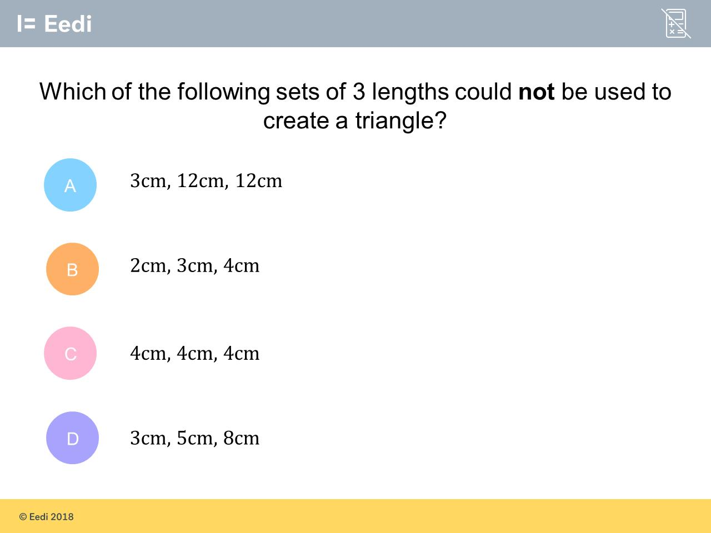
Question 1 – Constructing Triangles

Slide 3
Answer 1 – Constructing Triangles
CORRECT ANSWER | CORRECT EXPLANATION
3cm, 5cm, 8cm | To make a triangle, we need the sum of two sides to be greater than the other side. we have 3 + 5 = 8, so this would not be a triangle.
COMMON MISTAKES | WHAT MIGHT BE YOUR MISTAKE
3cm, 12cm, 12cm | The student may believe that there is too large a difference between the first two sides.
2cm, 3cm, 4cm | The student may believe that the first length is too short.
4cm, 4cm, 4cm | The student may believe all 3 sides are too short.

Slide 4
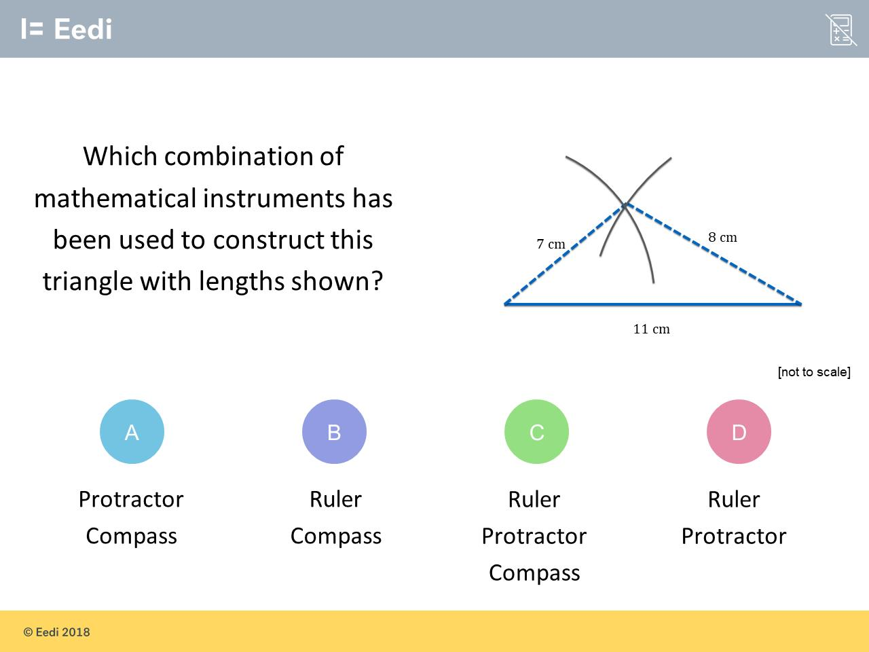
Question 2 – Constructing Triangles

Slide 5
Answer 2 – Constructing Triangles
CORRECT ANSWER | CORRECT EXPLANATION
B | The ruler is necessary to measure the 11 cm base of the triangle The compass is then set at 7 cm with the point placed at the left end of the 11 cm line. An arc is then drawn. The compass is then set at 8 cm and another arc drawn so as to intersect with the first arc (as shown). This point is the apex of the triangle, and the sides of 7 and 8 cm can now be drawn to form the triangle.
COMMON MISTAKES | WHAT MIGHT BE YOUR MISTAKE
A | The student may not realise that no angle values have been given in the question.
C | The student may not realise that the angles will be fixed by the length of the sides, and no angle values have been given anyway.
D | The student may not understand that the sides need to be measured, whereas angle values are not given.

Slide 6
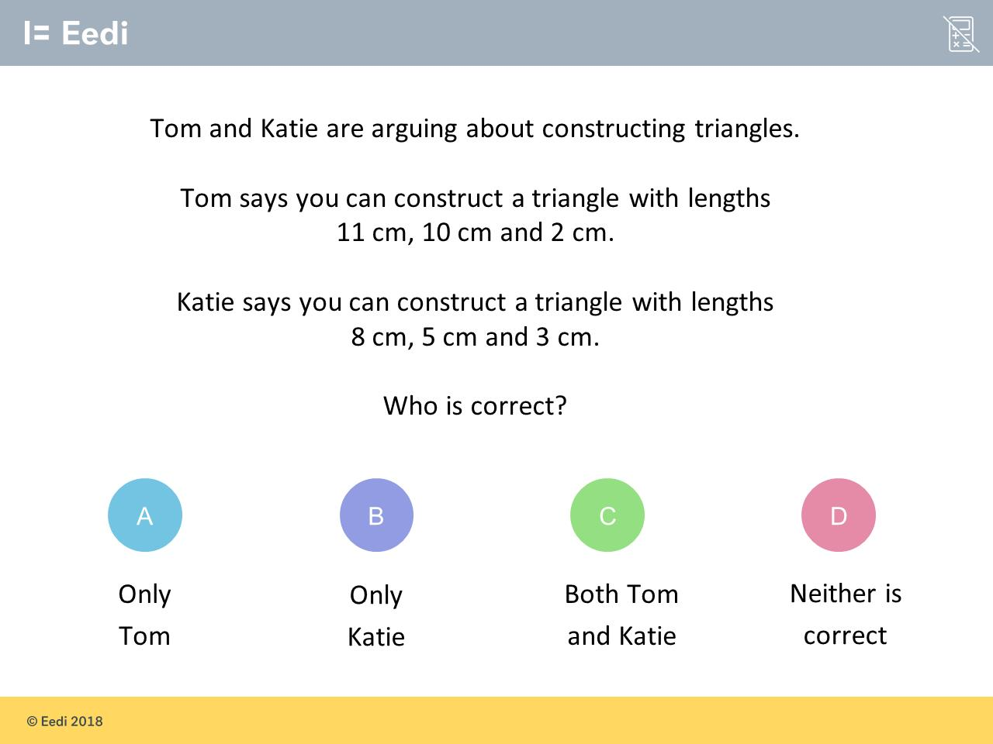
Question 3 – Constructing Triangles

Slide 7
Answer 3 – Constructing Triangles
CORRECT ANSWER | CORRECT EXPLANATION
A | For Tom’s statement, picture just two sides of a triangle (with lengths 11 cm and 10 cm). Now imagine the angle between them varying. The possibilities for the length of the third side are endless, and would include a value of 2 cm. Values must, however, be greater than 1 cm: a value of 1 cm would mean there would be no angle between the two longer sides, and hence, no triangle. This is what would happen with Katie’s lengths because 5 ＋ 3 = 8.
COMMON MISTAKES | WHAT MIGHT BE YOUR MISTAKE
B | The student may be think the shortest lengths just need to add to the longest length, and be confused by the big difference between the longest and shortest sides.
C | The student may be think the shortest lengths just need to add to the longest length.
D | The student may be confused by the big difference between the longest and shortest sides.

Slide 8
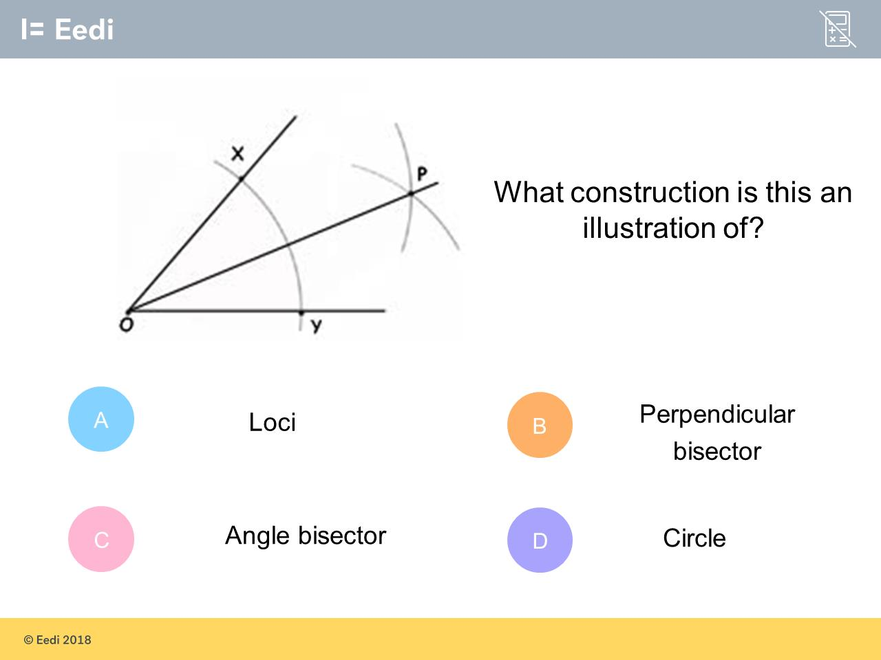
Question 4 – Bisecting Lines and Angles

Slide 9
Answer 4 – Bisecting Lines and Angles
CORRECT ANSWER | CORRECT EXPLANATION
C | This is an angle bisector, as the angle is split into two equal segments.
COMMON MISTAKES | WHAT MIGHT BE YOUR MISTAKE
A | The student may be confused with the general term for this topic.
B | The student may be confused with another common type of construct.
C | The student may be confused by the arc, which is part of a circle.

Slide 10
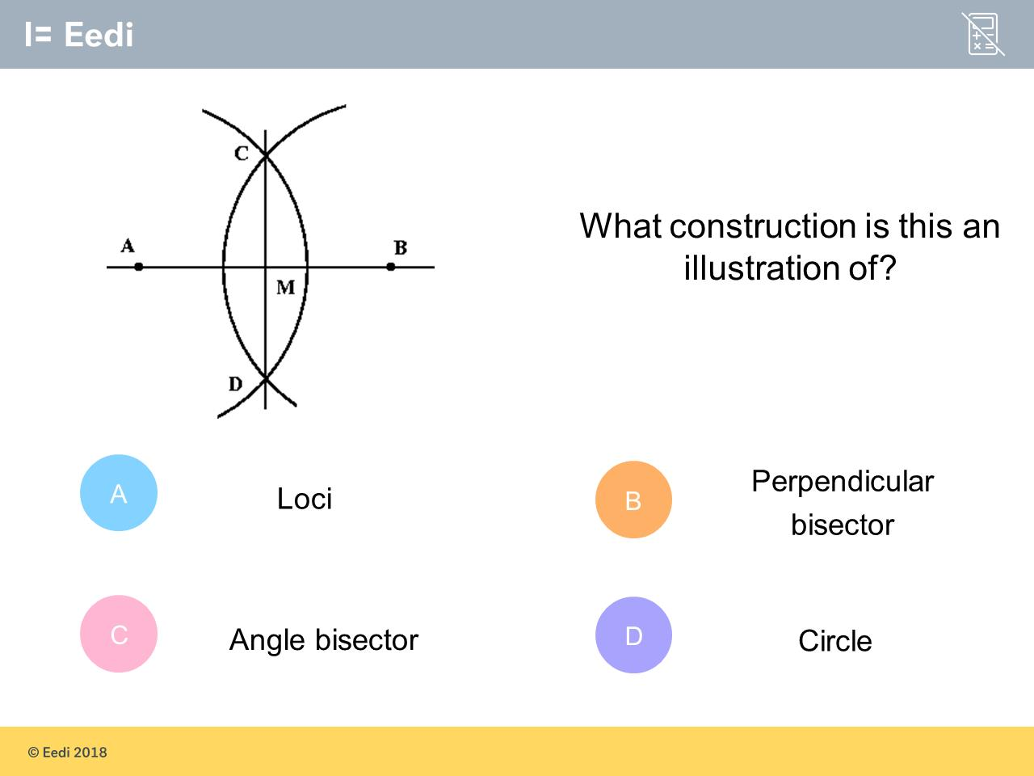
Question 5 – Bisecting Lines and Angles

Slide 11
Answer 5 – Bisecting Lines and Angles
CORRECT ANSWER | CORRECT EXPLANATION
B | This is a perpendicular bisector as we have a perpendicular line that is equidistant from A and B.
COMMON MISTAKES | WHAT MIGHT BE YOUR MISTAKE
A | The student may be confused with the general term for this topic.
C | The student may be confused with another common type of construct.
D | The student may be confused by the arc, which is part of a circle.

Slide 12
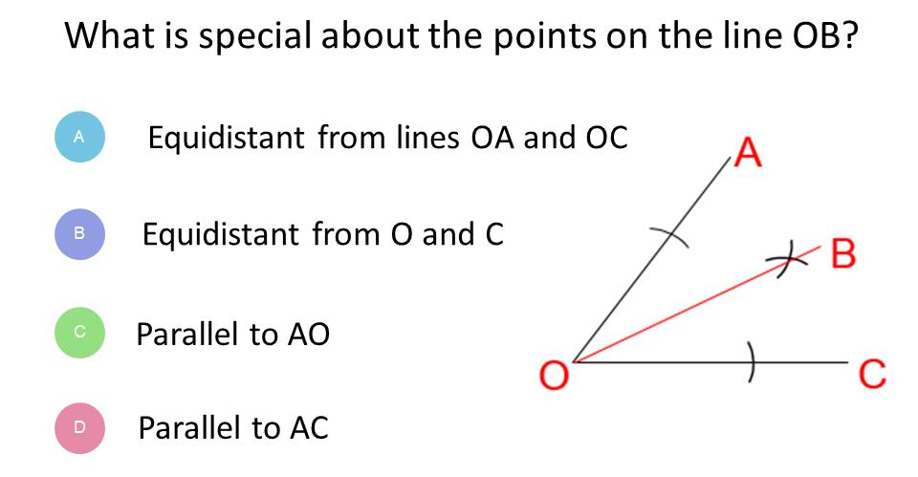
Question 6 – Bisecting Lines and Angles

Slide 13
Answer 6 – Bisecting Lines and Angles
CORRECT ANSWER | CORRECT EXPLANATION
A | This is an angle bisector, so the line is equidistant from OA and OC.
COMMON MISTAKES | WHAT MIGHT BE YOUR MISTAKE
B | The student has used the wrong construction.
C | The student has used the wrong construction.
D | The student has used the wrong construction.

Slide 14
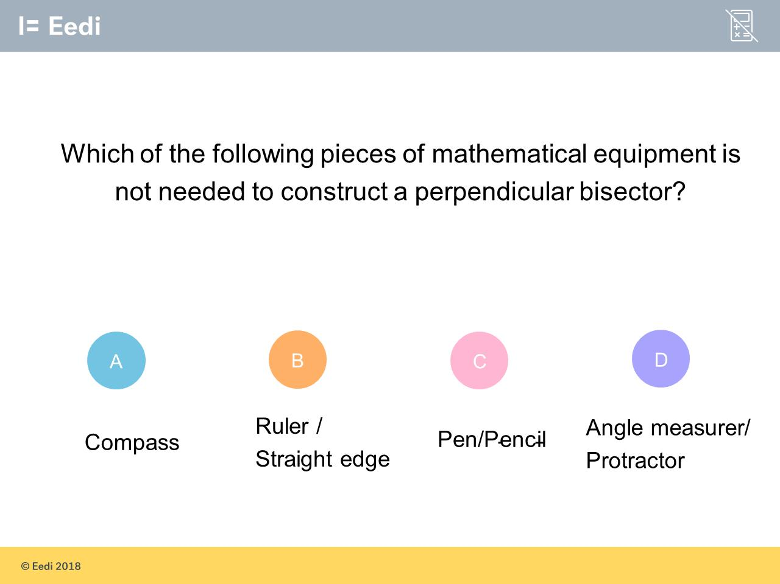
Question 6 – Bisecting Lines and Angles

Slide 15
Answer 6 – Bisecting Lines and Angles
CORRECT ANSWER | CORRECT EXPLANATION
D | To construct a perpendicular bisector, we need a compass, a ruler and a pencil.
COMMON MISTAKES | WHAT MIGHT BE YOUR MISTAKE
A | The student may be guessing.
B | The student may be guessing.
C | The student may be guessing.

Slide 16
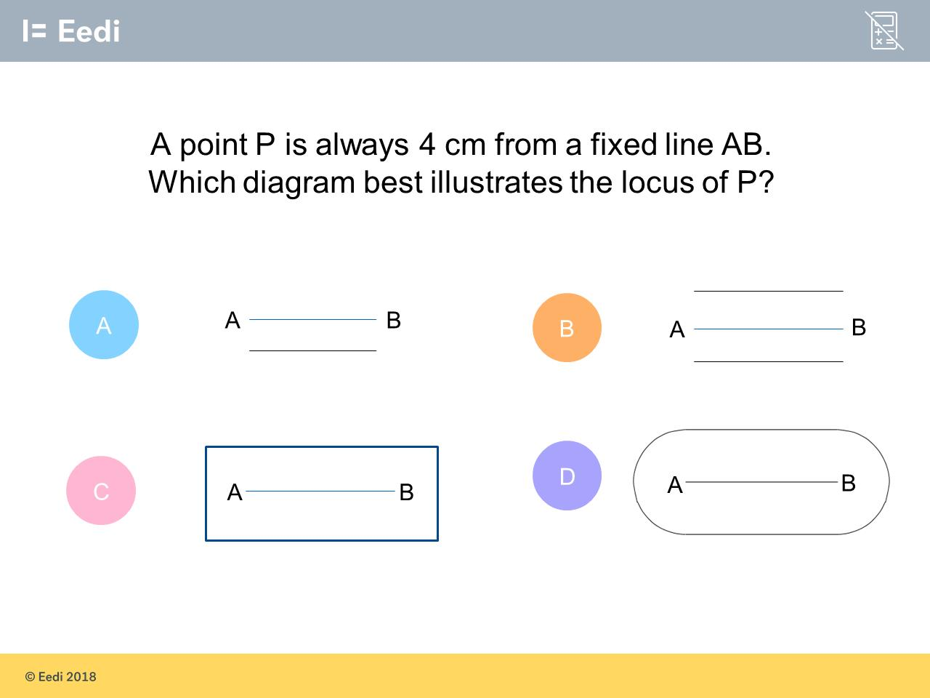
Question 7 – Loci

Slide 17
Answer 7 – Loci
CORRECT ANSWER | CORRECT EXPLANATION
D | To draw this locus, we need to draw 2 parallel lines up to the ends of AB. We can then use a compass with one point on the end to draw a semicircle with radius 4.
COMMON MISTAKES | WHAT MIGHT BE YOUR MISTAKE
A | The student has forgotten to draw a line on the other side of AB.
B | The student has forgotten the locus at the ends of the line.
C | The student has forgotten the arcs at the end.

Slide 18
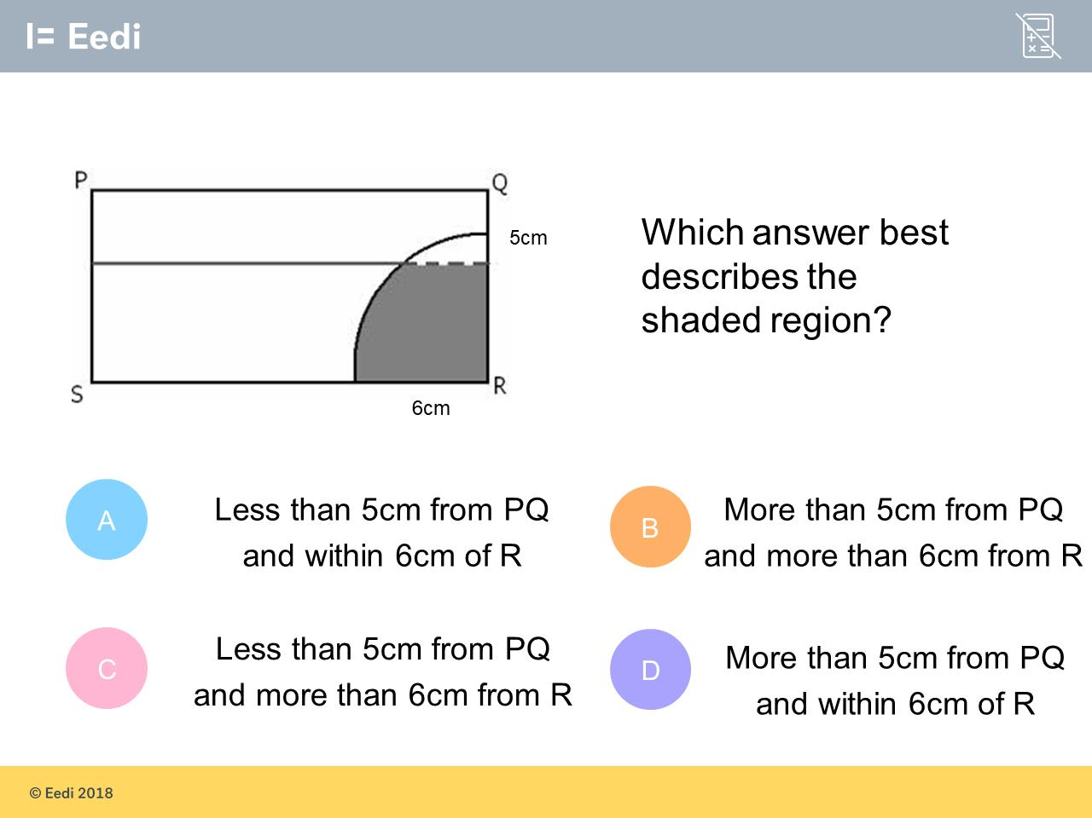
Question 8 – Loci

Slide 19
Answer 8 – Loci
CORRECT ANSWER | CORRECT EXPLANATION
D | The area is within 6cm of R, as a circle has been drawn with radius 6 centred at R, and the inside has been shaded. The region is also more than 5 cm away from PQ, which we can tell from the parallel line 5 cm from PQ.
COMMON MISTAKES | WHAT MIGHT BE YOUR MISTAKE
A | The student has found the wrong side of the parallel line.
B | The student has found the wrong side of the circle.
C | The student may have thought that the white region was to be found.

Slide 20
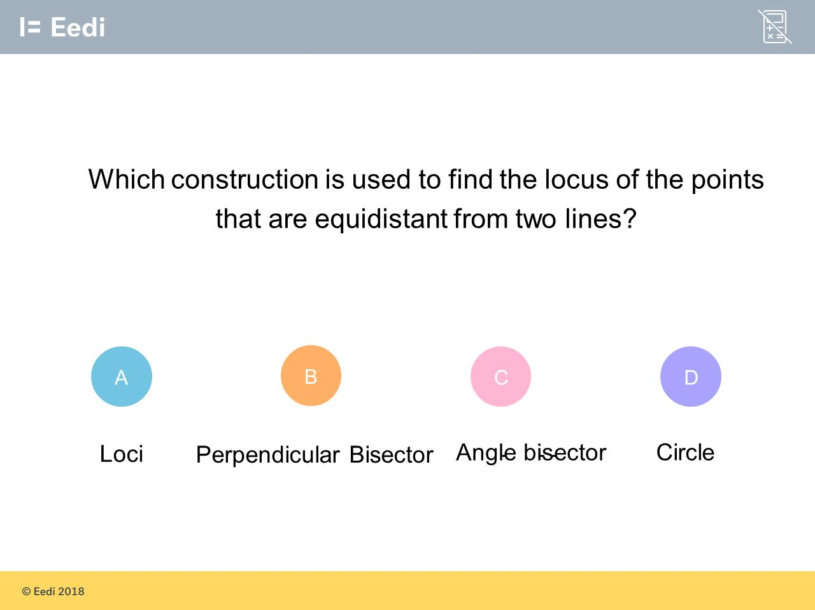
Question 9 – Loci

Slide 21
Answer 9 – Loci
CORRECT ANSWER | CORRECT EXPLANATION
C | This is an angle bisector, as the angle between the two lines is split into two equal segments.
COMMON MISTAKES | WHAT MIGHT BE YOUR MISTAKE
A | The student may be confused with the general term for this topic
B | The student may be confused with another common type of construct.
D | The student may be confused with the locus the points that are equidistant from a single point.

Slide 22

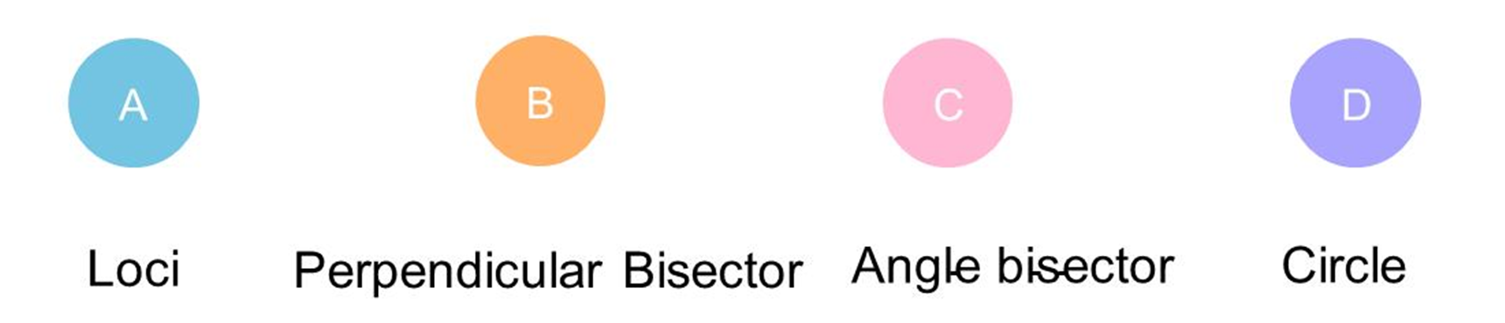
Question 10 – Loci

Slide 23
Answer 10 – Loci
CORRECT ANSWER | CORRECT EXPLANATION
B | This is a perpendicular bisector as we have a perpendicular line that is equidistant from A and B.
COMMON MISTAKES | WHAT MIGHT BE YOUR MISTAKE
A | The student may be confused with the general term for this topic.
C | The student may be confused with another common type of construct.
D | The student may be confused by the arc, which is part of a circle.

Slide 24
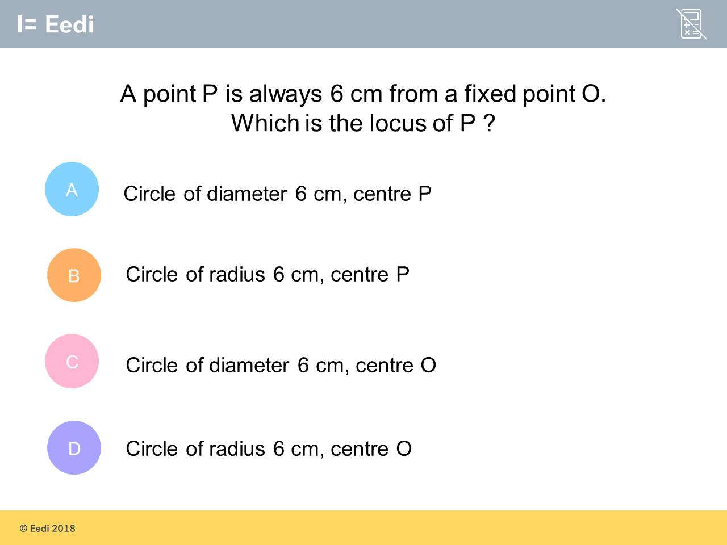
Question 11 – Loci

Slide 25
Answer 11 – Loci
CORRECT ANSWER | CORRECT EXPLANATION
30 | The locus of P is a circle drawn from the centre of the fixed point, O. The radius is 6cm as P is always 6cm away from O.
COMMON MISTAKES | WHAT MIGHT BE YOUR MISTAKE
20 | The student has found both the wrong radius and the wrong centre.
0 | The student has found the wrong centre.
10 | The student has found the wrong radius.

Slide 26
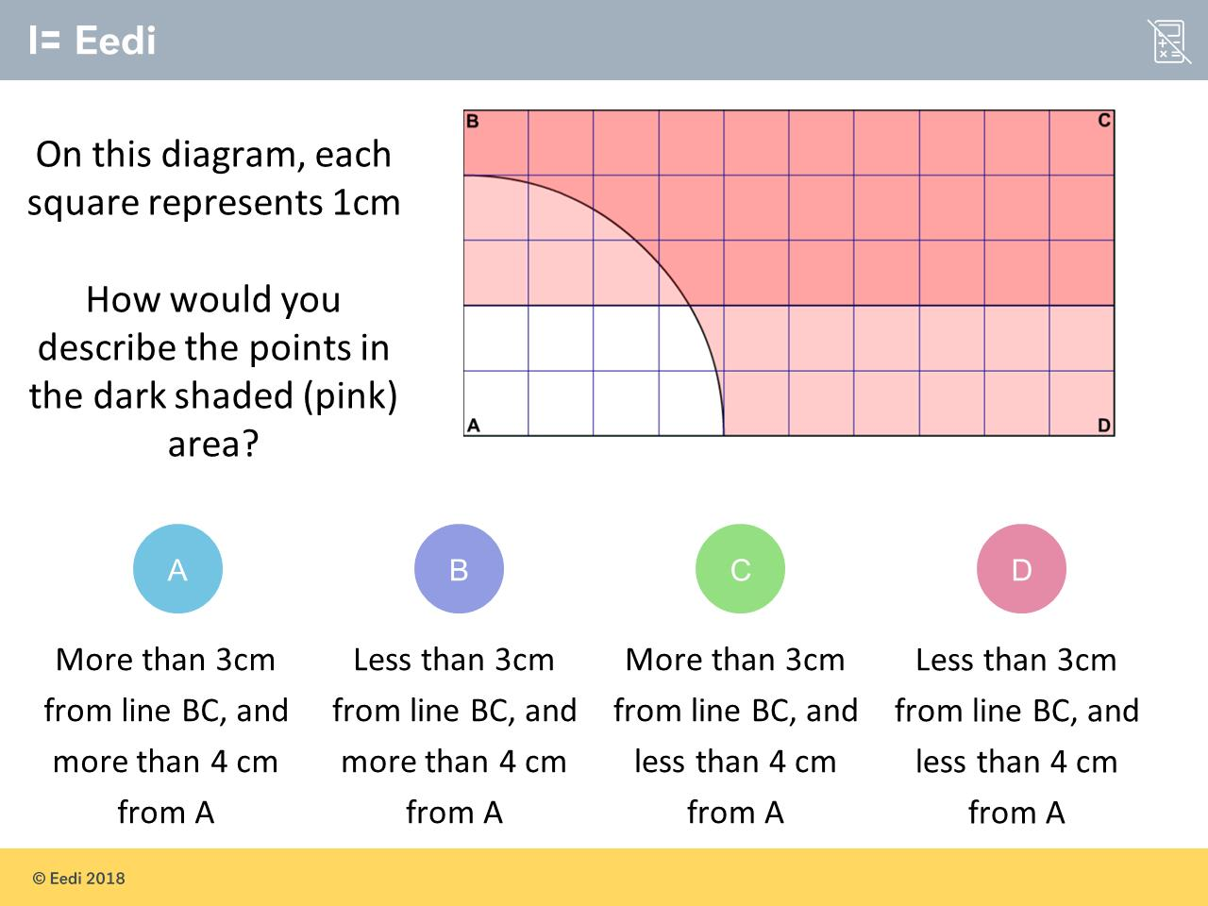
Question 12 – Loci

Slide 27
Answer 12 – Loci
CORRECT ANSWER | CORRECT EXPLANATION
B | We are more than 4 cm from A, as we are outside the circle, and we are less than 3 cm from BC, as the shaded area is on the same side as BC.
COMMON MISTAKES | WHAT MIGHT BE YOUR MISTAKE
A | The student has given the first condition wrong.
C | The student has given a the description of the non-shaded area.
D | The student has given the second condition wrong.

