Slide 1

Intermediate Challenge 2
SILVER

Slide 2
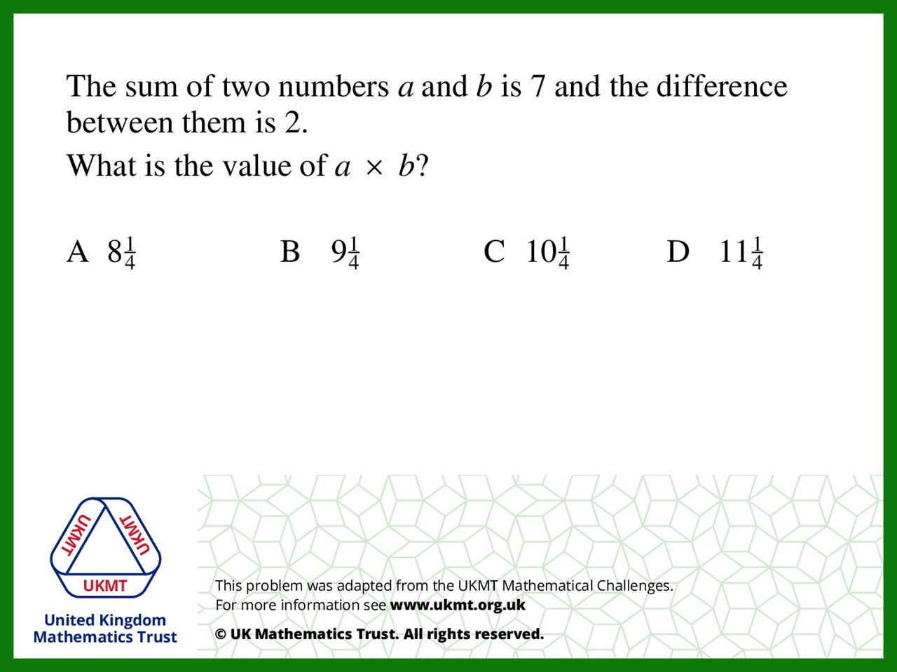
Q1.
2 + 4 = 6 (too low)
3 + 5 = 8 (too high)
2.5 + 4.5 = 7
2.5 x 4.5 = 11.25

Slide 3
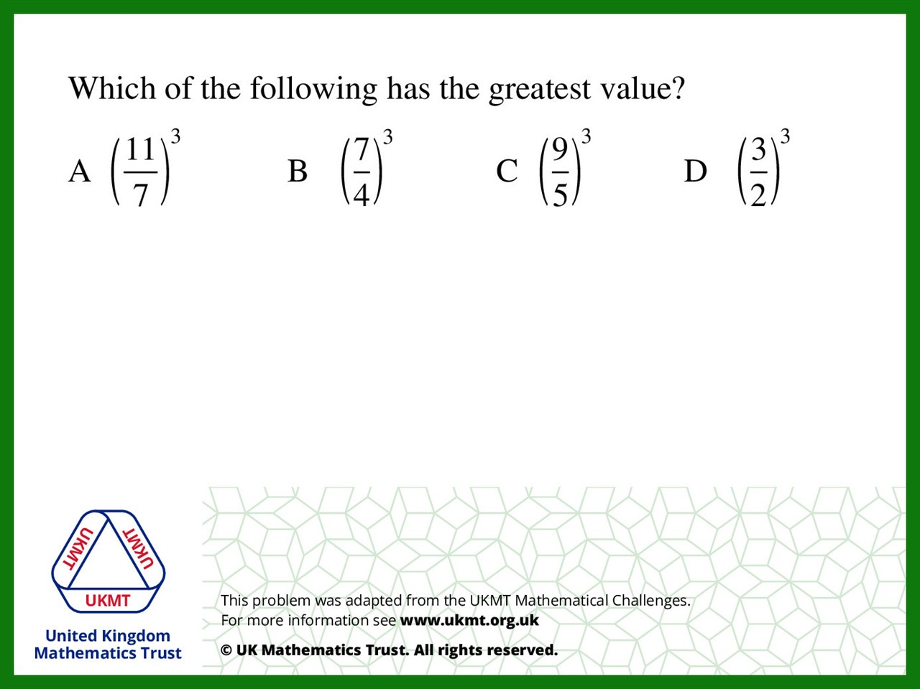
Q2.
Ignore the powers as all the same
A 11/7 = 1 and 4/7
B 7/4 = 1 and 3/4
C 9/5 = 1 and 4/5
D 3/1 = 1 and 1/2

Slide 4
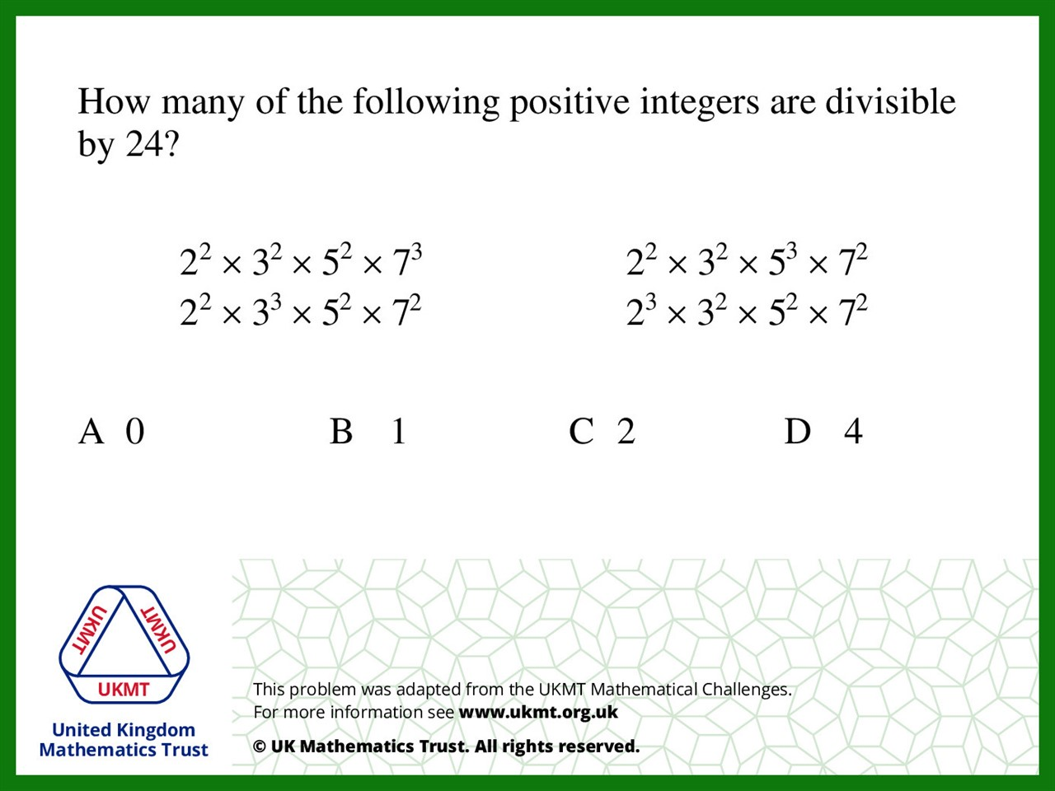
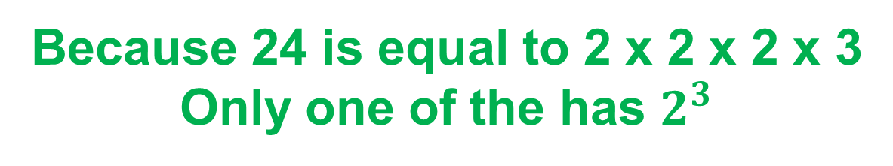
Q3.
Because 24 is equal to 2 x 2 x 2 x 3
Only one of the has $2^{3}$

Slide 5
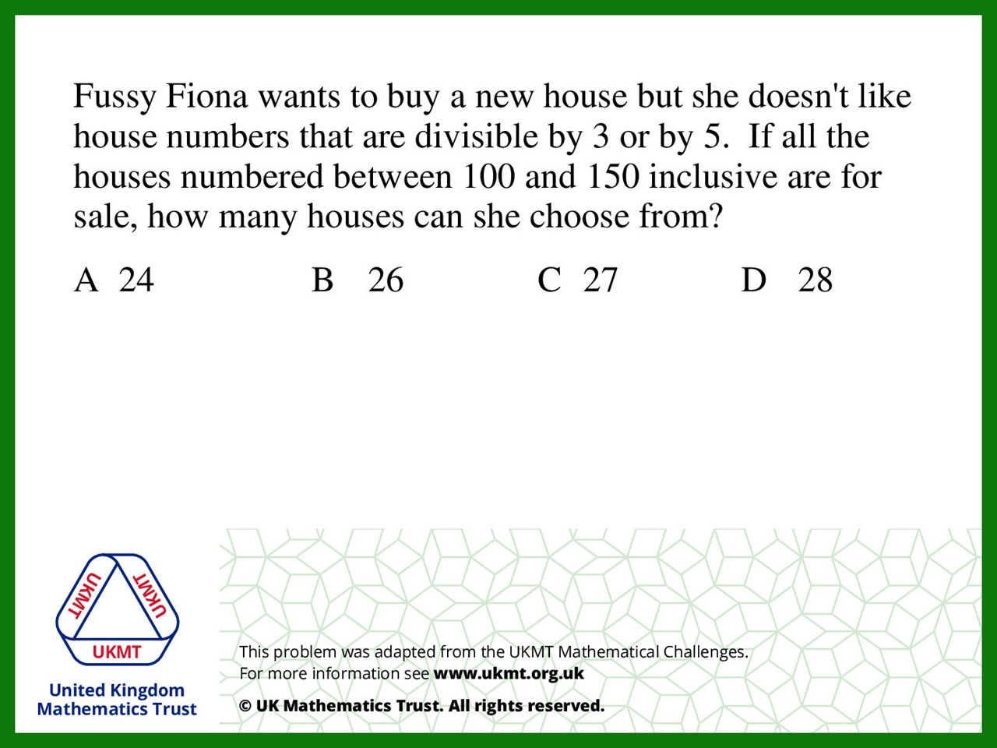
Q4.
There are 50 houses
10 of them are divisible by 5
13 are divisible by 3
so 50 – 23 = 27

Slide 6
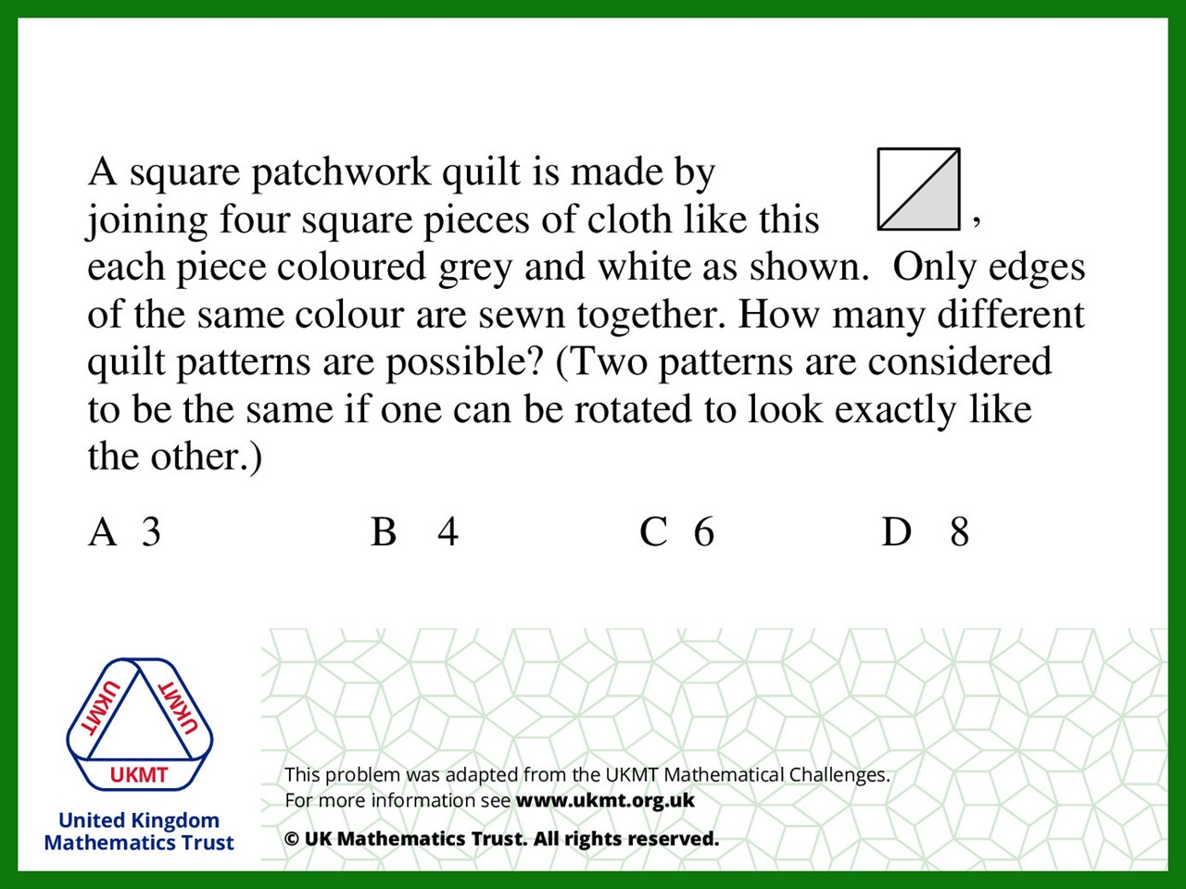
Q5.
There are 3 combinations
that can be rotated totaling 6

