Slide 1
Regression Correlation
and Hypothesis Testing
Hypothesis Testing
for Correlation
Chapter 1
(Part 3 of 3)

Slide 2
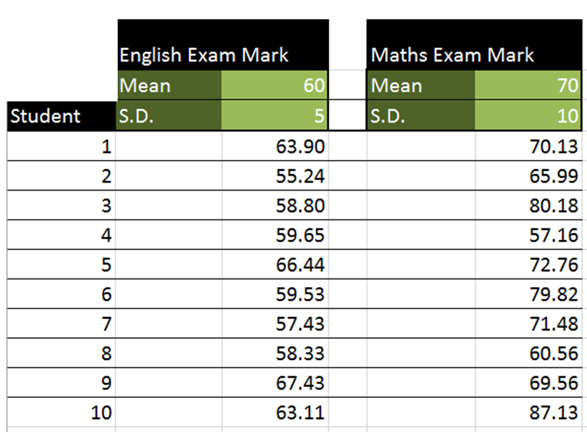
English and Maths results are
independently randomly generated.
PMCC
for this data set is 0.219
What PMCC did you except to get for this data set?
PMCC = 0 because the data was randomly generated.

Slide 3
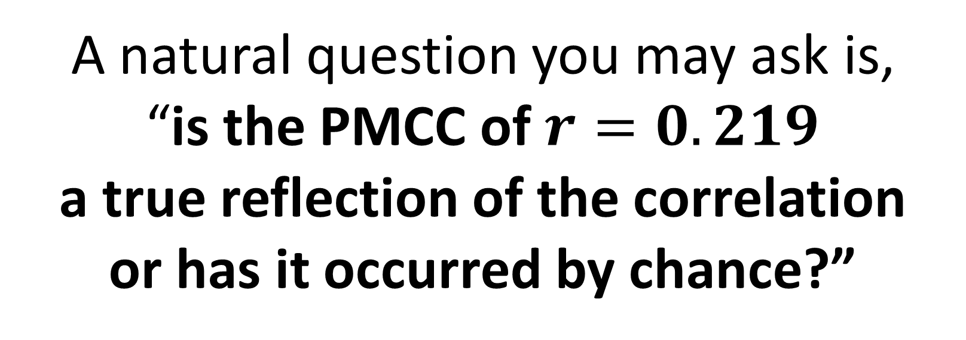
Hypothesis Testing for Correlation
A natural question you may ask is,
“is the PMCC of $r=0.219$
a true reflection of the correlation
or has it occurred by chance?”
This sounds like a Hypothesis Test!

Slide 4
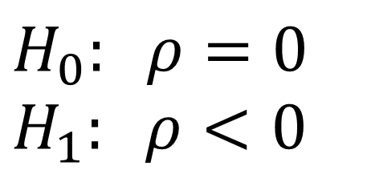
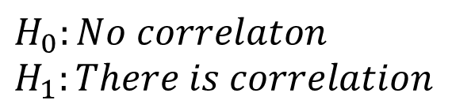
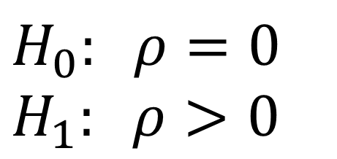
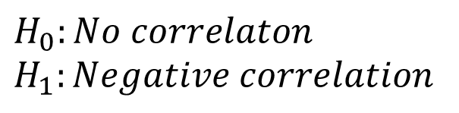
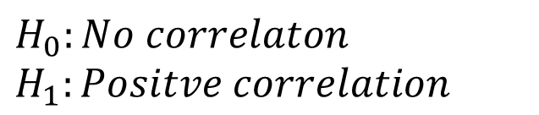
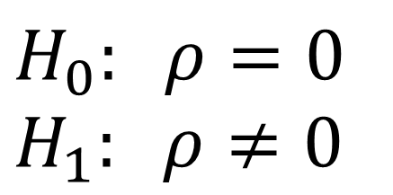
Hypothesis Testing for Correlation
Step 1) Write a hypothesis:
$$H_{0}: ρ=0 \\ H_{1}: ρ>0$$
$$H_{0}: ρ=0 \\ H_{1}: ρ<0$$
$$H_{0}: ρ=0 \\ H_{1}: ρ≠0$$
$$H_{0}:No correlaton \\ H_{1}:Positve correlation$$
$$H_{0}:No correlaton \\ H_{1}:Negative correlation$$
$$H_{0}:No correlaton \\ H_{1}:There is correlation$$
r denotes the PMCC for a sample, $ρ$ denoted the PMCC for a whole population,
It is the Greek letter rho

Slide 5
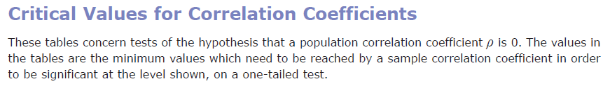
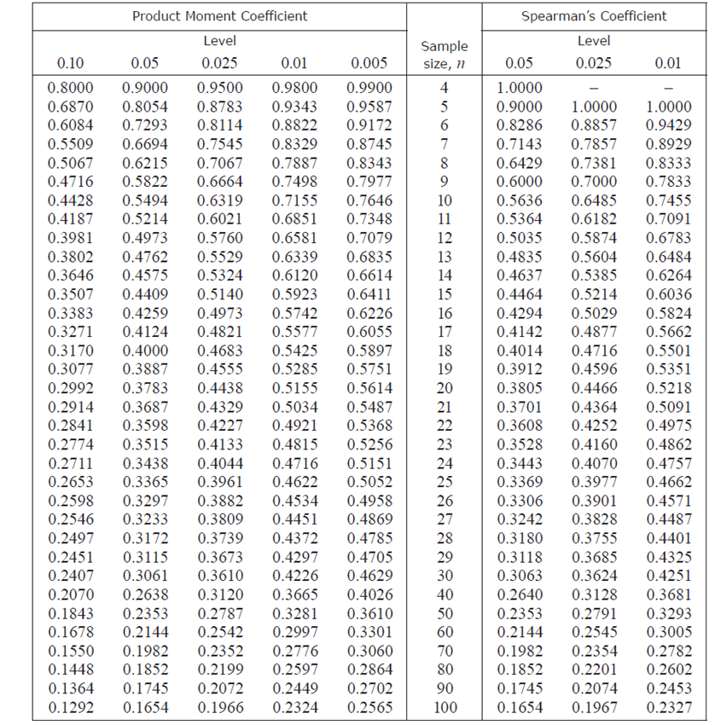
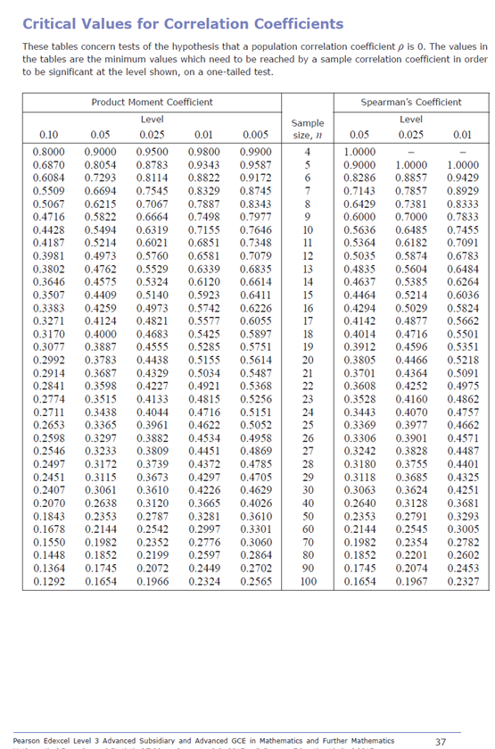
This can be found
towards the back of
the formula book.

Slide 7
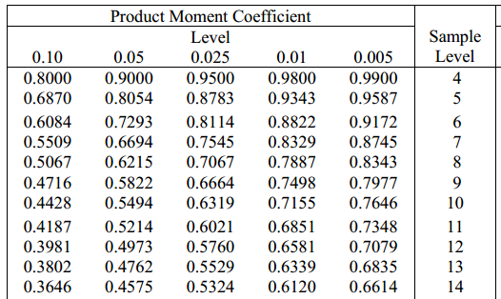
Step 2) Use a PMCC table to identify the minimum value needed to make the correlation statistically significant:
If significant level is 5% and the sample size is 10.

Slide 8
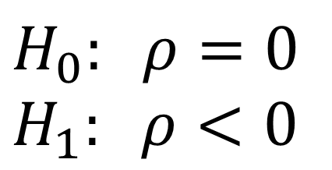
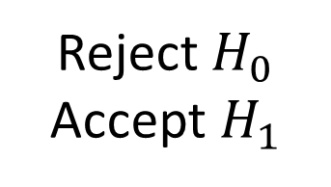
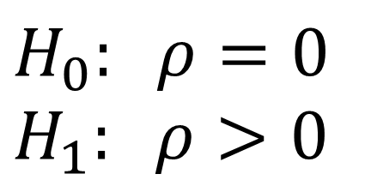
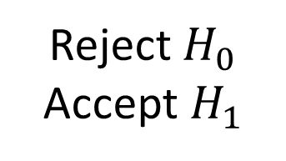
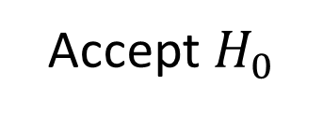
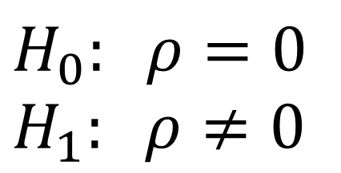
Step 3) Accept or reject your hypothesis:
$$H_{0}: ρ=0 \\ H_{1}: ρ>0$$
Table PMCC: 0.35
Sample PMCC: 0.25
Accept $H_{0}$
$$H_{0}: ρ=0 \\ H_{1}: ρ<0$$
Table PMCC: -0.5
Sample PMCC: -0.7
Reject $H_{0}$
Accept $H_{1}$
$$H_{0}: ρ=0 \\ H_{1}: ρ≠0$$
Table PMCC: 0.4
Sample PMCC: 0.5
Reject $H_{0}$
Accept $H_{1}$

Slide 9
Hypothesis Testing for Correlation
Two-Tailed Test

Slide 10
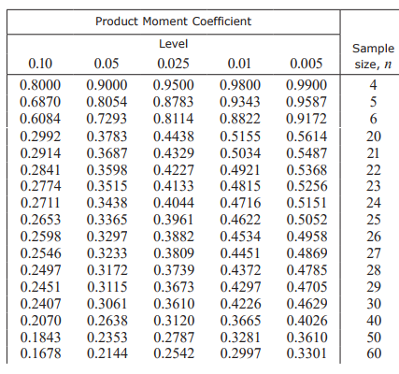
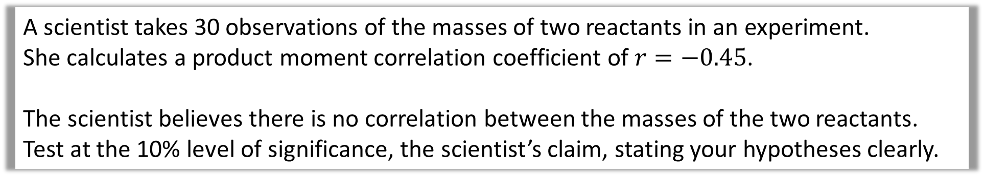
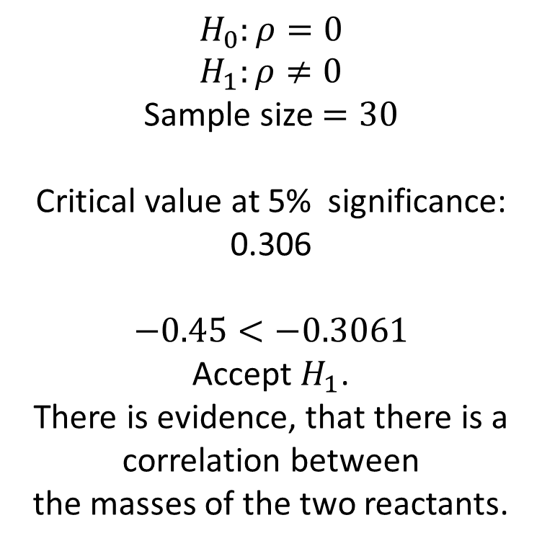
A scientist takes 30 observations of the masses of two reactants in an experiment.
She calculates a product moment correlation coefficient of $r=−0.45$.
The scientist believes there is no correlation between the masses of the two reactants.
Test at the 10% level of significance, the scientist’s claim, stating your hypotheses clearly.
$$H_{0}:ρ=0 \\ H_{1}:ρ≠0$$
Sample size $=30$
Critical value at 5% significance:
0.306
$−0.45<−0.3061$
Accept $H_{1}$.
There is evidence, that there is a correlation between
the masses of the two reactants.
Two-tailed, so 5% at each tail.

Slide 11
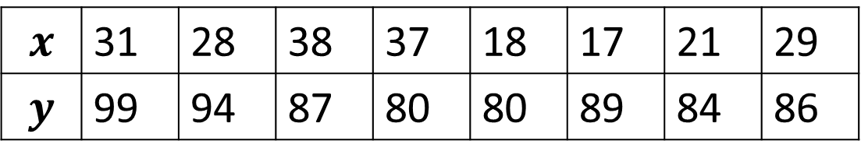
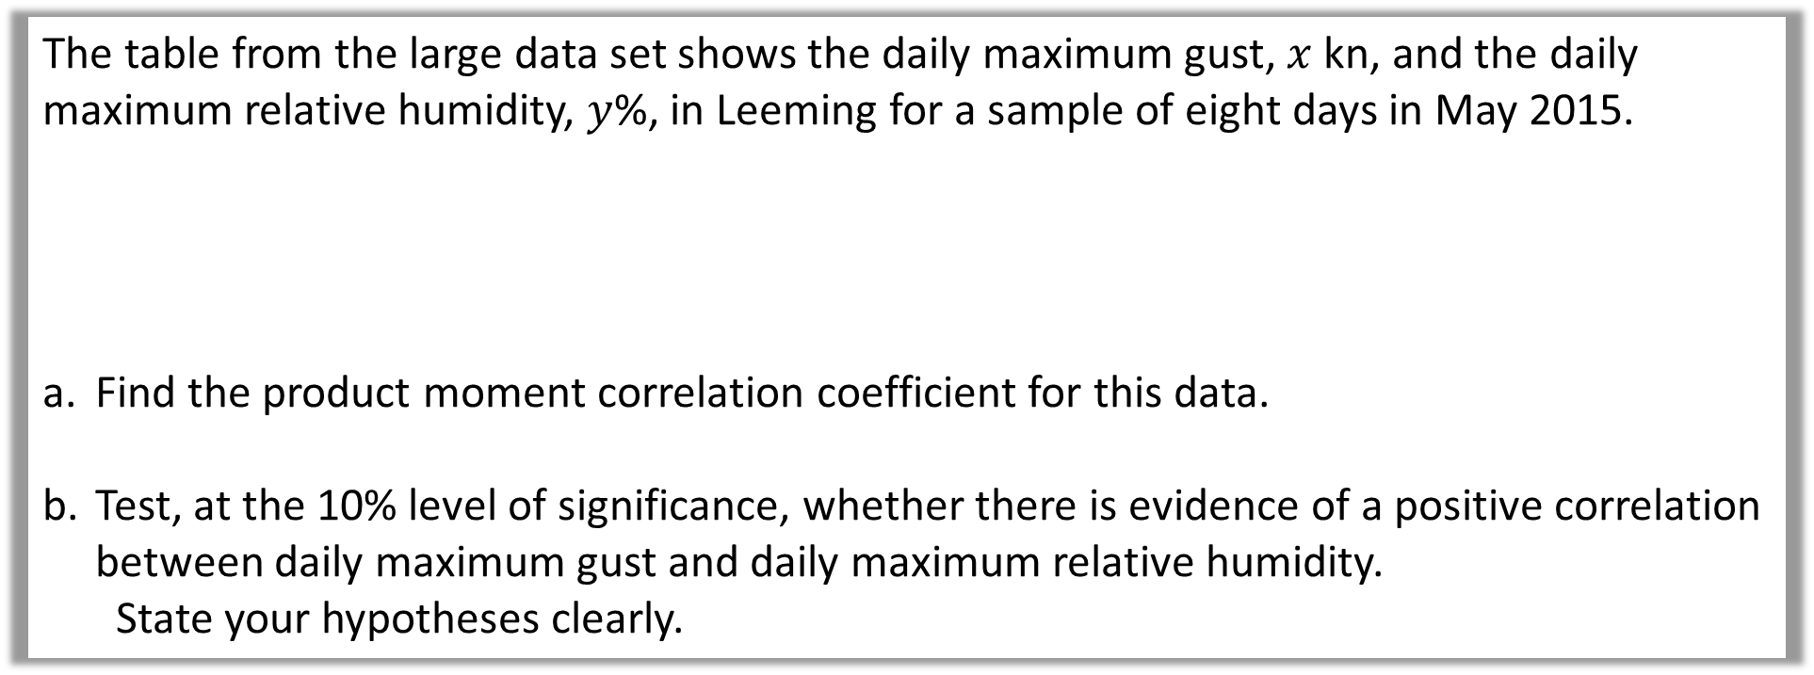
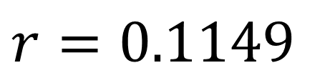
The table from the large data set shows the daily maximum gust, $x$ kn, and the daily maximum relative humidity, $y$%, in Leeming for a sample of eight days in May 2015.
Find the product moment correlation coefficient for this data.
Test, at the 10% level of significance, whether there is evidence of a positive correlation between daily maximum gust and daily maximum relative humidity.
State your hypotheses clearly.
$$x$$ | 31 | 28 | 38 | 37 | 18 | 17 | 21 | 29
$$y$$ | 99 | 94 | 87 | 80 | 80 | 89 | 84 | 86
a
$$r=0.1149$$

Slide 12

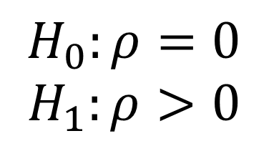

The table from the large data set shows the daily maximum gust, $x$ kn, and the daily maximum relative humidity, $y$%, in Leeming for a sample of eight days in May 2015.
Find the product moment correlation coefficient for this data.
Test, at the 10% level of significance, whether there is evidence of a positive correlation between daily maximum gust and daily maximum relative humidity.
State your hypotheses clearly.
$$x$$ | 31 | 28 | 38 | 37 | 18 | 17 | 21 | 29
$$y$$ | 99 | 94 | 87 | 80 | 80 | 89 | 84 | 86
Sample size = 8
Critical value at 10% significant level $=0.5067$
$0.1149<0.5067$
b
$$H_{0}:ρ=0$$
$$H_{1}:ρ>0$$
Accept $H_{0}$.
Not sufficient evidence, of a positive correlation between the daily maximum gust and the daily maximum relative humidity.

