Slide 1

Intermediate Challenge 3
BRONZE

Slide 2
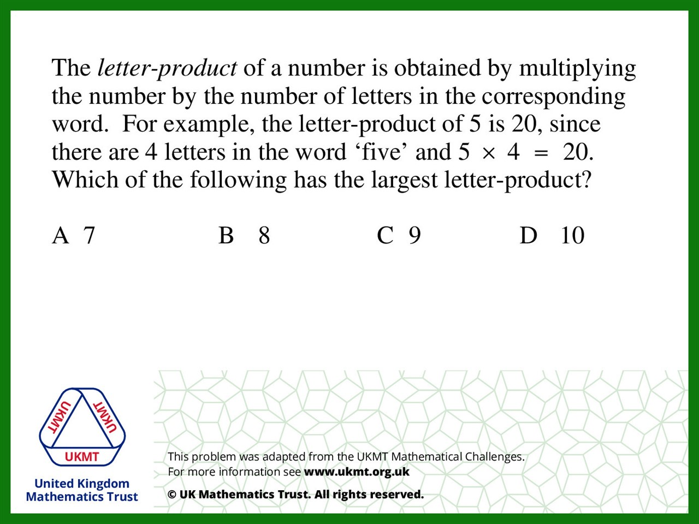
Q1.
8 = eight
8 x 5 = 40
8 is the largest letter-product

Slide 3
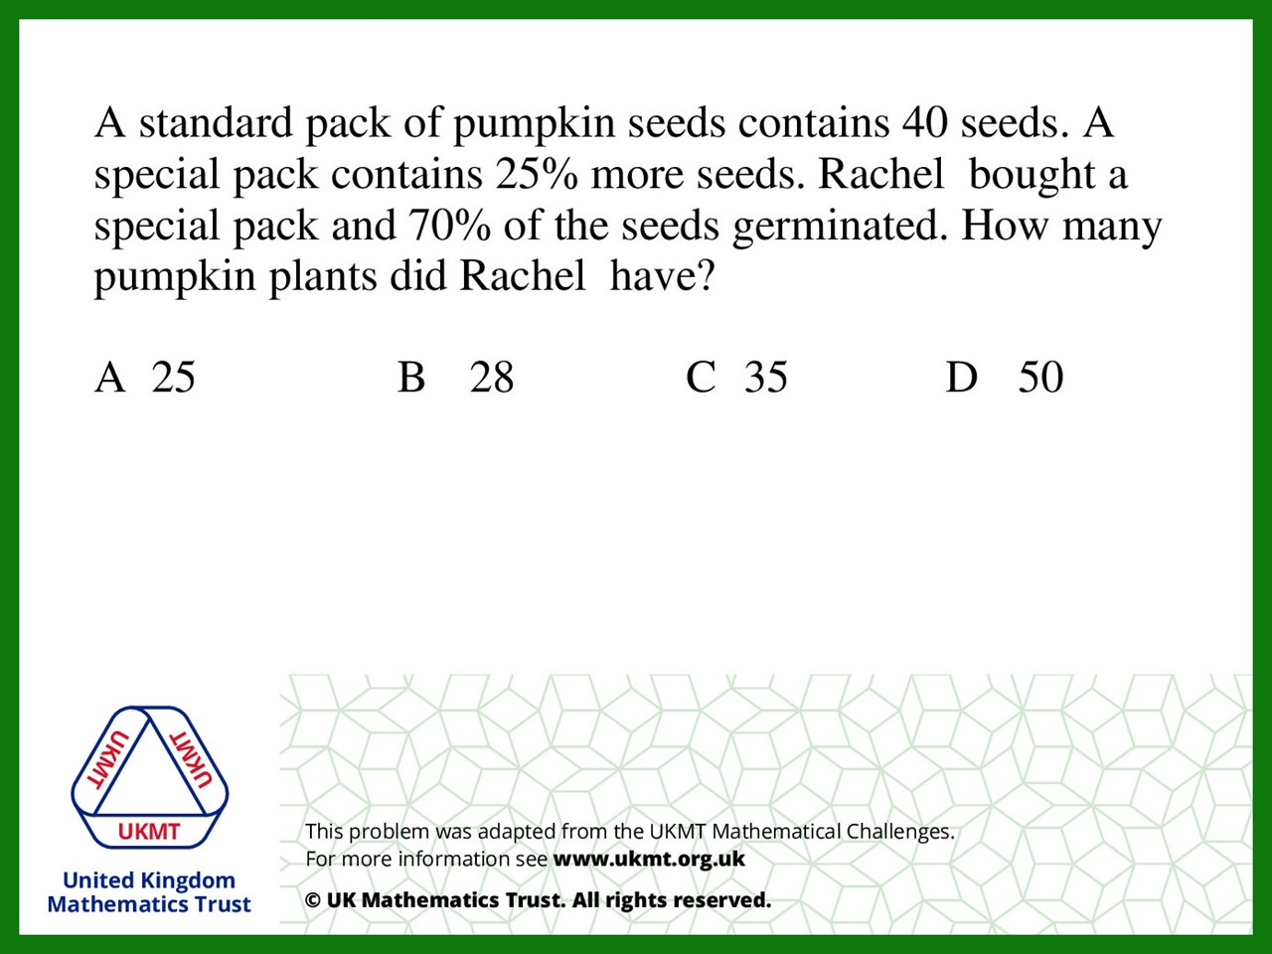
Q2.
The special packs have 50 seeds in,
so 50% of 70 and is 35.

Slide 4
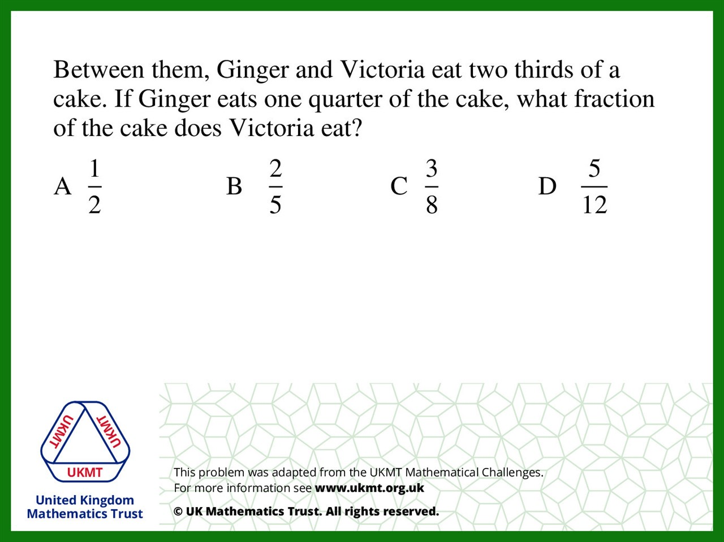

Q3.
$$\frac{8}{12} − \frac{3}{12}=\frac{5}{12}$$

Slide 5
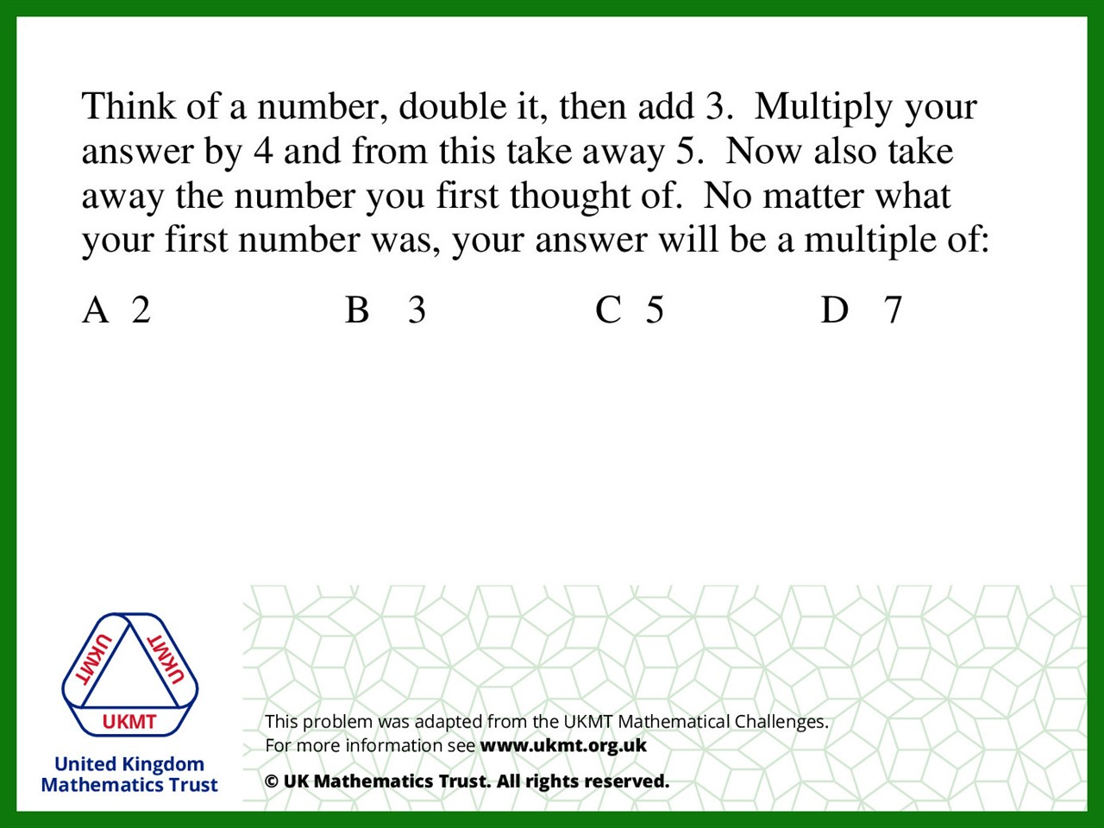
Q4.
3 x 2 = 6
3 x 4 = 12
12 – 5 = 7

Slide 6
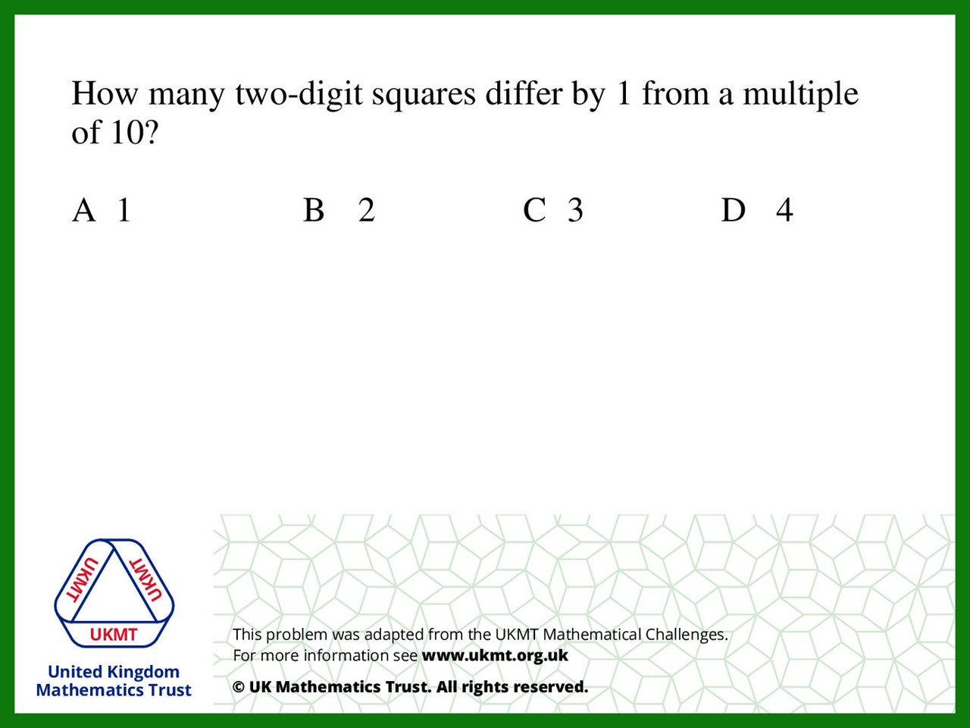
Q5.
3 x 3 = 9
7 x 7 = 49

