Slide 1
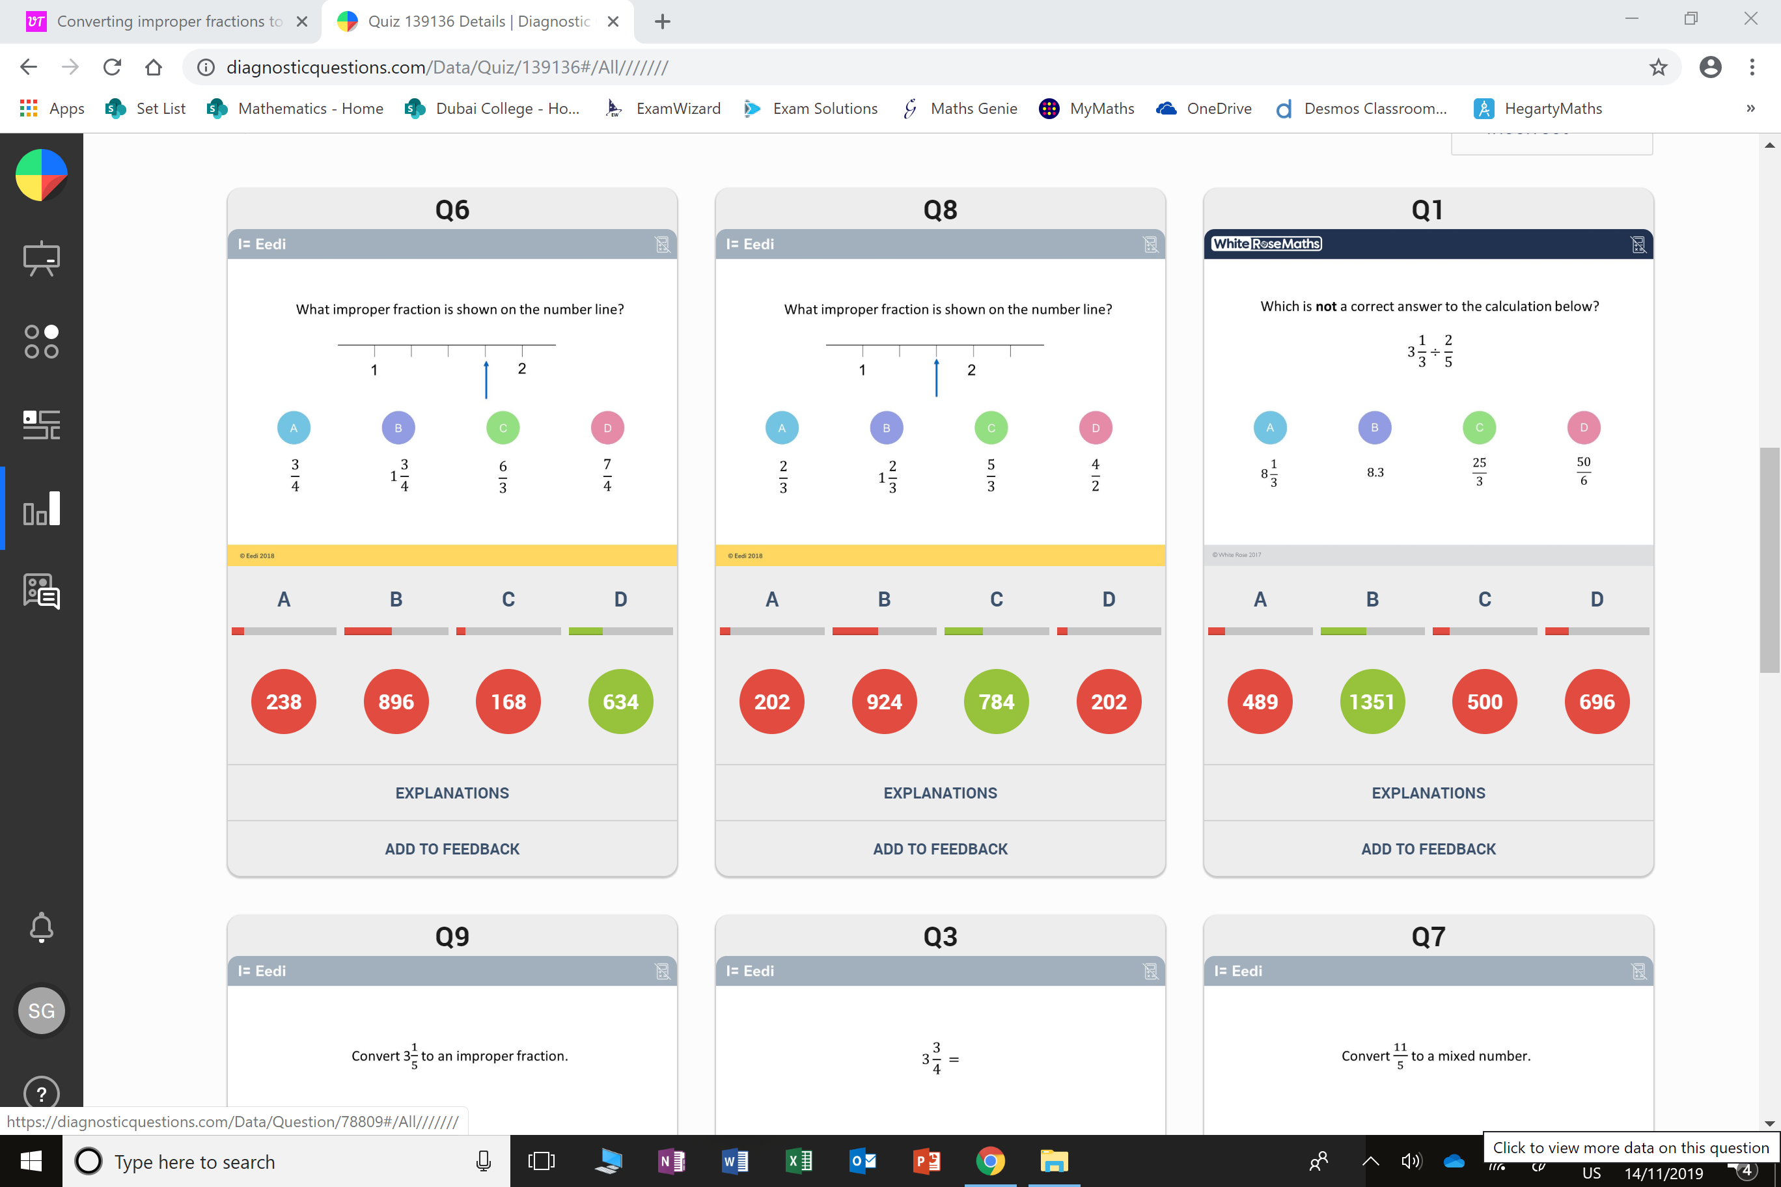
Which question had the lowest percentage of
correct answers?
For each question, what was the most common
wrong answer?

Slide 2
ANSWERS

Slide 3
Which question had the lowest percentage of
correct answers?
For each question, what was the most common
wrong answer?

Slide 4
B
They gave the correct answer but as a mixed fraction.

Slide 5
D
The student has picked an equivalent and correct fraction.

