Slide 1
Solve the quadratic inequalities
1) (5 – x)(1 + x) ≤ 0
2) (2 – x)(x + 8) ≥ 0
3) (2x – 1)(3x – 6) ≤ 0
4) (5x – 10)(x – 8) > 0
5) (6x + 3)(x + 4) < 0
6) x² – 5x + 4 < 0
7) x² – 10x + 21 ≥ 0
8) x² + 5x + 6 > 0
9) 12 – x – x ² ≤ 0
10) 5 + 4x – x² ≥0

Slide 2
ANSWERS

Slide 3
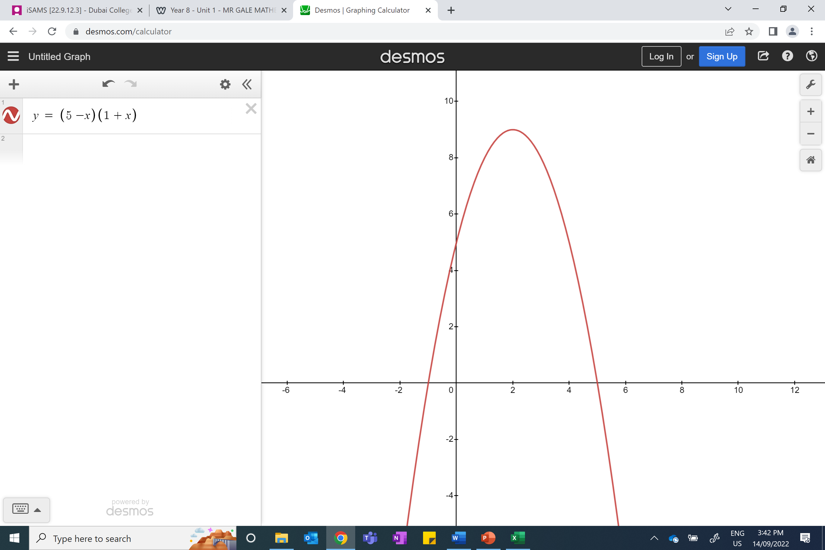
1) (5 – x) (1 + x) ≤ 0
x ≤ -1 and x ≥ 5

Slide 4
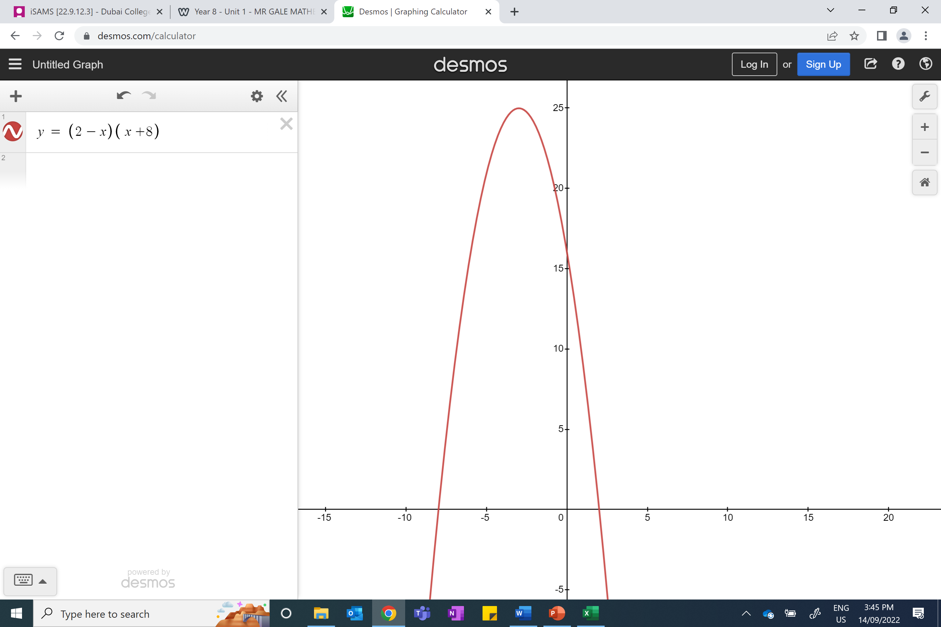
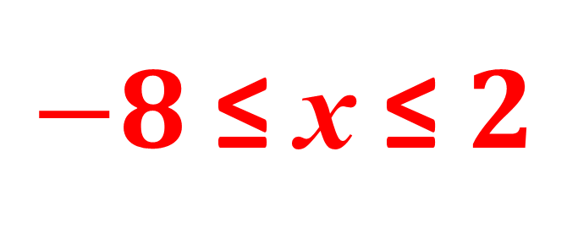
2) (2 – x)(x + 8) ≥ 0
$−8$ ≤ x ≤ $2$

Slide 5
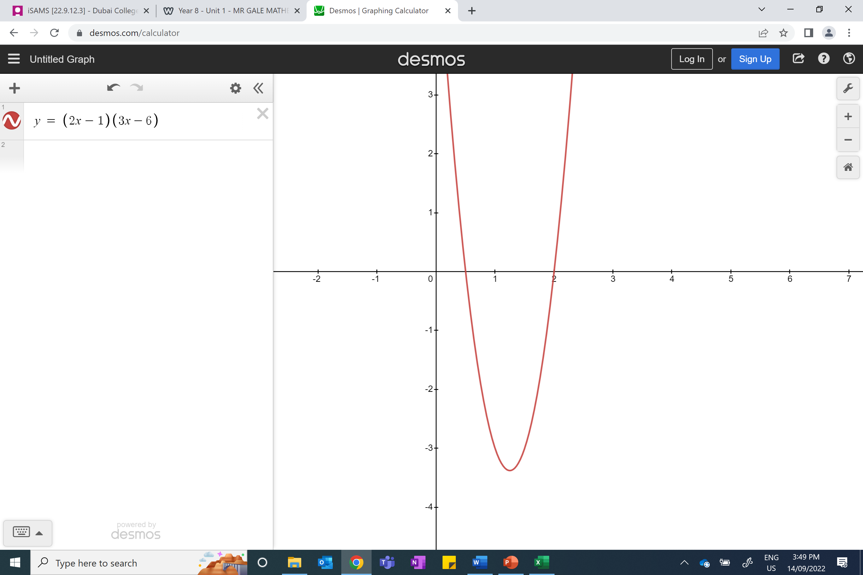
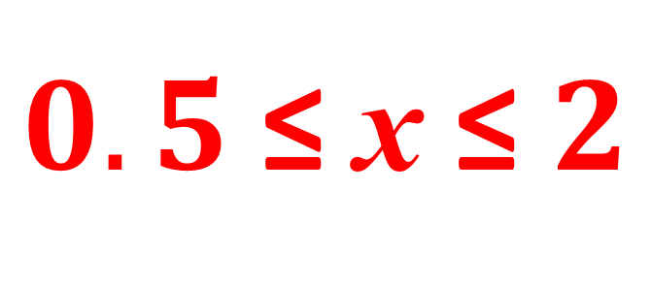
3) (2x – 1)(3x – 6) ≤ 0
$0.5$≤ x ≤ $2$

Slide 6
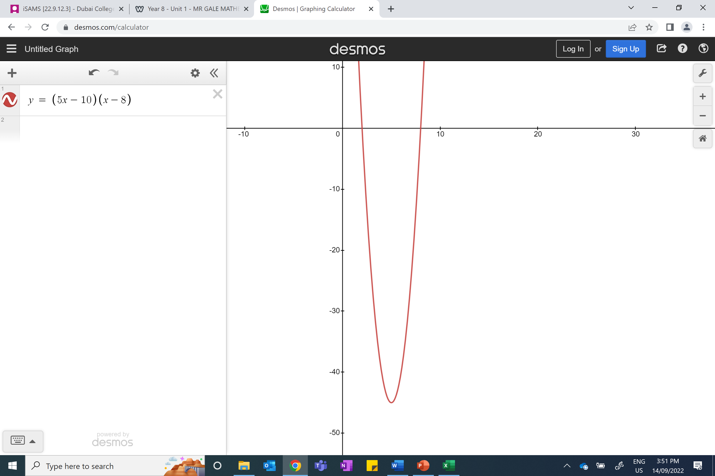
4) (5x – 10)(x – 8) > 0
x < 2 and x > 8

Slide 7
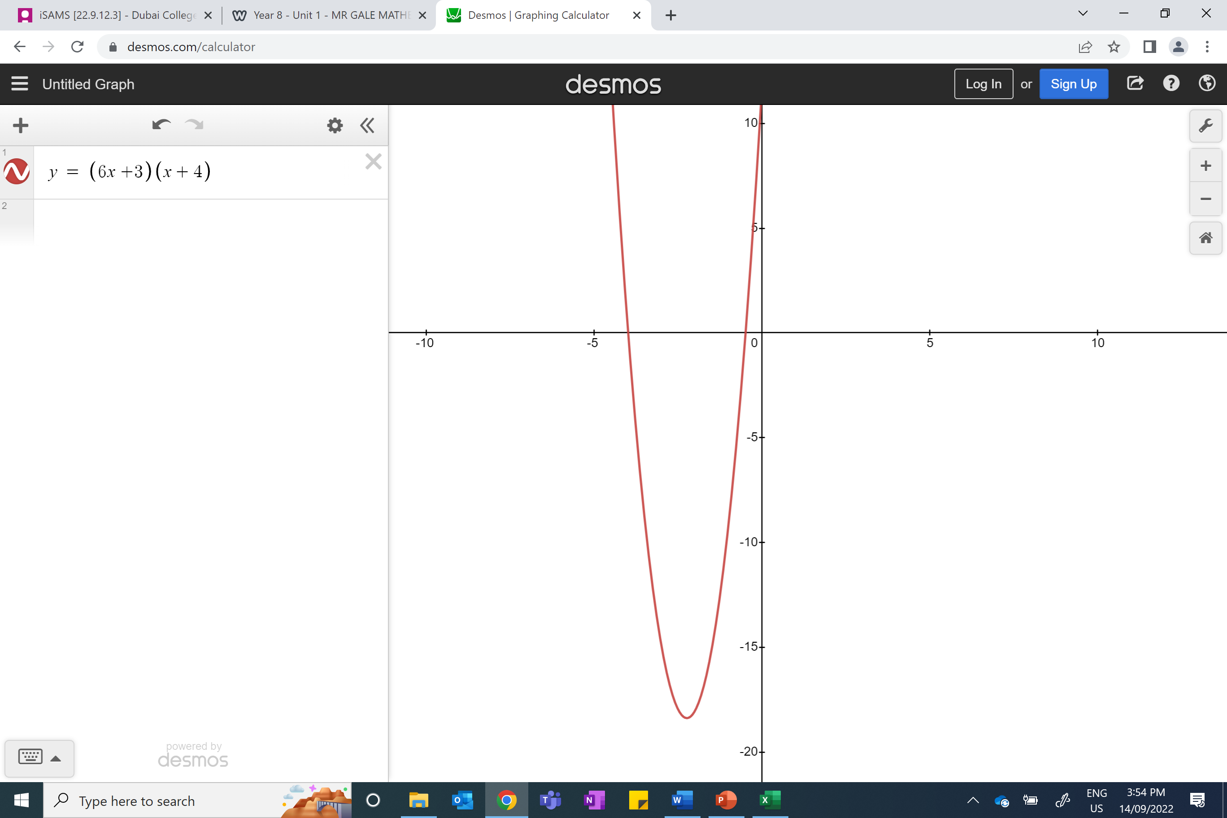
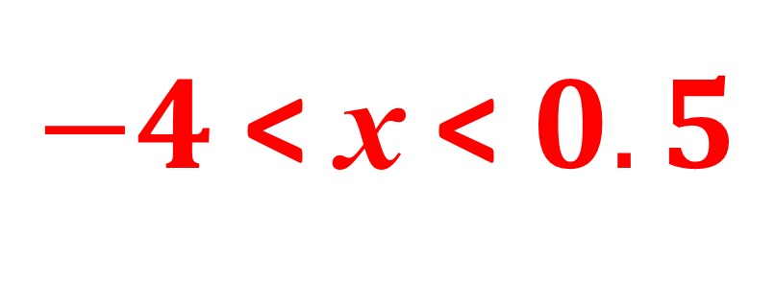
5) (6x + 3)(x + 4) < 0
$−4$ < x < $0.5$

Slide 8
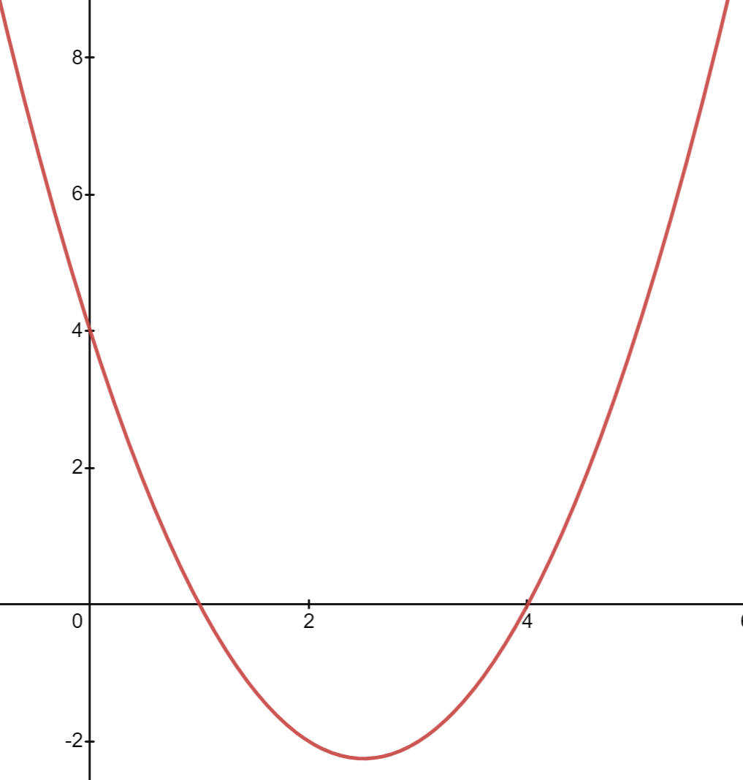
6) x² – 5x + 4 < 0
(x – 4)(x – 1) < 0
1 < x < 4

Slide 9
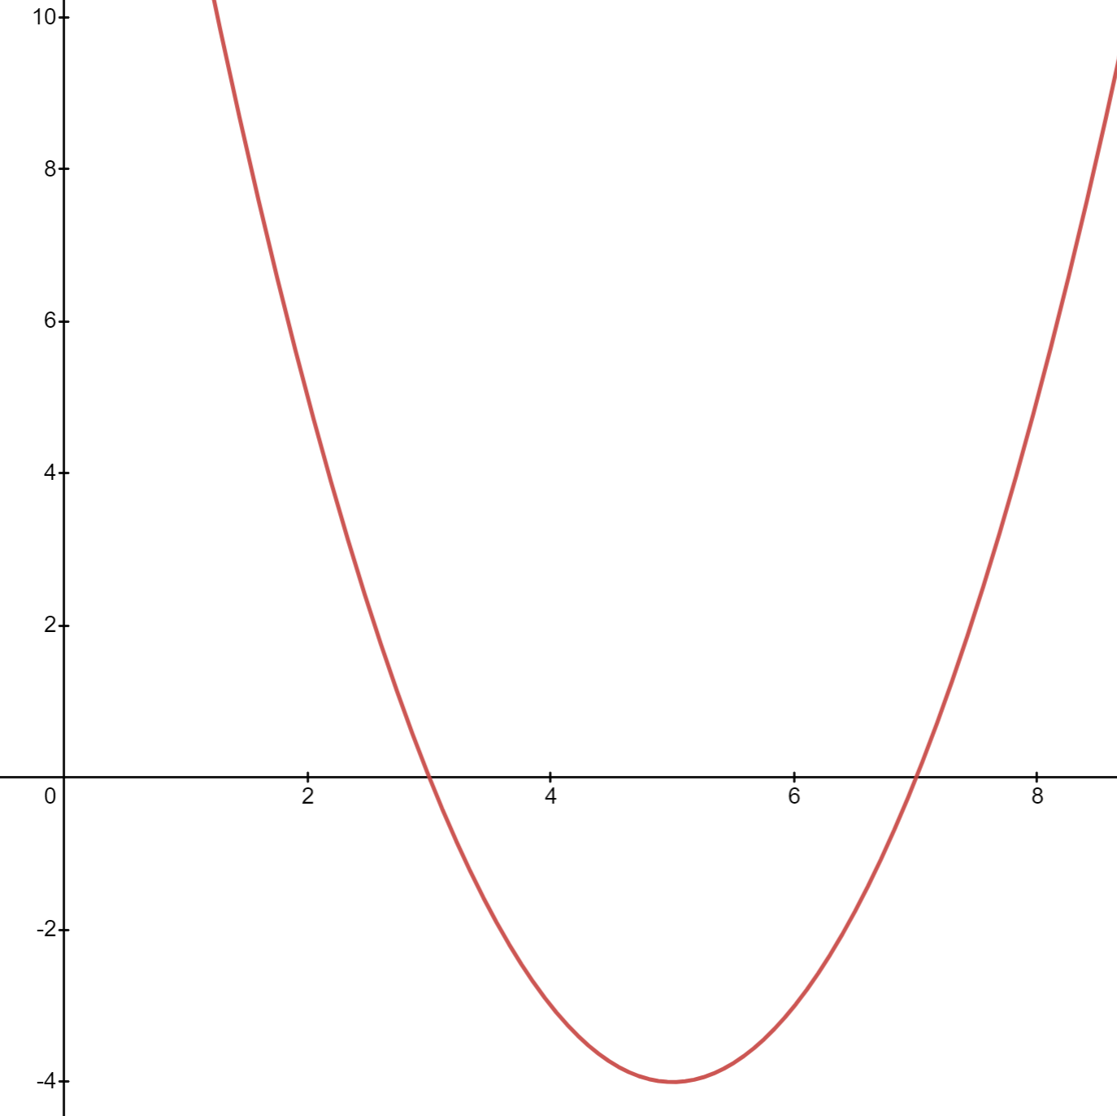
7) x² – 10x + 21 ≥ 0
(x – 7)(x – 3) ≥ 0
x ≥ 7
and
x ≤ 3

Slide 10
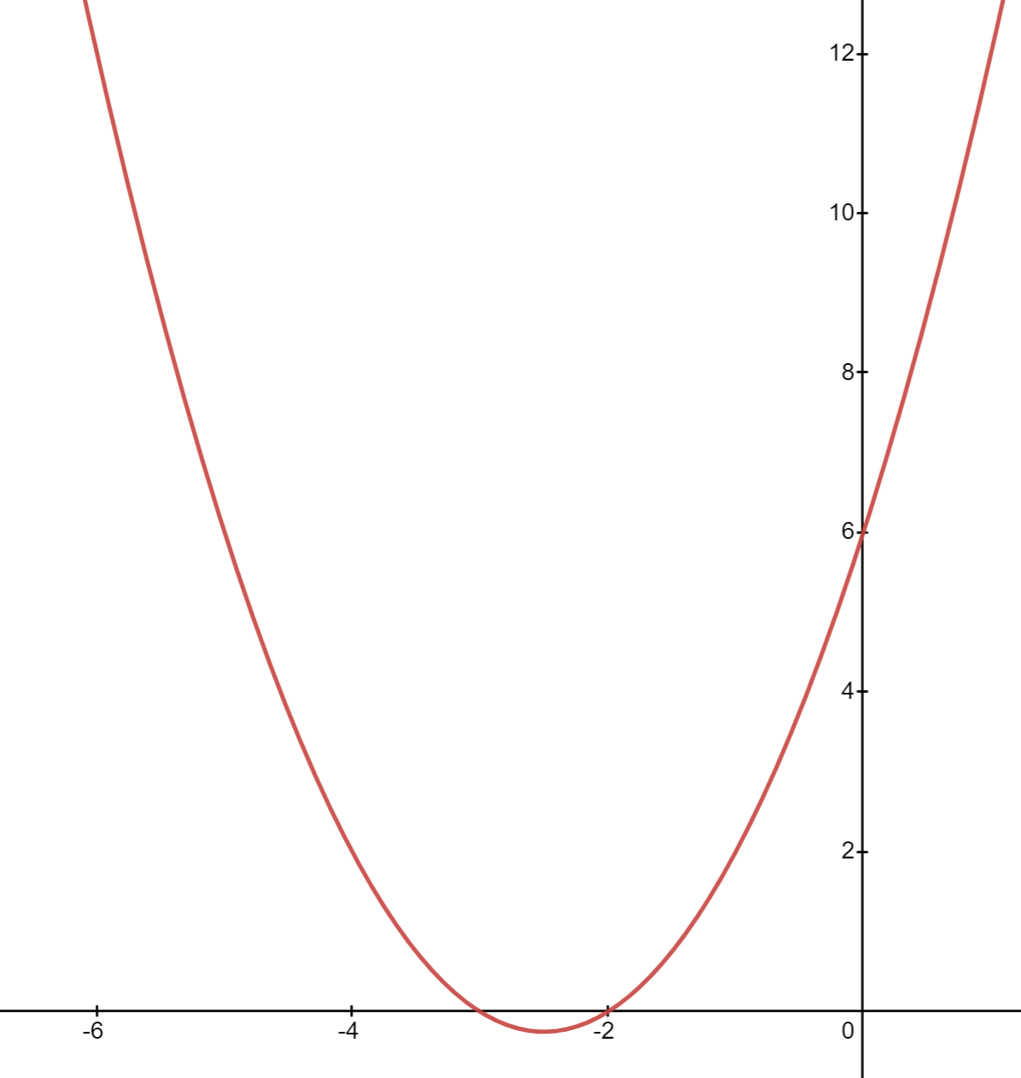
8) x² + 5x + 6 > 0
(x + 2)(x +3) > 0
x < -3 and x > -2

Slide 11
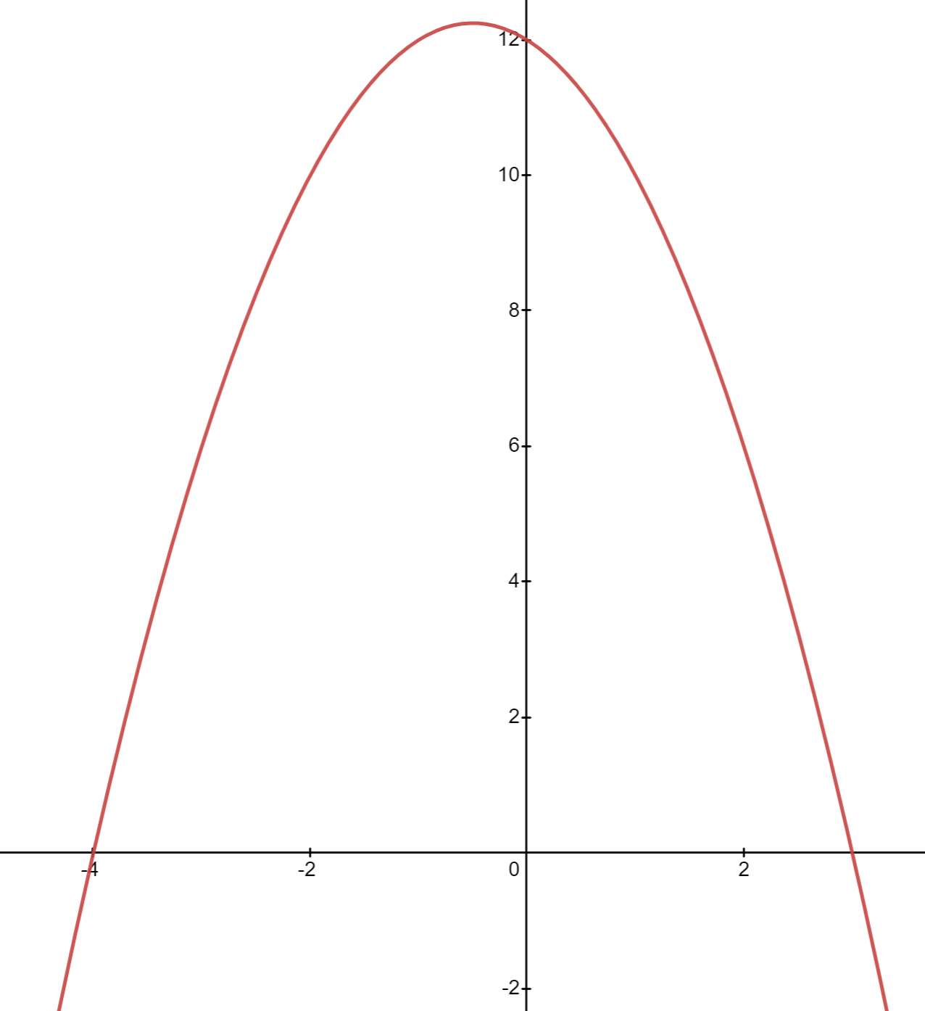
9) 12 – x – x ² ≤ 0
(3 – x)(x + 4) ≤ 0
x ≤ –4 and x ≥ 3

Slide 12

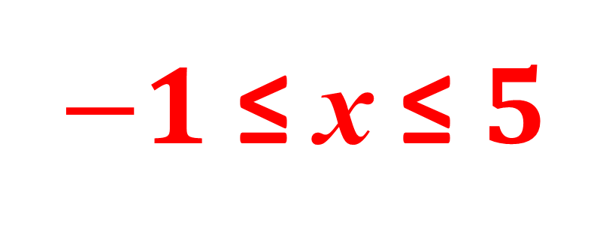
10) 5 + 4x – x² ≥ 0
(5 – x)(x + 1) ≥ 0
$−1$ ≤ x ≤ $5$

